Slide 1

Module 31: Business Layer Configuration: Picklists
0/5
Siebel 8.0 Essentials
Notes:
Time: Lecture: <n – n> minutes; Labs: <n – n> minutes
Intent: <What is the instructional goal of the module>
Flow: < Describe at a high level the overall flow of the module>.
Key Terms: <List terms the instructor should be familiar with in order to teach this module>
<Term>
<Term>
<Term>
<Term>

Slide 2
Module Objectives
After completing this module you should be able to:
  Describe the differences between dynamic and static picklists
  Administer a list of values
  Configure a static or dynamic picklist
Why you need to know:
  Enables you to add picklists to your Siebel application

Slide 3
Picklists
Allow users to populate one or more single-value fields by selecting a value from a list
  Enforces business rules and policies
  Makes data entry faster
  Reduces errors
Can be either static or dynamic

Slide 4
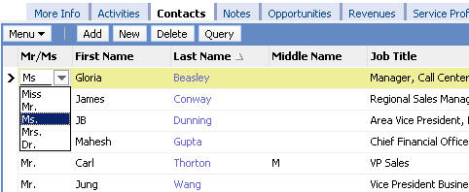
Static Picklist
Displays values in a drop-down list for user selection
Copies the selected value into destination field
  No link to the original picklist data
Can be bounded or unbounded
  Bounded picklist forces users to enter only a value in the picklist
  Unbounded picklist permits users to enter any value into the field
Draws values from picklist data managed by an administrator
  Values displayed in static picklists do not change during run time
Drop-down list
UI visual cue for static picklist

Slide 5
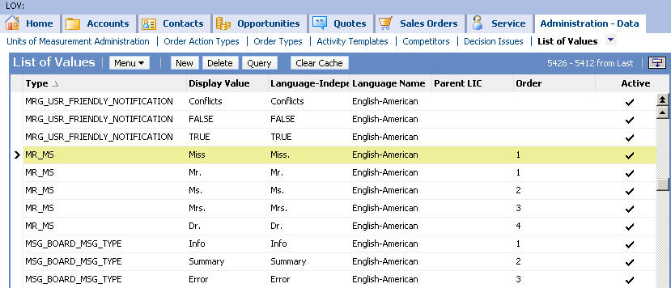
Static Picklist Values
Are stored for all static picklists in the S_LST_OF_VAL table
Appear in List of Values or LOV Explorer administrative views
  Administration – Data > List of Values (or LOV Explorer)
Each have a type, which indicates which static picklist the value belongs to
Values for the MR_MS static picklist

Slide 6
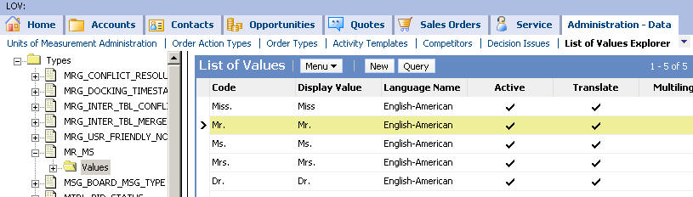
Administering a Static Picklist
Use Administration – Data > List of Values Explorer view
Select an existing picklist or create a new picklist type in the List of Values - Types applet
Expand the type and select the child Values folder
Edit the picklist values in the List of Values (LOV) applet

Slide 7
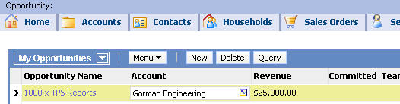

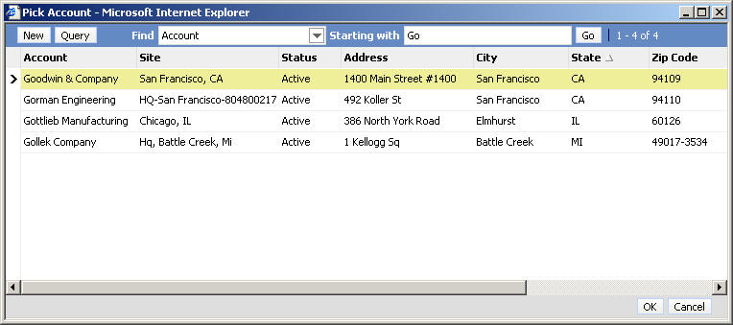
Dynamic Picklist
Displays values in a pick applet
Draws values from a business component (BC) with records edited by users
  Values are dynamic and depend on current BC records
Is used to update joined fields
  Copies foreign key reference to the selected value into destination field
UI visual cue for dynamic picklist
Pick applet displayed when select icon clicked

Slide 8
Picklist Terms
Siebel picklists:
  Are associated with a field in the originating business component
  Draw values from a pick business component
Opportunity: originating business component
Account: pick business component

Slide 9
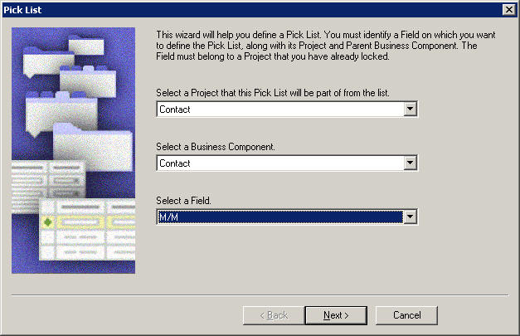
Create a New Picklist
Use the Pick List Wizard to create a new static or dynamic picklist
  Select File > New Object > Pick List

Slide 10
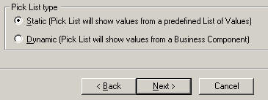
Wizard Inputs for a Static Picklist
The Pick List Wizard requires the following inputs:
  Project the created picklist object will be part of
  Business component and field populated by the picklist
  Picklist name and type (Static)
Business component and field populated by the picklist
Picklist type is static

Slide 11
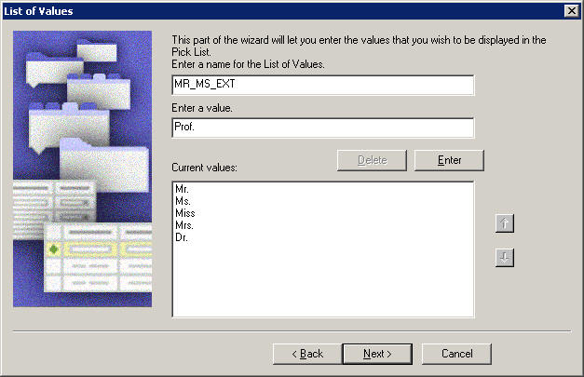
Wizard Inputs for a Static Picklist Continued
The Pick List Wizard requires the following inputs (continued):
  Bounded or unbounded picklist
  Type value (example: MR_MS)
  Pick list values
    May use existing type and/or values in S_LST_OF_VAL
Enter values for static picklist

Slide 12

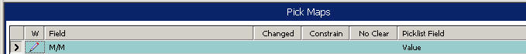

Pick List Wizard Outputs for a Static Picklist
The Pick List Wizard creates:
  A picklist object
  A pick map that specifies values copied to the S_LST_OF_VAL table
  Values in S_LST_OF_VAL for the picklist
  Activated drop-down list column or control in applets containing the originating field
Picklist
Pick map for originating field
Drop-down control

Slide 13
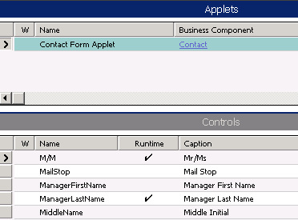
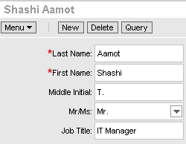
Activating a Drop-Down List Column or Control
The Pick List Wizard may activate drop-down control for picklist field
  The wizard displays all applets displaying the originating field
  Only the applets locked by developer will be activated
Wizard sets list column or control Runtime property to TRUE
  A drop-down arrow appears as a cue
Runtime set to TRUE

Slide 14
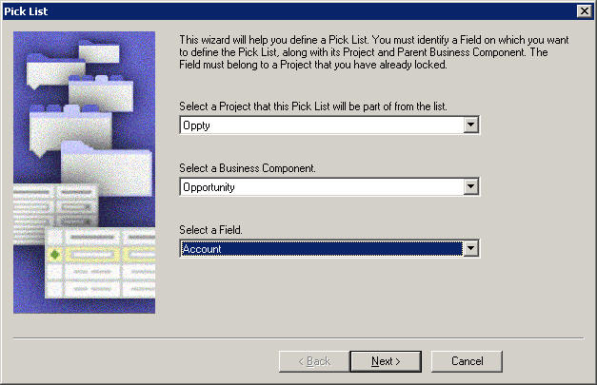
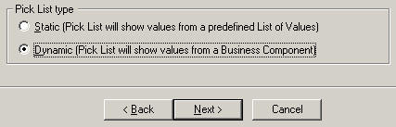
Wizard Inputs for Dynamic Picklists
The Pick List Wizard requires the following inputs:
  Project the created picklist object will be part of
  Originating business component and field for the picklist
  Picklist name and type (Dynamic)
Originating business component and field
Set type to Dynamic

Slide 15
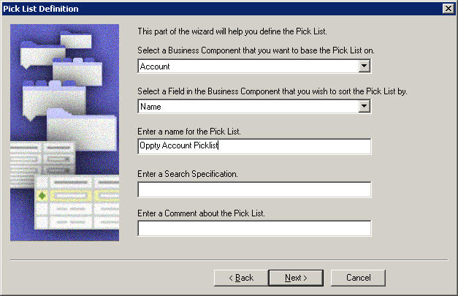
Wizard Inputs for Dynamic Picklists Continued
The Pick List Wizard requires the following inputs (continued):
  A pick business component
  A field in the pick business component to sort on
  A picklist name
  A search specification
Pick business component
Business component field to sort on

Slide 16
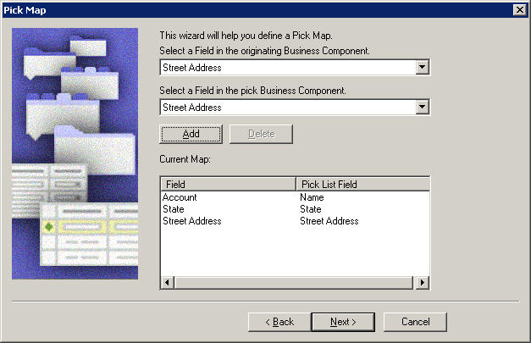
Wizard Inputs for Dynamic Picklists Continued
The Pick List Wizard requires the following inputs (continued):
  Pick applet properties (No Delete, No Insert, No Update, No Merge)
  Values for a pick map, mapping fields between originating and pick business components
Define a pick map

Slide 17
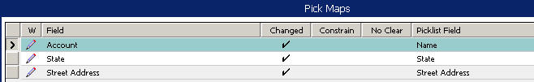
Pick List Wizard Outputs for a Dynamic Picklist
The Pick List Wizard creates:
  A picklist object
  A pick map constructed in the wizard
  A new pick applet, if needed
  Activated list column or control in applets containing the originating field
    List column or control for originating field must have Runtime property set to TRUE
Picklist
Pick map for originating field
Field with select icon

Slide 18
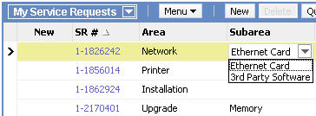
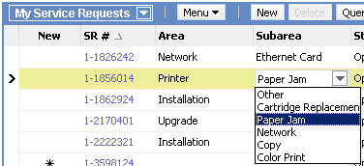
Constrained Picklist
Filters values dynamically based on value in parent picklist
Parent picklist
Constrained child picklist
Values available when Area is Network
Values available when Area is Printer

Slide 19
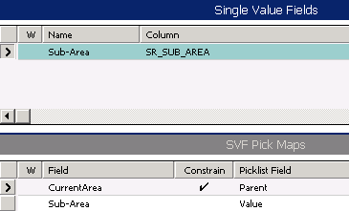
Constraining a Picklist
Create a pick map definition for each field that must match
Set the Constrain property to TRUE for each of the matching fields
  Filters the pick business component records for matches
  Does not copy values for the field
Constrained to return only Sub-Areas whose Parent is equal to the Current Area

Slide 20
Module Highlights
Picklists allow selection of values from a list for one or more single-value fields in an originating business component
Static picklists:
  Display values in a drop-down list
  Contain static values, which are managed through List of Values administrative views
  Store values in S_LST_OF_VAL table
Dynamic picklists:
  Display values in a pick applet
  Contain dynamic data, which is typically the result of user transactions
  Access data in pick business component using a foreign key
Picklists are created using Siebel Tools’ Pick List Wizard

Slide 21
Lab
In the lab you will:
  Create a new static picklist
  Create a new dynamic picklist

