Slide 1

Module 32: Configuring Multi-Value Groups
0/5
Siebel 8.0 Essentials
Notes:
Time: Lecture: <n – n> minutes; Labs: <n – n> minutes
Intent: <What is the instructional goal of the module>
Flow: < Describe at a high level the overall flow of the module>.
Key Terms: <List terms the instructor should be familiar with in order to teach this module>
<Term>
<Term>
<Term>
<Term>

Slide 2
Module Objectives
After completing this module you should be able to:
  Describe multi-value groups and their benefits
  Use Siebel Tools to configure a multi-value group
Why you need to know:
  Enables you to incorporate child data directly in an applet
    More child data can be available within a view
    More effective use of screen space

Slide 3
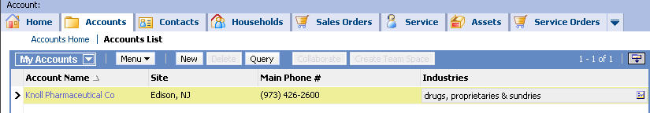

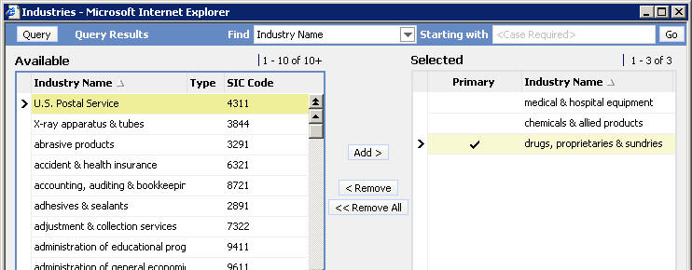
Multi-Value Group
A multi-value group (MVG) is a set of detail (child) records associated with a parent record
  The Parent applet displays only one of the child records
  The MVG applet opens on demand to display all child records
MVG applet

Slide 4
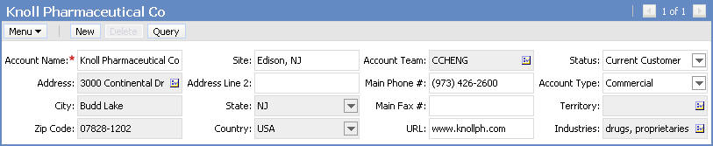
Multi-Value Group Continued
Is an alternative to a detail view for managing parent and related child records
  Makes effective use of space
    Does not require dedicated space on a view
  Allows for multiple sets of detail records to be available from a single view
Territory MVG
Business Address MVG
Account Team MVG
Industries MVG

Slide 5
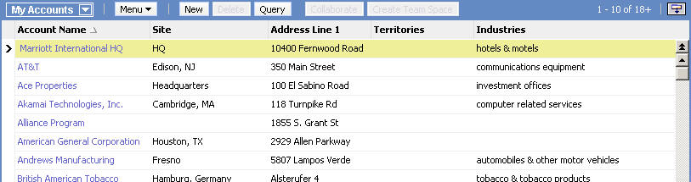
Multi-Value Group Continued
Allows users to access child records for multiple parent records in a single list view
Business Address MVG
Territory MVG
Industries MVG

Slide 6
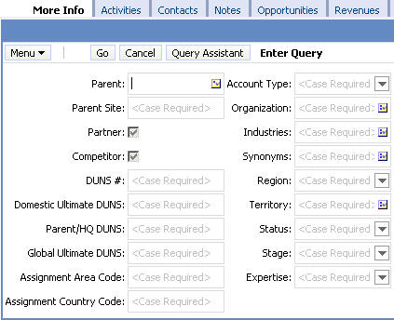
Multi-Value Group Continued
Allows for creating queries that include values for fields in both parent and child records
Query on Organization
Query on Industries
Query on Territory

Slide 7
Primaries
Primary key allows fast retrieval of the primary child record for display in the parent applet
  A primary refers to a designated child record
  Designating a primary allows one child record to be retrieved quickly for display
Supported by a primary foreign key field in the parent business component to reference the child’s primary key (ROW_ID)
  Siebel Data Model includes many primary foreign keys
Parent BC
S_ORG_EXT
S_ADDR_ORG
Child BC
ROW_ID
CITY
ADDR
ROW_ID
OU_ID
LOC
NAME
PR_ADDR_ID
Primary foreign key
Foreign key

Slide 8
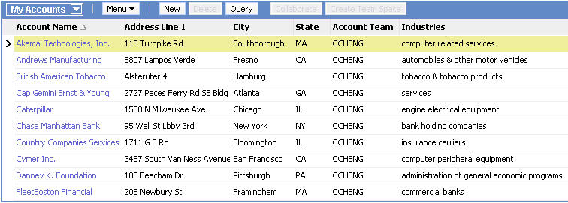
Primaries Performance Example
Three MVGs on a list applet displaying 10 parent records requires 31 queries to populate without primaries
  One query to populate parent fields in list applet
  30 queries (three per parent record) to populate the MVGs
Multi-value groups

Slide 9
Primaries Performance Example Continued
Using primaries, one query will populate all the fields on the list applet
  A query using SQL joins populates each MVG with its primary child record
Multi-value groups

Slide 10
Object Types Supporting MVGs
0/3
MVGs are implemented in Siebel applications using the following object types:
Link
Multi-Value Field (MVF)
MVG Applet

Slide 11
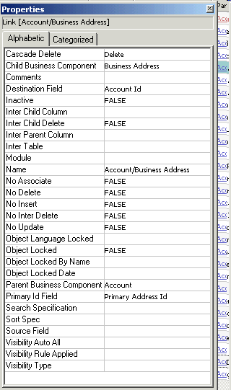
Link
1/3
Must exist between parent and child business components in the MVG
  Specifies how to get data from child business component
Parent business component
Account
Name
Location
City
Child business component
Business Address
City
Street Address

Slide 12
Multi-Value Field (MVF)
2/3
Is a field in the parent business component that references a field in the child business component
Is required for an MVG
Single-value field
Multi-value field
Parent business component
Child business component
Account
Name
Location
City
S_ORG_EXT
Business Address
City
Street Address
LOC
ROW_ID
EMP_COUNT
NAME
S_ADDR_ORG
ADDR
ROW_ID
ZIPCODE
CITY

Slide 13
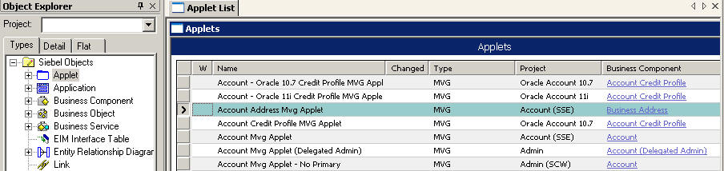
MVG Applet
3/3
Displays child business component records
  Displays list columns that allow the user to distinguish the desired record
MVG applets’ type is MVG

Slide 14
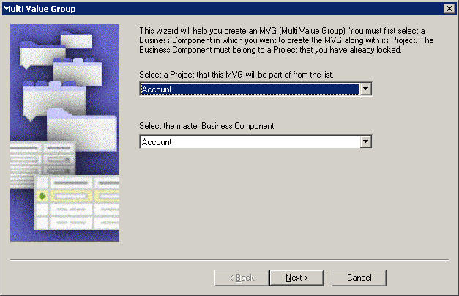
Creating a Multi-Value Group
Use the MVG Wizard in Siebel Tools to create a multi-value group
  Verify that a link between the parent and child business components exists
  Select File > New Object > MVG

Slide 15
Inputs to the MVG Wizard
Provide the following information to the MVG Wizard:
  The project that the MVG will belong to
  The master (parent) and detail (child) business components
  The name of the multi-value link
  The Auto Primary property (discussed later)
  The link properties

Slide 16
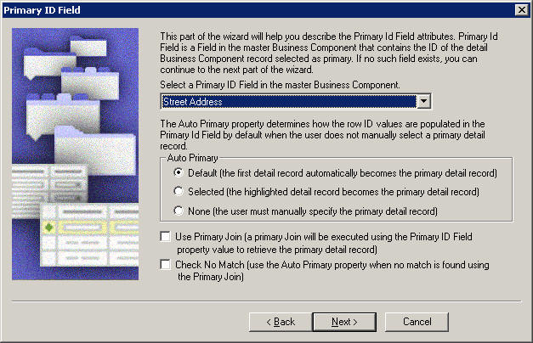
Setting Auto Primary Property in the MVG Wizard
Set the Auto Primary property to either:
  Default (the first child record becomes the primary)
  Selected (the highlighted record becomes the primary)
  None (the user must specify the primary)

Slide 17
MVG Wizard Output
The MVG Wizard creates an MVG
If no suitable MVG applet exists suitable for the choice of parent and child business components and MVFs, the wizard will open the MVG Applet Wizard

Slide 18
Multi-Value Groups for M:M Relationships
MVGs can be built on M:M relationships as well
  Link must specify the Inter Table property
Parent BC
Multi-value field
Child BC
Account
Industry
Name
Location
Industry
Name
SIC Code
S_ORG_EXT
S_INDUST
Intersection table
S_ORG_INDUST
LOC
ROW_ID
PR_INDUST_ID
NAME
_
SIC
ROW_ID
DESC_TEXT
NAME
Primary
INDUST_ID
ROW_ID
OU_ID
PK
PK
FK
FK

Slide 19

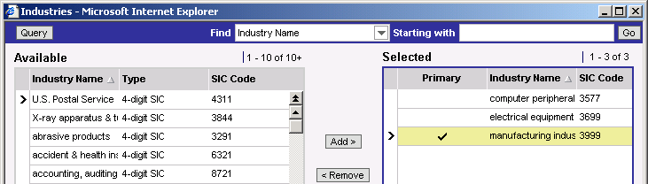
Configuring MVGs for M:M Relationships
Create object definitions required for 1:M MVGs
Specify an association applet for the MVG applet
  Allows users to select other child records to add to the MVG
Association applet

Slide 20
Module Highlights
A multi-value group (MVG) is a set of detail (child) records associated with a parent record
A primary is a designated child record that is displayed in the parent’s applet
  Speeds retrieval of parent record with primary child record for display in UI
  Supported by a primary foreign key
Objects needed to support an MVG are:
  Multi-value fields (MVFs)
  A multi-value link
  A MVG applet
Use the MVG Wizard to create an MVG in Siebel Tools

Slide 21
Lab
In the lab you will:
  Create a new MVG
  Create an MVG applet to display the MVG

