Slide 1

Module 33: Data Layer Configuration
0/5
Siebel 8.0 Essentials
Notes:
Time: Lecture: <n – n> minutes; Labs: <n – n> minutes
Intent: <What is the instructional goal of the module>
Flow: < Describe at a high level the overall flow of the module>.
Key Terms: <List terms the instructor should be familiar with in order to teach this module>
<Term>
<Term>
<Term>
<Term>

Slide 2
Module Objectives
After completing this module you should be able to:
  Create extension columns in a table
  Create custom tables
    Standalone table
    1:1 extension table
    1:M extension table
    Intersection table
Why you need to know:
  Enables you to incorporate additional attributes and business entities into a Siebel application

Slide 3
Incorporating Additional Data
Your business requirements may include:
  Adding new fields to capture additional data
  Creating new business components to capture additional business entities
Extending the Siebel database can satisfy these requirements
  Adding one or more columns to an existing table
  Creating new database tables to support new business components

Slide 4
Evaluate the Existing Database Tables
0/2
Prior to extending the Siebel database, consider using:
Unused Columns in an Existing Table
Existing 1:M Extension Table

Slide 5
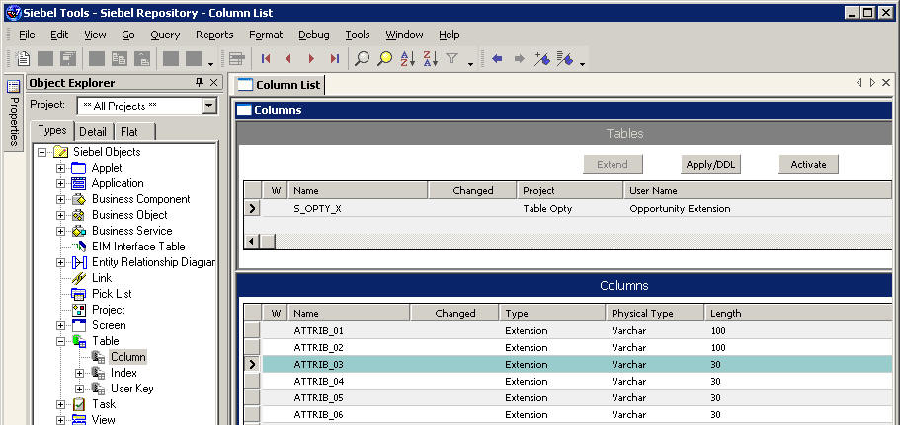
Unused Columns in an Existing Table
1/2
Consider mapping new fields to unused columns in an existing base or 1:1 extension table
  Verify that the candidate column has the desired type
  Consider possible upgrade conflicts in future releases
  Consider performance impact of a join to the 1:1 extension table
1:1 extension table of S_OPTY
Find desired type and length
Unused columns

Slide 6
Existing 1:M Extension Tables
2/2
Consider mapping the new business component to an appropriate 1:M extension table (as discussed in an earlier module)
  Verify that the business component has the correct M:1 relationship to the candidate parent business component
Contact
Favorite
Restaurants
New business component has M:1 relationship to parent (Contact)

Slide 7
Extending the Database
Changes the database schema and requires propagating the changes to:
  Other developers during development
  Mobile users after development for applications in production
  Production enterprise at completion of development and testing
Requires creating additional object definitions to:
  Map columns in the EIM tables needed to import and export data to the extension columns and tables
  Specify how data for these extension columns and tables are to be routed to remote users (Dock Objects)

Slide 8
Using Siebel Tools to Extend the Database
Supports creating new:
  Extension columns on tables
  Standalone tables
  1:1 extension tables
  1:M extension tables
  Intersection tables
Creates new object definitions for the database extension
  Invokes a wizard to build new tables
Makes the corresponding physical database changes
  Developers do not create, use, or maintain SQL scripts

Slide 9
Best Practices for Extending the Siebel Database
General suggestions:
  When adding a new column:
    If column is not often populated, use an existing column in an extension table if available
    If field often populated, avoid join overhead by using adding an extension column to base table
  If data for column appears in:
    A form applet, prefer an existing column in an extension table
    A list applet, prefer an extension column in the base table
      Join overhead can be significant when displaying many records

Slide 10
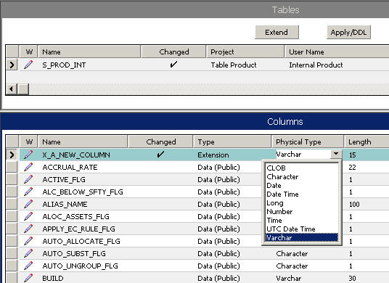
Creating a Custom Extension Column
Make logical changes to the Data layer
  Check out the appropriate project
  Select the table to be extended
  Create a new column record with the desired properties
    Name automatically prefixed with X_
Extension column
Select data type and length

Slide 11
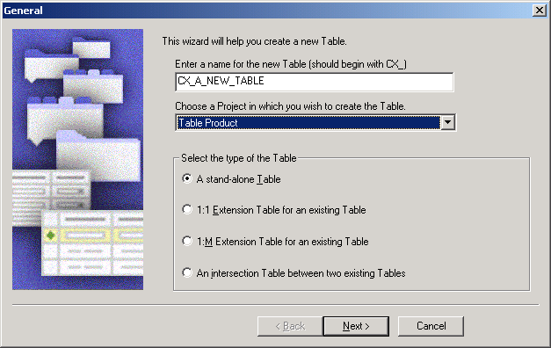
Creating a New Table
Use the Table Wizard to create a new table
  Select File > New Object > Table
Four types of table can be created:
  Standalone table
  1:1 extension table
  1:M extension table
  Intersection table

Slide 12
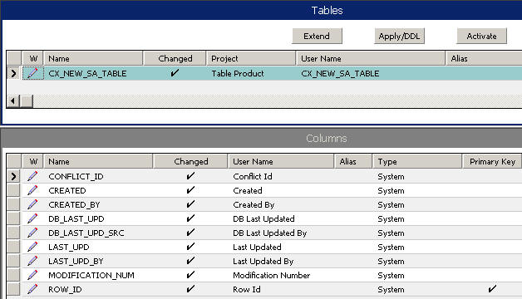
Creating a Standalone Table
Table wizard creates a standalone table with:
  Data (Public) as its type
  Nine system columns
  One index P1 on ROW_ID
System columns

Slide 13
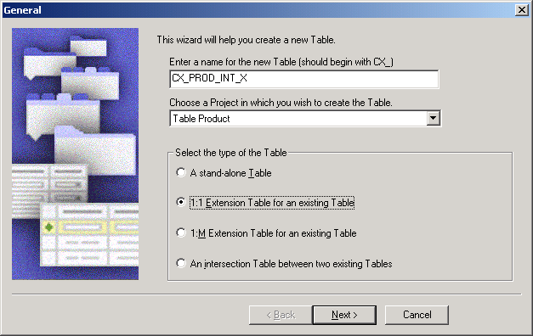
Creating a 1:1 Extension Table
Provide a base table as input to the Table Wizard
  Choice restricted to the Data (Public) type
  Multiple extension tables relate directly to the base table, and not to each other

Slide 14
Creating a 1:1 Extension Table Continued
The Table Wizard creates an extension table with:
  Ten system columns
    Required nine system columns
    PAR_ROW_ID column as the foreign key column to the base table
  Two indexes:
    P1 index on ROW_ID
    U1 index on PAR_ROW_ID and CONFLICT_ID
S_PROD_INT
CX_PROD_INT_X
ROW_ID
NAME
PART_NUM
UOM_CD
PAR_ROW_ID
ROW_ID
NEW COLUMN

Slide 15
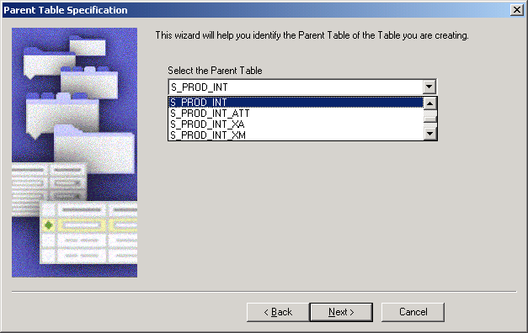
Creating a 1:M Extension Table
Create if the parent table does not have an existing 1:M table
Provide a parent table as input to the Table Wizard
  Choice restricted to the Data (Public) type

Slide 16
Creating a 1:M Extension Table Continued
Table wizard creates an 1:M extension table with:
  Data (Public) as its type
  Ten system columns
    Nine required columns
    PAR_ROW_ID column as the foreign key column to the base table
  TYPE and NAME columns
  Three indexes:
    P1 index on ROW_ID
    U1 index on PAR_ROW_ID, TYPE, NAME, and CONFLICT_ID
    M1 index on TYPE and NAME

Slide 17
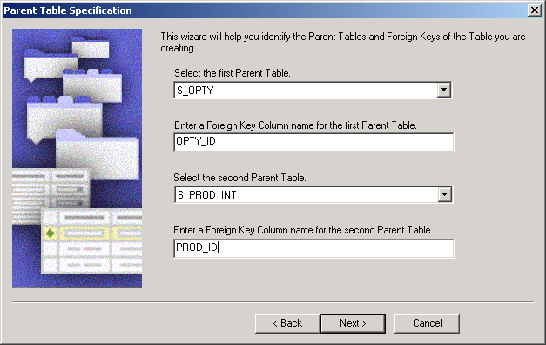
Creating an Intersection Table
Select both parent tables
  Choices restricted to the Data (Public) type
Specify the foreign key column name for each parent table

Slide 18
Creating an Intersection Table Continued
Table Wizard creates an intersection table with:
  Data (Intersection) as its type
  Nine system columns
  Two foreign key columns as specified
  Three indexes:
    P1 index on ROW_ID
    U1 index on two foreign key columns, TYPE, and CONFLICT_ID
    F1 index on foreign key to second parent table

Slide 19
Applying and Propagating Database Changes
0/3
Test changes locally before applying them to the server database
  Reduces the likelihood of undesired changes to the server schema
Best practices for changing the schema:
1. Apply Changes to the Local Database
2. Propagate Changes to the Server Database
3. Propagate Changes to Other Developers

Slide 20
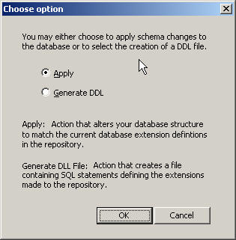
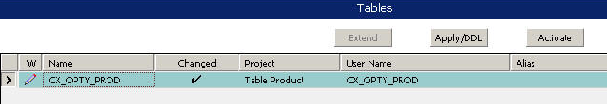
1. Apply Changes to Local Database
1/3
Click Apply/DDL to make the physical database changes
  Choice to apply schema changes or generate DDL script
  Changes are preserved across Siebel application upgrades
Compile relevant objects and projects
Test changes locally before checking in to the server
  Query tables/columns using a database SQL utility
New table

Slide 21


2. Propagate Changes to Server Database
2/3
Check project into the server
  Copies the table and column object definitions
  Does not apply those changes to the server database schema
Apply changes to the server database
  To make changes visible, press the Activate button on the Table object on the server machine
Compile and test against the server database
Server Machine
Developer Workstation
Developer Workstation
Developer Workstation
Apply
Check in

Slide 22
3. Propagate Changes to Other Developers
3/3
Other developers need to apply changes to their local databases
  Have other developers Get or check out the project and apply changes locally
  Alternatively re-extract developers and have them get all projects
Server Machine
Developer Workstation
Developer Workstation
Developer Workstation
Get/
Check out
Get/
Check out

Slide 23
Module Highlights
Alternatives to extending Siebel database schema:
  Utilize unused columns in an existing table
  Use an existing 1:M extension table if appropriate
Extend the Siebel database in Siebel Tools:
  Add an extension column to an existing table
  Use the Table wizard to create a new table:
    Standalone
    1:1 extension table
    1:M extension table
    Intersection table
Best practices to modify Siebel database schema:
  Apply changes locally and test
  Propagate changes to the server database
  Propagate changes to other developers

Slide 24
Lab
In the lab you will:
  Create a custom extension column on a table
  Check in configuration and apply to the server database

