Slide 1

Module 34: Siebel Business Services
0/5
Siebel 8.0 Essentials
Notes:
Time: Lecture: <n – n> minutes; Labs: <n – n> minutes
Intent: <What is the instructional goal of the module>
Flow: < Describe at a high level the overall flow of the module>.
Key Terms: <List terms the instructor should be familiar with in order to teach this module>
<Term>
<Term>
<Term>
<Term>

Slide 2
Module Objectives
After completing this module you should be able to:
  Describe a business service
  Describe the structure and role of property sets
  Use the business service simulator to test a business service
Why you need to know:
  Business services are an important building block for Siebel workflow
Notes:
Each objective and “why you need to know” should be stated aloud.

Slide 3
Automating Business Processes
A business process is a series of activities executed to achieve a specific business objective
  Example: the Quote to Cash business process (how an enterprise creates a quote and converts it to an order for submission)
Automation options within the Siebel application can address such challenges as:
  Maintaining and standardizing consistent business processes across all business units
  Routing and assigning tasks accurately and efficiently
  Responding in a timely, effective manner to customer inquiries and service requests
  Assisting users with the implementation of best practices
  Offering consistent and personalized service to customers

Slide 4
Siebel Workflow
Is a set of capabilities to extend the functionality of Siebel applications by automating business processes
Includes capabilities such as:
  Workflow Processes
    Automates steps in a business process
  Workflow Policies
    Invokes workflow process under specified conditions
  Tasks
    Guides users through a series of views to complete a step in business process
  Assignment Manager
    Automates assignment of data (such as opportunities and service requests) to the desired people
  State Model
    Enforces a limited life cycle for select business entities

Slide 5
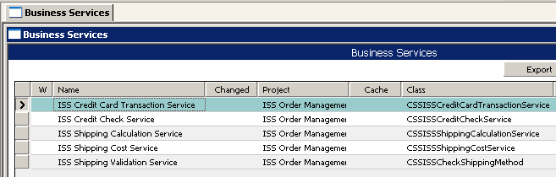
Business Service
Is a unit of functionality that is reusable and globally accessible
  Example: The ISS Shipping Cost Service computes shipping charges corresponding to a company’s shipping policies
Enables business logic to be executed repeatedly in multiple different contexts
  Business logic is not restricted to a specific object (business component, applet, and so forth)
Can be invoked in a Siebel workflow process or a Siebel task

Slide 6
Prebuilt Business Services
Siebel repository contains many prebuilt business services to support processing in areas such as
  Customer order management
    ISS Credit Check Service
    ISS Shipping Cost Service
    ISS Tax Calculation Service
  Enterprise application integration
    EAI Siebel Adapter
    EAI HTTP Transport
  XML document processing
    XML Hierarchy Converter
    XML Converter
  Enforcing customer business rules
    Business Rule Service
Notes:
Siebel Systems provides a set of business services to implement Customer Order Management. This course uses the business services listed in the first bullet only.

Slide 7
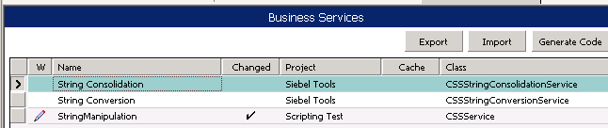
Repository-Stored Business Services
Some business services are stored in the Siebel repository
  Siebel-developed business services
    Are written in C++
    Cannot be modified by customers
  Custom business services developed by users
    Are written in Siebel Visual Basic or eScript
    Are created and modified by customers using Siebel Tools
Custom business service
Notes:
This slide points out that some business services are stored in the Siebel repository. Note that both Siebel-developed and customer-created business services can be repository-resident.

Slide 8
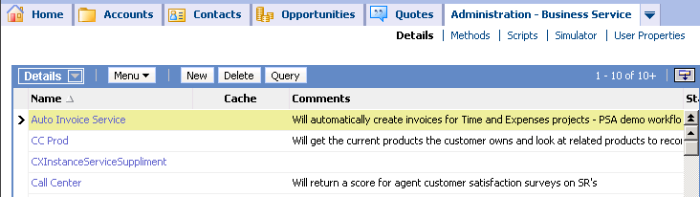
Client-Stored Business Services
Some business services are stored in the client database
  Siebel-developed business services
  Custom business services developed by users
Client-stored business services
  Are written in Siebel Visual Basic or eScript
  Are created and modified by customers using the Administration - Business Services screen
  Are never executed if there is a repository-stored business service of the same name
Notes:
Other business services are stored as user data in the Siebel database. Again, they can be either Siebel-delivered or customer-developed. However, in either case they are always written in script rather than C++.
Mention that the Siebel executable first checks for a business service in the Siebel repository and executes it. Only if it does not find the business service there does it check in the user tables. This implies that a client business service with a name that is the same as in the repository will never get executed. You can explain that the intent of the client business services is to support rapid development of business services. Once they have been tested and verified, they can be exported and then imported in Siebel Tools and compiled into the repository.

Slide 9
Methods
A business service consists of one or more operations called methods
  Each method has a set of input and output arguments, each with a specified type
Business service
StringManipulation
Argument name
InputString
Length
String
Length
Number
Argument type
InputString
Length
OutputString
String
Number
Truncate
String
String1
String2
OutputString
String
String
Concatenate
String
Input arguments
Output arguments
Method
Notes:
This slide discusses methods, input arguments, and output arguments. Students will examine this business service in detail in the lab.

Slide 10
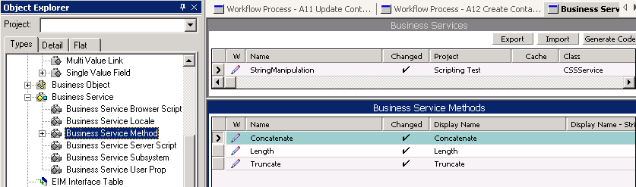
Identifying Methods for a Business Service
In Siebel Tools, navigate to Business Service | Business Service Method
Name that appears in client when selecting a business service method
Notes:
This slide shows how to determine the methods for a business service. Note that there is a hidden property for the Business Service Method object definition that effectively makes it unavailable for selection in Workflow and the business service simulator. The EAI XML Converter business service shows six methods, four or which are hidden.

Slide 11
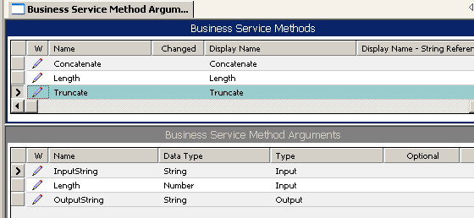
Identifying Arguments and Types for a Method
In Siebel Tools, navigate to Business Service | Business Service Method | Business Service Method Arg
Notes:
This slide shows how to determine the arguments for a business service method. Note that the list applet shows all arguments whether they are tagged as input, output, or input/output.

Slide 12
Invoking a Method
Involves:
  Assigning values to the input parameters
    Not all input parameters are required to have values
  Retrieving the values assigned to the output parameters
StringManipulation
Siebel
4
Length
Sieb
InputString
Length
OutputString
String
Number
Truncate
String
Concatenate
Notes:
When a method is invoked, values must be assigned to the input arguments. After the method completes, the output arguments contain the results of the method.

Slide 13
Property Set
Is the in-memory data structure used to:
  Pass a set of input arguments into a method
  Receive a set of output arguments from a method
Input property set
Output property set
StringManipulation
Siebel
4
Length
Sieb
InputString
Length
OutputString
String
Number
Truncate
String
Concatenate
Notes:
What is specific to Siebel applications is how the values of the input arguments are passed in and how the values of the output arguments are returned. This is done through two data structures called property sets.

Slide 14
Property Set Continued
Represents data using name/value pairs
Has two predefined properties: Type and Value
Has an array for storing user-provided name/value pairs
Is automatically created and populated when invoking most business services from a Siebel workflow or task
Values for predefined properties
Array of user-provided name/value pairs
Predefined property names
Type
InputString
Siebel
Value
Length
4
Input property set
Notes:
This slide defines the general structure of a property set. The example shows an input property set for passing in the values shown on the previous slide.
You might ask the class what the property set for the output arguments looks like. (It has one name value pair (Output String, Sieb)).

Slide 15
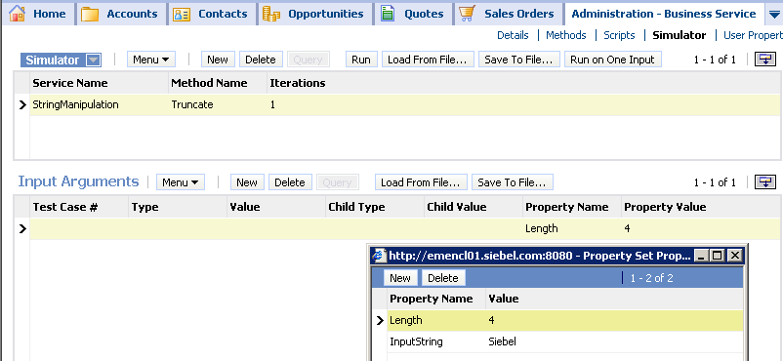
Testing a Business Service
Use the business service simulator in the Siebel Client
  Navigate to Administration - Business Service > Simulator
  Select the business service and method
  Create the property set name/value pairs
    Optionally load data from an input file
Input property set
Notes:
This slide introduces the business service simulator in the Siebel client. It explains how to test a business service.

Slide 16
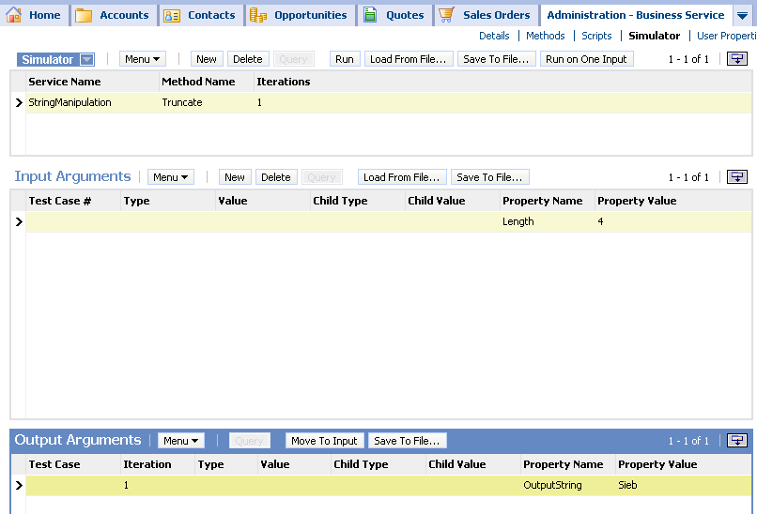
Testing a Business Service Continued
Use the business service simulator in the Siebel client
  Click Run on One Input
  Examine the output property set name/value pairs
  Optionally save the output to a file
Notes:
This slide completes the steps to test a business service.

Slide 17
Module Highlights
A business service is a unit of functionality that is reusable and globally accessible
  Can be stored in the repository or in user database tables
  Consist of one or more methods
    Each method is specified by a set of input and output arguments
A property set is an in-memory data structure consisting of name value pairs
A business service
  Is invoked by passing in the input arguments in a property set
  Returns the output arguments in a property set
Use the business service simulator to test a business service
Notes:
Review Question: <Question>
Answer: <Answer>

Slide 18
Lab
In the lab you will:
  Import a custom business service into the repository
  Examine the methods and arguments for a business service
  Use the business service simulator to test a business service and examine the output property sets
Notes:
Labs and Troubleshooting:
<Summarize the tasks the students will perform in this lab. Suggest specific guidance the instructor may provide if necessary to help the students complete the lab and avoid trouble spots.>

