Slide 1

Module 35: Building Siebel Workflow Processes
0/5
Siebel 8.0 Essentials
Notes:
Time: Lecture: <n – n> minutes; Labs: <n – n> minutes
Intent: <What is the instructional goal of the module>
Flow: < Describe at a high level the overall flow of the module>.
Key Terms: <List terms the instructor should be familiar with in order to teach this module>
<Term>
<Term>
<Term>
<Term>

Slide 2
Module Objectives
After completing this module you should be able to:
  List the types of workflow processes and workflow steps
  Create a new workflow process and configure business service, Siebel operation, and decision steps
Why you need to know:
  Siebel workflow processes are one of several declarative techniques to automate business logic
Notes:
Each objective and “why you need to know” should be stated aloud.

Slide 3
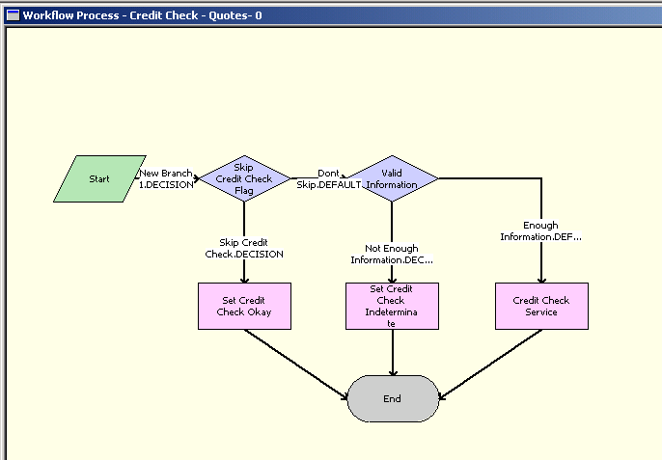
Workflow Process
Is an ordered set of steps executed in response to a defined set of conditions
Is used to automate parts of a business processes in a Siebel application
Notes:
This slide explains what a Siebel workflow is. The example is a workflow from eSales, and is chosen to illustrate the potentially complex nature of a workflow and the variety of types of steps in a workflow.

Slide 4
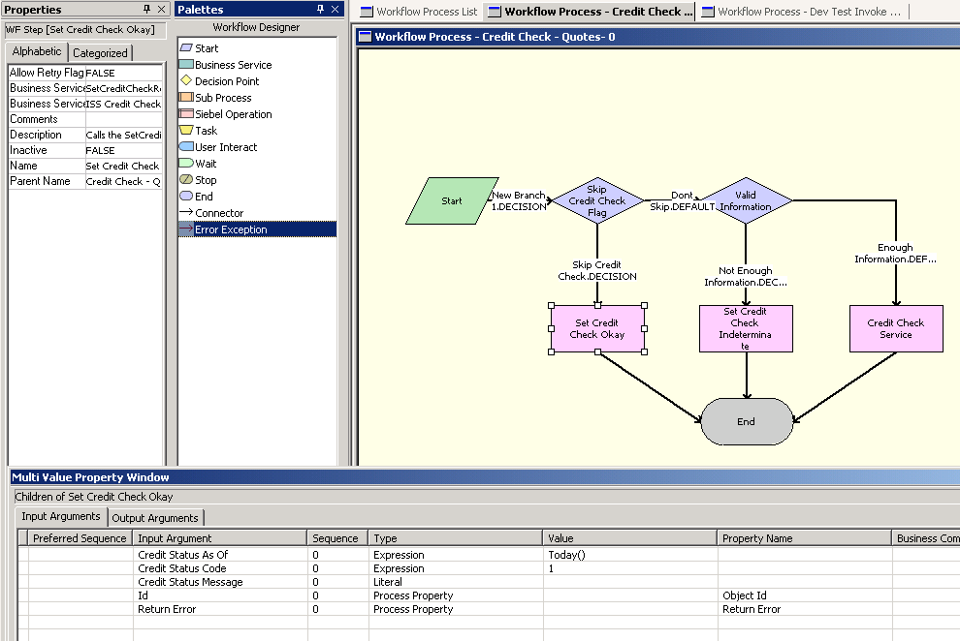
Workflow Designer
Siebel Tools includes a Workflow Designer used to create, examine, and modify Siebel workflow processes
  Contains a palette, workspace, and associated property windows
Workspace for editing workflows
Properties window (displays properties of selected item)
Palette of workflow steps
Multi Value Property Window (displays properties of child records of selected item)
Notes:
The Workflow Design Canvas includes a palette of the various types of workflow steps, a workspace for designing workflow processes, and a process detail applet.

Slide 5
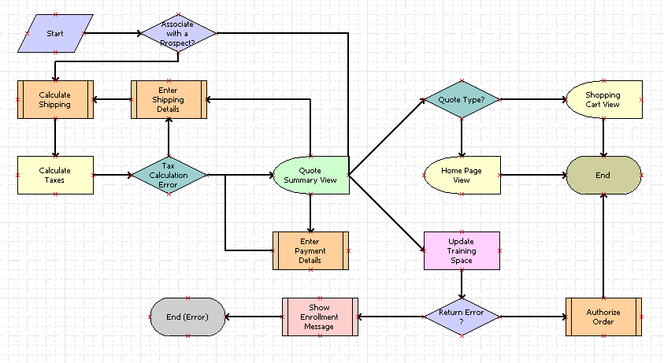
Workflow Process Steps
Siebel workflow processes consist of different types of steps
Start step
eSales – Complete Checkout Process
Decision point step
User interact step
Sub process step
Business service step
End step
Notes:
This slide explains what a Siebel workflow is. The example is a workflow from eSales, and is chosen to illustrate the potentially complex nature of a workflow and the variety of types of steps in a workflow.

Slide 6
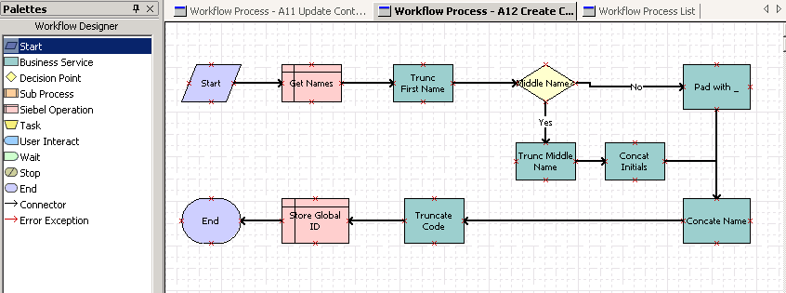
Workflow Process Steps Continued
All workflow processes have a:
  Start step
  End step
Workflow processes often include the following common steps:
  Business service step
  Siebel operation step
  Decision point step
Start step
End step

Slide 7
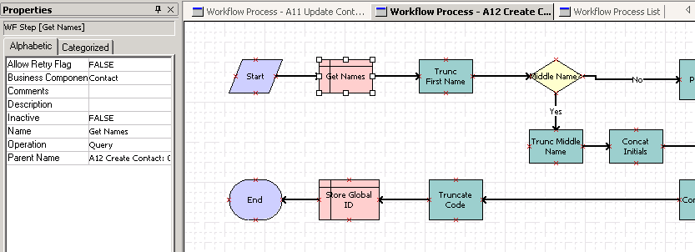
Siebel Operation Step
Performs the following operations on a business component
  Insert
  Update
  Delete
  Query
    Next record and previous record operations supported for iteration over multiple records returned by a query
Queries the Contact business component

Slide 8
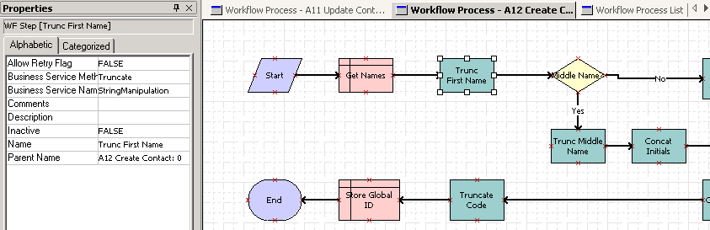
Business Service Step
Invokes a method of a business service
Invokes the Truncate method of the StringManipulation business service
Notes:
The teaching example used in the remainder of this module is based on the StringManipulation business service introduced in the prior module.
You might ask the class what the workflow accomplishes. The workflow is designed to concatenate a person’s first and last name, and truncate the string to 10 characters if longer than that.

Slide 9
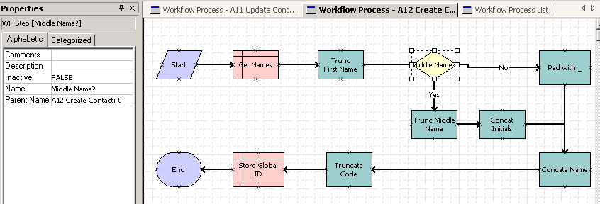
Decision Point Step
Allows a workflow to branch to one of multiple steps based on the value of inputs
If input = no
If input = yes

Slide 10
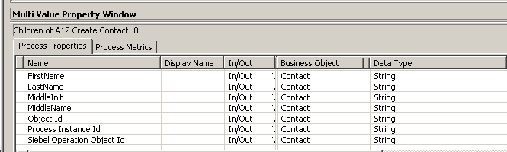
Process Properties
Process properties are variables that store inputs used by and outputs produced by workflow steps
Each workflow process has a set of process properties that persist while the workflow process is executing
  Some are populated when the workflow process is invoked
  Some return data to invoking workflow process or business service upon completion
Specific to this workflow
Some of default properties that appear in all workflows
Notes:
This slide introduces the role of process properties. Note that each process property is tagged as in, out, or in/out. In (in/out) process properties can be populated when the workflow is invoked, while out (in/out) process properties return output values upon completion of the workflow.

Slide 11
Process Properties Continued
Provide inputs to workflow steps
Receive outputs from workflow steps
  Can be used as inputs for following steps
Process Properties
FirstName
LastName
ContactCode
StringManipulation
Length
Truncate
String1
String2
OutputString
String
String
Concatenate
String
Business service step
Notes:
This slide shows how process properties and business service arguments are connected.

Slide 12
Configuring a Siebel Workflow
0/5
1. Create a New Workflow Process
2. Specify the Process Properties
3. Add Workflow Steps
4. Configure the Steps
5. Validate the Workflow Process
Notes:
This is a structuring slide for <insert what will be discussed>. Do not teach the steps or concepts here because the following slides cover them in detail. Provide a high level description of what will be discussed.

Slide 13
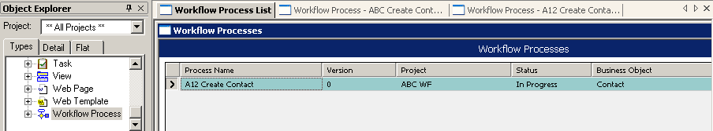
1. Create a New Workflow Process
1/5
In Siebel Tools, select the Workflow Process object type
Create a new workflow process definition
  Enter the process name
  Assign the process to a locked project
  Assign a business object
    Provides context for references to business components and fields
Right-click and select Edit Workflow Process to invoke the Workflow Designer

Slide 14
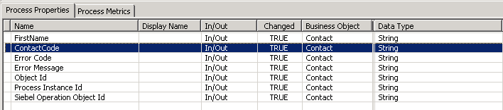
2. Specify the Process Properties
2/5
Select the Process Properties tab in the Multi Value Property Window (MVPW) to display the default process properties
Edit the default set of process properties
  Add new process properties to store additional values created and used by the workflow steps
  Leave the default process properties as it is
Default process properties for all workflows

Slide 15
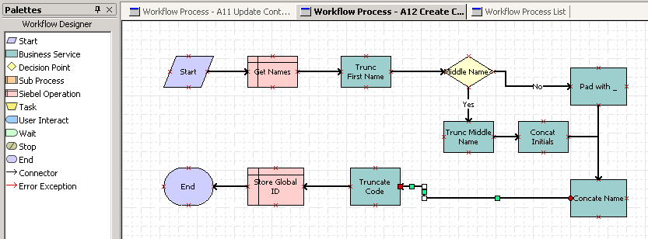
3. Add Workflow Steps
3/5
Add a start and end step to the designer
  Drag steps from the palette to the workspace
Add other steps as required
Add connectors to sequence the steps
  Make sure that connector ends are anchored (red box appears)
Connector anchored
Dynamic connectors (are drawn automatically with right angles as necessary)

Slide 16
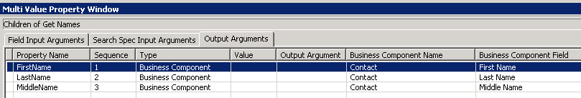
4. Configure the Steps (Siebel Operation)
4/5
For each Siebel operation step
  Specify the business component and operation
    Use the properties window
  Specify additional child arguments as required in the MVPW
    Field names
    Search spec input arguments
    Output arguments
Business component
Operation
Fields retrieved

Slide 17
4. Configure the Steps (Business Service)
4/5
For each business service step
  Specify the business service name and business service method
    Use the Properties window
Business service and method

Slide 18
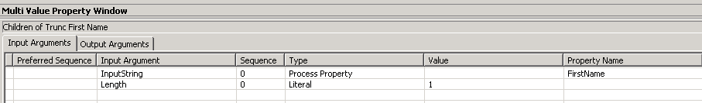
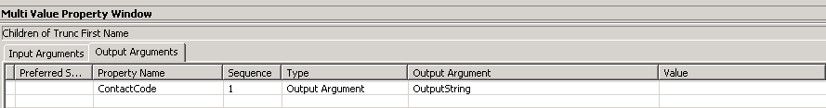
4. Configure the Steps (Business Service) Continued
4/5
For each business service step
  Specify inputs to use in the workflow
    Select the Input Arguments tab in the MVPW
    Assign a literal value or a process property to each input
  Specify outputs of the business service step
    Select the Output arguments tab in the MVPW
    Assign each output to a process property
Input arguments defined for method
Constant value assigned as input
Value of process property assigned as input
Value of output argument assigned to process property

Slide 19
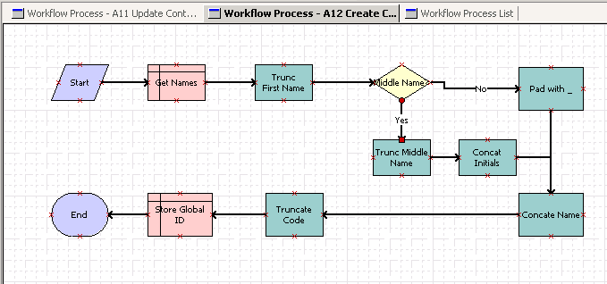
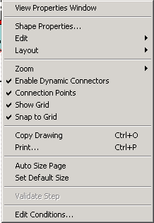
4. Configure the Steps (Decision Point Step) Continued
4/5
For each decision point step, set conditions on each branch (connector) originating at the step
  Select connector
  Right-click and select Edit Conditions

Slide 20
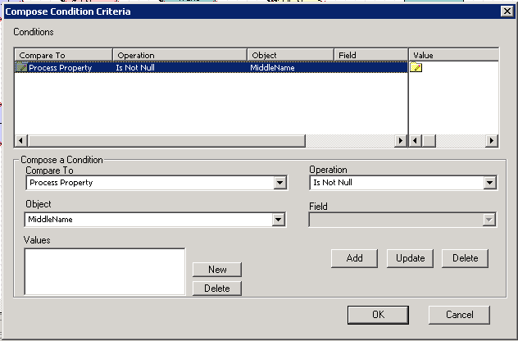
4. Configure the Steps (Decision Point Step)
4/5
Enter the condition criteria for each branch in the Compose Condition Criteria dialog box
Do not create a condition criteria for the default branch
  Execution path taken if no other branches are satisfied
Does contact have a middle name

Slide 21
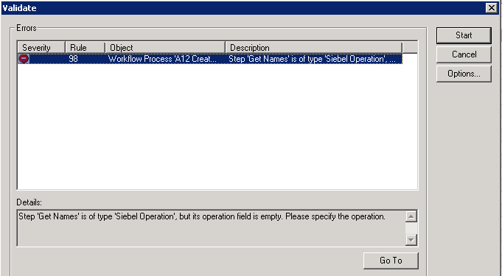
5. Validate the Workflow Process
5/5
Save all the configuration performed in the Workflow Designer
Return to the Workflow Process List
Right-click the workflow and select Validate
Click Start to perform the validation checks
  Syntactic errors are displayed in the Errors window

Slide 22
Additional Workflow Steps
Siebel workflows may contain additional types of steps
  Sub process
    Invokes another workflow process as a sub process
  User interact
    Navigates the user a view and waits for user activity
  Wait
    Pauses the workflow for a specified period of time before proceeding
  Stop
    Stops the workflow process instance if a predefined exception occurs
  Task
    Invokes a Siebel task (subject of a subsequent module)

Slide 23
Workflow Modes
Workflows are characterized by modes that describe their runtime behavior
  Service Flow
    Executes a discrete set of steps and completes
    Is the default mode for a new workflow
    Cannot include wait or user interact steps
  Interactive flow
    Designed to navigate users through a set of views
    Is being replaced by Siebel tasks
  Long running flow
    Is a workflow that is intended to persist for some indeterminate period of time
    Can be paused and resumed as an inbox item
    Cannot include a wait step
  7.0 flows
    Provided for backward compatibility of workflows defined prior to Siebel 7.5 release
    Should not be used for any new workflows

Slide 24
Module Highlights
A workflow process is an ordered set of steps executed in response to a defined set of conditions
  Is used to automate parts of a business processes in a Siebel application
Siebel workflow processes consist of different types of steps (Business service, Siebel operation, decision point, etc.)
Process properties are variables that store inputs used by and outputs produced by workflow steps
Build a workflow process by:
  Creating a new workflow process
  Specifying the process properties
  Adding workflow steps
  Configuring each step
  Validating the workflow process
Notes:
Review Question: <Question>
Answer: <Answer>

Slide 25
Lab
In the lab you will:
  Configure a workflow process that includes business service steps
  Configure a workflow process that includes a decision point step
Notes:
Labs and Troubleshooting:
<Summarize the tasks the students will perform in this lab. Suggest specific guidance the instructor may provide if necessary to help the students complete the lab and avoid trouble spots.>

