Slide 1

Module 36: Testing and Deploying Workflow Processes
0/5
Siebel 8.0 Essentials
Notes:
Time: Lecture: <n – n> minutes; Labs: <n – n> minutes
Intent: <What is the instructional goal of the module>
Flow: < Describe at a high level the overall flow of the module>.
Key Terms: <List terms the instructor should be familiar with in order to teach this module>
<Term>
<Term>
<Term>
<Term>

Slide 2
Module Objectives
After completing this module you should be able to:
  Test a Siebel workflow process using the simulator
  Deploy a Siebel workflow process
Why you need to know:
  Workflow processes should be tested to verify that they behave as desired prior to deployment
  Deployment is a critical step in making a new workflow process available for use
Notes:
Each objective and “why you need to know” should be stated aloud.

Slide 3
Managing Siebel Workflow Processes
Workflow process differ from most other object definitions
  Are not compiled into an .srf file
  Cannot be archived into .sif files
  Can be exported to and imported from XML files
After a workflow process has been configured in Siebel Tools
  Simulate the workflow
  Deploy the workflow

Slide 4
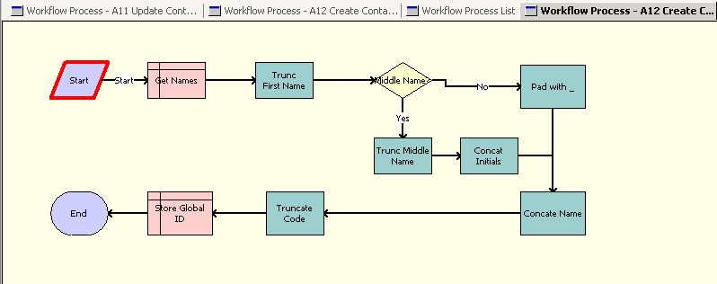
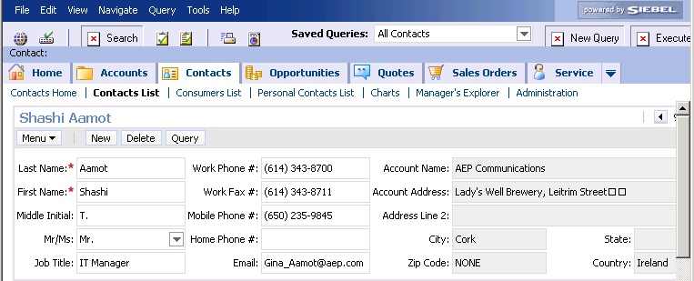
Workflow Simulator
Use the workflow simulator to verify that the workflow performs as desired
  Workflow simulation is controlled in Siebel Tools
  Workflow is actually executed in an instance of a Siebel client
    Tools and the Siebel client must be connected to a common database
DB

Slide 5
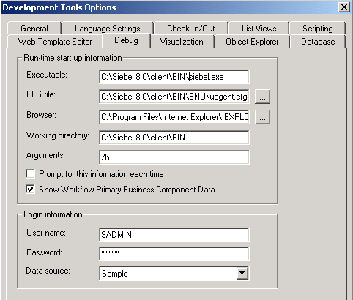
Enabling Workflow Simulation
Configure the connection to the Siebel run-time instance
  In Siebel Tools, select View > Options > Debug
    Simulator shares the connection parameters used by Tools Debugger
  Specify the run-time Siebel instance
  Provide a valid login
Executable: Location of siebel.exe file for the Mobile Web Client
CFG file: Location of the Mobile Web Client configuration file
Working directory: The Mobile Web Client directory
Arguments: Use default, opens communication between Tools and Mobile Web Client
Login information: Login name, password, data source

Slide 6
Test a Workflow Using the Workflow Simulator
0/4
1. Specify the Test Record
2. Start the Simulator
3. Start the Simulation
4. Execute the Workflow
Notes:
This is a structuring slide for <insert what will be discussed>. Do not teach the steps or concepts here because the following slides cover them in detail. Provide a high level description of what will be discussed.

Slide 7
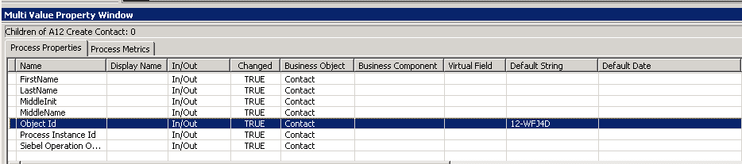
1. Specify the Test Records
1/4
In the Siebel client, create test records to support the simulation
  Use About Record to determine the row ID
In Siebel Tools, enter the row ID of the test record as the default string for the Object ID process property
  When the workflow is invoked in production, row ID of the record is passed in as an input argument

Slide 8
2. Start the Simulator
2/4
Make sure that all instances of the Siebel client application are closed
Right-click the Workflow Designer workspace and select Simulate
  Workflow Designer displays the workflow in the simulator window

Slide 9
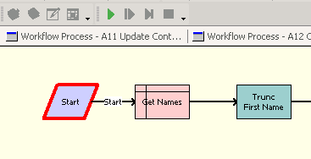
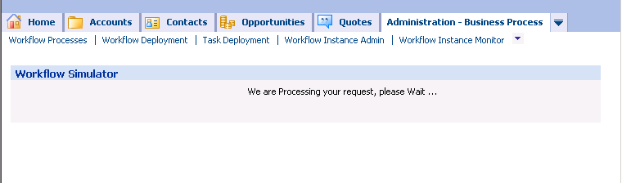
3. Start the Simulation
3/4
Click the Start Simulation button in the simulation toolbar
  Use View > Toolbars > Simulation to display the simulation toolbar
A new instance of the Siebel client is launched
Start simulation
Wait until Siebel client application starts and displays the Workflow Simulator view

Slide 10
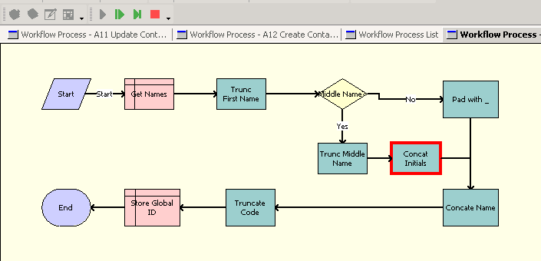
4. Execute the Workflow
4/4
Execute the workflow in either
  Single step mode using the Simulate Next button
  Continuous mode using the Complete Simulation button
Verify that the workflow branches correctly at decision steps
Simulate next
Complete Simulation

Slide 11
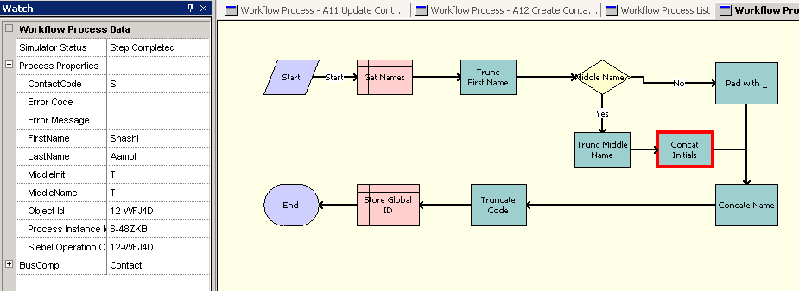
4. Execute the Workflow Continued
4/4
Inspect the watch window to verify that process properties have the expected values
  Values of user added process properties can be edited during a simulation
Inspect process properties in watch window

Slide 12
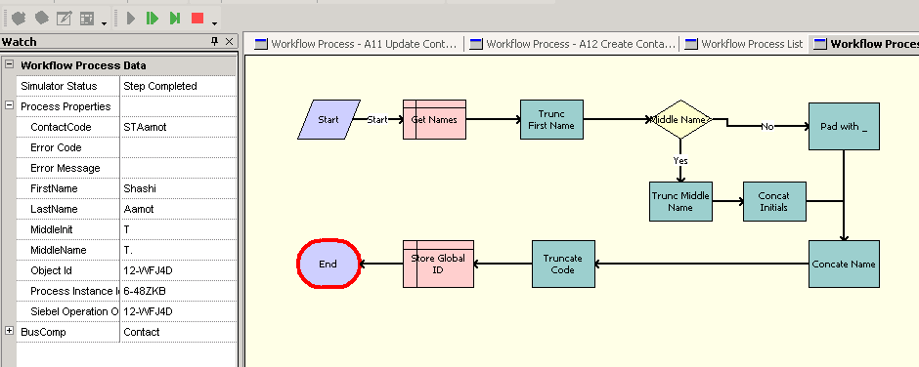
4. Execute the Workflow Continued
4/4
Complete the simulation
  Use either Simulate Next or Complete Simulation buttons
Verify that the final values of process properties are correct
Click the Stop Simulation button
Inspect the client and verify that the desired changes occurred
Stop simulation

Slide 13
Workflow Simulator Considerations
Cannot simulate workflow processes that invoke server components
  Must test these workflows directly on the Siebel Web Client
Cannot simulate workflows with run-time events on start steps (discussed in a subsequent module)
Can simulate workflows with user interact steps
  Requires the developer to perform the activity in the client application to allow the simulation to proceed

Slide 14
Managing Siebel Workflow Processes
After a workflow process has been configured in Siebel Tools
  Simulate the workflow
  Deploy the workflow

Slide 15
Deploying Workflow Processes
Transfers the workflow from the repository to run-time tables to make it available for use
Consists of:
  Developer setting the workflow complete in Siebel Tools
  Administrator activating the workflow in the run-time client

Slide 16
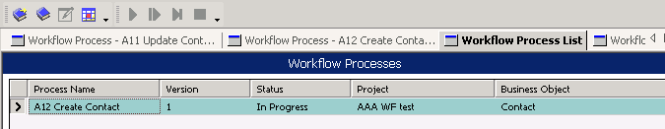

Publish the Workflow
In Siebel Tools, click the Publish button in the Workflow toolbar
  Sets the status to Completed
    Prevents any further editing of the workflow process
  Makes the workflow available for activation
Publish

Slide 17
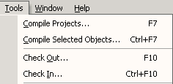
Checking in the Workflow Process
In Siebel Tools, check in the completed workflow process to the server repository
  Siebel Web Client can now access the workflow

Slide 18
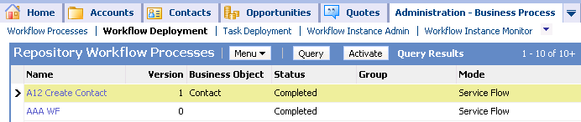
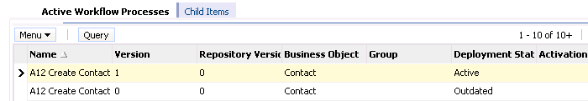
Activating the Workflow
In the Siebel Web Client, activate the workflow
  Navigate to Business Process - Administration > Workflow Deployment
  Select the newly deployed workflow and click Activate
    Transfers the workflow definitions in the repository tables into corresponding run-time tables

Slide 19
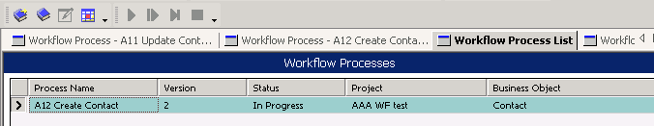
Publishing/Activating a Workflow Process
Developers can deploy and activate a workflow process from Siebel Tools to expedite testing of the deployed workflow
In Siebel Tools, click the Publish/Activate button in the Workflow toolbar
  Sets the status to Completed
  Transfers the workflow definitions in the repository tables into corresponding run-time tables
    Siebel client (for testing) must use the same database as Siebel Tools
Publish/Activate

Slide 20
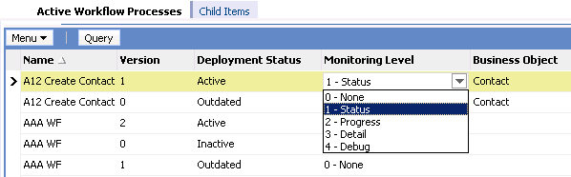
Workflow Monitoring
Navigate to Business Process - Administration > Workflow Deployment
  Select the active workflow process
  Set the monitoring level in the active workflow process as required
    The value assigned is used whenever the workflow process is invoked or resumed

Slide 21
Monitoring Level
Monitoring levels can be set as follows to record differing degrees of detail
  Performance can degrade as level of detail recorded increases
* In Detail, data is written at the end of the workflow
** In Debug mode, data is written to disk after every step
Levels | Record Process Instance | Record Step Instance | Record Process Properties
0-None | N | None | None
1-Status | Y | None | None
2-Progress | Y | All Steps | None
3-Detail* | Y | All Steps | All steps
4-Debug** | Y | All Steps | All Steps

Slide 22
Deployment Considerations
Deploy all child workflows (sub processes) first to make them available to the deployed workflow
Compile any new repository objects referenced in the deployed workflow such as business components, fields, and views

Slide 23
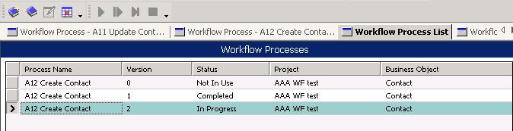
Revising Workflows
Workflows are versioned
  Existing versions are kept and a new version is created
To revise a workflow
  In Siebel Tools, select the desired workflow (check out if necessary)
  Click the Revise button in the Workflow toolbar
    Creates a copy of the workflow
      Increments the version number
      Sets status to In Progress
  Edit and test the workflow
  Deploy the workflow
Revise

Slide 24
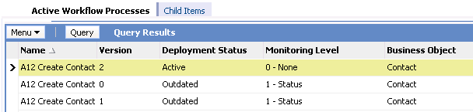
Administering a Revised Workflow
In the Siebel Web Client, activate the workflow as before
  Sets the deployment status of the prior version to Outdated
After being activated the new version will be invoked
  Any instances of the prior workflow version running at the time of activation run to completion

Slide 25
Module Highlights
Use the workflow simulator to verify that the workflow behaves as designed
  Workflow simulation is controlled in Siebel Tools
  Workflow is executed in an instance of a Siebel client
Deploy a workflow to make it available for use in the run-time client
  In Siebel Tools, publish the workflow
  In the run-time client, activate the workflow to make the workflow available for invocation
Revise a deployed workflow to edit it
  This creates a new version
Notes:
Review Question: <Question>
Answer: <Answer>

Slide 26
Lab
In the lab you will:
  Simulate workflows you previously configured
Notes:
Labs and Troubleshooting:
<Summarize the tasks the students will perform in this lab. Suggest specific guidance the instructor may provide if necessary to help the students complete the lab and avoid trouble spots.>

