Slide 1

Module 37: Executing Workflow Processes
0/5
Siebel 8.0 Essentials
Notes:
Time: Lecture: <n – n> minutes; Labs: <n – n> minutes
Intent: <What is the instructional goal of the module>
Flow: < Describe at a high level the overall flow of the module>.
Key Terms: <List terms the instructor should be familiar with in order to teach this module>
<Term>
<Term>
<Term>
<Term>

Slide 2
Module Objectives
After completing this module you should be able to:
  Describe the workflow execution architecture
  List several ways to invoke workflow
  Invoke a workflow process using a run-time event
  Invoke a workflow process using a custom control
Why you need to know:
  There are multiple ways to invoke a workflow process and you need to understand the choices available
Notes:
Each objective and “why you need to know” should be stated aloud.

Slide 3
Executing Workflow Processes
Workflow processes are executed either in
  The user’s application object manager
    Supports synchronous processing
  A separate server component known as the Workflow Process Manager component
    Supports asynchronous processing
In both cases workflow processes are executed using the Workflow Process Manager business service
  Is often referred to as the Workflow Engine

Slide 4
Synchronous Workflow Processing
Is typically executed in the user’s application object manager
  User is forced to wait until the workflow completes (or pauses)
    Hourglass icon appears
Can be triggered by an action on the part of the user:
  Directly by clicking a button or menu item
  Indirectly by performing a record or applet operation
Is used to execute specific business logic that:
  Is triggered by the user’s activity
  Should be completed before the user continues activity

Slide 5
Asynchronous Workflow Processing
Is executed in the Workflow Process Manager server component
  User (if any) is not prevented from continuing activity
Is typically triggered by a change in the value of some column in a database table
  Can respond to changes not associated with user activity
    For example: updates resulting from Enterprise Integration Manager imports
  Can respond to conditions that exist for some threshold period of time
Is used to execute specific business logic when a specified condition is satisfied
Will be discussed in the following module

Slide 6
Invoking Workflow Processes
A workflow process can be invoked by a variety of mechanisms
  Run-time events
  Custom buttons and menu items
  Workflow policies
  Programmatically (that is as part of script)
This module
Next module
Beyond scope

Slide 7
Run-Time Events
Are a mechanism that allows customer-configured processing to be triggered by user activity
Consist of:
  A specification of some user activity such as:
    Record being updated
    Navigating to/from an applet
  The resultant processing
    Workflow
    One or more calls to business services
      Known as an action set

Slide 8
Run-Time Events Continued
Can be defined for three types of objects:
  Application
    Examples: logging in, logging out
  Applet
    Examples: displaying an applet, displaying a record
  Business component
    Examples: Querying, deleting a record, setting a field value
Are fired when a user performs the corresponding activity

Slide 9
Business Component Events
Business component events often come in pairs such as:
  PreDelete/Delete
  PreSetField/SetField
  PreWriteRecord/WriteRecord
The Pre- event is fired immediately prior to object manager executing the operation
  Example: PreWriteRecord executes customer processing before the record is saved
    Allows for possible verification of field values
The other event is fired immediately after the object manager executes the action
  Example: WriteRecord executes customer processing after the record is written
    Allows for follow-on processing after a record is saved

Slide 10
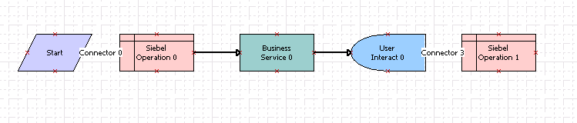
Adding a Run-Time Event to a Workflow Process
A run-time event can be added to a workflow process as a condition on the connector out of a:
  Start step
    Used to invoke the workflow
  Wait step
    Used to resume the workflow
  User interact step
    Used to resume the workflow
Add run-time event here
Add run-time event here

Slide 11
Invoking a Workflow Using a Run-Time Event
0/3
1. Add the Run-Time Event
2. Deploy and Activate the Workflow
3. Reload the Run-Time Events
Notes:
This is a structuring slide for <insert what will be discussed>. Do not teach the steps or concepts here because the following slides cover them in detail. Provide a high level description of what will be discussed.

Slide 12
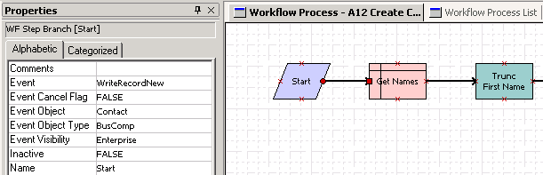
1. Add the Run-Time Event
1/3
Create the workflow process as usual
Select the connector to attach a run-time event
  Must be a start, wait, or user interact step
In the properties window, specify the triggering event
Caution: A workflow with a run-time event on the start step cannot be tested with the workflow simulator
Select connector
Specify the event type, business component, and event to monitor

Slide 13
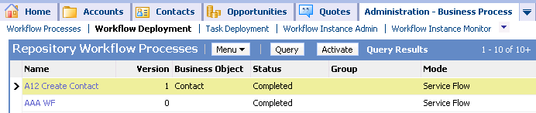
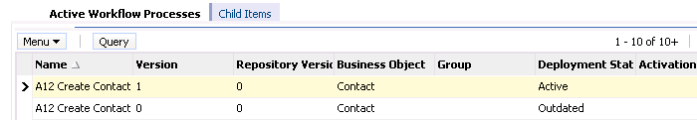
2. Deploy and Activate the Workflow
2/3
In Siebel Tools, deploy the event
In the Siebel client, activate the event

Slide 14
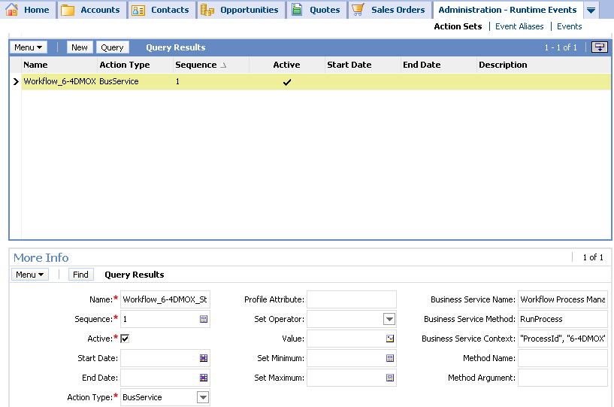
2. Deploy and Activate the Workflow Continued
2/3
Activating the event automatically registers the run-time event and associated workflow with the Siebel run-time event engine
  Creates an action set that invokes the Workflow Process Manager
Row ID of activated workflow
Business Service, method to invoke
Arguments to pass in

Slide 15
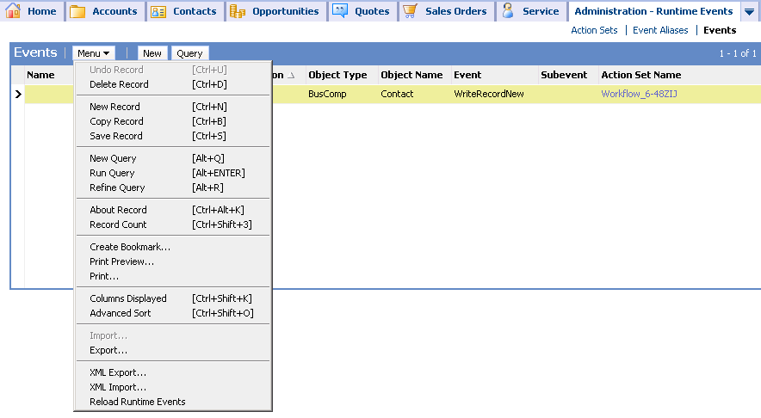
3. Reload the Run-Time Events
3/3
Navigate to Administration - Runtime Events > Events
Select Menu > Reload Runtime Events
  Updates the run-time event engine with the new run-time event
  Not necessary to query for the specific run-time event
Run-time event created by activating the workflow process

Slide 16
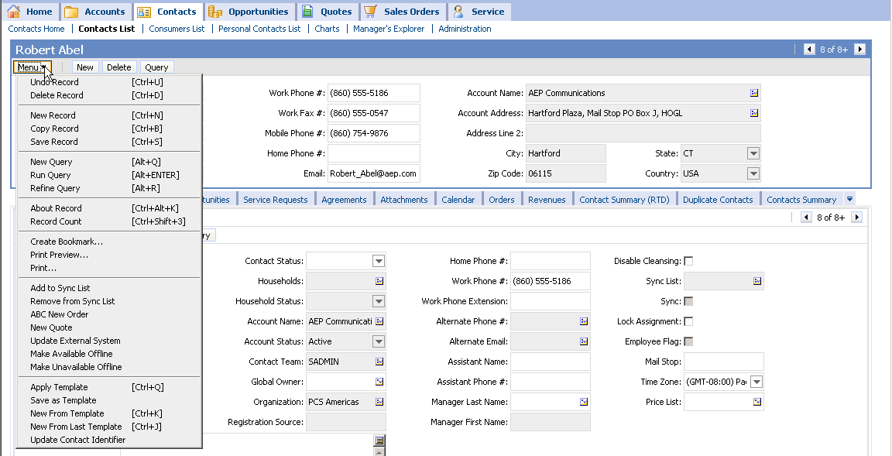
Invoking Workflows Using a Custom Control
User explicitly clicks a custom button or menu item to invoke the workflow
Configuration involves applet user properties
Custom menu item that invokes a workflow

Slide 17
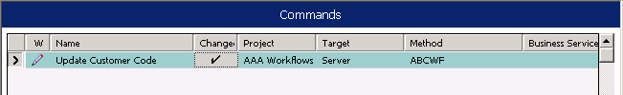
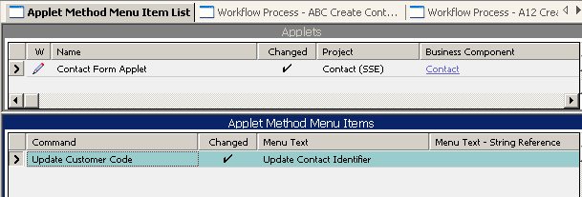
Invoking a Workflow Using a Custom Menu Item
Create a command object
  Specify a value for the Method property
Add an applet method menu item to reference the command

Slide 18
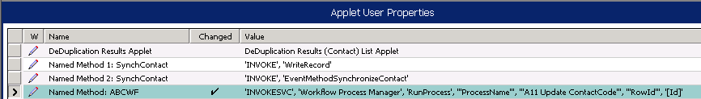
Invoking a Workflow Using a Custom Menu Item Continued
Add a new Applet User property that associates the workflow to be invoked with the new named method
Invoke this business service and method and …
… pass in these pairs of argument names and values

Slide 19

Invoking a Workflow Using a Custom Button
Create a custom control for the button
  Specify a value for the Method Invoked property
Add a new Applet User property that associates the workflow to be invoked with the new named method
Specify a user-defined name for a Method to invoke on the control
Create an applet user property specifying the workflow to execute when the named method is invoked

Slide 20
Invoking a Workflow Process Explicitly
The Workflow Process Manager business service can be referenced explicitly:
  In a script
  As parameters in declarative configuration
Developers must specify:
  The name of the business service and method
  The name of the workflow process and other parameters as input arguments
    Often the RowId parameter must be passed in

Slide 21
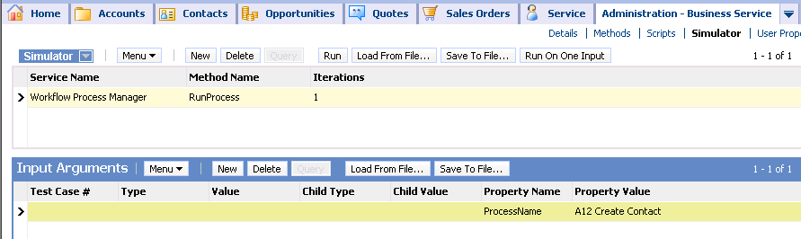
Invoking a Workflow Process Explicitly Continued
A workflow process can also be executed using the business service simulator
  Is an alternative way of testing new workflows
Business service that executes workflow processes
Provide name of workflow process as input argument

Slide 22
Module Highlights
Workflow processes are executed in the Workflow Process manager in either the application object manager or in a server component
  Can be executed either synchronously or asynchronously
A workflow process can be invoked by a variety of mechanisms
  Run-time events
  Custom buttons and menu items
  Workflow policies
Run-time events are a mechanism that allows customer-configured processing to be triggered by user activity
Notes:
Review Question: <Question>
Answer: <Answer>

Slide 23
Lab
In the lab you will:
  Invoke a workflow from a custom menu item
  Invoke a workflow using a run-time event
Notes:
Labs and Troubleshooting:
<Summarize the tasks the students will perform in this lab. Suggest specific guidance the instructor may provide if necessary to help the students complete the lab and avoid trouble spots.>

