Slide 1

Module 38: Using Workflow Policies
0/5
Siebel 8.0 Essentials
Notes:
Time: Lecture: <n – n> minutes; Labs: <n – n> minutes
Intent: <What is the instructional goal of the module>
Flow: < Describe at a high level the overall flow of the module>.
Key Terms: <List terms the instructor should be familiar with in order to teach this module>
<Term>
<Term>
<Term>
<Term>

Slide 2
Module Objectives
After completing this module you should be able to:
  Create a workflow policy that invokes a workflow process in the Workflow Process Manager server component
  Enable the workflow policy using workflow server components
Why you need to know:
  Some workflow processes are best executed asynchronously on the Siebel server
Notes:
Each objective and “why you need to know” should be stated aloud.

Slide 3
Asynchronous Workflow Processing
Some workflows need to be executed asynchronously
  They might run for a long time and should not execute in the user’s object manager
  They might need to wait for the invoking condition to be satisfied for some period of time
    Example: If a critical service request remains unassigned for more than two hours, notify the service manager and set the priority to High
Workflow policies are a mechanism for asynchronous execution of workflow processes

Slide 4
Workflow Policies
A workflow policy is a rule consisting of:
  One of more policy conditions
  A policy action
Action is invoked when all conditions are true
Example: When a service request priority = Critical AND substatus = Unassigned:
  Send urgent message to service manager
Workflow
Policy
IF True…
then execute
Conditions:
Substatus = Unassigned
Service Request Priority = Critical
Actions:
Update priority to High
Send message to service manager

Slide 5
Workflow Policy Conditions
Policy condition specifies a logical relationship between a workflow policy column and a value
All policy conditions must be satisfied for a condition to apply
Policy may have a duration specified
  Conditions must apply for the duration before the action is executed
Workflow
Policy
Duration = 2 hours
IF True for at least two hours …
then execute
Conditions:
Status = Open
Service Request Priority = High
Actions:
Update priority to Very High
Send message to owner

Slide 6
Workflow Policy Actions
A workflow policy action is the response to be executed
Consists of:
  Type of program to be executed
    Examples: Run workflow process, send email, send message broadcast
  One or more program-specific arguments
Multiple types of programs are supported
  Not restricted to running workflow processes
Actions are defined separately
  Can be used in multiple workflow policies

Slide 7
Workflow Policies
Leverage:
  A separate server component known as the Workflow Process Manager component
    Is a server component optimized for executing workflows
      Behaves like an object manager
        Can access the business and data layers
      Does not have a user interface for direct user interaction
  Database triggers:
    A trigger is a process or a stored procedure attached to a database table that fires when a specified data modification event occurs
    Are created by the Generate Triggers server component

Slide 8
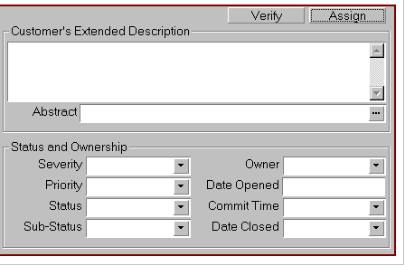
Executing Workflow Policies
Generate Triggers creates the database triggers required to monitor conditions in policies
Workflow Monitor Agent checks for fired triggers
  Identifies policy conditions that are satisfied
  Invokes the desired workflow process
Workflow Process Manager executes the workflow process
    Execution is asynchronous
End-user activity or server process
S_ESCL_REQ
EIM
Generate Triggers
Create triggers corresponding to policy conditions
Siebel
Database
Triggers fire when conditions satisfied and inserts record
Executes the workflow process specified in action
Retrieves records and executes the action
Workflow
Process Mgr
Server
Request Broker
Workflow
Monitor Agent

Slide 9
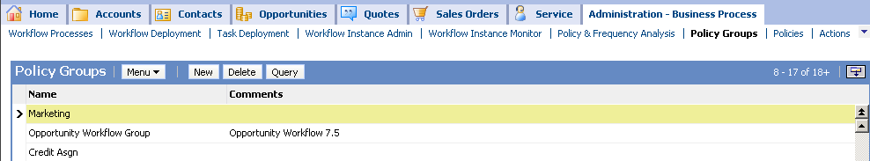
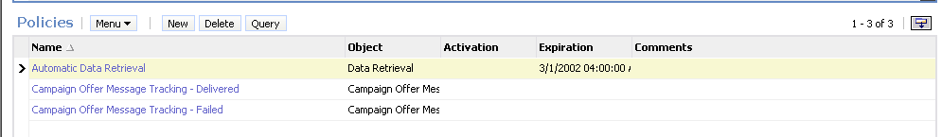
Workflow Policy Groups
A workflow policy group is a collection of workflow policies that are monitored as a group by a workflow monitor agent process
  Typically workflow policies that can be monitored at the same frequency are assigned to the same policy group

Slide 10
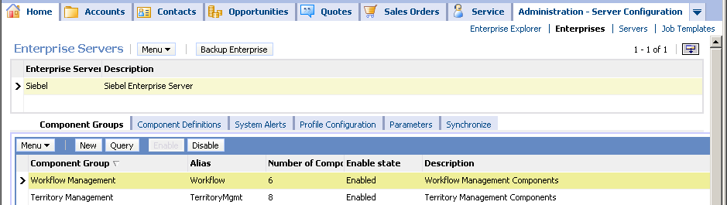
Prerequisite for Executing Workflow Policies
Enable the Workflow Management component group on the enterprise
Assign and enable the component group on a server
  Navigate to Administration - Server Configuration > Enterprises > Component Groups
Notes:
Before users can run a workflow process using Workflow Policies, the server components for workflow must be enabled. Users must check to see if the Workflow component group is enabled, and that each workflow server component is online. Workflows that are invoked using run-time events do not require the server component since they are invoked on the object manager.
Students learned how to enable component groups earlier in the course. In the student notes, students are reminded that if they enable a component group via the UI, they will need to stop and start the Siebel Server and Siebel Gateway Name Server services.

Slide 11
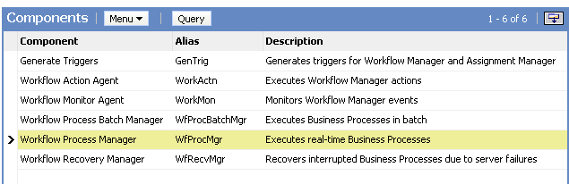
Workflow Component Definitions
Workflow Component Group consists of six server component definitions
Notes:
Each server component is explained in the student note, although this module covers only Generate Triggers and Workflow Monitor Agent.
Workflow Action Agent runs within Workflow Monitor Agent. There is no need to start Workflow Action Agent as a separate component on the server.
Refer students to the Siebel Business Process Designer Administration Guide for more information on the Workflow Action Agent, Process Batch Manager, Workflow Process Manager, and Workflow Recovery Manager.

Slide 12
Implementing a Workflow Policy
0/5
1. Create a Workflow Group
2. Create a Workflow Policy Action
3. Create a Workflow Policy
4. Generate Database Triggers
5. Start Workflow Monitor Agent
Notes:
This is a structuring slide for <insert what will be discussed>. Do not teach the steps or concepts here because the following slides cover them in detail. Provide a high level description of what will be discussed.

Slide 13
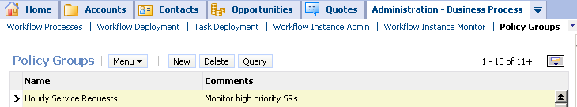
1. Create a Workflow Group
1/5
Navigate to Administration - Business Process > Policy Groups
Create a new policy group
Notes:
A workflow group can be made up of similar policies. As the slide suggests, this could mean all policies with a high frequency, or all policies dealing with integration, and so forth. Alternatively, all policies could be bundled together. All the policies in a group are monitored concurrently.
Each Workflow Monitor Agent is assigned one workflow policy group. The reasons to use multiple Workflow Policy Agents are:
To shorten the time between when the policy event is triggered and when Workflow Monitor Agent notices the event
To spread the workload across multiple application servers
To adjust the polling interval so that polling for non-critical policies does not prevent efficient processing of critical policies
Policies with similar time intervals are generally grouped together. By creating groups of policies with similar time intervals, you can assign the workflow policy group a Workflow Monitor Agent with a polling rate that matches the needs of the workflow policies. This results in a more efficient use of resources.

Slide 14
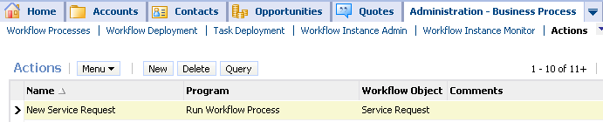

2. Create a Workflow Policy Action
2/5
Navigate to Administration - Business Process > Actions
Create a new action
  Specify Run Workflow Process
Provide workflow process as an argument
Specify the Run Workflow Process program
Specify the workflow process to invoke
Notes:
Workflow policy actions are events that users want to occur when the conditions of their workflow policy are met. They must create the necessary workflow policy actions before they create the policy that will use the action. If the action calls a process, the process must already be created in the application and have an Active status.
Demo: A demonstration suggestion is to go to some examples in the sample database and show the students an action. Be sure to go through the bullet points while looking at the demo. Note that actions are independent of policies. That is, they can be reused with other policies. For example, you may have an action that pages the Service Request Manager. Several different conditions could result in this action.

Slide 15
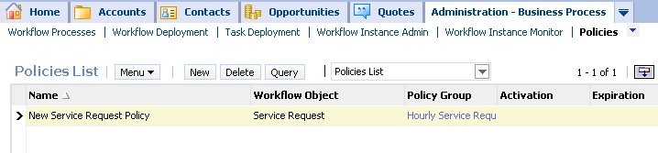
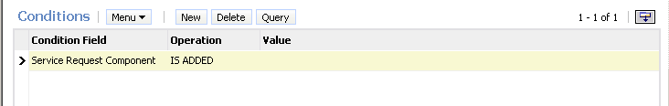

3. Create a Workflow Policy
3/5
Navigate to Administration - Business Process > Policies
Create a new policy
  Specify conditions
  Add one or more actions
Create a policy
Create a condition
Associate an action to invoke the workflow process
Notes:
For the policy, at least one condition must be defined, which causes an action to start a workflow process. Summarize the pieces that make up a workflow policy.

Slide 16
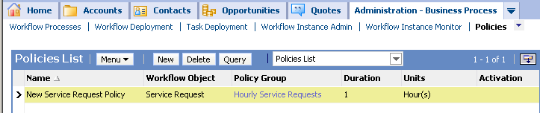
3. Set Duration
3/5
Set duration for the workflow policy
  All conditions must be met and the policy duration must be satisfied to trigger the workflow policy actions
  Defaults to 0
    The workflow policy actions are triggered as soon as the policy conditions are met
Notes:
In addition to conditions, duration is a factor for workflow policies. There must be a duration defined (even if it is zero) to fire triggers in the database. Once the policy conditions have been met, and the duration has been exceeded, then the action occurs.
As an example, consider a critical service request and a business rule by which a gold customer is to be contacted within 24 hours. For this example, the conditions to be met are 1) the service request is prioritized as critical, and 2) the customer is a Gold customer. The duration in this example is 24 hours. After 24 hours have passed, the action calls a workflow process.

Slide 17
4. Generate Database Triggers
4/5
Run a Generate Triggers batch job to create database triggers corresponding to the policy conditions
  When a trigger fires against a Policy Condition, a record is inserted in the Escalation Request Table (S_ESCL_REQ)
  S_ESCL_REQ contains all the rows in the database that could trigger a policy to take action
Generate Database
Triggers
Record is inserted, updated, or deleted
S_ESCL_REQ
Table updated
Notes:
Triggers monitor the database for records with conditions that match the policies.
The EXEC parameter must be set to TRUE for the Generate Triggers task, so that the Generate Triggers component automatically creates the SQL script and applies it to the server database. Students will get practice doing this in the lab.

Slide 18
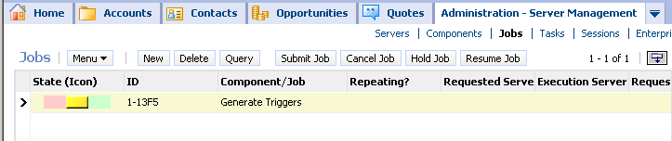
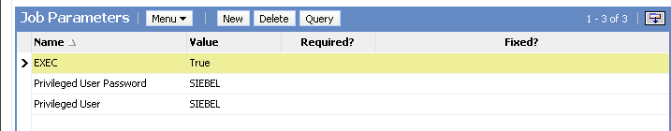
4. Generate Database Triggers Continued
4/5
Navigate to Administration - Server Management > Jobs
Create a new job
  Select Generate Triggers
  Specify parameters
Submit job
Create new Job and select Generate Triggers
Click Submit Job to start Component Job
Specify parameters
Notes:
Students were introduced to submitting a task earlier in the course. This slide summarizes how to submit a Generate Database Triggers task.
By default, the Generate Triggers component will generate triggers for both Assignment Manager and Workflow (Mode = ALL). If you set Mode = WORK then just workflow triggers are generated. Mode = ASSGN will generate triggers for Assignment Manager only.
The SQL file generated is called trigger.sql and is located in the Siebsrvr folder.
When triggers find records that satisfy necessary conditions, they copy the records to the S_ESCL_REQ table.

Slide 19
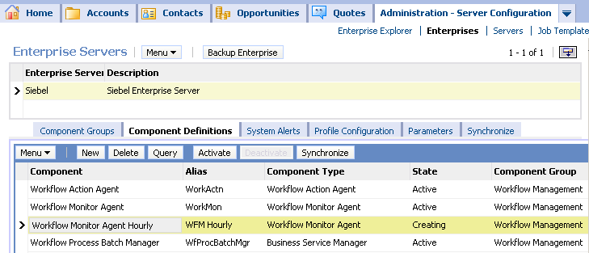
5. Start Workflow Monitor Agent
5/5
Create a custom Workflow Monitor Agent component definition to specify a Workflow group
  Monitors all policies within a single Workflow group
Activate the new component definition to make it available
Notes:
In the previous version of this course, students used the command line interface to start the workflow monitor agent. Although this is still a valid technique, this module describes how to create a custom Workflow Monitor Agent component definition in the client application to start the Workflow Monitor Agent.
The lab provides detailed steps for copying an existing component definition to create a custom definition, then use this custom definition when the job is created.

Slide 20
Verify the Workflow Policy
Create a test record (or modify an existing record) that violates the policy condition
Wait for at least the policy duration
Verify that the desired workflow actions are executed

Slide 21
Comparing Different Methods
Use different methods for different needs
Generate Triggers | Required | Not Required | Not Required
WF Monitor Agent | Required | Not Required | Not Required
Runtime Event | Not Used | Invokes process | Not Used
Synchronous | Asynchronous (runs in background) | Synchronous (runs in user session) | Synchronous (runs in user session)
Runs on Mobile Client | No (runs on Siebel Server) | Yes | Yes
Workflow
Policies
Runtime
Events
Custom Control

Slide 22
Module Highlights
A workflow policy is a rule consisting of one or more conditions and a policy action to be executed when the conditions are satisfied
Workflow policies implement asynchronous execution of workflow processes
Workflow policies require the use of:
  Generate Triggers to create the database triggers
  Workflow Monitor Agent to check for fired triggers
  Workflow Process Manager to execute the associated workflow policy
Notes:
Review Question: <Question>
Answer: <Answer>

Slide 23
Lab
In the lab you will:
  Create a workflow policy
  Enable the workflow management group components
  Test the workflow policy
Notes:
Labs and Troubleshooting:
<Summarize the tasks the students will perform in this lab. Suggest specific guidance the instructor may provide if necessary to help the students complete the lab and avoid trouble spots.>

