Slide 1

Module 39: Siebel Task UI
0/5
Siebel 8.0 Essentials
Notes:
Time: Lecture: <n – n> minutes; Labs: <n – n> minutes
Intent: <What is the instructional goal of the module>
Flow: < Describe at a high level the overall flow of the module>.
Key Terms: <List terms the instructor should be familiar with in order to teach this module>
<Term>
<Term>
<Term>
<Term>

Slide 2
Module Objectives
After completing this module you should be able to:
  Describe the role and benefits of Siebel Task UI
  Invoke and complete a task
Why you need to know:
  Siebel Task UI provides an alternate style of user interaction that assists successful completion of business tasks and incorporates automation of activities
Notes:
Each objective and “why you need to know” should be stated aloud.

Slide 3
Business Challenge
Many tasks require users to perform several steps to complete the task
  Users may not be familiar with the sequence of steps
  Users may inadvertently skip a step
  Users often require additional training to complete the task
Companies would like to implement a user interaction style that assists users in completing such tasks

Slide 4
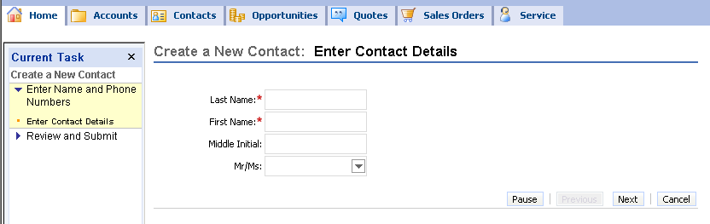
Business Solution: Siebel Task UI
Uses a wizard-like interface to guide users through steps in a task
  Consists of a sequenced set of views, each of which collects a small set of relevant data from the user
Extends business process automation to the UI layer
  Users are directed to complete some steps in a task in a prescribed order

Slide 5
Features of Siebel Task UI
Supports forward and backward navigation through a sequence of views
  Allows for a set of records to be reviewed and corrected prior to completion of the task
Supports branching based on user input
Supports pausing and resuming tasks if users are interrupted
  Instance of the partially completed task is saved in the user’s inbox
    Context and all data are maintained
  Task is resumed from the Universal Inbox
Supports transfer of paused tasks to other users

Slide 6
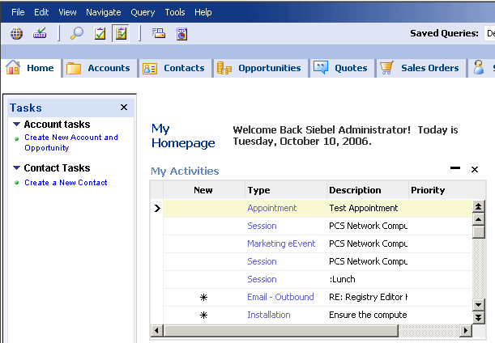
Using Task UI
Click the Task button to expose the Task pane
  Displays links to tasks that can be invoked in the current application context
Task button
Task pane
Task group (a collection of related tasks)
Task link

Slide 7
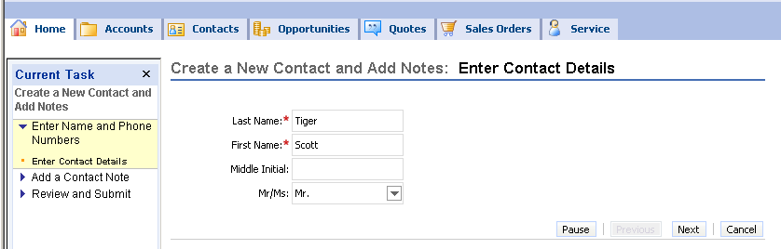
Invoking a Task
Click the link for the desired task
  A task view replaces the standard Siebel view
  Task pane displays other views in the task to provide context for the overall task
    Views may be grouped into chapters
Enter data in fields in the first view
Click Next to proceed to subsequent views
Click Next to proceed
Task pane shows current position in task
Enter data

Slide 8
Invoking a Task Continued
Task views are typically characterized by:
  Small number of fields in each applet in the view
    Each view focuses the user on a specific set of data to edit
  A set of navigation buttons located above and/or below the applets
    Known as a Playbar applet
  Absence of navigation options such as view tabs and hyperlinks
Small number of related fields
Click Next to proceed
Playbar applet
Task view

Slide 9
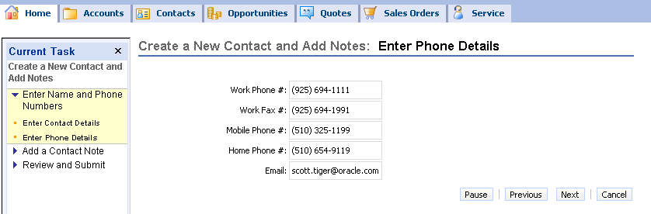
Progressing Through a Task
Enter data in each subsequent view
Click Next to proceed
Click Back to return to a previous view to inspect or modify previously entered data
Task views in chapter are listed as user navigates to the view

Slide 10
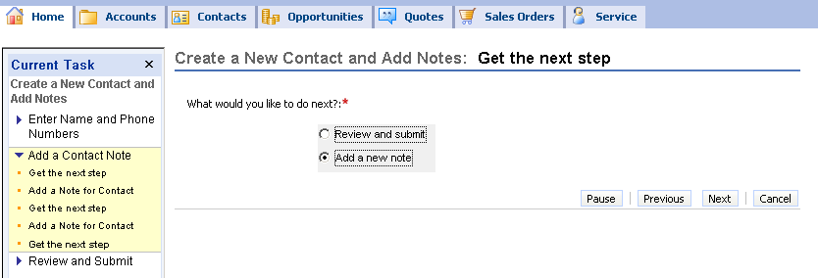
Branching in a Task
Tasks can branch based on data the user inputs
  Example: branching based on lead quality of an opportunity
Some views may explicitly present to the user a choice about the next step to be executed
  Select the desired activity and click Next
User makes a selection

Slide 11
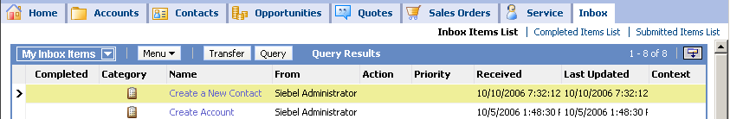
Pausing a Task
Click Pause to suspend task activity
  All data and context is retained
  A link to the paused task is added to the user’s inbox
Navigating outside the task view implicitly pauses a task
  For example clicking a screen tab or the site map button
Inbox

Slide 12
Resuming a Task
Click the link in the Inbox to resume the task
  Task resumes exactly where it was paused
Inbox
Task view reappears

Slide 13
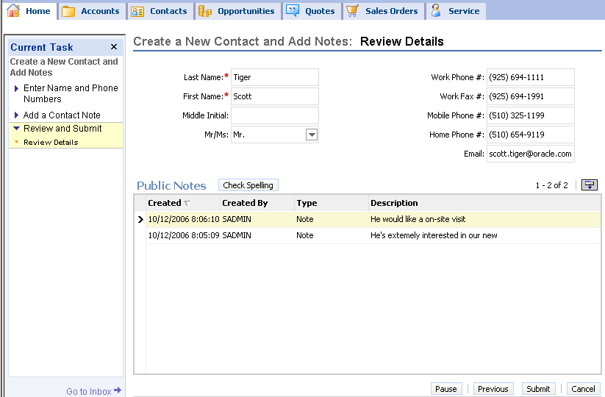
Completing a Task
Review the data if a final summary view is provided
Click Submit or Finish to complete the task
  Commits all remaining uncommitted data to the database
The task view is closed and the previous standard view is displayed

Slide 14
Persistent Data in Task UI
All data entered during a task is initially stored in temporary storage managed by the Object Manager
  Is not automatically written to the database as user proceeds to next view
Persistent data is committed to the database:
  When the task completes
  At intermediate points in the task flow if the underlying task flow contains explicit commit steps
Records can not be rolled back after being committed
Data created or modified is not available to others until it is committed
Data in temporary storage:
  Is maintained while the task is paused
  Is cleared only when the task is cancelled or completed

Slide 15
Transient Data in Task UI
Refers to data collected and used during the execution of a task but not saved afterwards
  Example: user choice about the next step
Transient data may be mapped to persistent data in a later step in the task
  User enters name of a contact to retrieve
  If no contact is found, a new contact record is created and saved
Transient data disappears when the task ends
Task applet
User’s selection does not need to be stored persistently

Slide 16
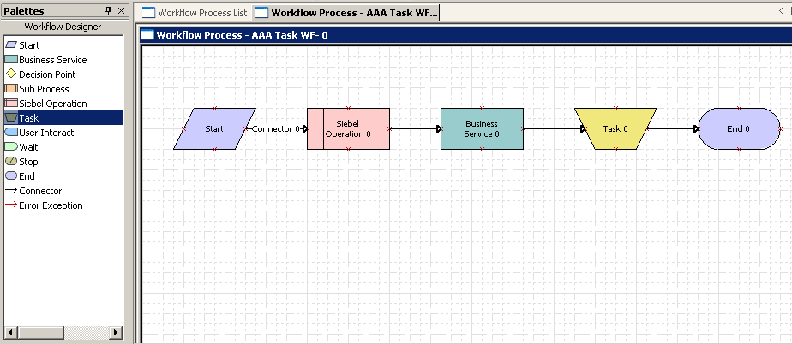
Tasks and Workflow Processes
A workflow process can invoke a task
  Invokes a task step in the workflow process
A task can invoke a workflow process
  Invokes Workflow Process Manager business service in a task flow
  Invokes a workflow using event handlers associated with a Playbar button

Slide 17
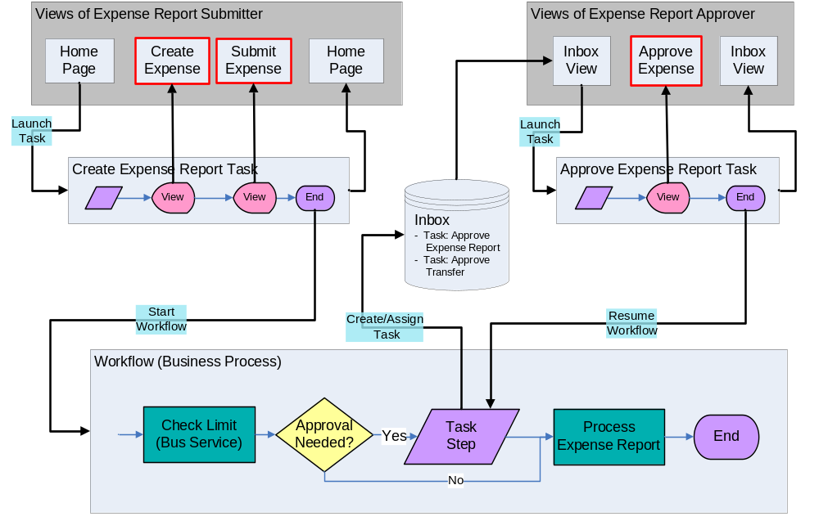
Tasks and Long-Running Workflow Processes
Initial task can start a long-running workflow upon completion
Long-running workflow can assign a task to a user’s inbox and then go to sleep
User can invoke the assigned task from the inbox and upon completion will wake up the long-running workflow
Task to create an expense report
Task to approve an expense report
Workflow may pause; waits for second task to complete
Workflow initiated by first task

Slide 18
Comparison of Task UI and the Standard UI
Consider using Task UI for tasks that:
  Are inherently complex
    Lengthy, complex sets of inputs, lots of branching
  Are performed by novice or infrequent users
  Can take advantage of the ability to pause and transfer tasks
  Involve transactional processing
  Might be integrated with workflows
Consider using the standard UI for tasks that:
  Are simpler
  Are performed frequently by power users
  Do not involve transactional processing

Slide 19
Module Highlights
Siebel Task UI is a wizard-like interface that guides users through steps in a task
Invoke a task from a link in the task pane
Use the buttons in the Playbar applet to proceed, return to the previous view, pause, or complete the task
  Paused tasks are resumed from the user’s inbox
Data collected during a task is not committed to the database
  Until the task is completed
  Or is explicitly committed at specific points in the task
Notes:
Review Question: <Question>
Answer: <Answer>

Slide 20
Lab
In the lab you will:
  Execute a task
Notes:
Labs and Troubleshooting:
<Summarize the tasks the students will perform in this lab. Suggest specific guidance the instructor may provide if necessary to help the students complete the lab and avoid trouble spots.>

