Slide 1

Module 41: Transient Business Components and Branching
0/5
Siebel 8.0 Essentials
Notes:
Time: Lecture: <n – n> minutes; Labs: <n – n> minutes
Intent: <What is the instructional goal of the module>
Flow: < Describe at a high level the overall flow of the module>.
Key Terms: <List terms the instructor should be familiar with in order to teach this module>
<Term>
<Term>
<Term>
<Term>

Slide 2
Module Objectives
After completing this module you should be able to:
  Describe the role of transient business components and task applets
  Configure branching logic in a task
Why you need to know:
  Transient business components allow you to incorporate branching logic into task flows and to manage user data that is not mapped immediately to a business component field
Notes:
Each objective and “why you need to know” should be stated aloud.

Slide 3
User-Entered Data
Is typically persistent
  Maps immediately to regular business component fields
  Is written to the database during or at the end of the task flow
May be transient
  Is entered and then referenced in a subsequent step in the task flow
  Does not need to be stored persistently

Slide 4
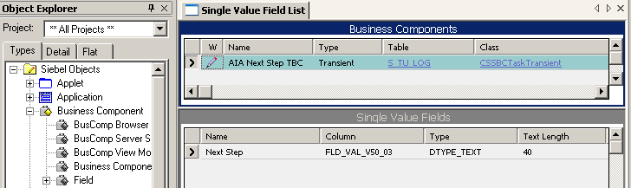
Transient Business Component (TBC)
Is used to represent user input and other data that does not need to persist beyond the lifetime of the task
  Type is Transient
  Has one or more single-value fields
  Does not support joins or multi-value fields
  Maps to a special table: S_TU_LOG
  Is based on a special class: CSSBCTaskTransient
  Stores one record at most
Is managed by the Object Manager

Slide 5
Uses for a Transient Business Component
Capture user selections that control the flow of a task at run-time
Collect data that will be incorporated into persistent data later in the task such as:
  Postal code or telephone area code
  Data that may be conditionally mapped to business component fields in subsequent task steps
Support applets that display data from several business components
    Example: an applet that needs to show some quote and order fields

Slide 6
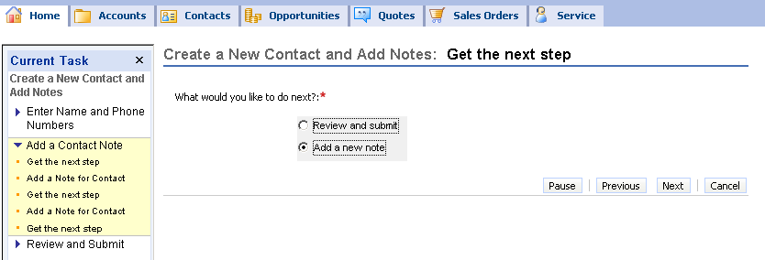
Task Applet
Is a special type of applet used to display and collect transient data
  Maps to a transient business component
  Displays data from only that business component
Can be assigned only to a task view
  Can appear in a view by itself or with one or more standard applets
Task Applet

Slide 7
Task Applet Continued
Differs from standard applets
  Is always a form applet displaying a single record
  Must be based on grid Web templates
    Applets do not display an applet title or applet menu
  Is based on a specialized class: CSSSWEFrameTask
Task applet

Slide 8
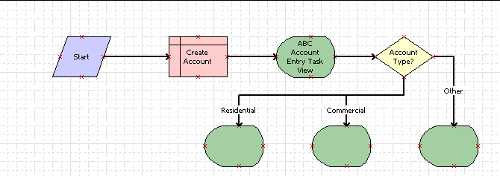
Branching in a Task
Task UI framework supports branching (in a task) based on user input
Input can be persistent data such as the account type
Is implemented by configuring a decision point step
  Follow the same procedure as in a workflow process
Decision point step for branching
Task flow with branching

Slide 9
Branching in a Task Continued
Input can also be transient data, such as the selection that the user makes when presented a choice about the next step
Requires the use of a transient business component
Is implemented by configuring a decision point step
User selection is transient data

Slide 10
Configuring Branching in a Task Using a TBC
0/7
1. Modify the Task Flow
2. Create a Picklist
3. Create the Transient Business Component
4. Create the Task Applet
5. Create the Task View
6. Configure the Decision Point Step
7. Complete the Configuration
Notes:
This is a structuring slide for <insert what will be discussed>. Do not teach the steps or concepts here because the following slides cover them in detail. Provide a high level description of what will be discussed.

Slide 11
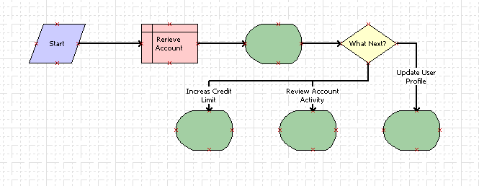
1. Modify the Task Flow
1/7
Add a task view step to the flow to allow the user to make a choice
Add a decision point step to evaluate the user’s choice
Add connectors to implement the desired business flow
  Example of direct branching
Task view to allow user to make choice
Decision point step to evaluate choice
Each branch corresponds to a member in an LOV
A separate task view for each user choice

Slide 12
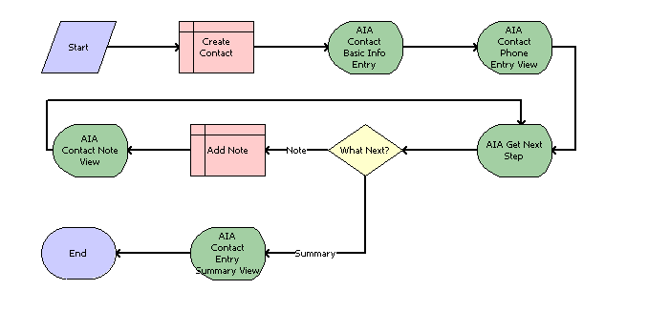
1. Modify the Task Flow Continued
1/7
  Example of iteration
Task view to allow user to make choice
Decision point step to evaluate choice
Loop that adds a note and then asks user to choose again
Each branch corresponds to a member in an LOV

Slide 13
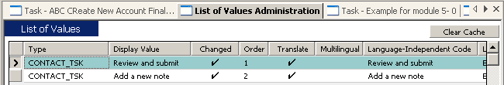
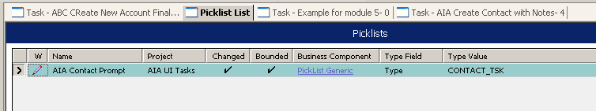
2. Create a Picklist
2/7
A picklist is required when the user is presented a set of choices
Select an existing picklist if available
Alternatively create a new picklist
  Represent the choices as members of a List Of Values type
  Configure the PickList object

Slide 14
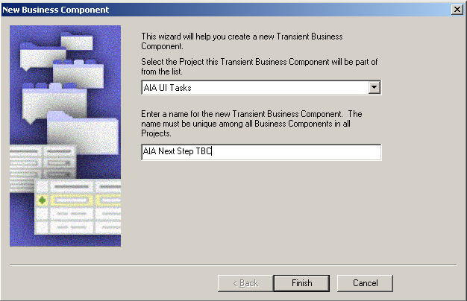
3. Create the Transient Business Component
3/7
Use the Transient BusComp Wizard to create the transient business component
  Should use the wizard since it assigns required values to multiple TBC properties

Slide 15
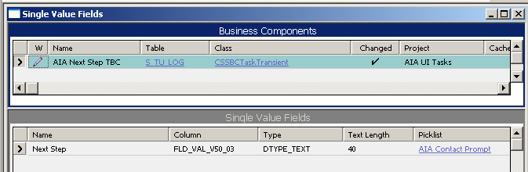
3. Create the Transient Business Component Continued
3/7
Add one or more fields
  Assign name, type, and length as required
  Do not assign a column
    Will be assigned automatically after the record is saved
  If required, assign the picklist
    Create the single-value field pick map
Assigned automatically by Siebel Tools
Provides choices for user selection

Slide 16
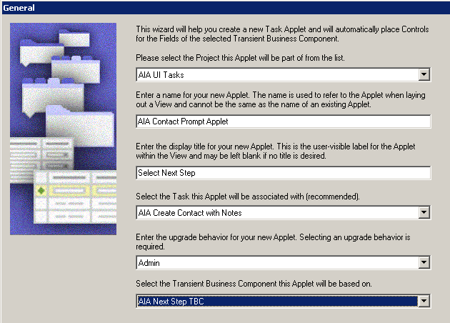
4. Create the Task Applet
4/7
Use the Task Applet Wizard to create the task applet
  Identify the transient business component
  Identify the task in which the applet will be used
  Select the TBC field(s) that are to be displayed

Slide 17
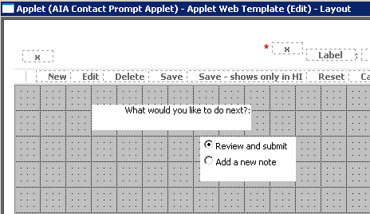
4. Create the Task Applet Continued
4/7
Inspect the applet in the Web Layout Editor
  Wizard assigns a radio button control to all fields
For fields with a picklist, the radio button control:
    Displays the members of the underlying list of values (LOV)
    Allows users to select a value by clicking a radio button
For other fields, manually change the HTML type to the desired value
Reposition and/or resize the label and control for each field
Radio button control (displays the members of a LOV)
Control caption, can be edited to include instructions

Slide 18
5. Create the Task View
5/7
Use the Task View Wizard to create a new task view
  Assign zero or more regular applets as required
  Assign the task applet
    Selection is restricted to task applets assigned to the task
  Select and position the Playbar applet
Alternatively, add the task applet to an existing task view
  Drag a Task Applet icon from the Applet pane to an applet placeholder
  Select the desired task applet

Slide 19
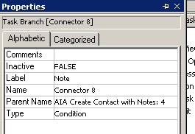
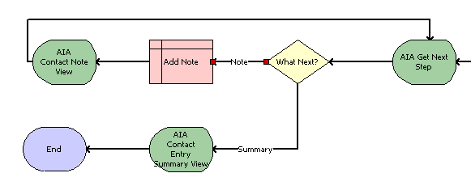
6. Configure the Decision Point Step
6/7
Right-click the decision point step
  Set the name property to a meaningful value
Right-click each connector leading from the decision point step
  Set the label property to a meaningful value as well

Slide 20
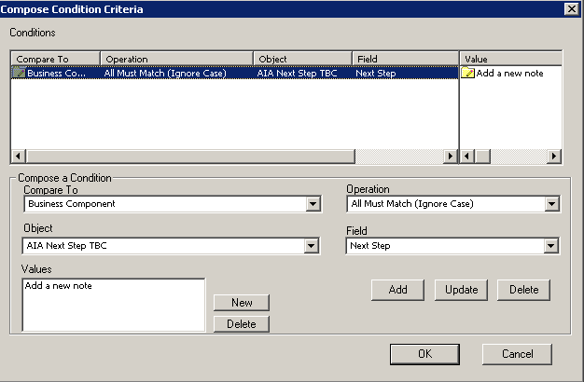
6. Configure the Decision Point Step Continued
6/7
Compose the conditions for each connector
  Right-click each connector leading from the decision point step and select Edit Conditions
  Select TBC, field, and desired value for this branch
TBC
Field
LOV member

Slide 21
7. Complete the Configuration
7/7
Configure remaining steps (task views, Siebel operation, and so on)
For each task view step, bind the corresponding task view
  Remember to set the Forward Button Type to Next
Assign each step to a chapter
Compile all new and modified objects

Slide 22
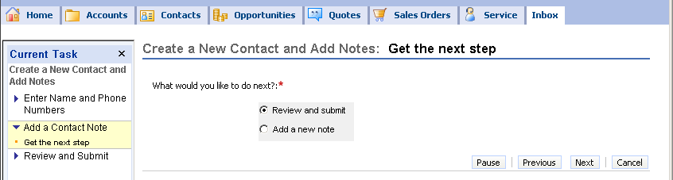
Test the Modified Task
Validate the task
Publish and activate the task
Invoke the task in the client and verify that the task applet appears and branches as desired

Slide 23
Module Highlights
Tasks may include transient data
  Data entered by users that does not need to be stored once the task completes
A transient business component is required to store data entered by a user that is not required after the task completes
A task applet is required to display data stored in a transient business component
A task can include branching based on user entered values including transient data
Branching requires adding a decision point step to the task flow
Notes:
Review Question: <Question>
Answer: <Answer>

Slide 24
Lab
In the lab you will:
  Extend a task to include branching
Notes:
Labs and Troubleshooting:
<Summarize the tasks the students will perform in this lab. Suggest specific guidance the instructor may provide if necessary to help the students complete the lab and avoid trouble spots.>

