Slide 1

Module 42: Siebel Business Rules
0/5
Siebel 8.0 Essentials
Notes:
Time: Lecture: <n – n> minutes; Labs: <n – n> minutes
Intent: <What is the instructional goal of the module>
Flow: < Describe at a high level the overall flow of the module>.
Key Terms: <List terms the instructor should be familiar with in order to teach this module>
<Term>
<Term>
<Term>
<Term>

Slide 2
Module Objectives
After completing this module you should be able to:
  Describe the Siebel Business Rules architecture
  Use HaleyAuthority to examine business rules
Why you need to know:
  Siebel Business Rules provides a powerful way to automate business decisions and logic in a Siebel application
Notes:
Each objective and “why you need to know” should be stated aloud.

Slide 3
Implementing Business Logic in Siebel Applications
Can often be done using declarative configuration such as:
  Properties in business components and fields
    Example: validation and post-default values
  Siebel workflows
  Siebel state models
Occasionally requires custom scripting
Can result in:
  Business logic that is distributed throughout the application
    Difficult to understand the complete set of implemented logic
  Business logic that is represented in multiple ways with different syntax
    Difficult to modify to meet new requirements
  The need to compile and deploy a new Siebel repository file (SRF)

Slide 4
Business Challenge
Companies want a more unified way to implement business logic
  Centralized store of business rules or logic that can be easily modified to incorporate changing business processes
  Reviewable by non-implementers such as business analysts
  Deployable without recompiling the SRF file
    Allows updating of business logic at run time

Slide 5
Solution: Siebel Business Rules
Provides the ability for companies to create and enforce rules that capture their business policies
  Rules are expressed in “natural English” rather than a script or SQL statements
    Rules can be specified and reviewed by business experts
  Rules are centrally developed and administered
  Rules are enforced globally throughout the Siebel application
Uses client-side configuration rather than repository-based configuration and compilation
  Allows rules to be created, updated, and deployed during run time

Slide 6
Examples of Uses of Siebel Business Rules
Perform validation of data
Provide default values for fields in records
Provide default child records
Update records
Implement dynamic read-only/required behavior
Compute values of parameters to be used in decision steps in workflow process and UI tasks
Perform business calculations
  Determine if a warranty applies
  Determine if a customer is eligible for a discount or offer and explain why
  Approve or reject an application for insurance
  Compute a limit for loans or insurance coverage

Slide 7
Siebel Business Rule
Is a conditional or qualified statement about business entities and characteristics that apply in a business environment
  Is written using the rules of English grammar
if an expense has any expense item which does not have a description then invalidate the expense with "All expense items must have a description"
Conditional rule statement
Set “Reimbursable Flag” of an expense item to false
if the expense item’s expense item type is “Personal”
unless the expense item’s description is “Pre-approved”
Qualified rule statement

Slide 8
Concepts
Are nouns that represent the entities and their characteristics
  Are used to build rule statements
Correspond to business components and fields in the Siebel data model
Concept (represents a business component)
Concept (Field)
if an expense has any expense item which does not have a description then invalidate the expense with "All expense items must have a description"
Rule statement

Slide 9
Siebel Business Rules
Are created using HaleyAuthority
Are executed in the Siebel client using a run-time inference engine

Slide 10
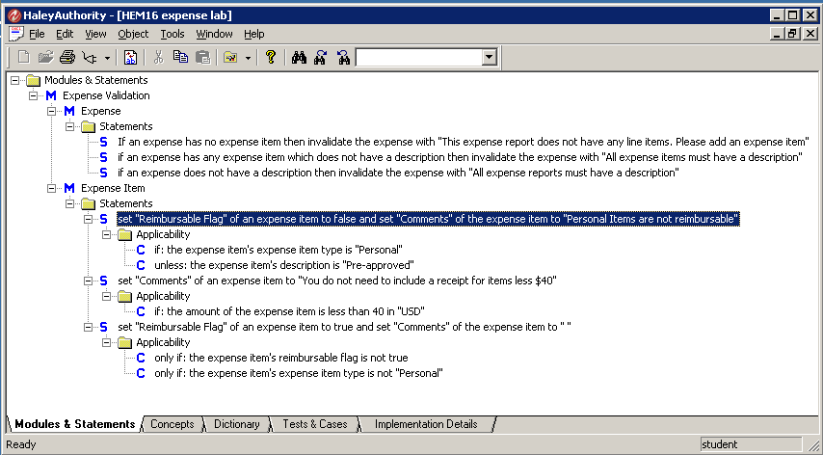
HaleyAuthority
Is a separate third-party application used to examine and develop Siebel business rules
  Is installed as part of a Siebel Tools installation
  Is invoked from the Siebel Tools program group

Slide 11
HaleyAuthority Continued
Imports relevant object definitions from the Siebel development repository
Generates the corresponding Haley concepts
Is used to author the rule statements based on the generated concepts
Stores concepts and statements in a separate database referred to as a knowledge base
Deploys rules to a set of tables in the Siebel run-time client

Slide 12
Run-Time Inference Engine
Is a third-party rules engine used to evaluate and execute business rules at run time
Is installed automatically in the Siebel client during a standard client installation
Is accessed by calling the Business Rules Service business service
  Serves as the interface to the inference engine
Can be invoked using:
  An action set in a run-time event
  A business service step in a Siebel workflow or task
  A business service call in a script

Slide 13
Exploring Rules
Use HaleyAuthority to examine rules
  Click the Modules & Statements tab to display rule statements

Slide 14
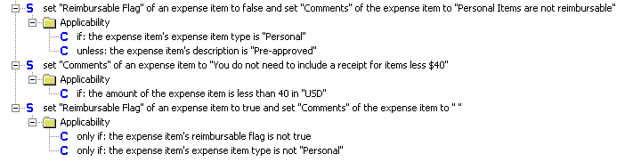
Structure of Rules
Rules are written using English grammar (“natural English”)
  A given rule can be expressed in several ways
Common practice is to create statements followed by qualifiers that determine if the statement applies
  If: statement applies when at least one if qualifier is true
  Unless: statement does not apply when unless qualifier is true
  Only if: statement applies when all only if qualifiers are true

Slide 15
Rule Statements
A statement can be either a:
  Statement of fact
    Example: An expense report is a valid expense report
  Statement of action
    Set “Reimbursable Flag” of an expense item to false
Siebel-specific actions consist of three action types
  Actions: Produce output or modify data in the Siebel application
    Set a field value, invalidate with reason
  Functions: Return a value from the Siebel application
    Get profile attribute, get active view name
  Predicates: Return a Boolean value
    User in task mode, currency is equal to

Slide 16
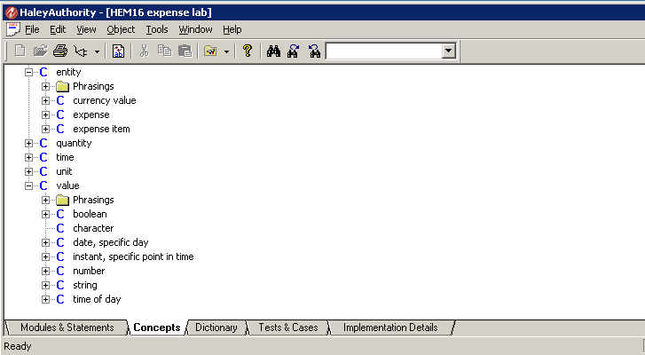
Concepts
Click the Concepts tab in HaleyAuthority to display the concepts
  Entity: Describes entities (things) in the business model
  Value: Describes characteristics of entities in the business model
Siebel Business Rules uses only these two types of concepts

Slide 17
Entities
Expand Entity to display the entities
  Represent the business components imported from the Siebel repository
Expense and Expense Item business components imported for these rules

Slide 18
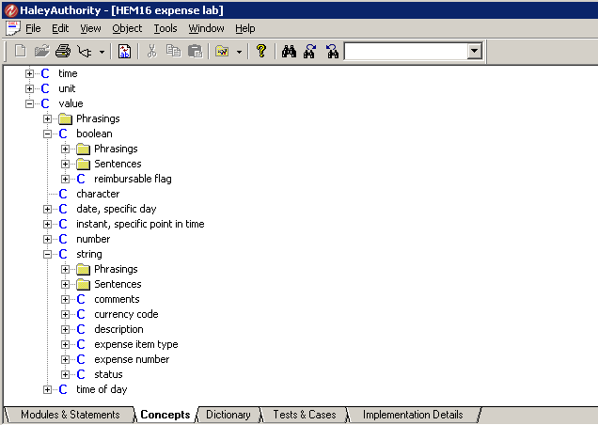
Value
Expand Value and its children types to display the values
  Represent business component fields imported from the Siebel repository
  Are grouped by the type of the field
Expense Item (Boolean) fields imported for these rules
Expense and Expense Item (text) fields imported for these rules

Slide 19
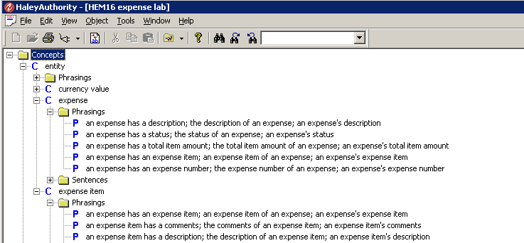
Phrasings
Consist of short expressions that capture a relationship between concepts
  Typically represent the relationship between a business component and one of its fields or a child business component
Are used to build rule statements
Capture relationship between business component and one of its fields
Capture relationship between parent and child BCs

Slide 20
Concepts in Siebel Business Rules
Concepts are generated automatically using the Siebel Object Importer in HaleyAuthority
  Entities correspond to Siebel objects
  Values correspond to single-value fields of objects
Rules developers must not modify or extend the concepts in any way

Slide 21
Module Highlights
Siebel Business Rules allows users to create and enforce rules that capture business policies
  Rules are expressed in natural English
  Rules are developed by client-side configuration
Siebel Business Rules consist of:
  Authoring tool accessible from Siebel Tools
  A run-time execution engine accessed by calling a business service
A rules module consists of multiple statements based on a set of predefined concepts, actions, functions, and predicates
  Concepts correspond to business components and fields in the Siebel repository
Notes:
Review Question: <Question>
Answer: <Answer>

Slide 22
Lab
In the lab you will:
  Examine an existing rule
Notes:
Labs and Troubleshooting:
<Summarize the tasks the students will perform in this lab. Suggest specific guidance the instructor may provide if necessary to help the students complete the lab and avoid trouble spots.>

