Slide 1

Module 44: Introducing Siebel Assignment Manager
0/5
Siebel 8.0 Essentials
Notes:
Time: Lecture: <n – n> minutes; Labs: <n – n> minutes
Intent: <What is the instructional goal of the module>
Flow: < Describe at a high level the overall flow of the module>.
Key Terms: <List terms the instructor should be familiar with in order to teach this module>
<Term>
<Term>
<Term>
<Term>

Slide 2
Module Objectives
After completing this module you should be able to:
  Explain the role of Siebel Assignment Manager
  List the elements used to create rules that assign business data
Why you need to know:
  Your company may have rules and policies about how to assign data that can be automated using Siebel Assignment Manager
Notes:
Each objective and “why you need to know” should be stated aloud.

Slide 3
Business Challenge
Companies need to assign business data in a timely fashion and in a way that consistently follows their business rules and policies
  Sales leads
  Contacts
  Accounts
  Service requests
Typical characteristics
  Large volumes of data
  Short response times
  Multiple rules and policies
    Complex
    Conflicting

Slide 4
Business Solution: Siebel Assignment Manager
Allows companies to automatically assign business data to the most appropriate positions, people, and organizations
Consists of:
  Administrative functionality to define assignment rules
  Server components to automatically assign business data according to the rules

Slide 5
Assignment Rules
Assignment Manager uses assignment rules to assign data
  Rules assign one or more candidates to assignment objects based on one or more criteria
Assignment Objects
Accounts
Campaigns
Service Requests
Product Defects
Opportunities
Activities
Candidates
Employees
Positions
Organizations
Skills
Expertise
Availability
Product
Workload
Sales Territory
Criteria

Slide 6
Assignment Objects
Assignment objects identify the type of data being assigned
Several assignment objects are pre-configured in the as-delivered application
  Examples:
    Account
    Contact
    Service Request

Slide 7
Assignment Candidates
Candidates are instances of entities to which data can be assigned
  Position
  Employee
  Organization
Examples of candidates for pre-configured objects:
  Accounts can be assigned to both positions and organizations
  Activities can be assigned to employees
  Service Requests can be assigned to both employees and organizations
Types of candidates must be consistent with the allowed access control mechanisms for the object

Slide 8
Assignment Criteria
Criteria express conditions that must be satisfied for data to be assigned
  Are expressed in terms of attributes of objects and/or candidates
  Examples:
    Account State = CA
    Account Product = a product that candidate has expertise for
Rules often include multiple criteria

Slide 9
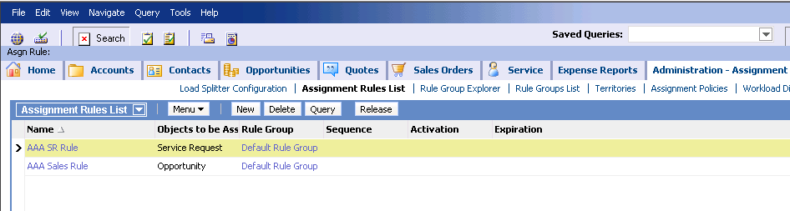
Administering Assignment Rules
Rules are created and administered using the Siebel Web Client
  Are not part of the Siebel repository
  Are not compiled into the .srf file
  Can be deployed during run time

Slide 10
Examples of Assignment Rules
0/2
Assign Accounts by Sales Region
Assign Service Requests to Skilled Agents
Notes:
This is a structuring slide for <insert what will be discussed>. Do not teach the steps or concepts here because the following slides cover them in detail. Provide a high level description of what will be discussed.

Slide 11
Assign Accounts by Sales Region
1/2
ABC Company assigns accounts to its sales organization
ABC Company also assigns accounts to its sales reps by sales region
  Opportunities in the Western Region (CA, OR, WA) are assigned to Sales Rep – West
  Opportunities in the Eastern Region (CT, MA, ME, NH, RI, VT) are assigned to Sales Rep – East
ABC Sales Organization
VP Sales - US
Pat
Sales Rep – West
Alex
Sales Rep – East
Jane

Slide 12
Rule to Assign Accounts by Sales Region
1/2
Rule includes
  Candidates (desired organization and positions)
  Criteria for determining region to assign the account
Rule: Assign East Accounts
Object: Account
Position candidate
Candidates:
Sales Rep – East
Sales Organization
Organization candidate
Rule applies when
Criteria: Account State is one of CT,MA,ME,NH,RI,VT

Slide 13
Rule to Assign Accounts by Sales Region Continued
1/2
A separate rule is required for each sales region
Rule: Assign West Accounts
Rule: Assign East Accounts
Object: Account
Object: Account
Candidates:
Sales Rep – West
Sales Organization
Candidates:
Sales Rep – East
Sales Organization
Criteria: Account State is one of CA,OR,WA
Criteria: Account State is one of CT,MA,ME,NH,RI,VT
This rule applies when
This rule applies when

Slide 14
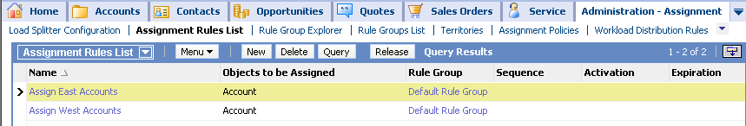
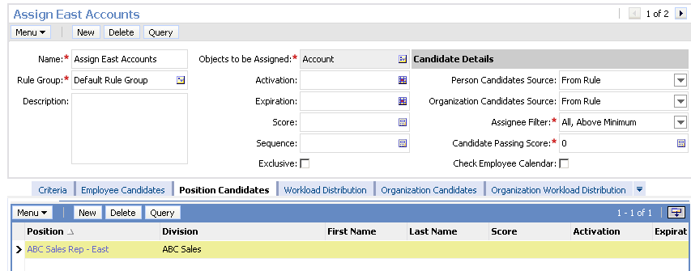
Candidates for Rules
1/2
Two assignment rule records are created
Candidates are listed in the Position Candidates view

Slide 15
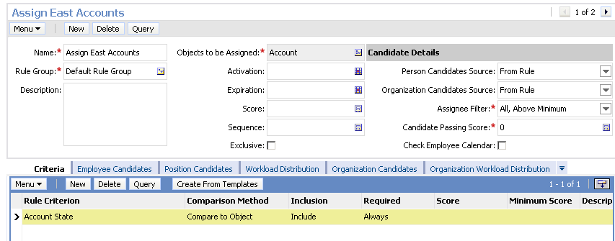
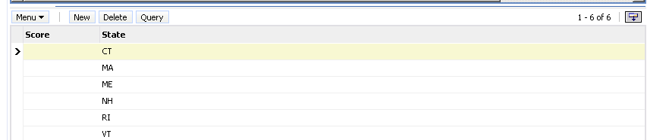
Criteria for Rules
1/2
Applicable states are listed in the Criteria view

Slide 16
Assign Service Request to Skilled Agents
2/2
XYZ company assigns service requests to employees with the correct skills to resolve them
  Skills are properties that reflect the candidate’s abilities in various areas such as:
    Product expertise
    Installation and upgrade skills
    Languages
Service Organization
VP Service
Chris
(no skill)
Service Agent 1
Craig
(Network)
Service Agent 2
Ellen
(CPUs)
Service Agent 3
Jack
(Power supplies)

Slide 17
Assign Service Request to Skilled Agents Continued
2/2
Rule includes
  Criteria for assigning request
    Employee skill matches the area of the service request
  Candidates to be considered
    Can list select employees or consider all available employees
Rule: Assign Service Request
Object: Service Request
Employee candidates
Candidates:
All service agents
Rule applies when
Criteria: Candidate’s product skill = product associated with Service Request

Slide 18
Running Assignment Manager
Assignment Manager can be invoked in three modes
  Batch Assignment: Can be used to submit batches of data for one-time assignment or reassignment
  Dynamic Assignment: Automatically invokes Assignment Manager to assign data in near real time as records are created or modified
  Interactive Assignment: Can be used to manually assign candidates in real time
    Enabled for Service Request and Activity assignment objects

Slide 19
Module Highlights
Siebel Assignment Manager allows companies to automatically assign business data to the most appropriate positions, people, and organizations
Assignment rules are used to assign candidates to objects
  Include assignment objects, candidates, and criteria
Notes:
Review Question: <Question>
Answer: <Answer>

