Slide 1

Module 45: Creating Assignment Rules
0/5
Siebel 8.0 Essentials
Notes:
Time: Lecture: <n – n> minutes; Labs: <n – n> minutes
Intent: <What is the instructional goal of the module>
Flow: < Describe at a high level the overall flow of the module>.
Key Terms: <List terms the instructor should be familiar with in order to teach this module>
<Term>
<Term>
<Term>
<Term>

Slide 2
Module Objectives
After completing this module you should be able to:
  Create an assignment rule that assigns sales data to a sales team
  Create an assignment rule that assigns service data to a skilled employee
  Test assignment rules
Why you need to know:
  Assignment Manager uses rules to assign data to candidates
Notes:
Each objective and “why you need to know” should be stated aloud.

Slide 3
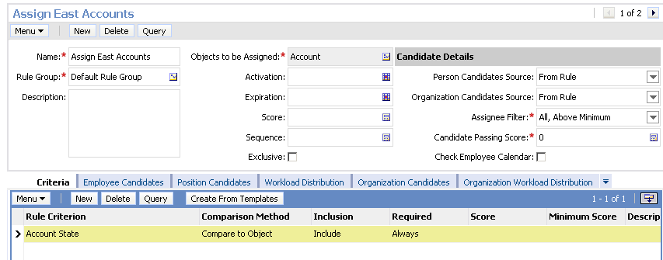
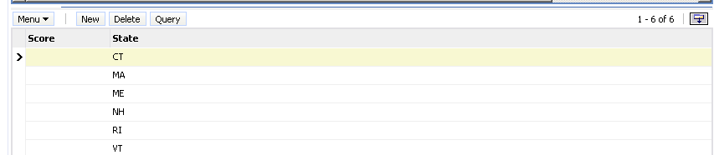
Assignment Rules
Assign one or more candidates to assignments objects based on one or more criteria
Are specified using several key concepts
Who to consider as candidates
How to pick the assignee from the qualified candidates
Captures the criteria aspect of the rule

Slide 4
Creating Assignment Rules
General process to create assignment rules:
  Design the rule
  Create the rule record
  Define the criteria
  Specify the candidates

Slide 5
Example: Assigning Data by Sales Region
0/4
1. Design the Assignment Rules
2. Create the Rule
3. Specify the Criteria
4. Specify the Candidates
Notes:
This is a structuring slide for <insert what will be discussed>. Do not teach the steps or concepts here because the following slides cover them in detail. Provide a high level description of what will be discussed.

Slide 6
1. Design the Assignment Rules
1/4
Determine the criteria to identify each sales region
  Example: Sales regions are based on account state
    East region includes MA, VT, NH, ME, RI, CT
Determine the candidates to be assigned in each sales region
Region | Positions
East (CT, MA, ME, NH, RI, VT) | Sales Rep - East Sales Mgr - East
West (CA, OR, WA) | Sales Rep - West 1 Sales Rep - West 2

Slide 7
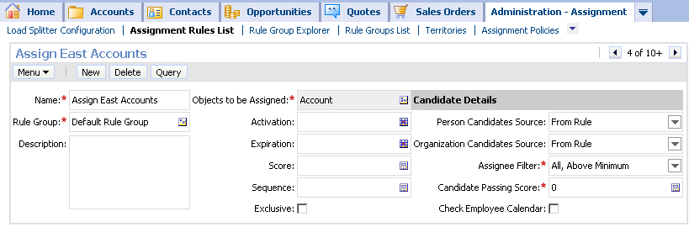
2. Create the Rule
2/4
Navigate to Administration - Assignment > Assignment Rules List
Create a new rule for each sales region
  Select the assignment object
  Set Person Candidate Source to From Rule
  Select the Assignee Filter
  Assign a rule group
Consider only the candidates listed in rule
Specify Default Group if not rule groups
Assigns multiple qualifying candidates

Slide 8
3. Specify the Criteria
3/4
Drill down on the rule
In the Criteria view, create a new Rule Criterion to be used to assign data
  Example: Only opportunities with an account state in the East region will be assigned
Specify the Comparison Method
Specify the attribute value(s) to be used in the comparison
Compares Account State to the list below

Slide 9
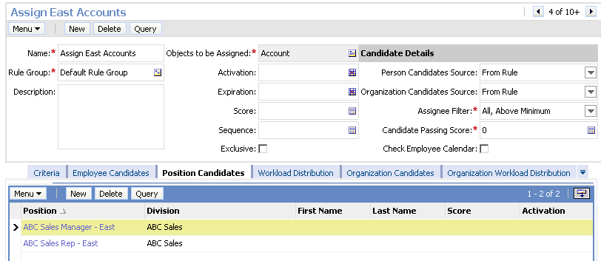
4. Specify the Candidates
4/4
Navigate to the Position Candidates view
Add a new record for each position to be assigned
Optionally assign organizations using the Organization Candidates view
Specify one or more positions

Slide 10
Example: Assigning Service Data to Employees
0/5
1. Design the Assignment Rule
2. Create the Rule
3. Specify the Criteria
4. Specify the Candidates
5. Associate Skills with Candidates
Notes:
This is a structuring slide for <insert what will be discussed>. Do not teach the steps or concepts here because the following slides cover them in detail. Provide a high level description of what will be discussed.

Slide 11
1. Design the Assignment Rule
1/5
Determine the criteria to assign a candidate to a service request
  Matching criteria include:
    Skill match
    Location
    Availability
    Workload
Determine the set of eligible candidates
  Alternatively consider all available employees
Object: Service Request
Candidates:
All service agents
Criteria: Candidate’s product skill = product associated with service request

Slide 12
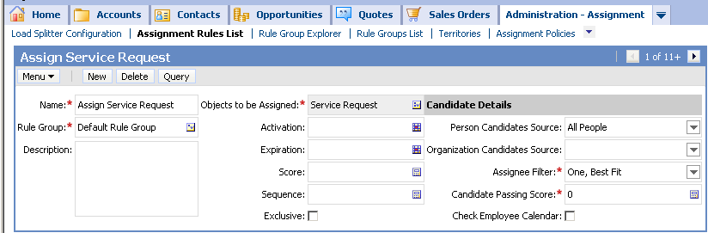
2. Create the Rule
2/5
Navigate to Administration - Assignment > Assignment Rules List
Select the assignment object
Set Person Candidate Source to All People
Set Assignee Filter to One, Best Fit
Assign a rule group
Consider all employees
Assign only one candidate

Slide 13
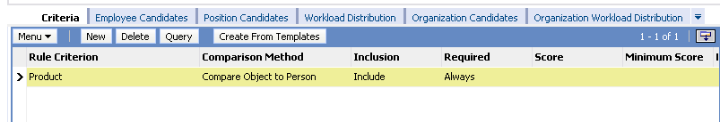
3. Specify the Criteria
3/5
Drill down on the rule
In the Criteria view, create a new rule criterion to be used to assign data
  Example: Consider employees only if they are skilled in the product associated with the SR
Specify the comparison method
Qualify only employees with product skill

Slide 14
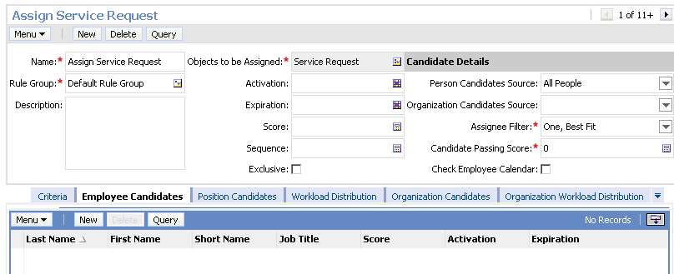
4. Specify the Candidates
4/5
When considering a restricted set of candidates for assignment, set Person Candidate Source = From Rule
  Navigate to the Employee Candidates view
  Add a new record for each employee to be considered
Otherwise set Person Candidate Source = All People
  Do not explicitly add any employees to rule
Do not add any employees

Slide 15
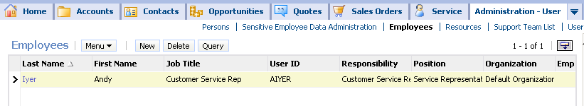
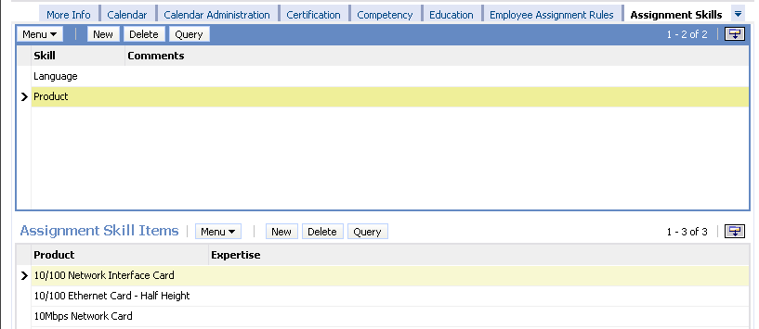
5. Associate Skills with Candidates
5/5
Navigate to Administration - User > Employees Assignment Skills
  Skills are employees attributes that can be used in assignment
Select a skill and assign one or more values that apply to the user
Areas of expertise
Specific skills in the area

Slide 16
Overview of Key Concepts
0/4
Person Candidate Source
Comparison Method
Scoring
Assignee Filter
Notes:
This is a structuring slide for <insert what will be discussed>. Do not teach the steps or concepts here because the following slides cover them in detail. Provide a high level description of what will be discussed.

Slide 17
Person Candidate Source
1/4
Determines the set of possible candidates that can be assigned to data by this rule
Candidate Source | Action
All People | Consider every employee/position as a candidate
From Rule | Consider only employees/positions listed explicitly as a candidate in the rule
Team Name | Consider the members of a team as candidates Implements dynamic assignment

Slide 18
Comparison Method
2/4
Determines how a rule is evaluated
  Expressed in terms of object and candidate attributes
Comparison Method | Action
Compare to Object | Checks if a record attribute matches a value specified in rule
Compare to Person | Checks if a person attribute matches a value specified in a rule
Compare Object to Person | Checks if a record attribute matches that attribute of an employee or position candidate
Compare to Organization | Checks if an organization attribute matches a value specified in a rule
Compare Object to Organization | Checks if record attribute matches that attribute of an organization candidate

Slide 19
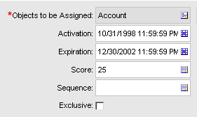
Scoring
3/4
Is a mechanism used to rank candidates for potential assignment
  Rules can specify passing scores
  Assign higher scores to more important criteria and lower scores to less important criteria
Add this value to candidates score if candidate qualifies

Slide 20
Assignee Filter
4/4
Determines how candidates that qualify are selected for assignment
  Multiple candidates might qualify
  Some rules may allow multiple candidates to be assigned
Assignee filter | Action
All, above minimum | Assign all candidates with a score higher than the rule’s passing score
All, must assign | Assign the highest scoring candidate as well as any others with scores higher than the rule’s passing score
One, best fit | Assign the candidate with the highest score (must score higher than the rule’s passing score)
One, random | Assign a single qualifying candidate by random selection

Slide 21
Testing Assignment Rules
0/5
After creating a rule, run Batch Assignment to test the rule
1. Release Assignment Rules
2. Enable Detailed Logging
3. Run a Batch Assignment
4. Examine the Assigned Records
5. Inspect the Assignment Log Files
Notes:
This is a structuring slide for <insert what will be discussed>. Do not teach the steps or concepts here because the following slides cover them in detail. Provide a high level description of what will be discussed.

Slide 22
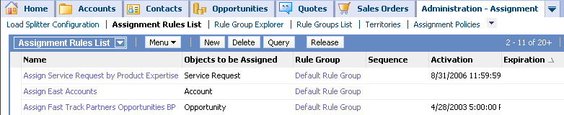
1. Release Assignment Rules
1/5
In the Assignment Rules List view:
  Verify that the rule has not expired
  Click Release to update the list of rules used by Assignment Manager
    A rule must be released again every time it is modified
All rules are active and are released

Slide 23
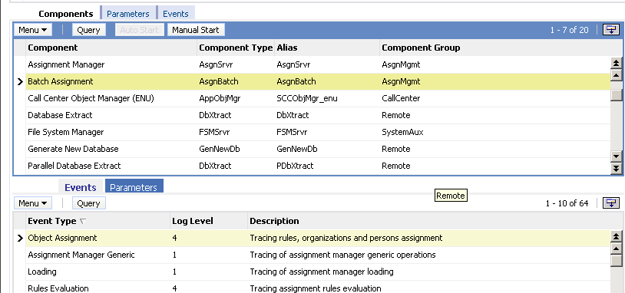
2. Enable Detailed Logging
2/5
Navigate to Administration - Server Configuration > Servers > Components
  Select Batch Assignment
  Set Log Level for Object Assignment and Rules Evaluation to 4
    Log levels can range from 0 to 5 in order of increasing detail

Slide 24
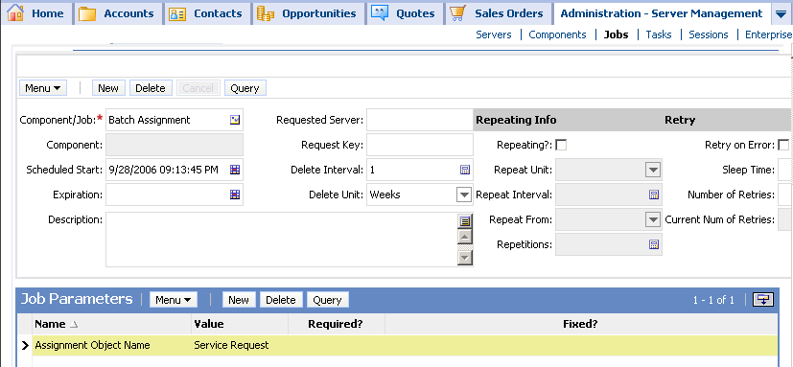
3. Run a Batch Assignment
3/5
Navigate to Administration - Server Management > Jobs
Create a Batch Assignment job and submit the request
Specify assignment object for this job

Slide 25
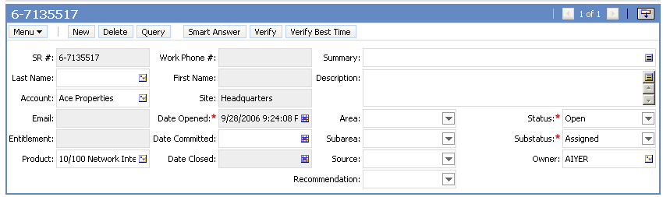
4. Examine the Assigned Records
4/5
Navigate to the list view for the data assigned
Inspect the records and verify that the desired assignments were made
Has expertise in this product

Slide 26
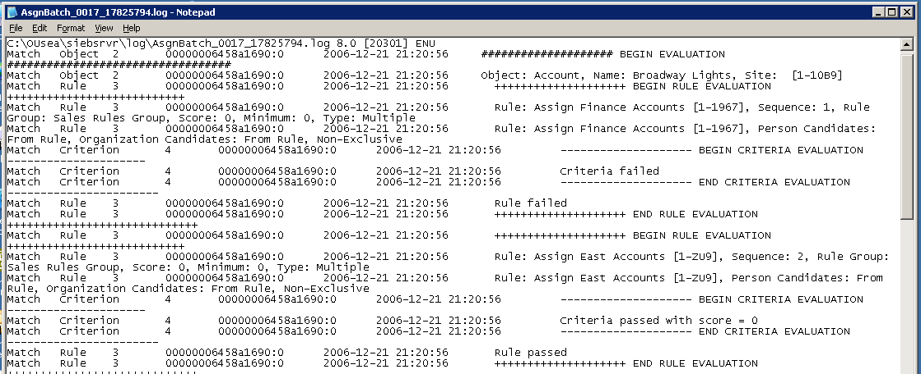
5. Inspect the Assignment Log Files
5/5
Navigate to the Siebel Server log directory to locate the log file generated by the Batch Assignment job
  Detailed log files document:
    How each rule is evaluated and why it failed or passed
    Whether the candidates from each passed rule qualify
    How the assignees are determined from the list of qualified candidates

Slide 27
Module Highlights
General process to create assignment rules:
  Design the rule
  Create the rule record
  Define the criteria
  Specify the candidates
Test assignment rules by:
  Releasing the rule
  Running a batch assignment
  Examining the assignment records
  Inspecting the assignment log files
    Enable an appropriate level of detailed logging
Notes:
Review Question: <Question>
Answer: <Answer>

Slide 28
Lab
In the lab you will:
  Create assignment rules
  Test the rules
Notes:
Labs and Troubleshooting:
<Summarize the tasks the students will perform in this lab. Suggest specific guidance the instructor may provide if necessary to help the students complete the lab and avoid trouble spots.>

