Slide 1

Module 46: Tailoring Assignment Manager Behavior
0/5
Siebel 8.0 Essentials
Notes:
Time: Lecture: <n – n> minutes; Labs: <n – n> minutes
Intent: <What is the instructional goal of the module>
Flow: < Describe at a high level the overall flow of the module>.
Key Terms: <List terms the instructor should be familiar with in order to teach this module>
<Term>
<Term>
<Term>
<Term>

Slide 2
Module Objectives
After completing this module you should be able to:
  Describe the steps in the assignment methodology
  Prioritize rules using exclusive rules and rule group sequencing
  Modify the behavior of an assignment object
Why you need to know:
  Developing effective rules requires an understanding of the ways assignments rules can be tailored
Notes:
Each objective and “why you need to know” should be stated aloud.

Slide 3
Assignment Methodology
Refers to the steps followed by Assignment Manager to assign candidates to objects
Simplified representation (does not contain all steps)
  Identify rules that apply
  Identify a list of qualified candidates for the applicable rules
  Determine primary assignee and assign candidates
For more details, consult the Assignment Methodology section in the Siebel Assignment Manager Administrative Guide

Slide 4
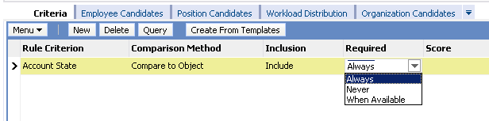
Identify Rules That Apply
Assignment Manager evaluates all rules that apply to the object
  Eliminates rules that fail the Compare to Object criteria
    Example: Value of Required field determines if rule qualifies
  Multiple rules may survive
Always: Rule qualifies if and only if State = CA, OR,or WA
Never: Rule qualifies regardless of state
When Available: Rule qualifies if state not specified or State = CA, OR,or WA

Slide 5
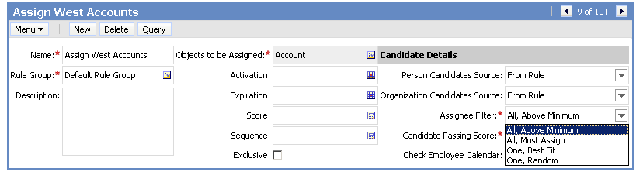
Identify Qualified Candidates
For each rule that passes, Assignment Manager generates a list of qualified candidates
  Evaluates the candidates specified in the rule using criteria:
    Compare to Person/Organization
    Compare Object to Person/Organization
  Scores each candidate
  Applies the Assignee Filter
Determines how to process qualifying candidates for the rule

Slide 6
Score Candidates
Scores can be defined for many parameters:
Item Scored | Action
Assignment rule | To apply the score to the candidate’s total score when the candidate meets the rule criteria
Criteria | To rank criteria from the most important to the least important
Criteria values | To rank criteria values from the most important to the least important
Candidate | To rank the best candidate from a group of qualified candidates
Workload distribution | To distribute workload across all candidates The higher the candidate’s current workload is, the lower his/her score is
Notes:
Demonstrate that scores appear in each of the appropriate views.

Slide 7
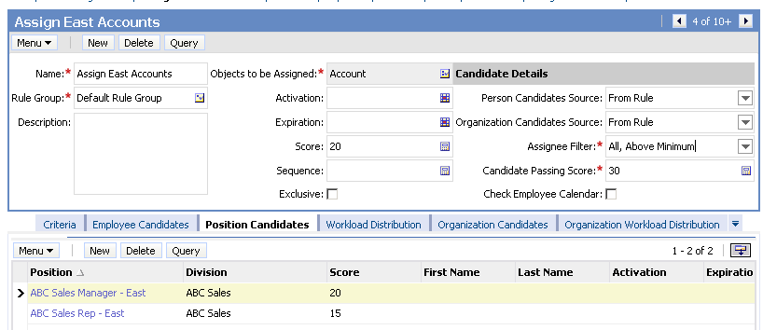
Score Candidates Continued
A candidate’s score is the sum of the individual scores
Candidate total score = 40 …
Candidate total score = 35 …
… so both candidates qualify as each score exceeds the passing score
Notes:
Demonstrate that scores appear in each of the appropriate views.

Slide 8
Assign Candidates
Assignment Manager:
  Generates assignments using the Assignees Filter from the rule with the highest scoring assignee
  For team-based assignment, the highest-scoring qualifying candidate from the highest-scoring rule is made primary
    Rule may optionally identify the primary explicitly
Will be assigned as primary (total score = 40)

Slide 9
Workload Distribution
Is used to distribute work among qualified candidates
  Prevents individuals from being overloaded with work
Consists of:
  Workload Distribution Rule
  Maximum Workload
  Score
Notes:
Workload Distribution Rules also impact scoring. They are discussed in more detail on slide 14.

Slide 10
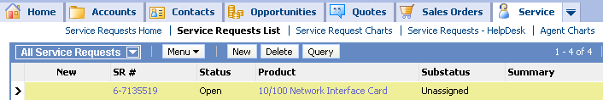
Service Scenario
Business Rule: Assign service requests to agents based on product skill and current workload
Assign incoming service requests …
… to the appropriate candidate
Employee: Craig
Skill: Network
Workload: 18 SRs
Employee: Ellen
Skill: CPU
Workload: 10 SRs
Employee: Jack
Skill: Network
Workload: 20 SRs
Notes:
This is a recap of the rule from the introduction module.

Slide 11
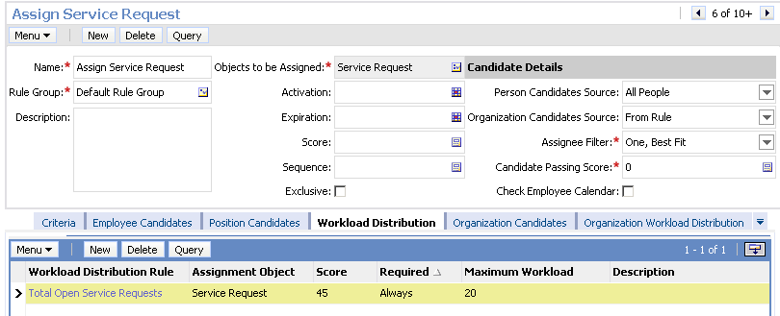
Workload Distribution Rules
Balance workload across candidates
Assign a computed score to candidates based on:
  Maximum Workload: the maximum number of service requests that a candidate should own at any time
  Score: the weight assigned to workload in comparison to other criteria
Notes:
Workload Distribution rules assign a score to candidates using the formula:
Score * (1- (current workload/maximum workload))
An example is shown on the next slide.

Slide 12

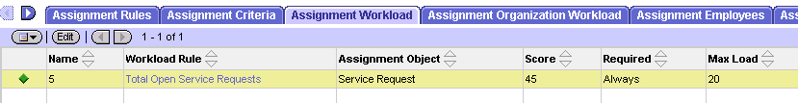
Calculating Scores for the Scenario
Compute a workload score and add it to other scores
  Assign a score for product skill
Assign incoming network service request to Craig
Employee: Craig
Skill: Network
Workload: 18 SRs
Service Request Product = Network
Employee: Ellen
Skill: CPU
Workload: 10 SRs
Employee: Jack
Skill: Network
Workload: 20 SRs
Employee
Product
Employee Workload Score
Total
Score
Score * [1
-
(Current Workload / Max Load)]
Score
Craig
20
45 * [1
–
(18 / 20)] = 4.5
Craig is assigned
24.5
Ellen
0
45 * [1
–
(10 / 20)] = 22.5
22.5
Jack
20
45 * [1
–
(20 / 20)] = 0
20
Notes:
Walk through the scenario of this record being assigned. Show that Craig would be the highest-scoring candidate for a network service request.
Then run through the scenario again, assuming another network service request comes in. Craig now has a workload of 19 SRs, and would achieve a score of 22.25. Ellen still receives a score of 22.5, and would be assigned to the data.
Point out that, to prevent Ellen from being assigned to data she is unskilled to handle, the product criteria may be required.

Slide 13
Rule Prioritization
Multiple assignment rules may exist for the same assignment object
  Can result in qualified candidates from both rules being assigned
Business policies may require that candidates from only a single rule be assigned
Assign Opportunities based on Account State to the state sales office
Assign Opportunities based on Account Industry to only the industry specialists
Only positions from this rule should be assigned

Slide 14
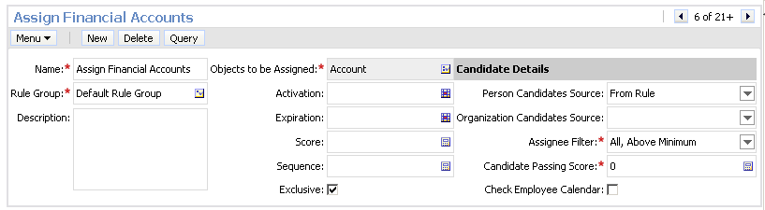
Exclusive Rules
Rules can be marked exclusive to prioritize them
  Results in only the qualified candidates from that rule being assigned
All rules are first evaluated and scored as before
  Exclusive rule must first pass and have qualifying candidates
Set flag to make rule exclusive

Slide 15
Multiple Exclusive Rules
When several exclusive rules have qualifying candidates, the rule with the highest scoring candidate prevails
  Keep qualifying assignees from only that rule
When two or more exclusive rules tie for highest score, none of the rules prevail
  Only the default candidate is assigned
  Design exclusive rules carefully to avoid such behavior

Slide 16
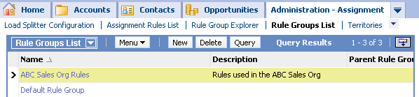
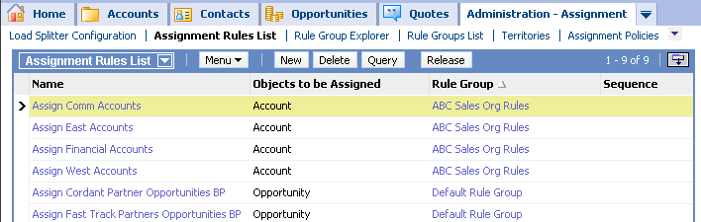
Sequencing Rules
Rules within a rule group can be sequenced to prioritize them
  A rule group is a named collection (or subset) of assignment rules
    A rule can appear in one and only one group
    Rules not explicitly assigned to a group belong automatically to the Default Rule Group
Defines rules groups

Slide 17
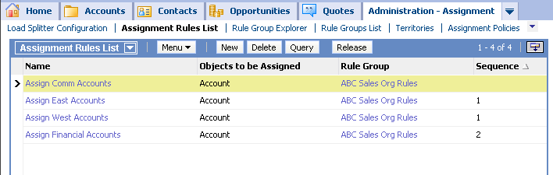
Rule Sequence
Specifies the order in which Assignment Manager evaluates rules in a group
  Rules with the same sequence number are evaluated in unspecified order
  Rules with no sequence number are considered to have a sequence number of 0
Rule evaluated first
Two rules evaluated next
Rule evaluated last

Slide 18
Rule Sequence Continued
Assignment Manager pauses after evaluating rules with a given sequence number
  Stops if an assignment can be made
  Otherwise, continues to rules with next higher sequence number
Permit hierarchical assignment strategies
  For example:
    Assign opportunity first to a qualifying local office
    If not, then to a district office
    If not, then to a regional office
    If not, then to headquarters

Slide 19
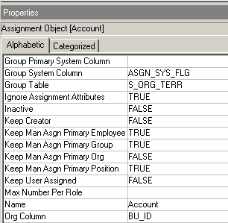
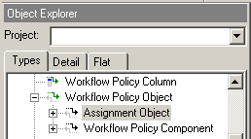
Run-Time Behavior of Assignment Manager
Is determined by the Assignment object definition
  Is located in the repository
  Is configured individually for each assignment object
70 plus properties

Slide 20
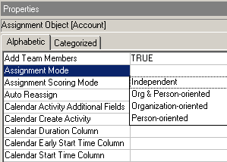
Assignment Mode
Specifies how candidates are assigned when a rule assigns both positions and organizations
Assign positions and organizations independently
Assign only positions/organizations pairs that both qualify
Assign organizations first and consider only corresponding positions
Assign positions first and consider only corresponding organizations

Slide 21
Default Candidate
Is a predefined position/employee who is assigned in the following situations:
  Conflict between two rules with same score
    Assigns candidates for both rules and assigns the default candidate to the team
    Makes default candidate the primary for team-based assignments
  Conflict between two exclusive rules with the same score
    Assigns default candidate to the team as primary
  Rules do not identify any candidates to assign
    Assigns default candidate to the team as primary

Slide 22
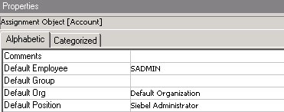
Default Candidate Continued
Is specified as properties of the Assignment Object definition
  Default Employee
  Default Group
  Default Org
  Default Position
Notes:
Default Candidates are initially set to SADMIN, the Siebel Administrator position, and the Default Organization. Developers should not delete or rename the seed administrative data to which Assignment Objects refer.
Conflicts are discussed in more detail on the following slide.

Slide 23
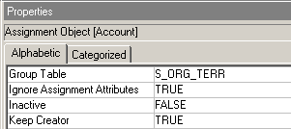
Keep Creator
If this property is set to TRUE, Assignment Manager keeps the creator of the record on the team regardless of which rules pass
Assign positions/employees to data
Assign positions/employees to data
Keep creator on team
Notes:
Examples:
A sales representative enters an opportunity into the Call Center application. Assignment Manager assigns other people to the sales team, but keeps the sales representative on the team.
A marketing intern types in data from business cards collected at a trade show. Assignment Manager removes the intern from the sales team when assigning the opportunities because the intern will not be involved with the lead after the data is entered.

Slide 24
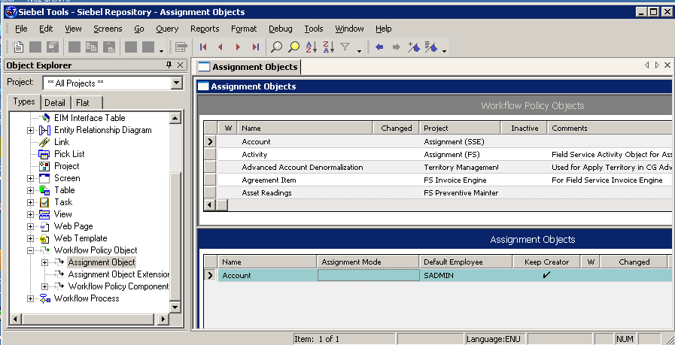
Configuring Assignment Manager Objects
Use Siebel Tools to edit object definitions to modify the behavior of Assignment Manager
  Same as editing other object definitions

Slide 25
Assignment Manager
Reads Assignment object from repository tables (not the repository file) at run time
  No need to compile the Assignment object itself
  Can deploy a modified Assignment object at run time

Slide 26
Module Highlights
Assignment methodology refers to the steps followed by Assignment Manager to assign candidates to objects
  Identify rules that apply
  Identify a list of qualified candidates for the applicable rules
  Scoring candidates
  Determine primary assignee and assign candidates
Workload rules can be used to distribute work among qualified candidates
Multiple assignment rules may exist for the same assignment object
  Rules can be prioritized by
    Marking a rule as exclusive
    Sequencing rules
Run-time behavior of Assignment Manager is specified by the configuration of the assignment object
Notes:
Review Question: <Question>
Answer: <Answer>

Slide 27
Lab
In the lab you will:
  Create prioritized rules
  Modify the run-time behavior of Assignment Manager
Notes:
Labs and Troubleshooting:
<Summarize the tasks the students will perform in this lab. Suggest specific guidance the instructor may provide if necessary to help the students complete the lab and avoid trouble spots.>

