Slide 1

Module 47: Invoking Siebel Assignment Manager
0/5
Siebel 8.0 Essentials
Notes:
Time: Lecture: <n – n> minutes; Labs: <n – n> minutes
Intent: <What is the instructional goal of the module>
Flow: < Describe at a high level the overall flow of the module>.
Key Terms: <List terms the instructor should be familiar with in order to teach this module>
<Term>
<Term>
<Term>
<Term>

Slide 2
Module Objectives
After completing this module you should be able to:
  List the modes in which Assignment Manager can be invoked
  Invoke Assignment Manager in dynamic mode
Why you need to know:
  You need to enable your Siebel environment to support dynamic assignment management
Notes:
Each objective and “why you need to know” should be stated aloud.

Slide 3
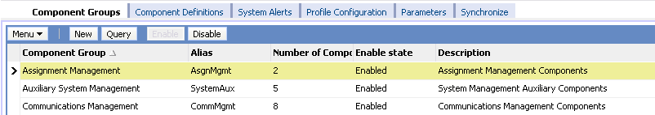
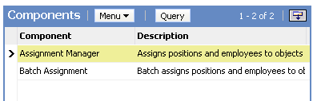
Running Assignment Manager
Assignment Manager is invoked in three modes:
  Batch Assignment
  Dynamic Assignment
  Interactive Assignment
All modes require that the Assignment Manager component group be enabled

Slide 4
Batch Assignment
Is used to submit batches of data for one-time assignment or reassignment
Is implemented via a server task
Business scenarios:
  Change assignment rules and reassign existing objects that are already assigned
  Sales region or territory realignment
  Existing assignments are inaccurate
  After a batch data load

Slide 5
Dynamic Assignment
Automatically invokes Assignment Manager to assign data in near real time as records are created or modified
Business scenarios:
  Whenever a service request is created, assign it to a service agent with the appropriate product skill
  Whenever an opportunity is created, assign it to the sales representative who handles that territory
Notes:
Dynamic assignment enables Assignment Manager to automatically assign objects when they are created or updated.

Slide 6
Dynamic Assignment Continued
Is implemented using:
  Assignment policies
  Generate Triggers
  Workflow Monitor Agent
  Assignment Manager
Is similar to workflow policies
  Both execute asynchronously on the server

Slide 7
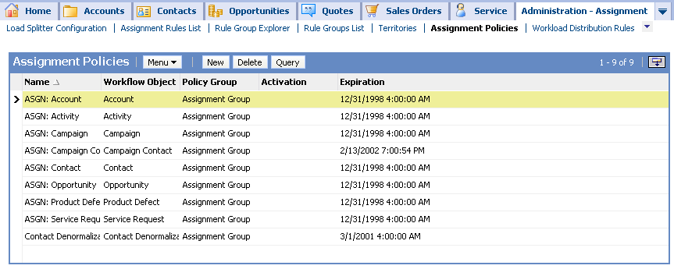
Assignment Policies
Specify which objects are to be assigned
Are expired by default
  Navigate to Site Map > Administration – Assignment > Assignment Policies
  Remove the expiration date to activate policies
Notes:
Since Assignment Manager is presented after Siebel Workflow in the course, students are already be familiar with the concept of policies.
Assignment policies are specific to Assignment Manager and provided as part of the Siebel seed data.
Demonstrate how to access assignment policies by navigating to Administration - Assignment > Assignment Policies.

Slide 8
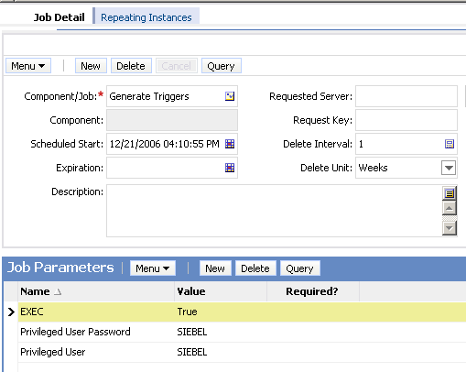
Generate Triggers
Is a server task that creates database triggers
  Builds triggers for all active assignment policies
Must be run after policies are activated
Requires a user with privileges to add triggers to the database
Notes:
The Generate Triggers server component creates database triggers from workflow policies (presented in a previous module) and assignment policies (explained here).
Students learned how to generate triggers in the previous workflow modules.

Slide 9
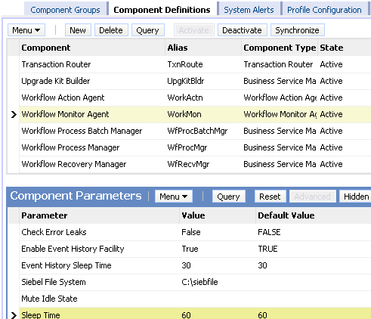
Workflow Monitor Agent
Start Workflow Monitor Agent and specify:
  Group Name (the group of assignment policies you activated)
  Sleep Time (interval in seconds between iterations)
Follow steps used in enabling workflow policies
Notes:
Workflow was presented prior to Assignment Manager in the course, so students are already familiar with the Workflow Monitor Agent task. It uses policies to monitor changes for Assignment Manager. Policies are presented on the next slide.
Siebel applications include predefined assignment policies for each of the predefined assignment objects. Users can use these predefined assignment policies or create new assignment policies for dynamic assignments.
Each Workflow Monitor Agent can monitor one or more assignment policies. Users can use a single Workflow Monitor Agent to monitor all assignment policies by placing all assignment policies in the same workflow group (the predefined assignment policies are defined this way). Users can also place the assignment policies in separate workflow groups and dedicate Workflow Monitor Agents for each workflow group. For example, for this task, users indicate in the Group parameter which group they want to monitor.

Slide 10
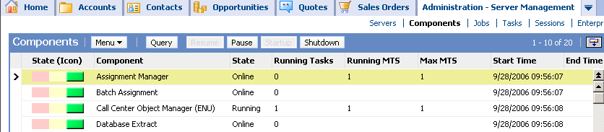
Assignment Manager
Is invoked by Workflow Monitor Agent
  Assignment Manager server component must be online
Performs the assignment of data to candidates
Notes:
Assignment Manager is a combined process, using the rules that the users created along with the Workflow Monitor Agent server component.

Slide 11
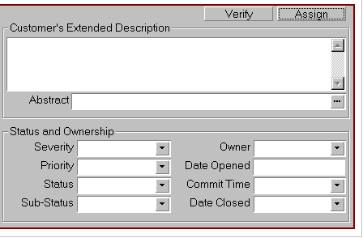
Dynamic Assignment Process Flow
Is similar to the flow for workflow policies
Create triggers corresponding to assignment policies
Account created
S_ESCL_REQ
Triggers fire when conditions satisfied
and write record
Generate triggers
Makes assignments
Siebel
Database
Assignment
Manager
Server
Request Broker
Workflow
Monitor Agent
Evaluate the assignment rules
Monitors S_ESCL_REQ table for changes and invokes Assignment Manager
Notes:
With dynamic assignment, Assignment Manager is invoked internally within Workflow Monitor Agent.
When a trigger fires as a result of a database insert or update, a record is written to the table S_ESCL_REQ. This table was described earlier in the Workflow modules. Workflow Monitor Agent monitors this table for changes in the database. It also maintains this table by deleting records once they have been processed by Workflow Monitor Agent.

Slide 12
Interactive Assignment
Is used to assign candidates in real time
  Enabled for Service Request and Activity assignment objects
Business scenarios:
  A customer service representative receives a call and creates a new service request, then clicks Assign to find the right person to work on that service request
  A field service supervisor wants to find the right person to work on a repair activity, and uses Interactive Assignment to obtain a list of people with the right skills to perform the repair
Notes:
Navigate to My Team’s Service Requests and My Team’s Activities and show the students the Assign option in the Menu button. If the record is not available for assignment, the Assign menu selection will be grayed out.
If you want to demo this, make sure that you are connected to a server and that the assignment components are running.

Slide 13
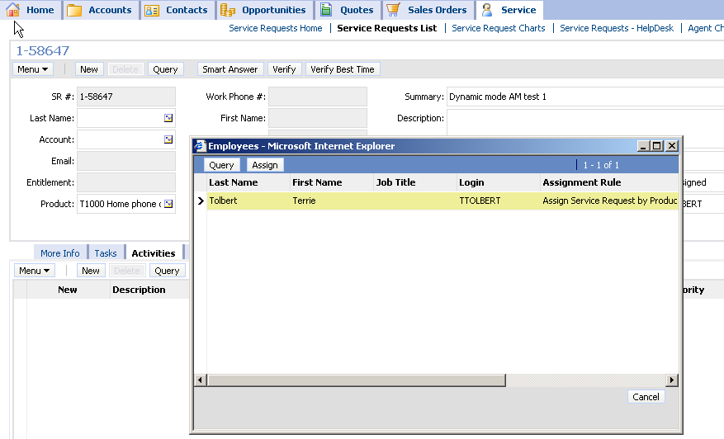
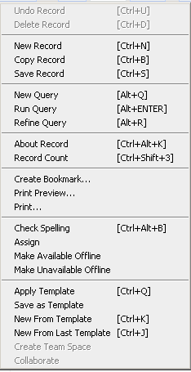
Using Interactive Assignment
Implemented via user interaction and tasks on server
  User makes assignment from a generated list of candidates
1. Select the work to be assigned
2. Click Menu and select Assign
3. Select employee and click Assign
Notes:
If an object is available for interactive assignment, (such as service requests and activities), the Assign action will be available for selection when clicking the Menu button.

Slide 14
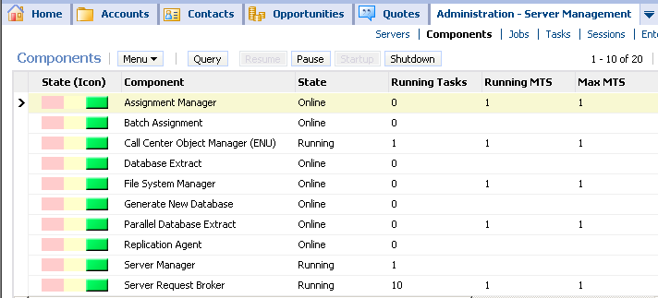
Requirements for Interactive Assignment
Verify that Assignment Manager is online and Server Request Broker is running
Performs Assignment
Brokers client requests
Notes:
Be prepared to talk about what to do if the component is not online. Users should verify that the Assignment Manager component group is enabled. When they enable a component group, the Siebel Server must be stopped and then restarted for the change to go into effect.

Slide 15
Module Highlights
Assignment Manager is invoked in three modes
  Batch Assignment: Is used to submit batches of data for one-time assignment or reassignment
    Is implemented by submitting a job request
  Dynamic Assignment: Is used to assign data in near real time as records are created or modified
    Is implemented using:
      Assignment policies
      Generate Triggers
      Workflow Monitor Agent
      Assignment Manager
  Interactive Assignment: Is used to assign candidates in real time
    Is implemented via user interaction and tasks on server
Notes:
Review Question: <Question>
Answer: <Answer>

Slide 16
Lab
In the lab you will:
  Create new service records and verify that they are dynamically assigned to the desired employee
Notes:
Labs and Troubleshooting:
<Summarize the tasks the students will perform in this lab. Suggest specific guidance the instructor may provide if necessary to help the students complete the lab and avoid trouble spots.>

