Slide 1

Module 48: State Models
0/5
Siebel 8.0 Essentials
Notes:
Time: Lecture: <n – n> minutes; Labs: <n – n> minutes
Intent: <What is the instructional goal of the module>
Flow: < Describe at a high level the overall flow of the module>.
Key Terms: <List terms the instructor should be familiar with in order to teach this module>
<Term>
<Term>
<Term>
<Term>

Slide 2
Module Objectives
After completing this module you should be able to:
  Describe how state models can enforce business logic
  Create a new state model
Why you need to know:
  A state model is a simple declarative way to enforce business logic that involves changes to values of certain fields in a business component
Notes:
Each objective and “why you need to know” should be stated aloud.

Slide 3
Business Entities and Life Cycles
Many business entities have a defined life cycle described by:
  A set of states named by the values of one of the entity’s fields
  A set of allowed transitions between the states
For example: A service request could have a life cycle defined in terms of these values of the status field:
  Open, Pending, Closed, Cancelled
Arrow indicates a permitted transition
State
Open
Pending
Closed
Cancelled

Slide 4
Business Challenge
A company’s business policies may restrict transitions between states
  Direct transitions between all pairs of states may not be permitted
  Not everyone may be permitted to invoke a specific transition
  There may be conditions that must apply before a transition can occur
Need a way to easily incorporate such restrictions into the life cycle of an entity
Open
Pending
Closed
Owner must be assigned
Permitted only by call center manager
Permitted only if severity <> critical
Cancelled

Slide 5
Business Solution
A state model captures and enforces such restrictions on transitions
  Uses a set of rules and conditions that specify allowed transitions
    Uses declarative configuration as opposed to script
  Is implemented in the Siebel client and not Siebel Tools
    Does not involve compiling and deploying a new SRF file

Slide 6
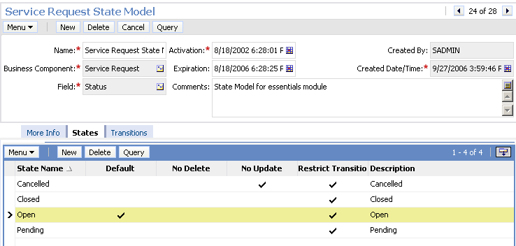
State Model
A state model consists of:
  A set of states corresponding to the values of a single-value field
    Must have a bounded picklist declared in the List Of Values table
State field
States for this state model

Slide 7
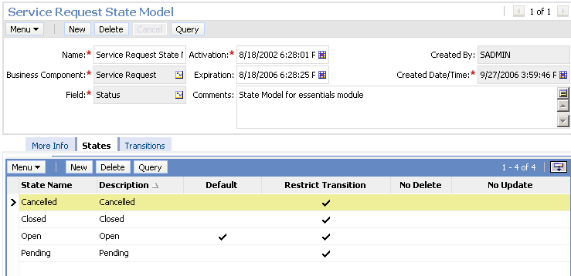
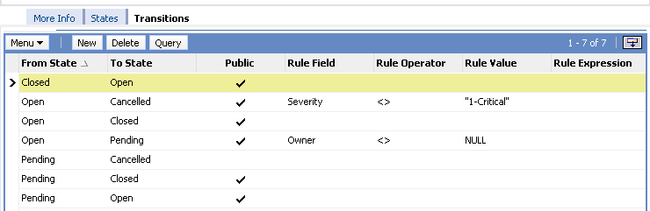
State Model Continued
A state model also consists of:
  A set of allowed transitions that can be restricted
    Only can be executed by authorized positions
    Only can be executed when a condition is satisfied
Unrestricted
Condition on transition
Only selected positions allowed to make transition

Slide 8
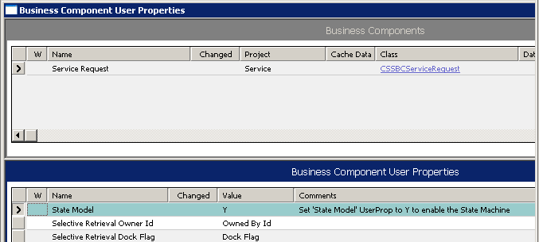
Enabling Siebel State Model
Only a small number of business components are enabled for state model in the as-delivered application
  Indicated by a business component user property (State Model, Y)
Other business components can be enabled for state model
  Business component class is restricted to CSSBCBase

Slide 9
Creating a State Model
0/6
1. Define the Desired Life Cycle
2. Create a New State Model
3. Specify the Allowed States
4. Specify the Allowed Transitions and Restrictions
5. Specify Authorized Positions
6. Test the State Model
Notes:
This is a structuring slide for <insert what will be discussed>. Do not teach the steps or concepts here because the following slides cover them in detail. Provide a high level description of what will be discussed.

Slide 10
1. Define the Desired Life Cycle
1/6
Review relevant business policies to identify restricted transitions
Document the allowed transitions and corresponding restrictions
Open
Pending
Closed
Owner must be assigned
Permitted only by call center manager
Permitted only if severity <> critical
Cancelled

Slide 11
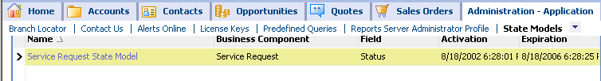
2. Create a New State Model
2/6
Navigate to Administration - Application > State Models
Create a new state model record
  Specify the business component and “state” field

Slide 12
3. Specify the Allowed States
3/6
Navigate to the States view
Create a record for each allowable value of the “state” field
  Specify one state as the default initial state in which new records are created
Set by default

Slide 13
4. Specify the Allowed Transitions and Conditions
4/6
Navigate to the Transitions view
Create a record for each allowable transition
  Select the from and to states using the drop-down list
  Indicate if there are restrictions on who can execute the transition
  Specify any conditions to be satisfied before transition can occur
4. Add any additional conditions on transition
3. Deselect Public if transition restricted
1. Select the from state
2. Select the to state

Slide 14
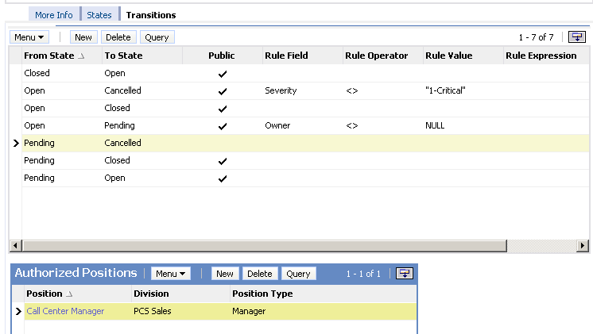
5. Specify Authorized Positions
5/6
For any transitions not marked Public, specify the positions that are permitted to execute the transition in the Authorized Positions applet
Transition restricted
Specify positions allow to make the transition

Slide 15
6. Test the State Model
6/6
Make sure the state model activation and expiration dates are valid
  Only one state model based on a given field can be active at any given time
Create one or more test records and verify that the business policy is correctly implemented
  New state model is effective when a new application object manager process starts
    New process reads the updated state model cache

Slide 16
Module Highlights
A state model restricts the life cycle of a business component
  Defines a set of states and allowed transitions between the states
State models:
  Are built in the Siebel client using declarative configuration
  Do not require recompiling the .srf file
Transitions between states can be restricted as follows:
  Not allowed at all
  Allowed under only certain conditions
  Allowed by only certain positions
A few as-delivered business components are enabled for state model
  Customers can enable others for state model if the business component class is CSSBCBase
Notes:
Review Question: <Question>
Answer: <Answer>

Slide 17
Lab
In the lab you will:
  Create and test a state model
Notes:
Labs and Troubleshooting:
<Summarize the tasks the students will perform in this lab. Suggest specific guidance the instructor may provide if necessary to help the students complete the lab and avoid trouble spots.>

