Slide 1

Module 49: Introducing Enterprise Integration Manager
0/5
Siebel 8.0 Essentials
Notes:
Time: Lecture: <n – n> minutes; Labs: <n – n> minutes
Intent: <What is the instructional goal of the module>
Flow: < Describe at a high level the overall flow of the module>.
Key Terms: <List terms the instructor should be familiar with in order to teach this module>
<Term>
<Term>
<Term>
<Term>

Slide 2
Module Objectives
After completing this module you will be able to:
  Describe the features of Enterprise Integration Manager (EIM)
  Describe how EIM supports referential integrity
  Describe why direct SQL statements must not be used to insert user data
Why you need to know:
  EIM enables you to properly import external data into the Siebel database
Notes:
Each objective and “why you need to know” should be stated aloud.

Slide 3
Enterprise Integration Manager (EIM)
Business Challenge: To exchange large volumes of data between an external application and the Siebel database
  Implementation project challenge: To perform an initial data load for a Siebel application
Business Solution: Enterprise Integration Manager (EIM)
  Is a server component that moves large volumes of data in batch mode between Siebel interface tables and Siebel base tables
    Interface tables act as a staging area for external data
Siebel Database
External
Database
SQL Utility
Siebel
Interface Tables
EIM
Siebel
Base Tables
Notes:
EIM is discussed in greater detail in modules that follow. The modules illustrate how EIM is used for the initial data load when implementing Siebel applications.

Slide 4
User Data
The Siebel database contains several types of data:
  Seed data: application data populated during product installation
  Repository data: metadata initialized at installation and modified during application configuration
  User data: user-supplied data, such as account records, contacts, price lists, or assignment rules
EIM is only used to move user data
Siebel Database
Seed
data
Repository
data
User-supplied data such as account information, contacts, or price lists
User data
Notes:
Seed data is populated when the database is installed using the DB Server Configuration wizard. Repository data is populated with the DB Server Configuration utility’s Import/Export Repository option. User data must be populated by the user. More information is provided on the next slide.

Slide 5
Populating and Managing User Data
Use the client application to enter, update, or delete small amounts of user data directly in the base tables
Use EIM to:
  Import large amounts of data from external sources through interface tables
  Delete large amounts of data
Notes:
This slide introduces base and interface tables. They will be defined on subsequent slides. You can populate user data in one of two ways. If it is a small amount of data, you can enter it through the application UI to populate data in base tables. Students have gotten practice so far using this approach. The second approach is used for large amounts of data. One can use a server component to bring in data from external sources through interface tables, which then will move the data to base tables.

Slide 6
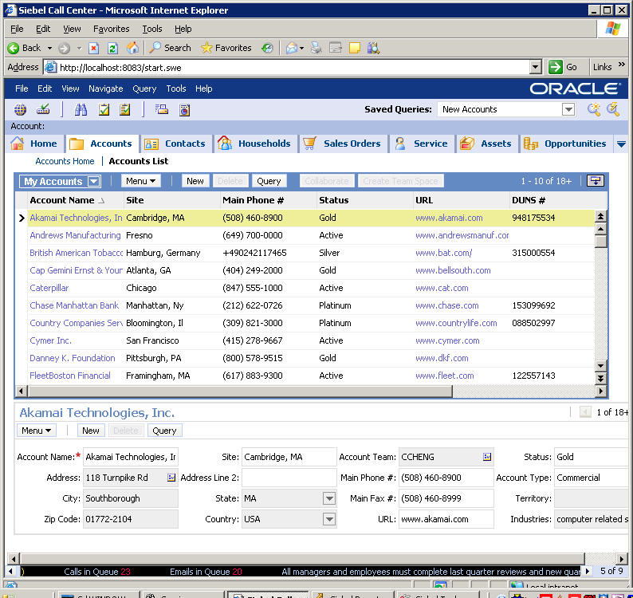
Components of EIM
0/4
Important components of EIM are:
Base Tables
Interface Tables
EIM Server Component
EIM Configuration File
Siebel Database
Non-Siebel loading tool
Prepared and cleansed external data
Interface table
Server component
Base table
Siebel client

Slide 7
Base Tables
1/4
User data is stored in one or more base tables in the Siebel database
  Relationships between base tables (referential integrity) rely upon primary keys (PKs) and foreign keys (FKs) based on ROW_IDs
    ROW_ID is the system primary key for every base table
    ROW_ID is a system-generated value
PK
PK
FK
FK
FK
S_BU
S_ORG_EXT
S_ADDR_ORG
Notes:
While you may not want to go into great depth on the subject of normalization, it should be stated that this principle is not unique to Siebel applications. Any implementation based on a RDBMS will use this technique. Normalization is a set of techniques for organizing data in tables in a manner that eliminates redundancy and incompleteness.
What is unique to Siebel applications is the use of ROW_ID. Any database can generate a row ID. However, the ROW_ID described here is specific to Siebel applications and is used to maintain referential integrity. Referential integrity ensures that for each foreign key value, there is a matching primary key value. Students have had practice looking at foreign key and primary key columns prior to this point in the course.
The main point here is that the system’s primary and foreign keys are managed by the Siebel application.

Slide 8
Interface Tables
2/4
Interface tables store external data inside the Siebel database
  Staging area for data to be imported, updated, or merged into base tables by EIM
  Staging area for data exported by EIM
  Staging area for data to be deleted in the base table by EIM
External database
EIM_ACCOUNT
S_ORG_EXT
EIM Server Component
S_ADDR_ORG
Interface Tables
External data
Base Tables
Notes:
Note with Siebel 7.7 interface tables are now called EIM tables.
It is important to point out that interface tables (or EIM tables) are tables inside the Siebel database. They are part of the initial schema. Interface tables tend to be denormalized, meaning that the tables contain multiple columns and are not designed for efficiency in relationships. These tables usually represent all of the data for a given entity (many base tables). For example, the EIM_ACCOUNT table contains columns for S_ORG_EXT, S_ADDR_ORG, and other base (normalized) tables.
Notice that external data may be in the form of other non-Siebel databases or flat files.
For more information about data cleansing, refer to Bookshelf. The important point here is that EIM does not fix inaccurate or inconsistent data.

Slide 9
Interface Tables Continued
2/4
Are meant to represent typical business “entities”
Typically map to multiple Siebel base tables
  Are denormalized
  Example: EIM_ACCOUNT interface table maps to eight base tables

Slide 10
EIM Server Component
3/4
Manages the exchange of data between interface tables and user data in base tables
Belongs to Enterprise Application Integration (EAI) component group
S_ORG_EXT
EIM_ACCOUNT
EIM Server Component
S_ADDR_ORG
External data
Notes:
Students are already familiar with EIM from the previous module; however, use this slide as an opportunity to refresh their memories and discuss EIM in greater detail.
Use the graphic to explain that Siebel EIM manages the bidirectional exchange of data between the Siebel databases and other corporate databases. This exchange of information is accomplished through intermediary tables called EIM tables (these tables were previously known as interface tables). The interface/EIM tables act as a staging area between the Siebel application database and other databases. Customers should use EIM to perform bulk imports, exports, updates, and deletes.

Slide 11
EIM Configuration File
4/4
EIM server component reads a configuration file (.ifb) to determine:
  Whether data should be imported, merged, deleted, or exported
  Which interface table(s) and base table(s) are used and affected
Import, merge, delete, or export
EIM Server Component
Configuration file (.ifb)
Notes:
The configuration file (.ifb) for EIM is not the same configuration file (.cfg) that is used by the client applications. Notice that the focus of the labs and of the class will be on IMPORT and DELETE.

Slide 12
User Keys
Based on multiple columns, user keys are used to uniquely identify a row for EIM
Primary and foreign keys based on ROW_ID are used for system-wide referential integrity
PK
User Key
FK
ROW_ID
NAME
LOC
BU_ID
S_ORG_EXT
S_BU
Notes:
This slide defines user keys and compares them with ROW_IDs. User keys are used to prevent duplication of records. ROW_IDs are used to maintain system-wide referential integrity. Later in the module, you will present how user keys are used by EIM to resolve ROW_IDs, maintaining referential integrity.

Slide 13
Referential Integrity
User key column mappings in interface tables are used to resolve ROW_IDs for base tables, maintaining referential integrity
PK (ROW_ID)
User key
1-8D
Acme
FK (ROW_ID)
Interface Table
1-8D
Base Tables
Notes:
The point here is that EIM uses user key data to figure out what the proper PK and FK ROW_IDs should be. Notice that Acme is in the interface table and it gets translated so that the proper rows in the base tables are accessed and processed. The user key identifies the row on the EIM table. The ROW_ID on base tables identifies relationships between tables. EIM is smart enough to generate and look up appropriate ROW_IDs during its processing. Therefore, it maintains the referential integrity of the database.

Slide 14

SQL
You must not use SQL to populate user data in base tables
  Relationships between tables are complex
  Referential integrity is maintained programmatically through ROW_IDs, not using constraints on the database
  SQL statements cannot generate Siebel ROW_IDs
PK
SQL
FK
S_ORG_EXT
S_ADDR_ORG
Notes:
This slide should be very clear. Since the Siebel ROW_IDs used for referential integrity are generated by Siebel programs, one must use Siebel programs to insert, update, and delete rows from tables. Siebel ROW_IDs cannot be generated using SQL and, therefore, running direct SQL insert, update, and delete statements against base tables will corrupt the referential integrity in the database. Students will see later that it is OK to run SQL against EIM tables.

Slide 15
Module Highlights
Enterprise Integration Manager (EIM) is a server component that supports bulk imports and exports to and from a Siebel database
  Useful for initial data loads
The main components of EIM are:
  Base tables
  Interface tables
  EIM server component
  EIM configuration files (.ifb)
You must not insert user data into Siebel base tables using SQL!
Notes:
Review Question: What role does the user key play in maintaining referential integrity?
Answer: Based on multiple columns, user keys are used to uniquely identify a row for EIM. EIM uses user key data to figure out what the proper PK and FK ROW_IDs should be. The user key identifies the row on the EIM table. The ROW_ID on base tables identifies relationships between tables.
Review Question: Why is it a bad idea to use SQL to directly update Siebel base tables?
Answer: Referential integrity is maintained programmatically through ROW_IDs, not using constraints on the database. SQL statements cannot generate Siebel ROW_IDs
True or false: EIM is a server process used only for imports and deletes of large amounts of data.
False. EIM reads a configuration file (.ifb) to determine whether data should be imported, merged, deleted, or exported.

