Slide 1

Module 50: Creating Data Maps
0/5
Siebel 8.0 Essentials
Notes:
Time: Lecture: <n – n> minutes; Labs: <n – n> minutes
Intent: <What is the instructional goal of the module>
Flow: < Describe at a high level the overall flow of the module>.
Key Terms: <List terms the instructor should be familiar with in order to teach this module>
<Term>
<Term>
<Term>
<Term>

Slide 2
Module Objectives
After completing this module you should be able to:
  Determine correct interface (EIM) tables and columns to use to import data into and delete data from Siebel base tables and columns
  Document data mappings between EIM tables and Siebel base tables
Why you need to know:
  Enables you to construct a strategy for successfully importing data into and deleting data from the Siebel database
Notes:
Each objective and “why you need to know” should be stated aloud.

Slide 3
Data Mapping
The first step in using EIM to import external data is data mapping
Data mapping determines:
  Which Siebel base table columns will store external source data
  Which interface (EIM) table columns will be used to import from source to destination
1. Decide where data ends up
Source
(external)
Destination
(base table)
2. Determine how to get there
Interface (EIM) table
Notes:
Usually data mapping is a design activity. It happens up front during the initial stages of the project. Here the focus is more on EIM to base table mappings rather than on external to Siebel database mappings.

Slide 4
Source Data
Analyze external source data
  Decide which attributes to store
  Determine which entity the collection of attributes represents
  Analyze relationships between entities
Customer
M:M
Sales
Person
Entity
Attribute
Name...
M:M
Name...
Decision
Maker
Name...
Notes:
This is not specific to a Siebel implementation. Any time you are looking to move or migrate data, you must analyze what the data represents. Entity and attribute are common terms used along with entity relationship diagrams (ERDs).

Slide 5
Siebel Destination
Analyze Siebel destination tables and columns
  Start with applets and fields used, and work down to business layer
  Use Siebel Tools to view tables and columns, business components (BCs), and relationships
Table
BC
Account
Position
Contact
Notes:
Students have practiced techniques for exploring the Siebel Data Model earlier in the course. Since the goal is to move data into the Siebel database, one must understand what the Siebel database has to offer. The engineering teams at Siebel Systems have put significant effort into designing the database and most of the data mapping needs should be addressed. Notice that the base table for each of the three depicted components is S_PARTY, which was defined in previous modules.

Slide 6
Identify and Verify Destination Tables and Columns
0/3
1. Determine Destination Applet
2. Identify BC Fields
3. Map BC Field to Database Column
Notes:
This is a structuring slide for <insert what will be discussed>. Do not teach the steps or concepts here because the following slides cover them in detail. Provide a high level description of what will be discussed.

Slide 7
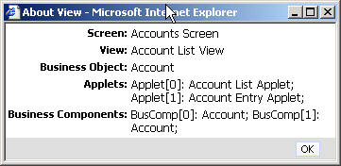
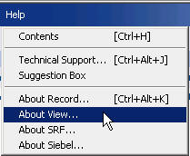
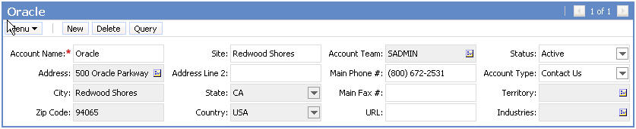
1. Determine Destination Applet
1/3
Use the Siebel client to identify applets and controls where external data is to be displayed
  Determine applet and business component names
Example: Verify mapping for Main Phone # field of an account
  Data to appear in Account Entry Applet
Applet name
Desired destination applet
BC Name
Control to map

Slide 8
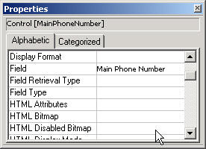
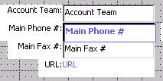
2. Identify BC Fields
2/3
Use Siebel Tools to map the applet control to the BC field
Locate control in Web Layout view
Properties window displays field name

Slide 9
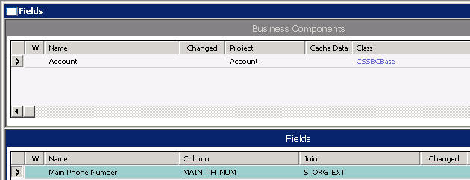
3. Map BC Field to Database Column
3/3
Examine BC field properties in Siebel Tools to determine which Siebel base table and column it maps to
BC field being mapped
Table and column

Slide 10
Map Source to Siebel Destination
Specify the source mapping to the Siebel destination
  Identify business component mapped to external entity
  Determine Siebel base tables and columns that will store source attributes
BC
Table
External entity
Account
Position
Customer
Sales
Person
Name...
Name...
Attribute
Contact
Decision
Maker
Name...
Notes:
Once you understand both sides, external and internal, in the Siebel database, then you must bring the data together. Which external piece ends up where in the Siebel database?

Slide 11
Document Mappings
Document mappings between source and base so that everyone has a common understanding
  EIM and configuration tasks are often performed by different people
  Can reduce need to re-do tasks if team members leave the project
Source Entity | Source Attribute | EIM Table | EIM Column | Base Table | Base Column
Customer | Name |  |  | S_ORG_EXT | NAME
Customer | Phone |  |  | S_ORG_EXT | MAIN_PH_NUM
 | Address |  |  | S_ADDR_ORG | ADDR
 |  |  |  | S_ADDR_ORG | CITY
 |  |  |  | S_ADDR_ORG | ZIPCODE
Notes:
People may join or leave a team, therefore, documenting mappings is critical. They must be documented. Students will practice working with spreadsheets to document mappings in the lab.

Slide 12
How to Get There: Determine Interface Tables
After verifying and documenting the source-to-base mappings, determine and document EIM-to-base mappings
Source Entity | Source Attribute | EIM Table | EIM Column | Base Table | Base Column
Customer | Name |  |  | S_ORG_EXT | NAME
Customer | Phone |  |  | S_ORG_EXT | MAIN_PH_NUM
 | Address |  |  | S_ADDR_ORG | ADDR
 |  |  |  | S_ADDR_ORG | CITY
 |  |  |  | S_ADDR_ORG | ZIPCODE
✓
✓
How to get there?
Destination
Source
?
Interface (EIM)
Notes:
This is the focus of the module. Once you know where the data should reside in the Siebel base tables, then you need to identify the EIM tables that would expedite the process.
Notice that the spreadsheet lists the EIM column on the left and the base column on the right. This is reversed when looking at the EIM Interface Tables report within Siebel Tools. Ensure that students do not get confused.
Make sure students understand what a base table is and how it will be used in the EIM process. Refer to the student note for a base table definition.

Slide 13
Table Relationships
An interface table may populate more than one base table
A base table may be populated by more than one interface table
EIM_ACCOUNT
S_ORG_EXT
EIM_ADDR_ORG
S_ADDR_ORG
Notes:
The point of this slide is that depending on the target base table, there may be several EIM tables to choose from.

Slide 14

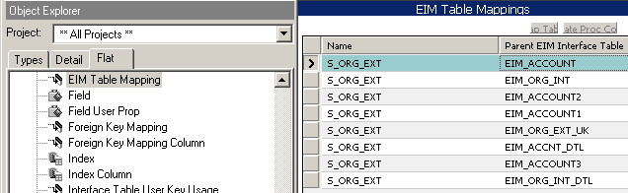
Locate EIM Tables
Locate candidate EIM tables using Siebel Tools
  Example: Locate EIM tables that populate S_ORG_EXT
Flat tab
Query
Result
EIM tables that populate S_ORG_EXT
Note: Use EIM_ tables, not _IF tables
Notes:
This slide shows a technique for finding the candidate or potential EIM tables that would populate a given base table. Stress to students that EIM_ tables must be used. The graphic adds EIM_ as additional query criteria.

Slide 15
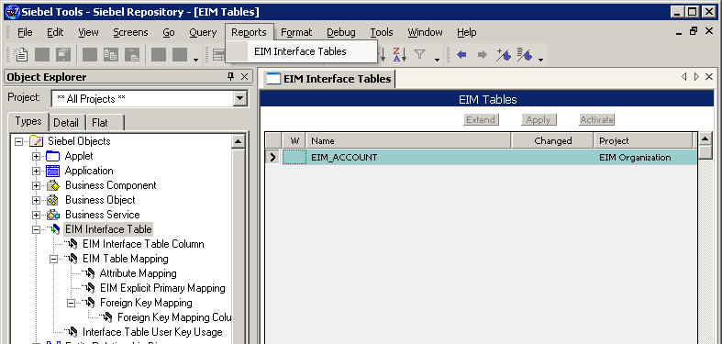
Interface Table Documentation
Mappings from interface tables to base tables are documented by:
  EIM Interface Table report available in Siebel Tools
  EIM Table Mapping objects
    Less convenient than using report
Query for interface table and…
…select Reports > EIM Interface Tables

Slide 16
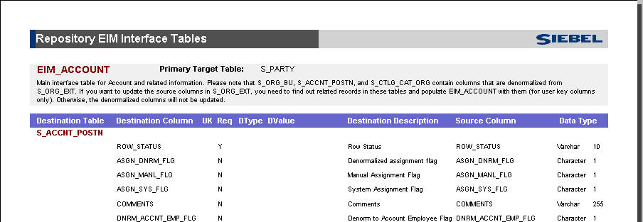
Interface Table Documentation Continued
Table report documents EIM Table Mapping attributes
Interface table report for EIM_ACCOUNT

Slide 17
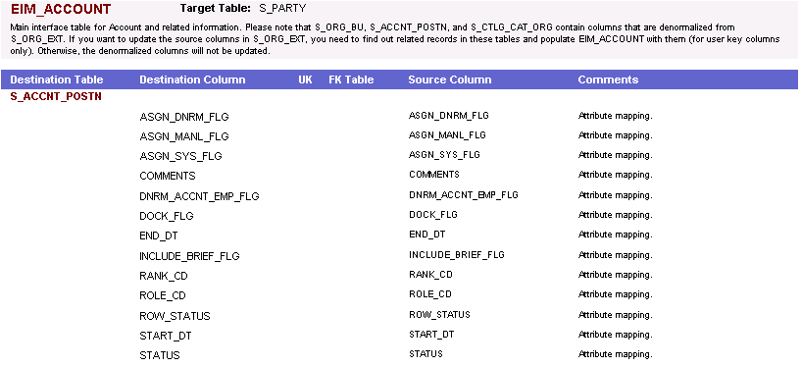
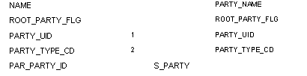
Interface Table Documentation Continued
The EIM Interface Table report shows mapping from a single EIM table to one or more Siebel base tables
  EIM column (source) to base table column (destination) mapping
  Column attributes (user keys, foreign key tables, required fields)
EIM table name
Base column
EIM column
Base table
Base table
Destination column attributes
Notes:
The best EIM table will be the one that allows you to populate the most data. You can use options to limit the target tables during the run. Therefore, having more targets or destinations than you need is an advantage. The graphic shows a modified screen capture of the EIM Interface Tables report generated in Siebel Tools and annotates how to read it.
Note: The graphic was modified in order to fit it on the slide.

Slide 18
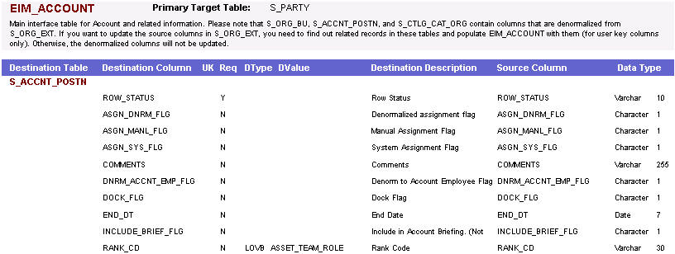
Select EIM Table
Select the EIM table that best maps to the target base tables and columns
  Pick the EIM table that maps the most columns that you need to migrate
Example:
  EIM_ACCOUNT can be used to map Account-related Position data because it maps to the intersection table S_ACCNT_POSTN
S_ACCNT_POSTN columns mapped by EIM_ACCOUNT

Slide 19
EIM to Base Mappings
Determine EIM columns that populate target base columns
Determine other EIM required columns to populate the target base table
  Other columns may be required based on required fields in the base table
EIM table
Base table
EIM column
Base column
Notes:
This is a positioning slide. The subsequent slides will show examples.
You want to determine which EIM columns map to your target columns. Then you must also supply “required” columns whether you want to populate those targets or not. Required means that the base table row will not be populated unless values are supplied in the EIM columns that map to the target columns. Required columns may be user keys or other columns.

Slide 20

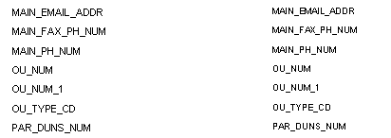
Determine EIM Columns
Determine which EIM column populates the target base column in Siebel Tools
  Example: MAIN_PH_NUM on EIM_ACCOUNT populates MAIN_PH_NUM on S_ORG_EXT
Base column
EIM column
Notes:
Notice that the column name on EIM tables is often the same as the column name on the base table, but not always.

Slide 21


Determine EIM Columns Continued
Alternate method is to query Attribute Mappings in Siebel Tools to determine which EIM column populates the base column
  Example: MAIN_PH_NUM on EIM_ACCOUNT populates MAIN_PH_NUM on S_ORG_EXT
Use Flat tab to query
Base table and column
Query
Result
EIM table and column
Notes:
You can also determine mappings using Siebel Tools. It may be quicker to search if you are not sure where to look in the documentation.

Slide 22
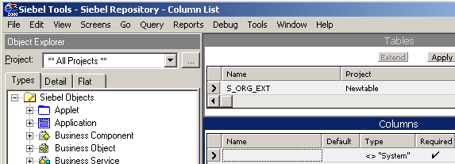
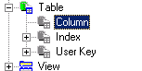
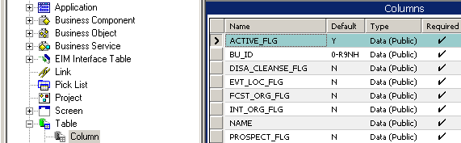
Determine Base Required Columns
Determine required base table columns that do not have defaults (EIM does not recognize non-system default values)
Query Column
Result = required base columns
Defaults not
recognized by EIM
Notes:
Using Siebel Tools to determine required columns is not as straight-forward as referencing the documentation. It is a two-step process. EIM does not recognize non-system default columns. In Siebel Tools, you can query for the required non-system columns. Notice that even though a default is specified and implemented in the database as a database constraint, EIM preprocesses data and does not recognize the default values.

Slide 23
Mapping Considerations
Understand how to enter organization data
  Fill in _BU column with name of the organization
  Leave _BI column blank
    Populated with foreign key during import processing
Understand additional columns that must be populated for party business components
  Use EIM Interface Table report to identify these
  Examples:
    PARTY_UID
    PARTY_TYPE_CD
    ROOT_PARTY_FLG
Notes:
This is important: In the EIM Interface Tables report within Siebel Tools, notice that for organization data, the documented mapping is to an EIM table column ending in “_BI” with datatype varchar (15).
For example, for the EIM_ACCOUNT table, the mapping to the S_ORG_EXT..BU_ID column is listed as ACCNT_BI. Instead of using the _BI column, use the corresponding _BU column, populating it with the name of the organization. EIM resolves to the foreign key during import processing. In the above example, you would use the ACCNT_BU column on EIM_ACCOUNT, populating it with the name of the organization, by default, “Default Organization”.

Slide 24
Mapping Considerations Continued
Be aware of access control and data visibility issues
  Set access control by:
    Importing ownership information, or
    Using assignment manager
  If ownership is not set or is set incorrectly, data visibility will be incorrect
Example:
  Import product information to Siebel database
    Product visibility is determined by organization
    Map product and ownership information to EIM_PROD_INT (Product interface table)
    Be sure to map from EIM_PROD_INT to both S_PROD_INT (Internal product base table) and S_PROD_INT_BU (Product/BU intersection table)
      Mapping documented in EIM Interface Table report

Slide 25
Module Highlights
Data mapping specifies:
  Which base tables and columns will hold external data
  Which interface tables and columns will be used by EIM during data movement
Steps to create data mappings for EIM:
  Map external entities to Siebel business-layer objects
  Use the Siebel Web Client to identify and verify mapping of external attributes to BC fields
  Select the interface table used by the mapping
  Use Siebel Tools’ EIM Interface Table report to perform column-to-column mappings between interface tables and base tables
  Map all external attributes of interest plus required non-system columns
Data mappings should be clearly documented
Notes:
Review Question: When mapping organization-related data, which column will you populate on the EIM table?
Answer: Fill in _BU column with name of the organization. Leave the _BI column blank.
Review Question: What is the first step in determining your data mapping?
Answer: Analyze external source data and look at the attributes that need to be stored, identify the entity that the collection of attributes represent and identify the relationship(s) between entities.

Slide 26
Lab
In the lab you will:
  Map external solutions data to EIM tables and base tables
  Map external product data to EIM tables and base tables
Notes:
See lab instructions for details.

