Slide 1

Module 51: Running Enterprise Integration Manager
0/5
Siebel 8.0 Essentials
Notes:
Time: Lecture: <n – n> minutes; Labs: <n – n> minutes
Intent: <What is the instructional goal of the module>
Flow: < Describe at a high level the overall flow of the module>.
Key Terms: <List terms the instructor should be familiar with in order to teach this module>
<Term>
<Term>
<Term>
<Term>

Slide 2
Module Objectives
After completing this module you should be able to:
  Populate interface (EIM) tables for imports
  Modify configuration (.ifb) files for imports
  Invoke an Enterprise Integration Manager (EIM) server task
  Modify configuration (.ifb) files to optimize imports
Why you need to know:
  To successfully import external data into the Siebel database

Slide 3
Interface Table Structure
All interface tables have three required columns:
  IF_ROW_BATCH_NUM and ROW_ID are set by the user to uniquely designate a record
  IF_ROW_STAT is used by EIM to return status after an EIM run
Number to identify all records that should be processed in the batch
Unique number to identify the record in the batch
Non-null character value that is reset during the run
IF_ROW_BATCH_NUM | Row_ID | IF_ROW_STAT | NAME
100 | 1 | IMPORTED | Photocopier
100 | 2 | IMPORTED | Fax Machine
200 | 1 | IMPORTED | Shredder
200 | 2 | IMPORTED | Toner Cartridge
If import job is successful, system sets value to IMPORTED

Slide 4
Running an EIM Task for Data Imports
0/5
1. Populate EIM Tables
2. Determine Processing Order
3. Run an EIM Task
4. Verify EIM Task Results
5. Remove Data from EIM Tables

Slide 5
1. Populate EIM Tables
1/5
Populate source data into EIM tables using a non-Siebel process
  Use database vendor utilities to load data from flat files
  Use SELECT INTO to pull data from other SQL databases
  Use direct SQL insert, update, or delete statements to update columns in EIM tables
  Use SQL queries to verify that EIM tables populated correctly
External data
EIM_PROD_INT
Non-Siebel process

Slide 6
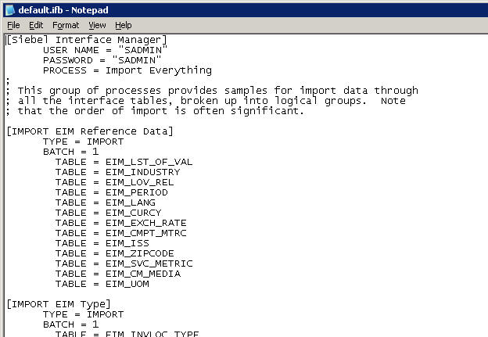
2. Determine Processing Order
2/5
Determine the correct processing order for EIM tables
  When importing, tables referenced via foreign key must be
  loaded first
  Refer to the default.ifb for recommended processing order
Order of imports

Slide 7
3. Run an EIM Task
3/5
Creates an operating system (OS) process that reads the .ifb file, loads the dictionary, executes EIM steps, and writes log entries
Dictionary
.ifb
EIM Server Component
Log

Slide 8
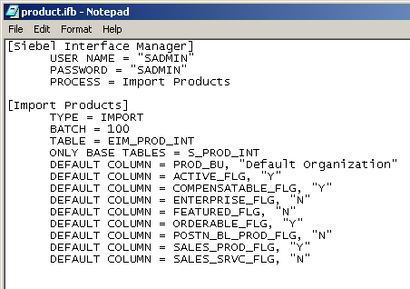
3. Run an EIM Task Continued
3/5
Direct the execution of an EIM task using a configuration (.ifb) file
  Specifies the batch, order, and type of processing
  Use default.ifb as a template
Section to process
IF_ROW_BATCH_NUM value (rows to process)
Destination table
EIM table
Default column values

Slide 9
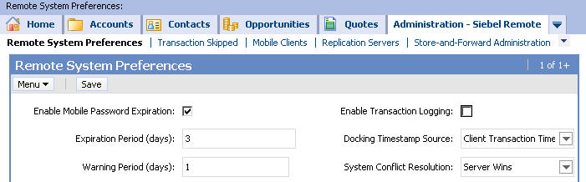
3. Turn Off Transaction Logging
3/5
Siebel Remote logs transactions to allow synchronization of mobile clients
Transaction logging reduces EIM performance
  Before initial loads, turn off logging
    Navigate to Administration – Siebel Remote > Remote System Preferences
  After initial loads, turn on logging to support mobile clients
    Turning off transaction logging in a running production system will require subsequent re-extraction of all mobile user databases
Logging disabled during initial loads

Slide 10
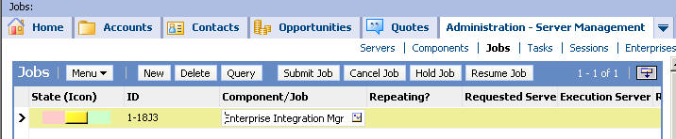
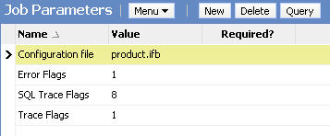
3. Create and Run an EIM Job
3/5
Navigate to Administration - Server Management > Jobs
3. Click Submit Job
1. Create a new job and select Enterprise Integration Manager
2. Specify job parameters, including EIM configuration file

Slide 11
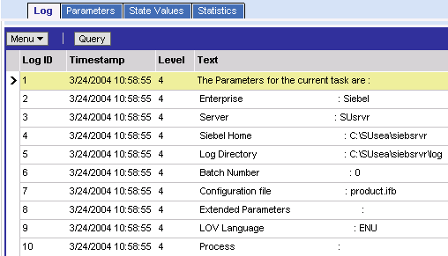
3. Monitor the EIM Task
3/5
Navigate to Administration - Server Management > Tasks
  Query to view progress
  Review Task Information Log
Log displays diagnostic information, including task parameters

Slide 12
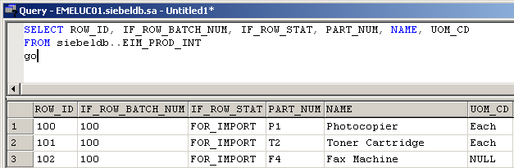
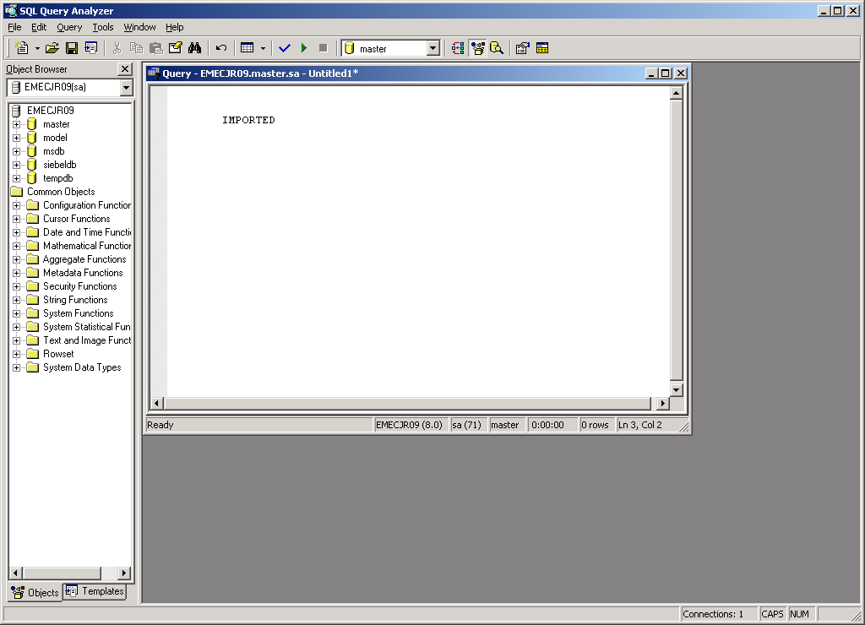

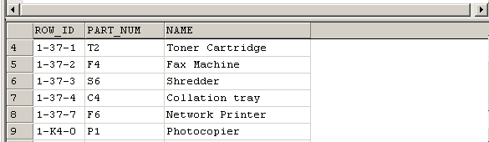
4. Verify EIM Results
4/5
Run SQL SELECT statements to verify the table data
Select from EIM table
Select from base table

Slide 13
4. Verify EIM Results Continued
4/5
After import, IF_ROW_STAT will contain a value that describes the status of each imported row
IF_ROW_STAT Value
Description
IMPORTED
Success for all destination tables
PARTIALLY_IMPORTED
Success for target base table; failure for
secondary table
REQUIRED_COLS
Failed because required column has
NULL value
DUP_RECORD_EXISTS
Failed because target table has row
with same values
FOREIGN_KEY
Failed because a required foreign key
could not be resolved
PICKLIST_VALUES
Failed because required picklist value not
found in S_LST_OF_VAL

Slide 14
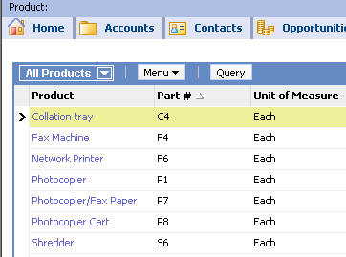
4. Verify EIM Results Continued
4/5
Verify imported data in the application using appropriate views
  Example: Products > Internal Product List
Verify that products were imported successfully

Slide 15
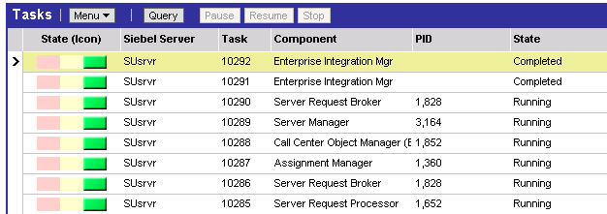
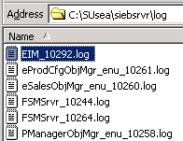
4. Verify EIM Results Continued
4/5
For troubleshooting:
  Navigate to Administration – Server Management > Tasks
  Find task number for EIM task
  Examine log file in Siebel server log directory
Find EIM task number
Examine task log file

Slide 16
4. Verify EIM Results Continued
4/5
Job parameters can override component-level event logging to create additional information in the log
  Trace Flags = 1
    Records processing steps
  SQL Trace Flags = 8
    Records summary SQL
    Should only be done in test
    environment
    Dramatically impedes EIM
    performance and generates
    large log file
  Error Flags = 1
    Records details regarding
    failed rows
EIM logging flags used for troubleshooting

Slide 17
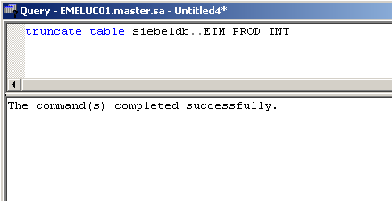
Remove Data from EIM Tables
5/5
You are responsible for removing records from the EIM tables
  Use SQL to delete EIM table records once they have been successfully processed

Slide 18
Additional Configuration (.ifb) Parameters
0/3
Use enhanced configuration parameters to speed EIM processing and reduce elapsed time:
Process Options
Import Options
Primaries

Slide 19
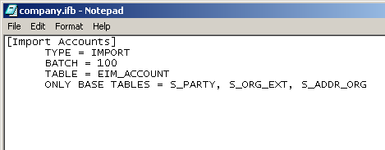
Process Options
1/3
Explicitly include or exclude tables and columns to avoid unnecessary processing
  Use ONLY BASE TABLES, ONLY BASE COLUMNS
  or
  Use IGNORE BASE TABLES, IGNORE BASE COLUMNS
Example:
Directs task to process only these target tables

Slide 20
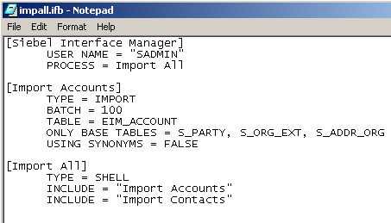
Process Options Continued
1/3
Set options to control processing and enhance performance
  Set USING SYNONYMS to FALSE to avoid unnecessary processing
    USING SYNONYMS applies to accounts only
  Use SHELL to process multiple EIM tables/sections in a single run
Example:
Directs task to ignore account synonyms

Slide 21
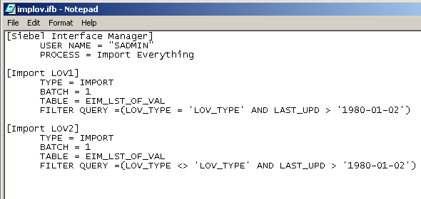
Import Options
2/3
Set options to preprocess EIM rows and columns
  Use FILTER QUERY to select a subset of EIM rows for processing
  Use DEFAULT COLUMN or FIXED COLUMN to set values for EIM columns
Example:
EIM column, operator, and value

Slide 22
Primaries
3/3
Improve performance by eliminating sub-queries when displaying data from parent and child tables
If primaries are not used, a new query needs to be executed to identify any child records each time a parent record is displayed
Two types of Primary settings:
  Explicit Primary
  Implicit Primary

Slide 23
Set Primaries: Explicit Primaries
3/3
Use the Primary flag to set explicit primaries through EIM
  Use when the external system knows which child should be primary
EIM table column for primary
EIM table
EIM_ACCOUNT
NAME ADDR_ADDR ADDR_CITY ACC_PR_ADDR
Acme Elm Street Boston
Acme Main Street Fremont Y
Columns
Set the PFK to point to this child data
S_ORG_EXT
ROW_ID NAME PR_ADDR_ID
1-WEZ Acme 2-AB4
S_ADDR_ORG
OU_ID ROW_ID ADDR CITY
1-WEZ 2-AB8 Elm Street Boston
1-WEZ 2-AB4 Main Street Fremont
Base tables

Slide 24
Set Primaries: Implicit Primaries
3/3
Allow EIM to implicitly set primaries
  Use when the external system does not know the primary
  Sets the primary to be the child with the lowest ROW_ID
  Mimics auto primary in the application
EIM table
EIM_ACCOUNT
NAME ADDR_ADDR ADDR_CITY
Acme Elm Street Boston
Acme Main Street Fremont
Columns
Base table
S_ORG_EXT
ROW_ID NAME PR_ADDR_ID
1-WEZ Acme 2-AB8
S_ADDR_ORG
OU_ID ROW_ID ADDR CITY
1-WEZ 2-AB8 Elm Street Boston
1-WEZ 2-AB4 Main Street Fremont
Base table

Slide 25
Using EIM with Database Modifications
To populate base table extension columns through EIM:
  Add an extension column to the EIM table
  Map the EIM column to the base column
  Test the mapping by running EIM on the server
Use the Interface Table Mapping Wizard
EIM table
Base table
EIM Extension Column
Base Extension Column

Slide 26
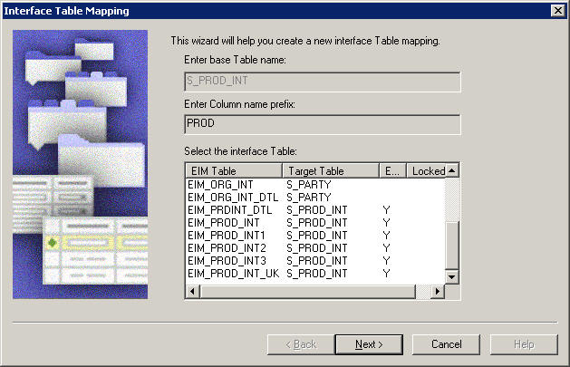
Using EIM with Database Modifications Continued
Update EIM table mappings to include columns or tables you have added using the Interface Table Mapping Wizard
Select the table in Tools, right-click, select EIM Table Mapping… and complete the wizard

Slide 27
Module Highlights
All EIM tables have three special columns:
  IF_ROW_BATCH_NUM
  ROW_ID
  IF_ROW_STAT
EIM import steps are:
  Populate EIM tables
  Create an EIM configuration file (.ifb)
  Run an EIM job
  Verify job results
  Remove EIM table records
Parameters that can speed EIM processing:
  No transaction logging
  Process and import options in .ifb file
Can set primaries during EIM import

Slide 28
Lab
In the lab you will:
  Load solutions data into the interface table
  Import solutions data from the interface table to base table
  Load company data into the interface table and import it to the base table

