Slide 1

Module 52: Introducing Application Deployment Manager
0/5
Siebel 8.0 Essentials
Notes:
Time: Lecture: <n – n> minutes; Labs: <n – n> minutes
Intent: <What is the instructional goal of the module>
Flow: < Describe at a high level the overall flow of the module>.
Key Terms: <List terms the instructor should be familiar with in order to teach this module>
<Term>
<Term>
<Term>
<Term>

Slide 2
Module Objectives
After completing this module you should be able to:
  Describe the Application Deployment Manager (ADM) architecture
  Describe how deployment options are configured
Why you need to know:
  ADM provides a framework to deploy application customizations efficiently and predictably
Notes:
Each objective and “why you need to know” should be stated aloud.

Slide 3
Business Challenge: Application Migration
Deploying a customized Siebel application typically involves:
  A development enterprise (a collection of Siebel servers), where customizations are created
  A QA/test enterprise used to test application functionality
  One or more production enterprises that require tested and stable software
    May involve many production Siebel enterprises
The migration of customizations may be very complex:
  May involve hundreds of customizations
  Source and target enterprises may have different configurations
    Development enterprise may be simpler than test enterprise
  Customizations may have dependencies on each other
    Example: A new state model needs to be deployed after the modified business component object definition the model uses
  Development and testing often occur concurrently

Slide 4
Business Solution: Application Deployment Manager (ADM)
Is a framework for deploying application customizations to a target Siebel enterprise
Is designed to provide an extensible facility for quick, reproducible deployment of a wide range of customizations
  Includes support for many data types
  Supports deployments ranging from a small patch with only a handful of application modifications to a major release with a new SRF file
  Allows creation of reusable deployment packages that can be applied to multiple target enterprises

Slide 5
Types of Customization
0/3
ADM recognizes three types of application customizations:
  Database customizations
  Repository customizations
  File customizations
The steps to export and deploy each type differ

Slide 6
Database Customizations
1/3
Are changes to administrative and master data records in the Siebel database
  Does not include repository table changes
  Use EIM to migrate application records, such as Accounts, Contacts, Opportunities
ADM supports deployment of many data types, including:
  Lists of Values (LOVs)
  User Lists
  Assignment Rules
  Access Groups

Slide 7
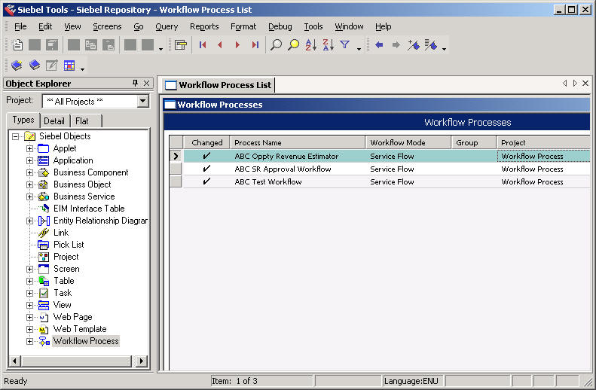
Repository Customizations
2/3
Are changes to object definitions made in Siebel Tools
New or modified repository objects

Slide 8
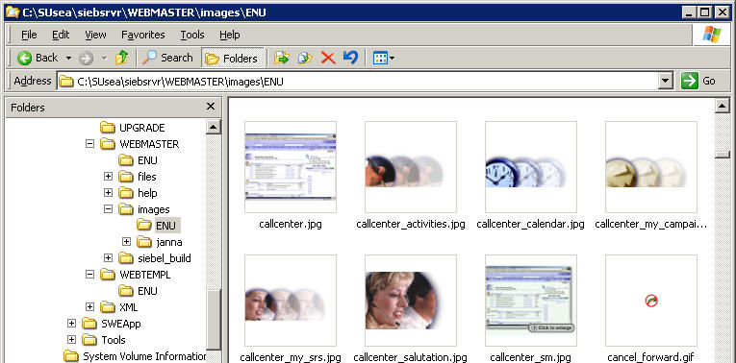
File Customizations
3/3
Are files modified as part of application configuration
Examples:
  Web Template files (.swt)
  Image and Cascading Style Sheet (CSS) files
  Siebel Repository file (.srf)
  Reports files
Example: image files

Slide 9





ADM Architecture
0/3
The three major parts of the ADM architecture are the:
  Source enterprise
  Orchestration environment
  Destination enterprise(s) (can be multiple targets)
Deployment package
Deployment Package
Source
Enterprise
Orchestration
Environment
Destination
Enterprise

Slide 10
Source Enterprise
1/3
Is the Siebel enterprise containing modifications to be deployed
  Example: a development enterprise
Source enterprise components related to ADM include:
  Siebel client and Siebel Tools functions to export customizations
  A packager utility to bundle application customizations
Source
Enterprise
Orchestration
Environment
Destination
Enterprise

Slide 11
Orchestration Environment
2/3
Is a system used to execute ADM deployment
Orchestration environment components include:
  The Siebel Management Server
  A database containing records on all deployments and data types contained in ADM packages
  An ADM command line interface (CLI)
  An ADM registry file
  A target enterprise profile file, which describes the target environment and deployment steps
Command line interface
Deployment package
Orchestration
Environment

Slide 12
Orchestration Environment Continued
2/3
Siebel Management Server is a service that supports:
  The ADM orchestration environment
  The Diagnostic Tool, which allows performance measurement of Siebel servers
Siebel Management Server is the primary component of ADM orchestration environment

Slide 13
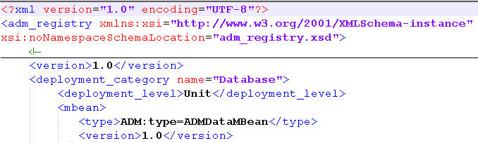
Orchestration Environment Continued
2/3
The enterprise profile file:
  Specifies target enterprise parameters
  Is used to configure deployment options
  Is discussed later in this module
The ADM registry file:
  Lists data types supported by ADM
  Defines ADM operations for each data type
  Defines deployment validation rules
  Is usually not modified
ADM registry file

Slide 14
Destination Enterprise
3/3
Is the target for deployment using ADM
  Example: a QA/test Siebel enterprise
  Can be multiple destination enterprises
Source
Enterprise
Orchestration
Environment
Destination
Enterprise

Slide 15
Destination Enterprise Continued
3/3
Destination enterprise components for ADM include:
  A Siebel Management Agent for each Siebel Server in the target enterprise
  ADM server components on each Siebel Server
Siebel Management Agent is a service that runs in combination with a Siebel Server and provides support for Management Server requests
Siebel Management Server
Orchestration Environment
Siebel Mgmt
Agent
Siebel Mgmt
Agent
Siebel Mgmt
Agent
Destination
Enterprise
Siebel Server
Siebel Server
Siebel Server

Slide 16
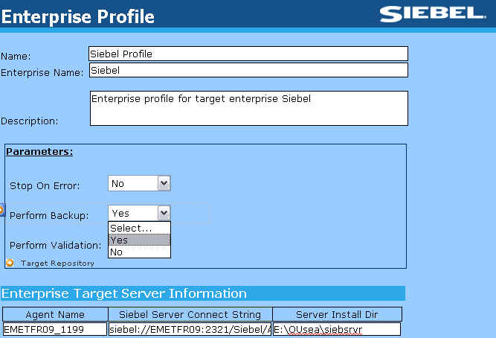
ADM Enterprise Profile File
The enterprise profile file contains:
  Parameters that specify target enterprise configuration
  Parameters that control deployment orchestration
Parameters that describe target enterprise configuration include:
  Siebel Server connect string(s)
  Siebel Management Agent name(s) and port number(s)
Enterprise profile file opened in Microsoft InfoPath

Slide 17
ADM Enterprise Profile File Continued
Complex deployments can be customized by setting parameters to control:
  Deployment sequence (some deployment units have dependencies)
    Example: A modified assignment object may need to be deployed before a new assignment rule
  Serial versus parallel deployment
    ADM supports parallel deployment of file and database type customizations
  Staging
    Specifies deployment groupings by deployment unit or group, target Siebel server, or a collection of servers
  Stop on error
    Sets behavior of deployment on error

Slide 18
Module Highlights
ADM may be used to move Siebel application modifications from a development environment to a test environment
  Database changes (LOVs, assignment rules, and so on)
  Repository changes (objects definitions, workflows, and so on)
  Files changes (Web templates, CSS files, .srf files, and so on)
The ADM architecture includes components on:
  Source environment
  Orchestration environment
  Target environment
Advanced deployment options are set by modifying the enterprise profile file EntProfile_<EnterpriseName>.xml
Notes:
Review Question: <Question>
Answer: <Answer>

