Slide 1

Module 53: Deploying Application Customizations
0/5
Siebel 8.0 Essentials
Notes:
Time: Lecture: <n – n> minutes; Labs: <n – n> minutes
Intent: <What is the instructional goal of the module>
Flow: < Describe at a high level the overall flow of the module>.
Key Terms: <List terms the instructor should be familiar with in order to teach this module>
<Term>
<Term>
<Term>
<Term>

Slide 2
Module Objectives
After completing this module you should be able to:
  Use the packager utility to bundle application customizations
  Deploy a package using the ADM command-line interface
Why you need to know:
  ADM provides a framework to deploy application customizations efficiently and predictably
Notes:
Each objective and “why you need to know” should be stated aloud.

Slide 3
Steps in Using ADM
0/6
Identify All Customizations to Deploy
Export Database Customizations
Export Repository Customizations
Move File Customizations
Create an ADM Package
Deploy the Package
Notes:
This is a structuring slide for <insert what will be discussed>. Do not teach the steps or concepts here because the following slides cover them in detail. Provide a high level description of what will be discussed.

Slide 4
Identify All Customizations to Deploy
1/6
The first step in planning the deployment of application customizations is to identify changes
  Examination of software configuration management or development logs may suffice
Identify repository customizations within Siebel Tools:
  Use Tools > Compare Objects to compare objects and/or archives
  Generate a mid-level release (covered later in this module)
Identify database changes using the Siebel client or development logs
Determine file changes using operating system (OS) timestamps or third-party tools like diff

Slide 5
Identify All Customizations to Deploy Continued
1/6
Analyze data dependencies to ensure successful deployment
  Some ADM supported data types (parent types) are dependent on other data (child types)
  Deploy parent types after child types
  Examples:
    User List depends on Users
    Access Group depends on User Lists
    State Model depends on List of Values
Specify the order of deployment before exporting database changes using the Siebel client (covered later in this module)

Slide 6
Export Database Customizations
2/6
Use the Siebel Web Client to export database modifications to files suitable for ADM packaging
  Example: Export a collection of new User Lists
Exported files include:
  A file containing the exported data (XML)
  A descriptor file (XML)
  A log file giving export details and status
To export database changes:
  Create and enable a deployment project
  Specify data dependencies
  Create and deploy a deployment session

Slide 7
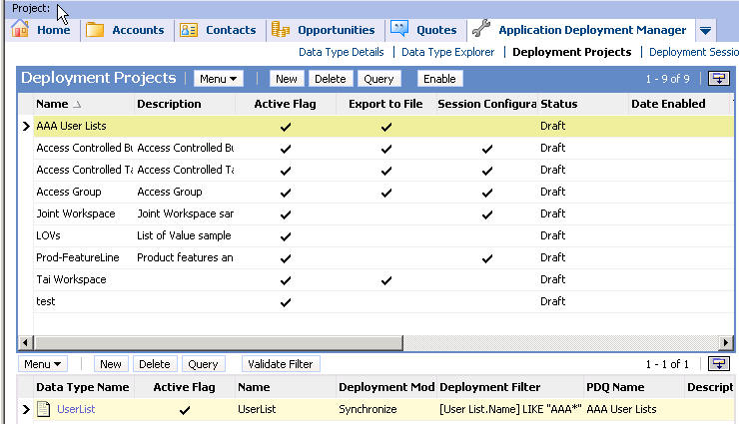
Export Database Customizations Continued
2/6
Navigate to Application Deployment Manager > Deployment Projects
Create, specify, and enable a deployment project
  A deployment project is a specification of data to deploy
1. Specify Name and Export to File
4.Enable project
3. Specify a deployment filter to limit records exported
2. Specify Data Type Name

Slide 8

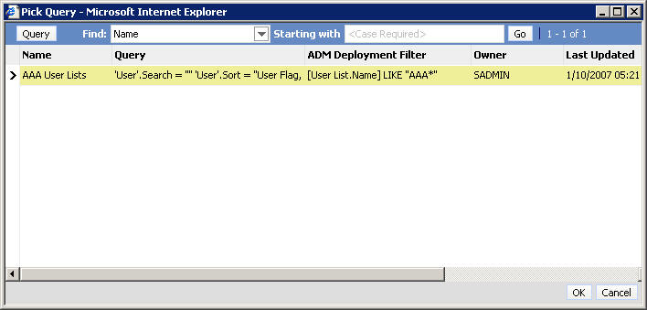
Export Database Customizations Continued
2/6
Use a deployment filter to limit the records to be exported:
  Save a query that selects the records to be exported
    Example: Save a query that selects User Lists with Name = “AAA*”
  In the ADM Deployment Projects view, enter saved query name in the Deployment Filter field
Data types applet in Deployment Projects view
Select saved query

Slide 9
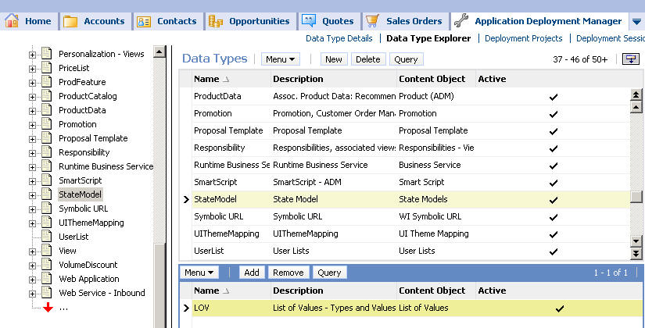
Export Database Customizations Continued
2/6
Determine order of data type deployment in the Application Deployment Manager > Data Type Explorer view
Select parent data type in the Data Types applet, then add child type in child applet
State Model (parent) type…
…depends on LOV (child) type

Slide 10
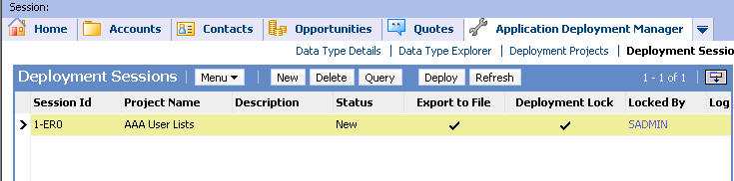
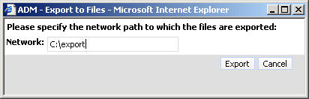
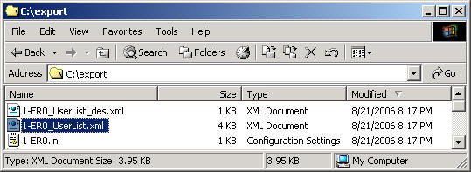
Export Database Customizations Continued
2/6
Navigate to Application Deployment Manager > Deployment Sessions
Create a new session and specify project name
Deploy the session
  Select Export to File, then specify export destination
2. Click Deploy
3. Specify export path
1. Select Project Name
4. File prefix is Session Id

Slide 11
Export Repository Customizations
3/6
Use Siebel Tools to export repository customizations
Files created during export include:
  A .sif file containing the changes
  A deployment descriptor file (XML)
  A log file of export steps and status
Tools offers two methods for exporting customizations:
  Hot fix: typically a small set of hand-selected modifications
  Mid-level release: repository changes after a specified cutoff date
    List of objects may be edited after it is generated

Slide 12
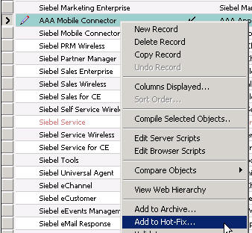
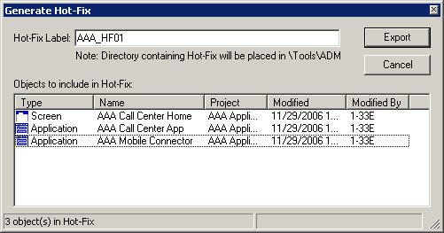
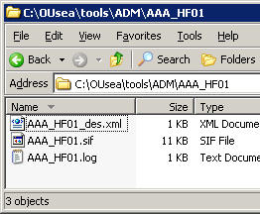
Export Repository Customizations Continued
3/6
To create a hot fix in Siebel Tools:
  Select the object definition to add to the hot fix
  Right-click and select Add to Hot-Fix
  Specify a name for the hot fix
  Return to Tools’ Object Explorer and List Editor to add additional object definitions
  When done, click Export
    Hot fix output is saved in …\Tools\ADM\<HF Name>

Slide 13
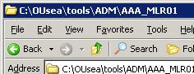
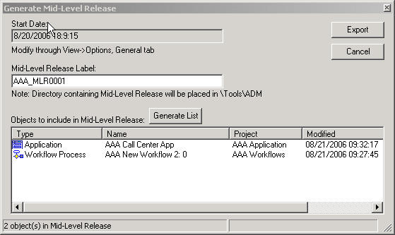
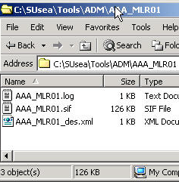
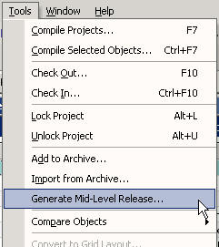
Export Repository Customizations Continued
3/6
To create a mid-level release in Siebel Tools:
  Navigate to View > Options > General and set Changed Date to specify the cutoff date for the release
  Select Tools > Generate Mid-Level Release
  Provide a name for the release and click Generate List
  Verify list contents and delete entries if necessary
  Click Export
    Package is created in …\Tools\ADM\<MLR name>
Objects modified since Start Date

Slide 14
Move File Customizations
4/6
File type customizations do not need to be exported using the Siebel client or Siebel Tools
  Move files to the correct directory in the package tree (discussed later)
The type for a custom Siebel Repository File (.srf) is File, not Repository

Slide 15
Create an ADM Package
5/6
An ADM package is a collection of application customizations and includes:
  A directory structure that organizes different types of customization (database, repository, and file )
  An ADM package descriptor file describing its contents
ADM includes a utility, admpkgr, which can create and verify an ADM package
  Runs from command line
  ADM packager syntax:
  % admpkgr <init | generate | validate> <pkg_name>
Steps to create a package:
  Create an empty package structure
  Populate the package directory structure
  Generate the package descriptor file
  Validate the package

Slide 16
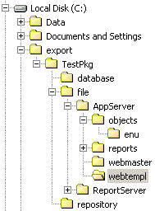
A. Create an Empty Package
5/6
Invoke admpkgr with the init command to create an empty package directory structure
Command syntax:
  % admpkgr init <package name with path>
Example:
Empty package directory structure
Package location

Slide 17
B. Populate the Package Directory Structure
5/6
Database and repository exports and file modifications need to be moved to the new package directory tree
  For database type, move the .xml file containing data + descriptor file
  For repository type, move the .sif file + the descriptor file
  For file type modifications, the package sub-directory depends on the file category:
    Repository file (.SRF): <pkgdir>\file\AppServer\objects\<lang>
    Web templates: <pkgdir>\file\AppServer\webtempl\<lang>
    Images, CSS files, browser script files: <pkgdir>\file\AppServer\webmaster\<lang>
    Report files: <pkgdir>\file\ReportServer\<lang>
Unused package sub-directories should be deleted

Slide 18

C. Generate the Package Descriptor File
5/6
Invoking admpkgr with the generate command:
  Validates package directory contents
  Calculates a checksum to ensure future integrity of the package
  Creates a package descriptor file for the package
Command syntax:
  % admpkgr generate <package name with path>
Example:
Package descriptor file

Slide 19
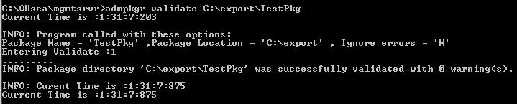
D. Validate the Package
5/6
Invoking admpkgr with the validate command:
  Verifies the existence and format of package descriptor file
  Checks for empty folders and redundant units
  Performs consistency checks for units
  Checks for the existence of valid unit files and descriptor files for database and repository types
Using validate is optional
Command syntax:
  % admpkgr validate <package name with path>
Example:

Slide 20
Deploy the Package
6/6
The ADM command-line interface (CLI) command set is executed on the Management Server host
  Commands contained in a batch file created by a Perl script bundled with the Management Server
  Batch file is named deploy_<enterprise name>.bat
    Example: if enterprise name = Siebel, then ADM CLI batch file is named deploy_Siebel.bat
    Typically created in …\<mgmt server install dir>\bin
ADM commands take command-line arguments:
  Command name
  User name
  Password
  Package name
  Optional switches

Slide 21
Deploy the Package: Commands Overview
6/6
The ADM CLI supports both required and optional commands
Commands execute in a specific order
Management
Server
Target
Enterprise
valent
delete
restore_activate
load
acknowledge
restore_copy
create
status
restore_session
validate
activate
backup
required
copy
optional
covered in this course

Slide 22




Deploy the Package: Load
6/6
Call load command to put references to package contents into the orchestration environment’s database
  Validates package structure and checksum
  Uses package descriptor file to map package contents to Management Server database
  Command syntax:
  deploy_<enterprise> load <user> <password> <package name>
  Example:
User/password
Package name
Source
Enterprise
Orchestration
Environment

Slide 23

Deploy the Package: Create
6/6
Call create to initiate a deployment session
  Command syntax:
  deploy_<enterprise> create <user> <password> <package name>
  Example:
New
Session
Orchestration
Environment

Slide 24
Deploy the Package: Copy
6/6
Call copy to move package contents to destination enterprise
  Uses the appropriate copy method for each type of customization
    Repository changes are copied to target repository
    Database changes are loaded into target database
    File changes are moved to correct location in target file system
  Command syntax:
  deploy_<enterprise> copy <user> <password> <package>
  Example:
Orchestration
Environment
Destination
Enterprise

Slide 25
Deploy the Package: Activate
6/6
Call activate to perform any steps required to make customizations available to users
  Most data types do not require activation
    Example: Proposal Template
  Activation examples:
    LOV activation clears the LOV cache
    Workflow process activation sets the process to Active
    Image, CSS file, or Web template file activation propagated to Web server
  Command syntax:
  deploy_<enterprise> activate <user> <password> <package name>
  Example:

Slide 26
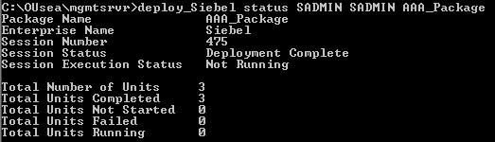
Deploy the Package: Status and Acknowledge
6/6
Call status to get information about the deployment status of a package
  Gives a summary of deployment status of units in the package
  Use status_detail to see status information for each unit
To complete a command-line deployment, call acknowledge:
  Ends deployment session
  Sets session status to complete in Management Server local DB
  Removes backup package data from Management Server DB
Status example:

Slide 27
Deploy the Package: Other Commands
6/6
Other optional ADM CLI functions include:
Command | Description
valent | Validates enterprise profile file
validate | Performs checks on target enterprise before deployment
backup | Creates backup copy of target enterprise data that will be affected by deployment
restore_session, restore_copy, restore_activate | Sequence of commands that allows rollback of a deployment
list | Lists packages deployed by Siebel Management Server
delete | Deletes package references and session info from Siebel Management Server

Slide 28
Module Highlights
Export application customizations using:
  Siebel Tools for repository modifications
  The ADM screen in the Siebel client for database modifications
  File copy into package for file modifications
Use the ADM packager utility to bundle modifications for deployment to the target enterprise
Execute commands from the ADM CLI to deploy an ADM package:
  Load the package
  Create a deployment session
  Copy the package to the target environment
  Activate the customizations (optional)
  Status to verify correct deployment
  Acknowledge to end the deployment session
Notes:
Review Question: <Question>
Answer: <Answer>

Slide 29
Lab
In the lab you will:
  Export repository and database customizations
  Create an ADM package
  Use the ADM CLI to deploy this package
Notes:
Labs and Troubleshooting:
<Summarize the tasks the students will perform in this lab. Suggest specific guidance the instructor may provide if necessary to help the students complete the lab and avoid trouble spots.>

