Slide 1
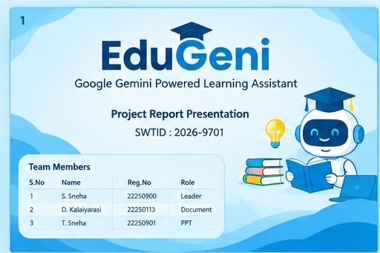

Slide 2
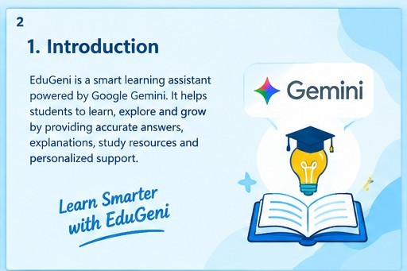

Slide 3
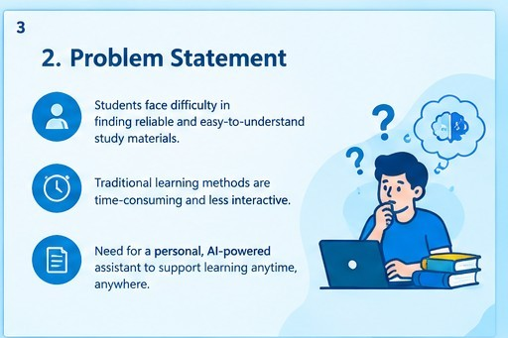

Slide 4
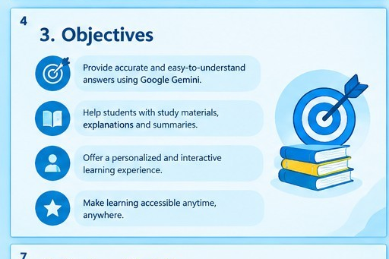

Slide 5
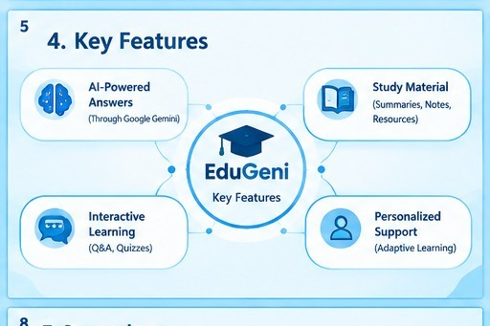

Slide 6
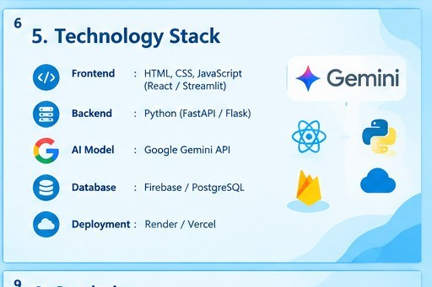

Slide 7
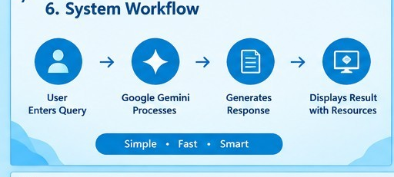

Slide 8
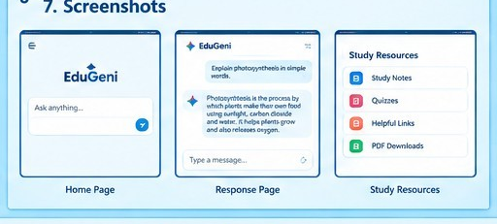

Slide 9
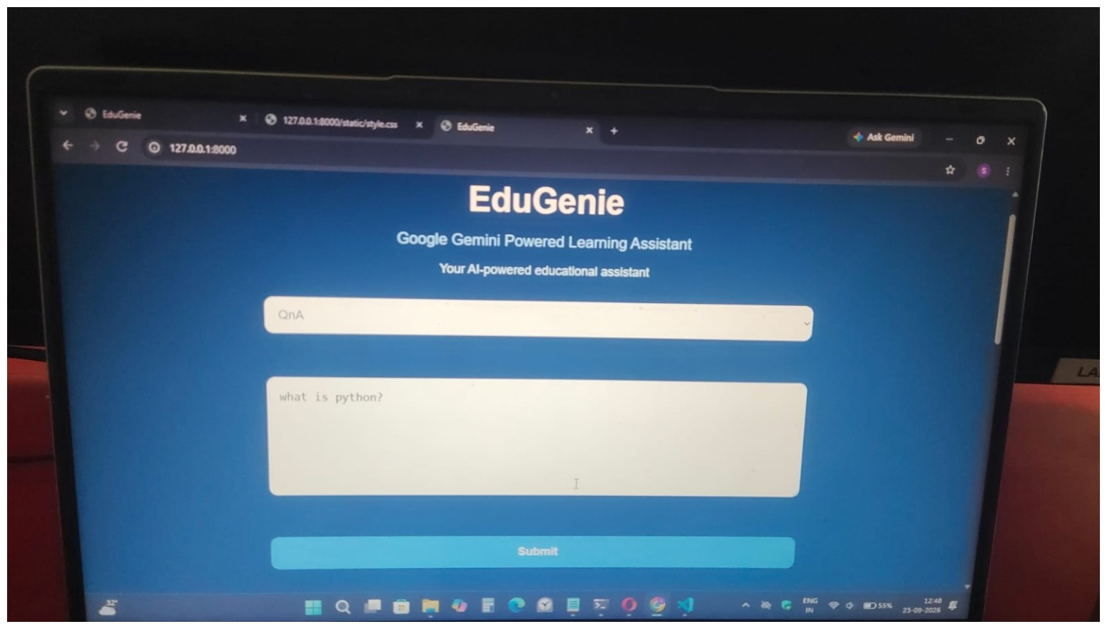

9. Output
EduGenie – Learn Today, Lead Tomorrow

Slide 10
“Learning is not just about
getting answers. It’s about
finding the right questions.”
Thank You!
Questions?
📖 EduGeni
Google Gemini Powered Learning Assistant
EduGeni – Learn Today, Lead Tomorrow

