Slide 1

LOVELY PROFESSIONAL UNIVERSITY JALANDHAR,PUNJAB SIX WEEK TRAINING ON MICROLEARNING IN DATA SCIENCE
SUBMITTED BY:
NAME : SNEHA SINGH
REGISTRATION NO.:11808742

Slide 2
TOPICS COVERED
INTRODUCTION TO DATA SCIENCE
BUSINESS ANALYTICS WITH EXCEL
DATA VISUALIZATION WITH TABLEAU
MATHS FOR DATA SCIENCE
ADVANCED SQL
PYTHON FOR DATA SCIENCE
DEEP DRIVE INTO MACHINE LEARNING

Slide 3

WHAT IS DATA SCIENCE??

Slide 4
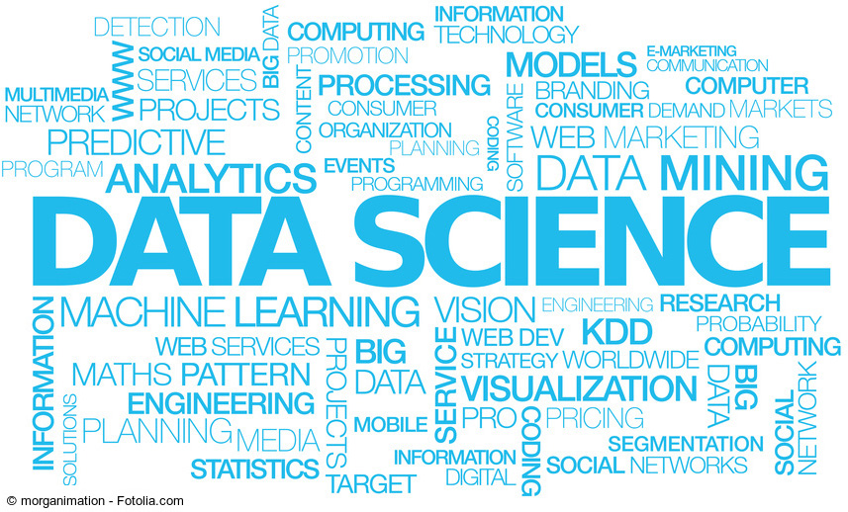
Data science provides meaningful information based on large amounts of complex data or big data. Data science, or data-driven science, combines different fields of work in statistics and computation to interpret data for decision-making purposes.

Slide 5
ASPECTS OF DATA SCIENCE
PREDICTIVE ENGINE
DATA VISUALIZATION
DATA ANALYSIS
SERIES DATA ANALYSIS
UNSTRUCTURED DATA ANALYSIS
SIMULATION – DETERMINISTIC AND PROBABILISTIC, AND OPTIMIZATION
DEEP LEARNING

Slide 6
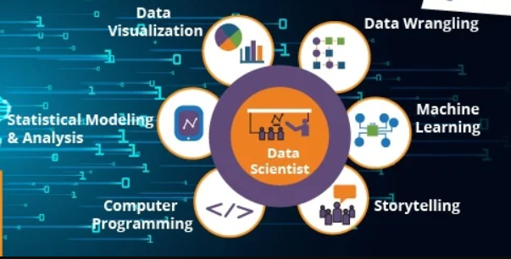
ROLE OF DATA SCIENTIST
DATA VISUALIZATION
DATA ANALYSIS
STORY TELLING
PROGRAMMING

Slide 7
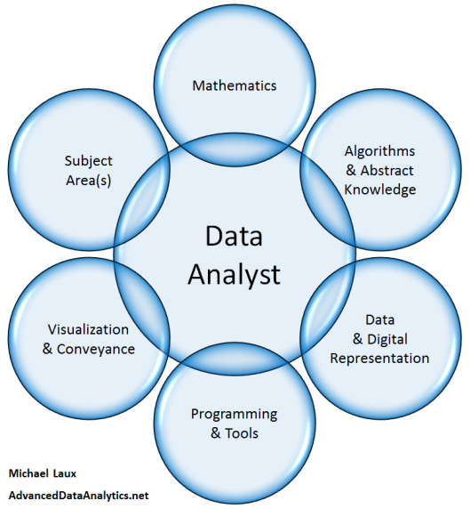

Slide 8
TOOLS USED
EXCEL
TABLEAU
JUPYTER
SCKIT-LEARN
MATPLOTLIB

Slide 9
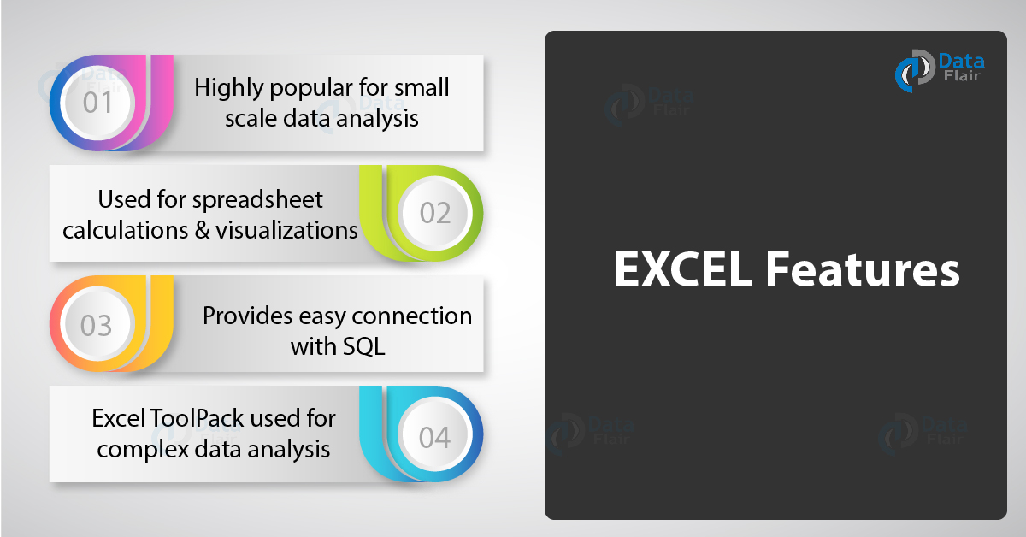

Slide 10
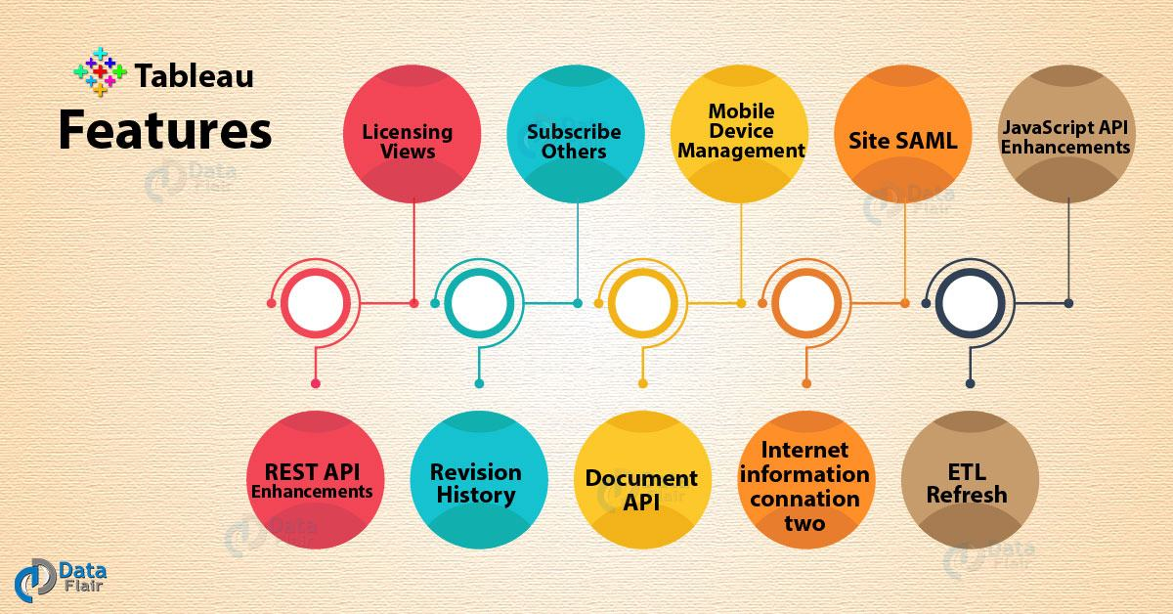

Slide 11
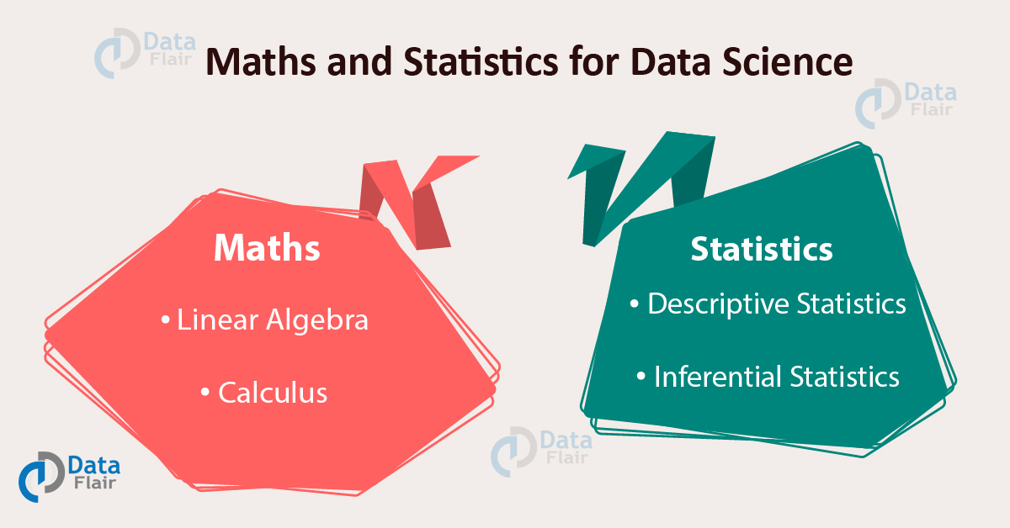
MATHS FOR DATA SCIENCE
PROBABILITY
STATISTICS
LINEAR ALGEBRA

Slide 12
Mathematics is very important in the field of data science as concepts within mathematics aid in identifying patterns and assist in creating algorithms. The understanding of various notions of Statistics and Probability Theory are key for the implementation of such algorithms in data science.

Slide 13
MACHINE LEARNING IN DATA SCIENCE
Machine learning is a method of data analysis that automates analytical model building. It is a branch of artificial intelligence based on the idea that systems can learn from data, identify patterns and make decisions with minimal human intervention

Slide 14
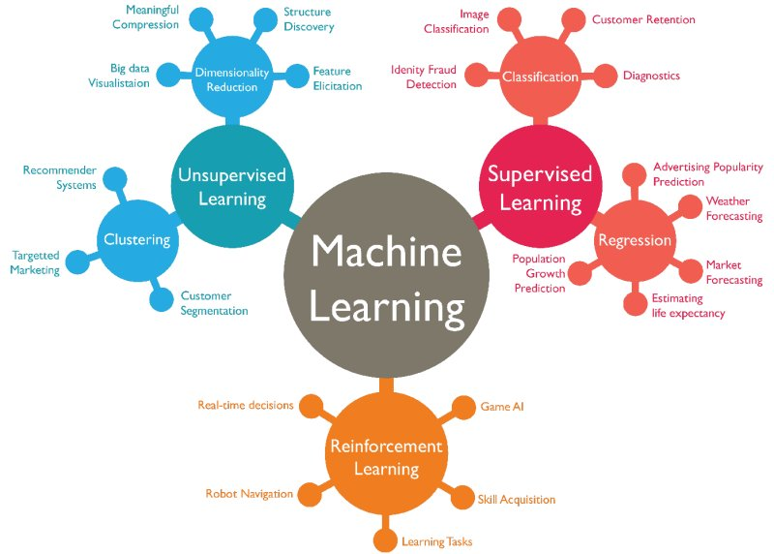
MACHINE LEARNING ALGORITHMS USED IN DATA SCIENCE

Slide 15
PROJECTS

Slide 16
UNIVERSITY DASHBOARD
IN THIS PROJECT I HAVE MADE THIS PROJECT IN EXCEL BY USING DIFFERENT EXCEL PROPERTIES.
PIVOT TABELS
SLICERS
PIE CHART
BAR GRAPH
HISTOGRAM
REPORT CONNECTIONS

Slide 17
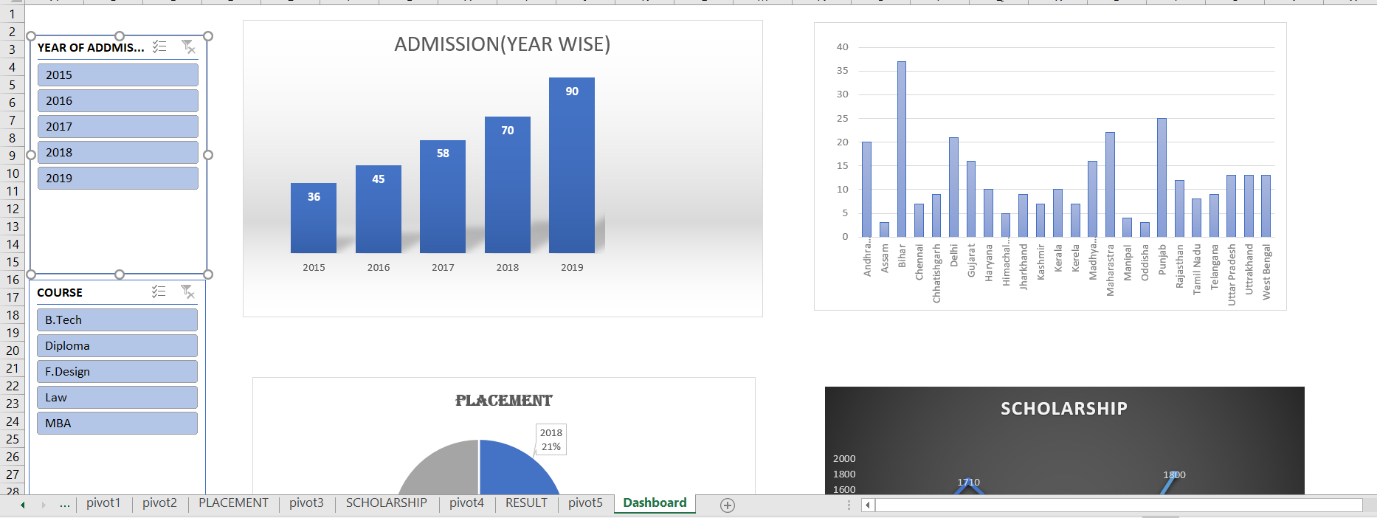

Slide 18
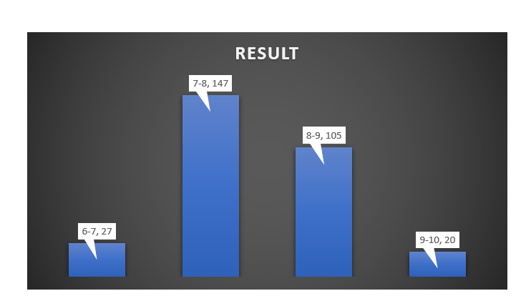
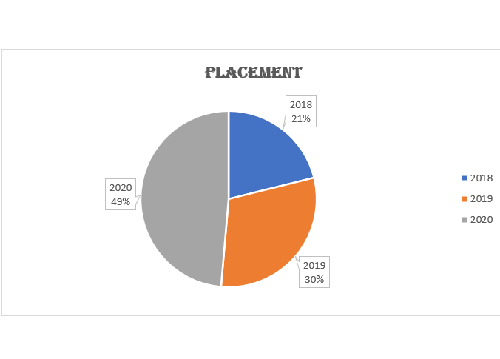
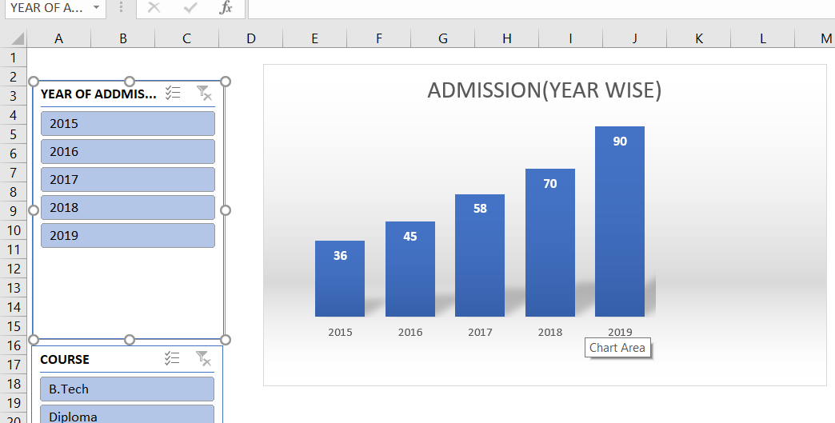

Slide 19
UDEMY DASHBOARD
IN THIS PROJECT I HAVE MADE A DASHBOARD USING TABLEAU
DATA VISUALIZATION
STORY TELLING

Slide 20
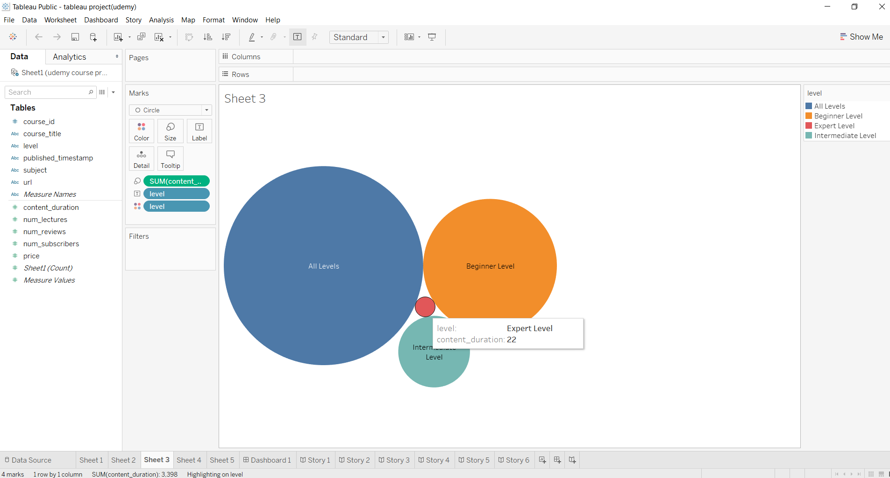

Slide 21
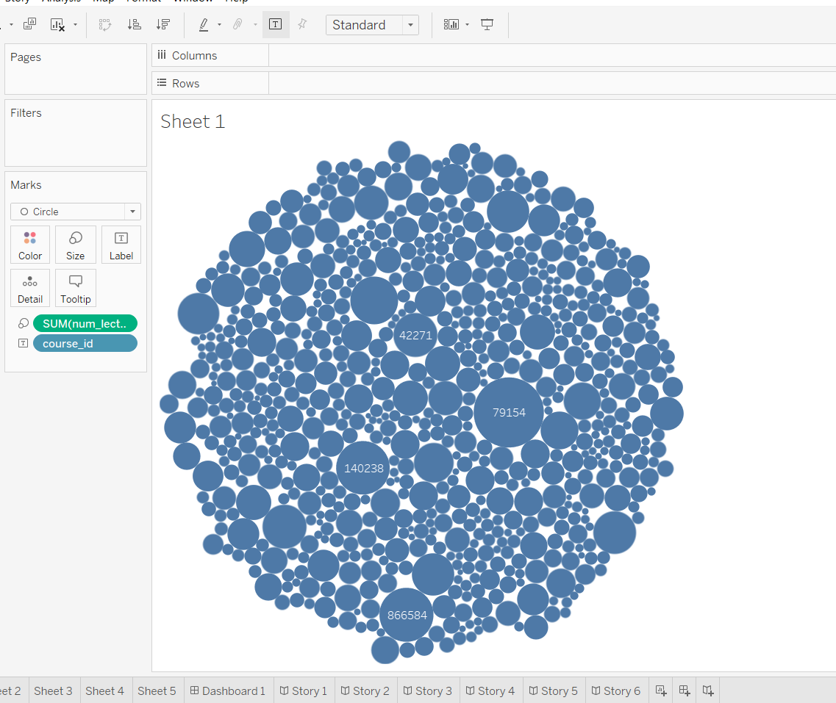
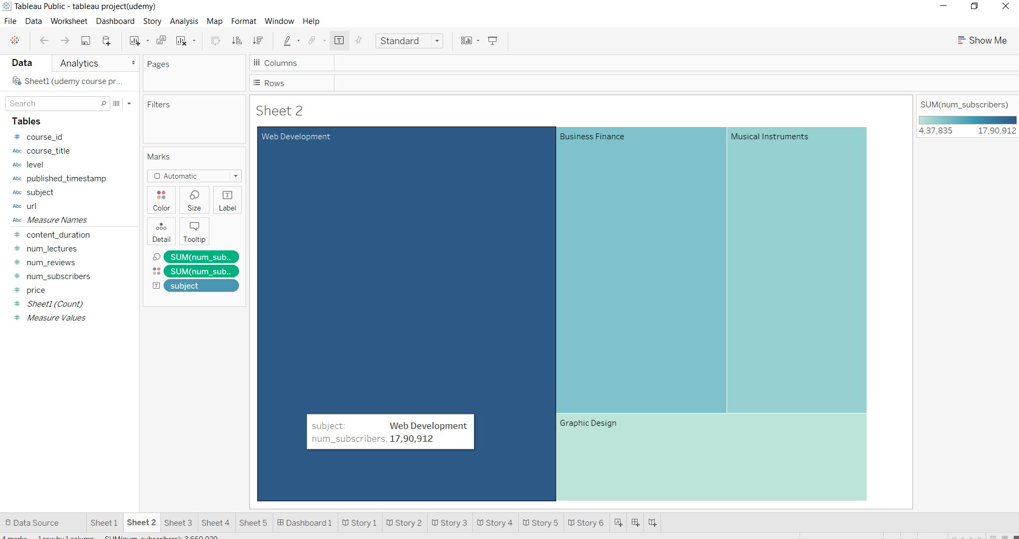

Slide 22
PROJECT USING ML
HEAT MAP
MATPLOT
DISPLOT
REGPLOT

Slide 23
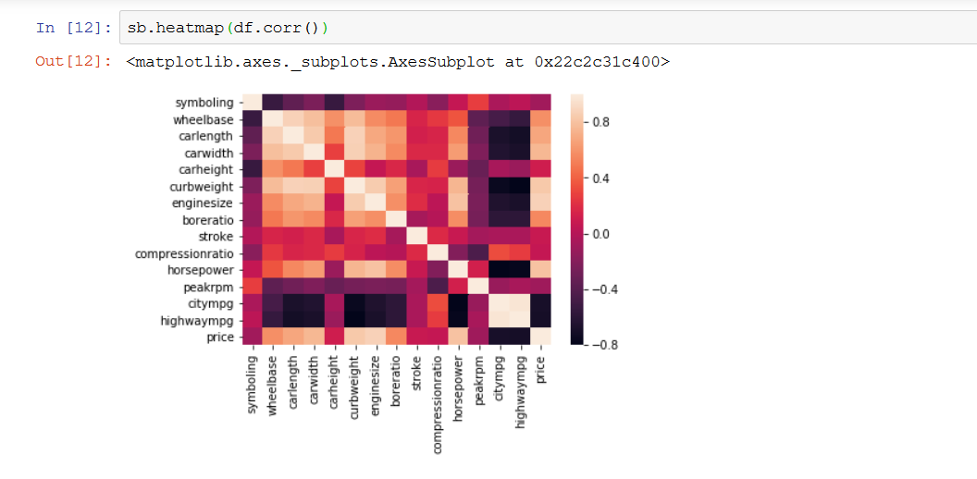

Slide 24
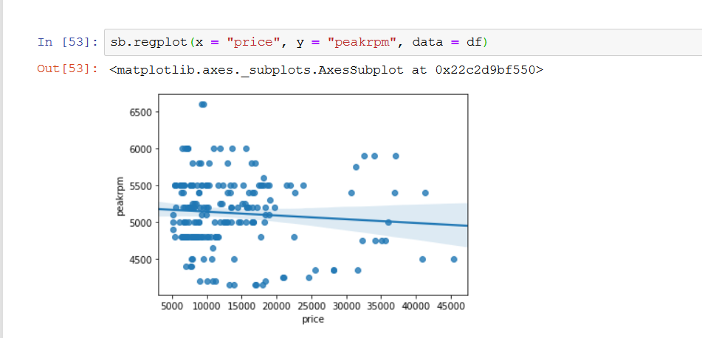

Slide 25
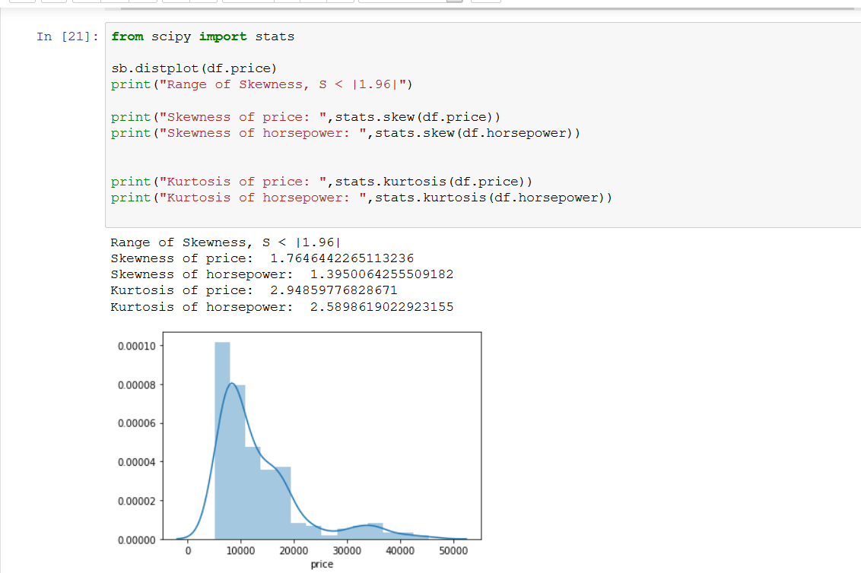
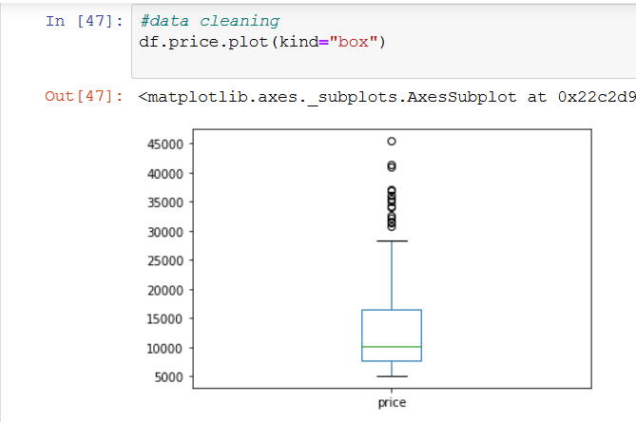

Slide 26
PROJECT USING PYTHON
SEABORN
BAR GRAPH
HEAT MAP
BOX PLOT

Slide 27
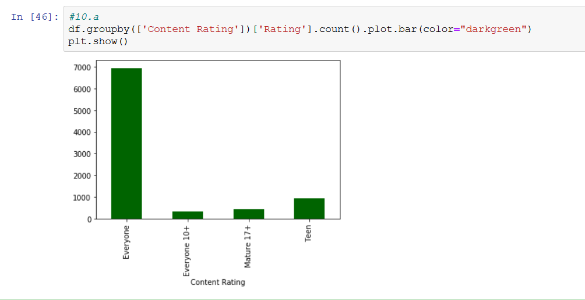

Slide 28
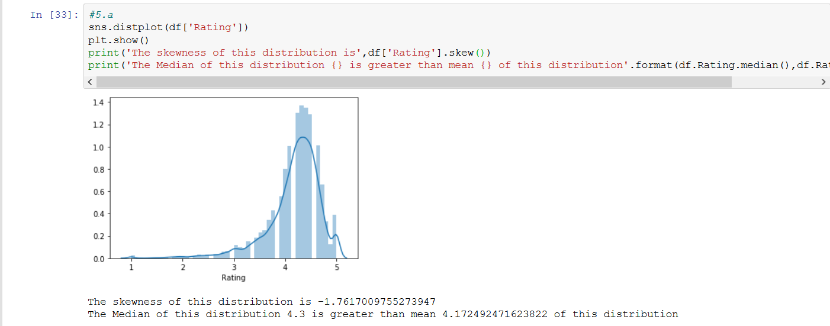
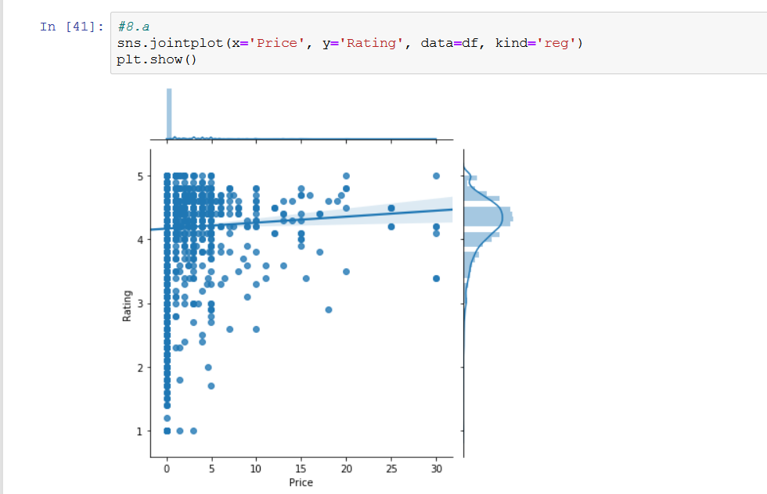

Slide 29
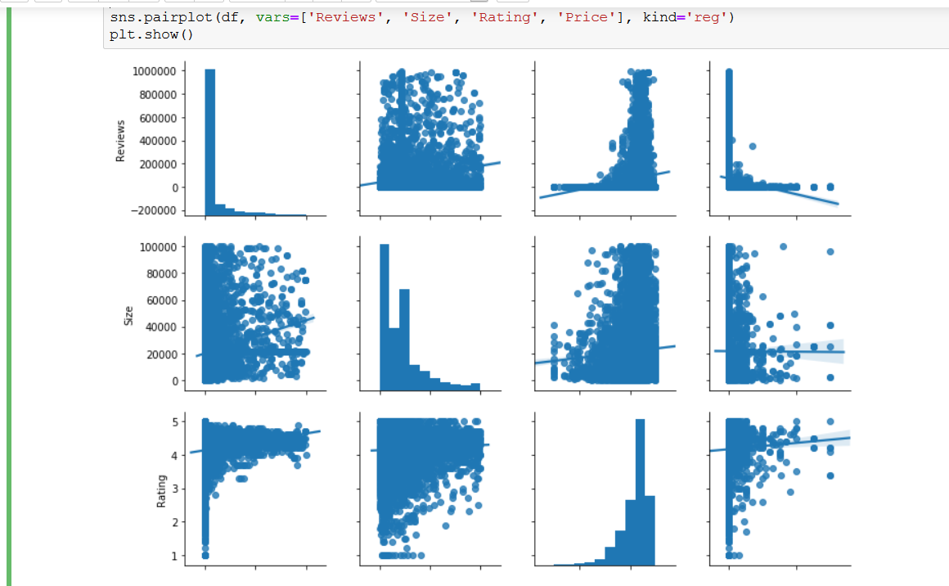

Slide 30
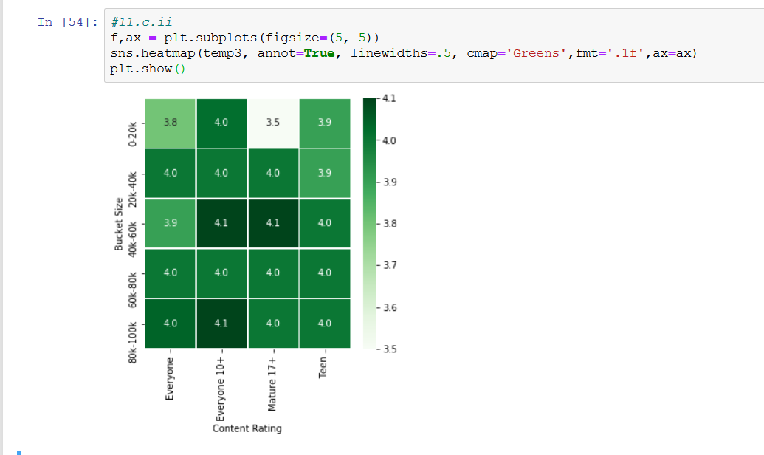
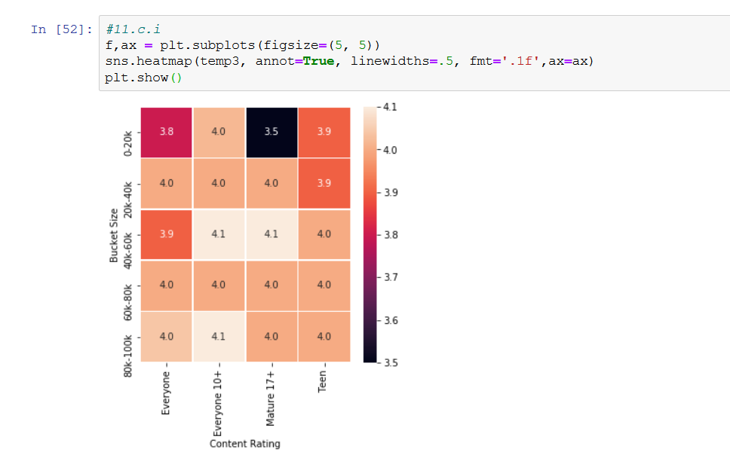

Slide 31
FUTURE SCOPE FOR DATA SCIENCE
Virtual Reality will be friendlier
An astonishing incline in data growth
Companies’ Inability to handle data

Slide 32
CAREER IN DATA SCIENCE
Business Intelligence Developer
Data Architect
Applications Architect
Infrastructure Architect
Enterprise Architect
Data Analyst
Data Scientist
Data Engineer
Machine Learning Scientist
Machine Learning Engineer
Statistician

Slide 33
CONCLUSION
Data science education is well into its formative stages of development; it is evolving into a self-supporting discipline and producing professionals with distinct and complementary skills relative to professionals in the computer, information, and statistical sciences. However, regardless of its potential eventual disciplinary status, the evidence points to robust growth of data science education that will indelibly shape the undergraduate students of the future. In fact, fueled by growing student interest and industry demand, data science education will likely become a staple of the undergraduate experience. There will be an increase in the number of students majoring, minoring, earning certificates, or just taking courses in data science as the value of data skills becomes even more widely recognized.

Slide 34
THANK YOU!!!

