Slide 1


Slide 2
Part 10
Updated Sep 15 2026
Presented at SNU Chennai
Sivasubramanian Natarajan
Web Application
Security
CS4013

Slide 3
Recap
Identity and Access Management definitions
  User Registration
  User Identity
  Simple Authentication
Overview of Authentication, Authorization and Session management with OIDC, OAUTH and JWT tokens

Slide 4
Application Security Component 1 - Authentication

Slide 5
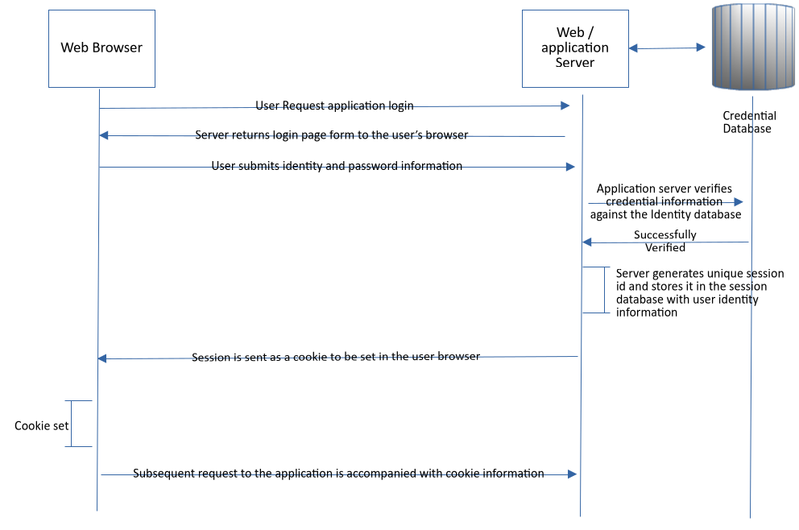
Simple Cookie based Login Architecture
All requests to the server and from the server are http(s)
Cookie properties are controlled by the server.
Critical properties are
  Same site
  Secure cookie
  Non-persistent
  Can only be set by the server.

