Slide 1
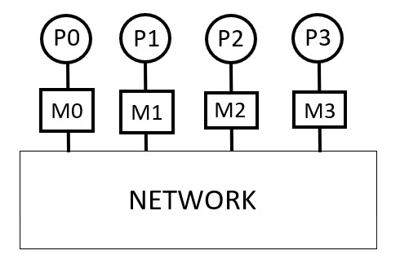
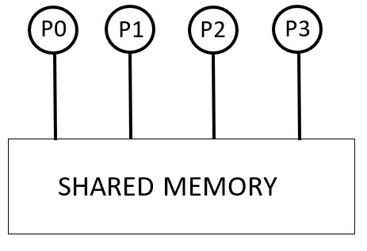
Parallel Programming in Fortran 90 using OpenMP
Shared Memory Architecture: parallel machines built upon a set of processors
that have access to a common memory.
Distributed-memory architecture: each processor has its own private memory
and information is interchanged between processors through messages.
i.e., typical cluster computing systems.
OpenMP is used for development on shared-memory machines. Supports
incremental parallelization (which for most of us is a really nice feature as we
can take our existing programs and parallelize them without “starting over”).

Slide 2
Goals of OpenMP
Standardization:
Industry standard first developed in 1997.
Provide a standard among a variety of shared memory architectures/platforms.
Lean and Mean:
Establish a simple and limited set of directives for programming shared memory machines. Significant parallelism can be implemented by using just 3 or 4 directives.
Ease of Use:
Provide capability to incrementally parallelize a serial program, unlike message-passing libraries which typically require an all or nothing approach.
Provide the capability to implement both coarse-grain and fine-grain parallelism.
Portability:
Supports Fortran (77, 90, and 95), C, and C++
To Compile with gfortran:
gfortran -fopenmp code.f90

Slide 3
Shared Memory, Thread Based Parallelism:
OpenMP is based upon the existence of multiple threads in the shared memory programming paradigm. A shared memory process consists of multiple threads.
Explicit Parallelism:
OpenMP is an explicit (not automatic) programming model, offering the programmer full control over parallelization.
Fork - Join Model:
OpenMP uses the fork-join model of parallel execution:
All OpenMP programs begin as a single process: the master thread. The master thread executes sequentially until the first parallel region construct is encountered.
FORK: the master thread then creates a team of parallel threads
The statements in the program that are enclosed by the parallel region construct are then executed in parallel among the various team threads
JOIN: When the team threads complete the statements in the parallel region construct, they synchronize and terminate, leaving only the master thread
Compiler Directive Based:
  Most OpenMP parallelism is specified through the use of compiler directives which are imbedded in C/C++ or Fortran source code.

Slide 4
Let’s look at some example codes

