Slide 1



Microsoft Technology options and recommendation
For Queuing mechanism
Shruti WANKHADE
Application Development Manager
Version 1.0
13 April 2020

Slide 2
Business Case – Ticketing application
Synchronous Architecture
Fill-in ticket details
I
N
T
E
R
N
E
T
Ticketing web app
Validate request
Execute ticket logic workflows
Register ticket
Respond
SQL Server data store
User
browser
Identity provider
Submit ticket
Response
Cache
Problems
Not scalable for peak load of 1000s of users
Latency in response
No possibility of load leveling
Poor customer experience
Risks
Risk of losing the ticket requests in case of system failure, as it is a synchronous communication
Risk of losing customers to the competition
Solution
Re-design the architecture to make it asynchronous by implementing a queuing mechanism in-between the ticketing application and SQL Server data store
Benefits
No data / request loss
Load leveling
Ordering and Prioritization of the requests

Slide 3
To-Be / Target Architecture
Queue/s
Asynchronous Architecture
I
N
T
E
R
N
E
T
Ticketing web app
Fill-in details
User
browser
Front End
Validate request
Add the ticket request to Queue
Respond
SQL Server data store
Identity provider
Submit
Worker/s
Consume request from Queue
Execute business logic workflows
Register ticket
Notify user (async.)
Cache
Response
Queue:
A message oriented middleware (MOM) which is a software or hardware infrastructure supporting sending and receiving messages between distributed systems
Notes:
1. Queue decouple systems and helps to provide the ability to share data amongst them asynchronously.
2. Front End will send the message to queue as well as do some real time operations for DB (like Delete).
3. The implementation can also be made such that only during peak times asynchronous communication is enabled else it will work real time

Slide 4
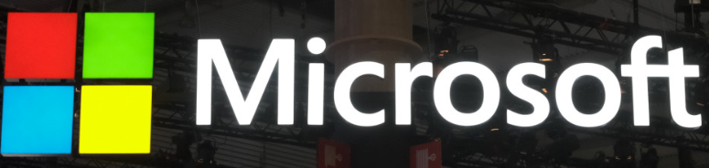
Different Microsoft Queuing technologies
Microsoft Message Queuing (MSMQ)
SQL Server Service Broker (SSB)
Microsoft Enterprise Service Bus (ESB)
Service Bus for Windows
Azure Messaging Service

Slide 5
Technology assessment considerations
Comparison Criteria's:
Technology support for future
Implementation and Ownership cost
Development complexity
Troubleshooting complexity
Performance
Support for Queuing Features
Queue size limit
Load leveling
Schedule delivery
Prioritization
Filtering
Poison message handling
Defer
Batching, etc.

Slide 6
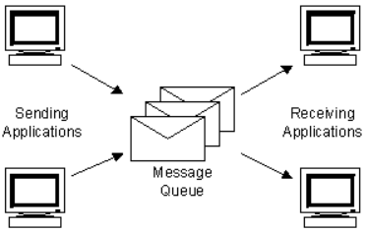
Microsoft Message Queuing (MSMQ)
This technology enables applications running at different times to communicate across heterogeneous networks and systems that may be temporarily offline.
Pros:
Cons:
MSMQ is natively available as part of the Windows operating system
Message Queuing provides guaranteed message delivery, efficient routing, security, and priority-based messaging
Supports the distribution of a single message to multiple destinations
MSMQ does not offer a native publish-subscribe mechanism
However, things don't look so good when MSMQ must be managed - supplied MSMQ management console (MMC) does not cover many real life situations
MSMQ is technically outdated as it is not available on .NET Core
Notes:
MSMQ is essentially a messaging protocol that allows applications running on separate servers/processes to communicate.
A queue is a temporary storage location from which messages can be sent and received reliably, as and when conditions permit.
This enables communication across networks and between computers, running Windows, which may not always be connected.

Slide 7
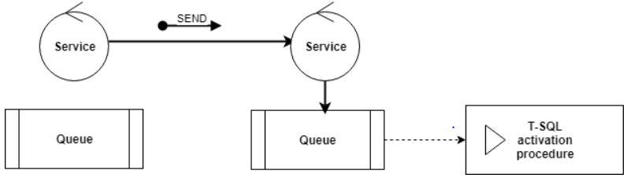
SQL Server Service Broker (SSB)
Service Broker is a message delivery framework that enables you to create native in-database service-oriented applications.
Pros:
Cons:
Guaranteed message delivery
Guaranteed message sequencing – Service Broker uses internal locking and sequencing mechanisms to also guarantee that all messages will be processed in the order in which they were sent.
Durability – Service broker messages and conversations are persistent across server restarts.
Development and troubleshooting is tedious
Works only for the in-database messaging – hence not applicable for this ticketing application use case where we want to have queuing done outside

Slide 8
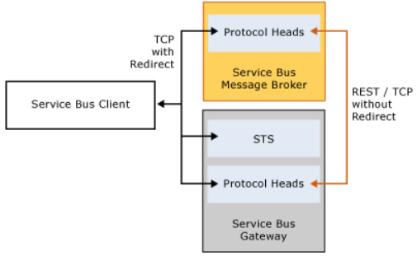
Service Bus for Windows Server 1.1
Service Bus for Windows Server is a set of installable components that provides the messaging capabilities of Microsoft Azure Service Bus on Windows Server.
Pros:
Cons:
Provide similar capabilities of Microsoft Azure on windows server 1.1
Supports both Queues and Topics
Durability – Service broker messages and conversations are persistent across server restarts.
Development and troubleshooting is tedious
Gone out of mainstream support on January 9, 2018
Notes:
windows service Bus - As these are the installable components on Windows server , if the application is build on another Platform then no support.

Slide 9
Azure messaging services
Azure messaging services
Applicable when application is to store over 80 GB of messages in a queue
Service bus queue is cheaper than a storage queue
Storage queues
Applicable when queue size will not grow larger than 80 GB
application handles messages that can exceed 64 KB but will not likely approach the 256 KB limit
Service Bus -queues/topics
It uses a publish-subscribe model that enables event-driven, reactive programming.
Event Grid isn't a data pipeline, and doesn't deliver the actual object that was updated
Azure Event Grid
Azure Event Hubs
Distributed data streaming platform

Slide 10
Storage queues vs Service bus queues
DIFFERENCE CRITERIA | STORAGE QUEUES | SERVICE BUS QUEUES
Delivery guarantee | At-Least-Once | At-Least-Once
 |  | At-Most-Once
Can send in Batch | No | Yes
Ordering | No | Yes - First-In-First-Out
Transaction support | No | Yes
Can log server-side transaction | Yes | No
Support for Duplicate detection | No | Can be done on sender side
Fetching message sessions by ID | No | Yes
Dead lettering | No | Yes

Slide 11
Azure Service Bus – Recommended
Microsoft Azure Service Bus is a fully managed enterprise integration message broker on cloud. Service Bus can decouple applications and services.
Pros:
Cons:
It is the latest Microsoft messaging technology available
Service Bus offers a reliable and secure platform for asynchronous transfer of data and state.
Improve reliability and scalability of applications and services. Client and service don't have to be online at the same time.
Supports both Queues and Topics
Supports all the advanced features of messaging
Session, auto-forwarding, Dead-letter queue, Schedule delivery, Message deferral, Batching, Transactions, Filtering and Actions, Duplicate detection, etc.
Defining Topic Subscription Rules is not possible in the Azure portal, it can only be defined with the custom code
When the Service bus message receiver stops working due to an issue, there might be a need to process those messages, this is not possible in Azure
Purging the Service bus message without the custom code is not possible

Slide 12
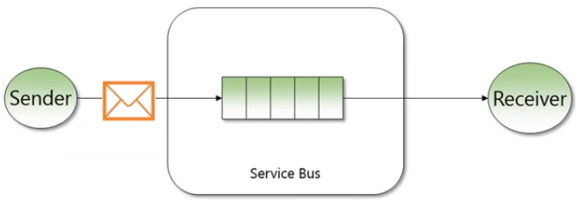
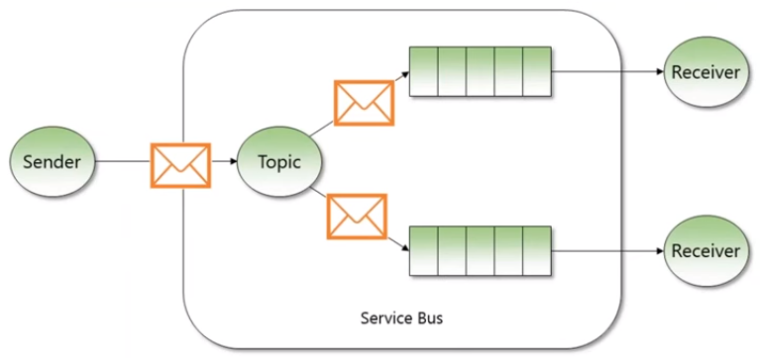
Azure service bus Queue
Follows a simple messaging protocol – a message sender delivers a message to a Queue that will be residing in a Service Bus Namespace, which would then be received by a receiver in initial or later stage.
Queues follow asynchronous communication model where messages tend to go only in one direction via FIFO pattern,
A message stays in a queue as long as the receiver picks it up.
Azure service bus Topic
Same as Queue with multiple, independent subscriptions
It can have zero or more subscriptions, but a subscription can only belong to one Topic
If you do not want all subscribers to read all the messages, then filtering rules can be applied to modify message properties

Slide 13
POC – Demo
https://github.com/ssolanke/TheTicketingSystem
Notes:
FIrst Azure Portal Service Bus NameSpace . Here you can create Queus as well as topics.
Ticketing App
ServiceBusMessaging plugin for Sender and consumer
Set Connection Strings to Azure Queue
In StatrtUp, It will add the Sender and consumer services to the application.
COnsumer Service bus will check if we have any messages to process
on main application , after add ticket Sender will send message.

Slide 14
High level activity plan
Sr. No. | Activities | Deliverables
1 | Work together with businesses to understand the detailed business requirements and expected business values | Requirement Specification Business values
2 | Map the business requirements to different functionalities / features | Functional Specification
3 | Provide different possible alternate solution options - with their pros and cons | Solution options
4 | Recommend the most appropriate solution option | Recommendation
5 | Design the architecture of the possible solution - massaging architecture | Technical architecture specification
6 | Identify and define the KPI's with business | KPI list
7 | Work with development team to build the POC of critical components in the solution - Configuring the Azure queue - Distributing the application into two modules - Front End and Worker - Establishing the synchronous/asynchronous communication in between these modules | POC’s
8 | Ensuring the compliance of all the Microsoft standards and recommended practices | Compliance guidelines
9 | Keeping track of KPI's and making sure the business value is realized | KPI measurement

Slide 15
Q&A

