Slide 1
COEN 380
GROUP PROJECT
Arthi Sivakumar
Nicholas Fong
Saurabh Somani
Shraddhaben Padariya
Vikas Shetty

Slide 2
Dataset
MovieLens (https://grouplens.org/datasets/movielens/100k/)
Data set consists of:
100,000 ratings (1-5) from 943 users on 1682 movies.
Each user has rated at least 20 movies.
Simple demographic info for the users (age, gender, occupation, zip)
Tables:
User (userid, age, gender, occupationid, zipcode)
Movie (movieid, title, release_date, genre)
Occupation (occupationid, occupation)
Zipcode (zipcode, city, state)
Data (userid, itemid, rating, timestamp)
Notes:
Normalization is used to minimize redundancy and update anomalies. When the same piece of data is stored in multiple locations, it leads to data redundancy. Due to data redundancy there is an increase in storage space. Data redundancy causes data inconsistency.

Slide 3
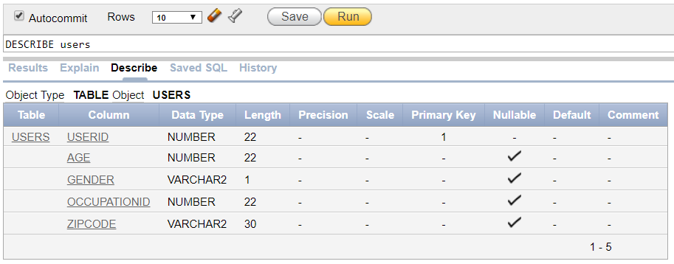
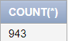
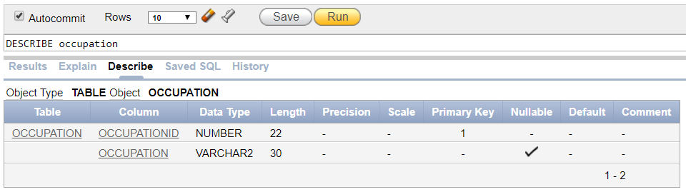
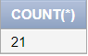
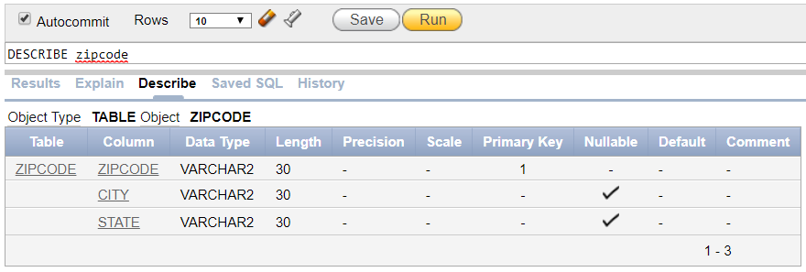
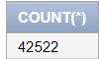

Slide 4
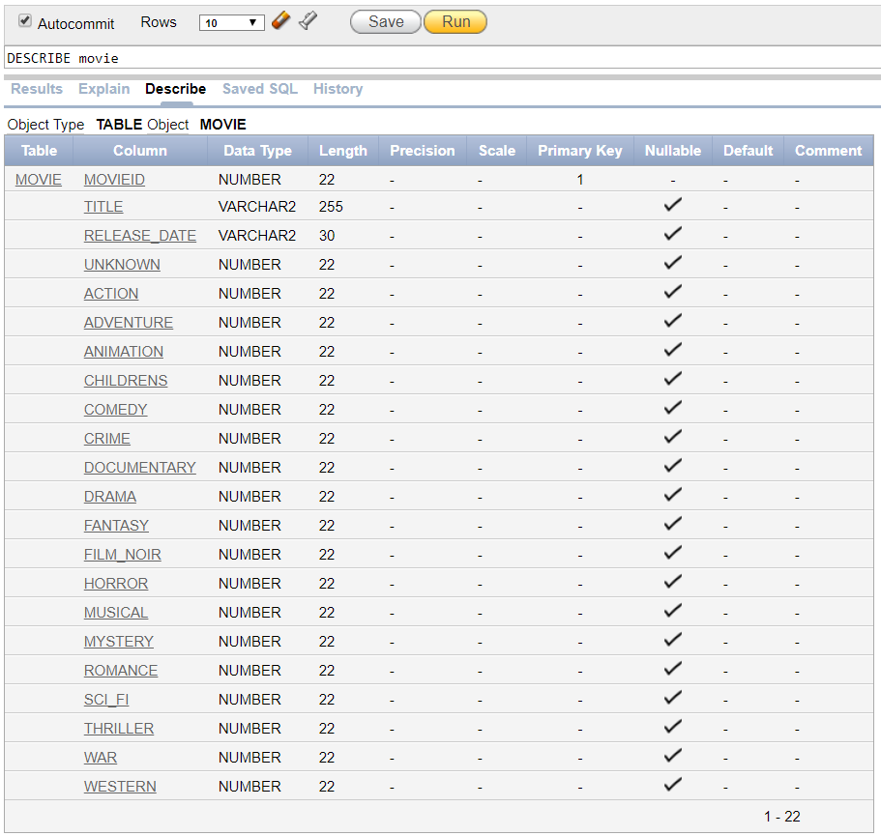
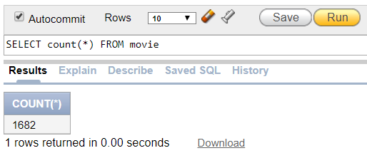
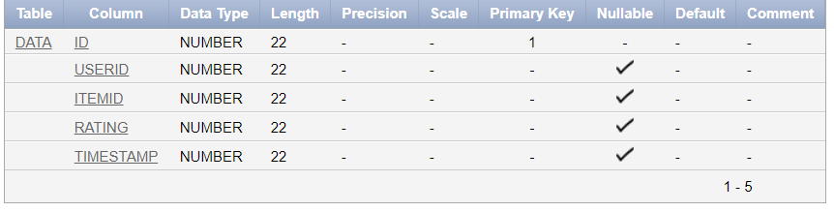
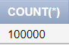

Slide 5
Data Cleaning
Removing unnecessary columns
Removing duplicate rows
Removing rows that don’t match foreign keys
Removing commas in string values
Notes:
Duplicate rows from zipcodes having multiple cities per zipcode
We remove commas because we upload data to Hive using comma separated values
Hive doesn’t accept header column names

Slide 6
Query 1
Select all the movies under Comedy and Crime genre
SELECT title, release_date
FROM movie
WHERE Comedy = 1 AND Crime = 1
Results:
Rows fetched : 16
Oracle : 0.00 seconds
Hive: 11.368 seconds

Slide 7
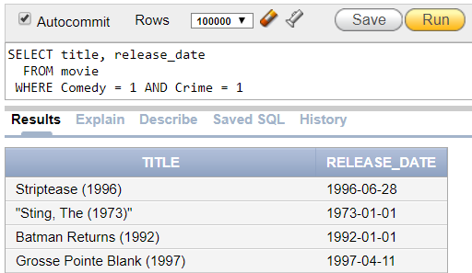
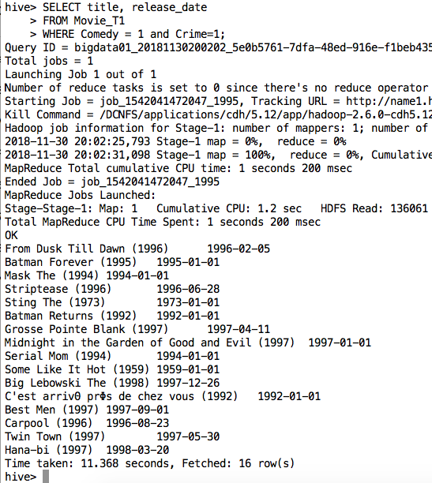

Oracle and Hive query results

Slide 8
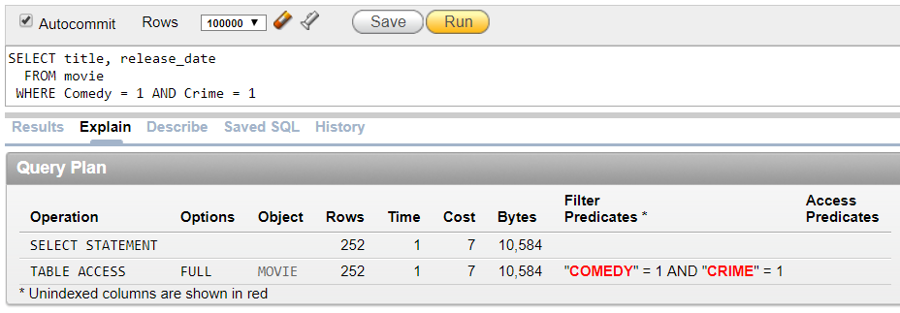
Oracle Explain Plan for Query 1

Slide 9
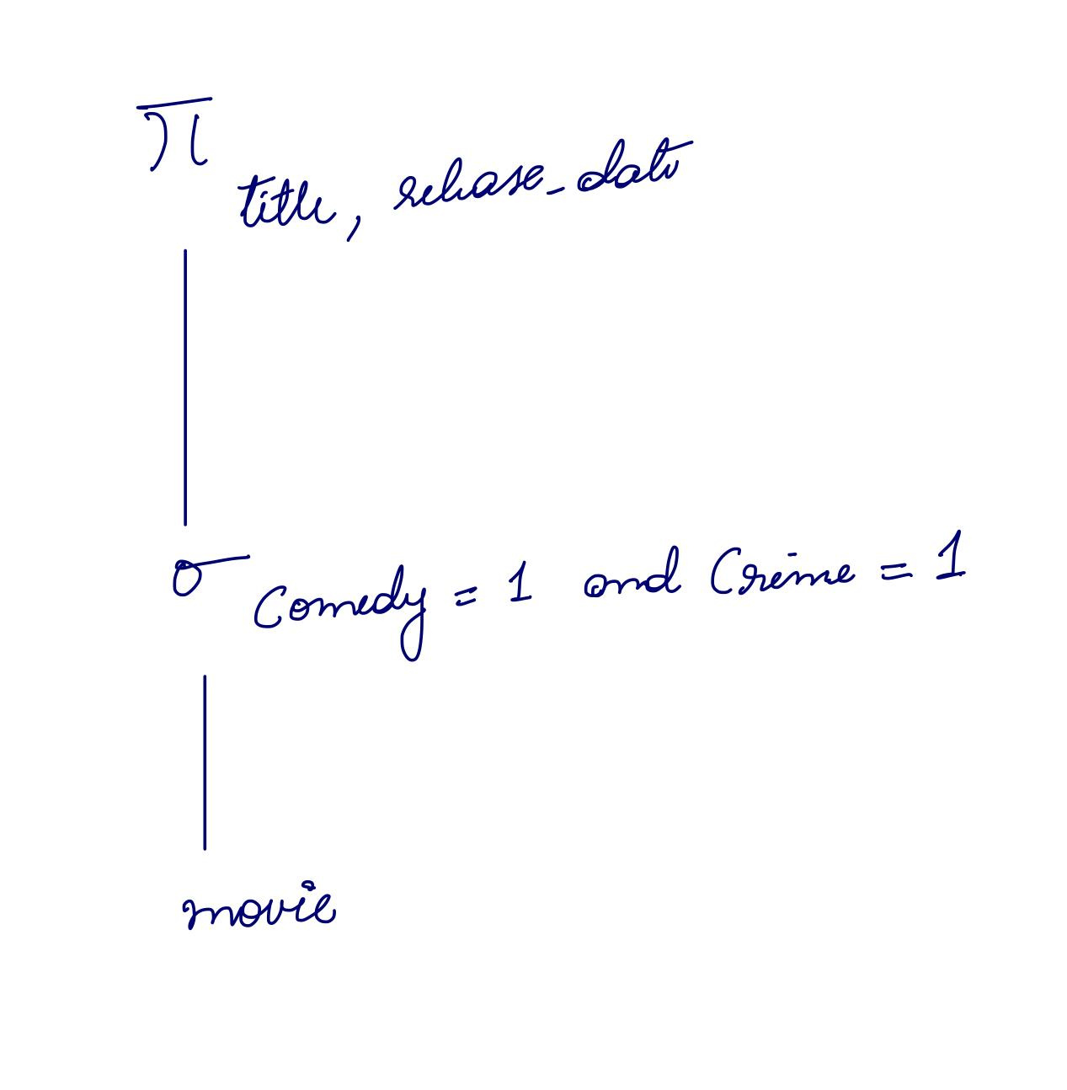
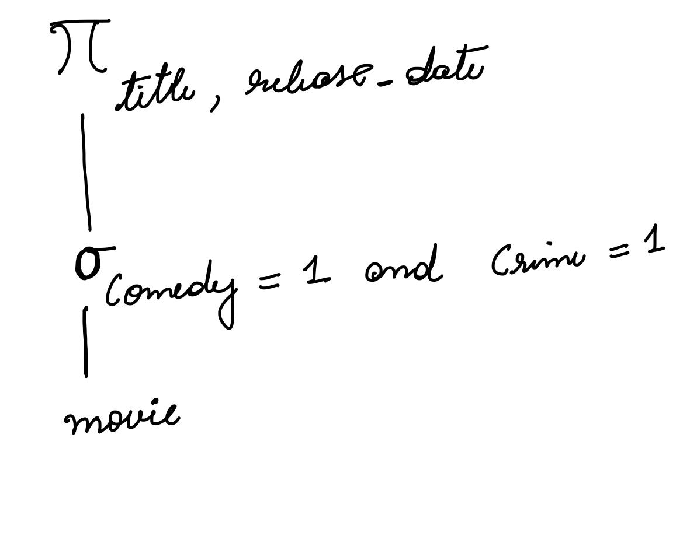
Our Explain Plan
Oracle’s Explain Plan

Slide 10
Query 2
Most popular movies among women
SELECT m.movieid, m.title
FROM movie m
INNER JOIN (
SELECT d.userid, d.itemid, d.rating
FROM data d
INNER JOIN (
SELECT userid, gender
FROM users
WHERE gender = 'F') f
ON d.userid = f.userid
WHERE d.rating = 5) d
ON m.movieid = d.itemid​
Result:
Rows fetched: 5975
Oracle : 0.09 seconds
Hive : 28.04 seconds

Slide 11
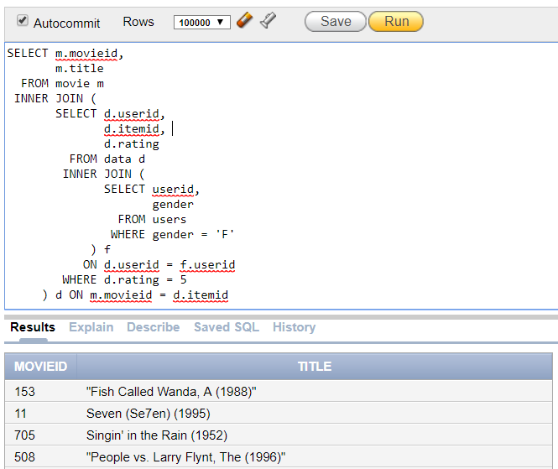
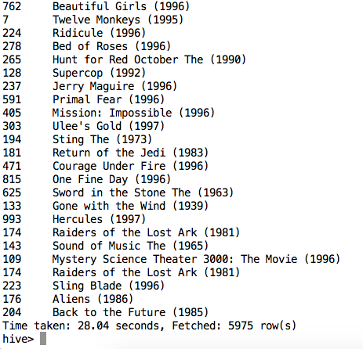
Oracle and Hive query results

Slide 12
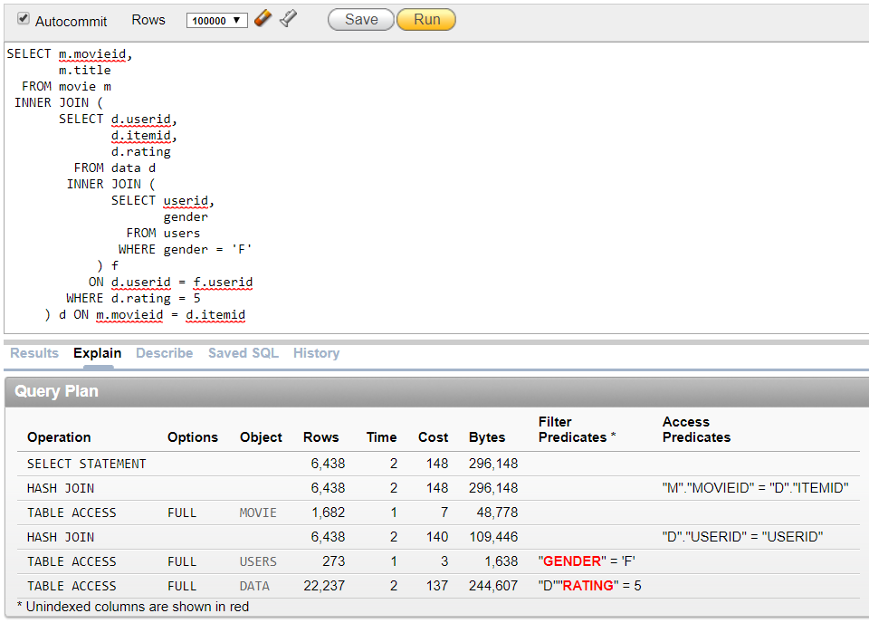
Oracle Explain Plan for Query 2

Slide 13
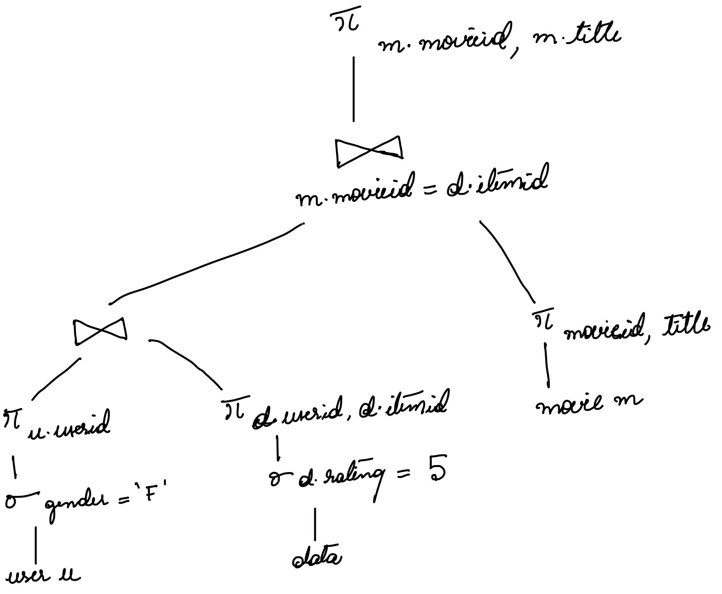
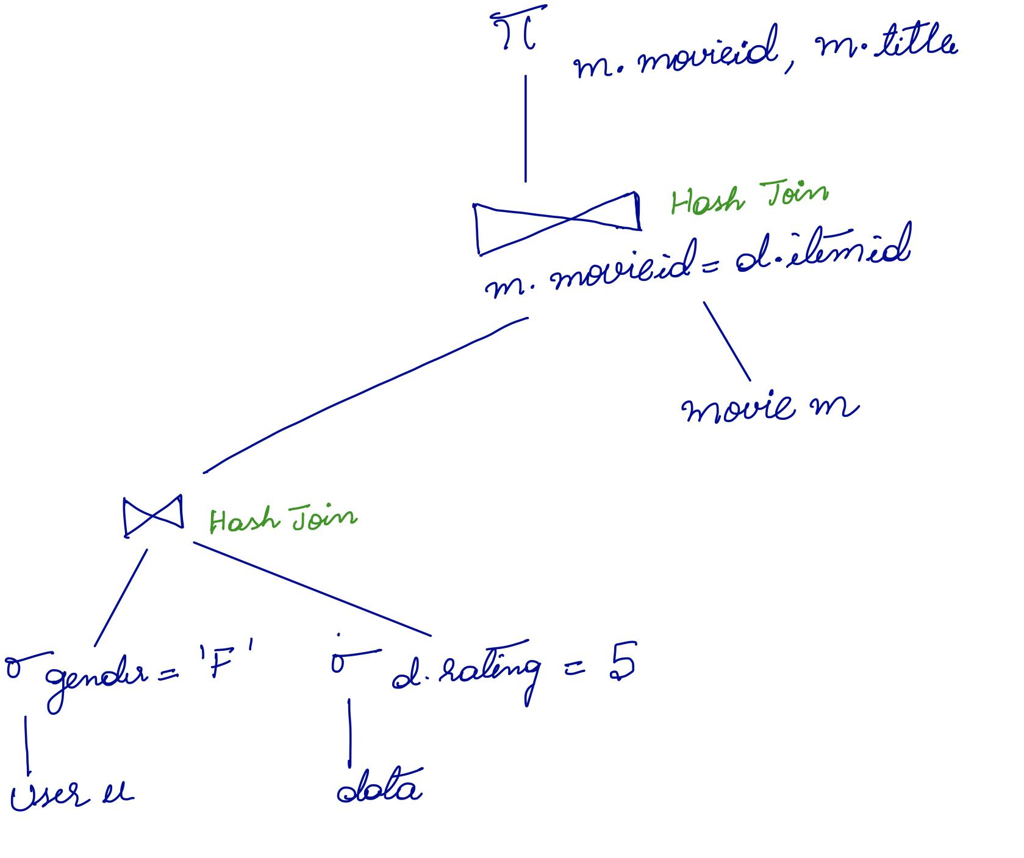
Our Explain Plan
Oracle’s Explain Plan
Notes:
Theta Join
Why Oracle is not projecting b

Slide 14
Query 3
Average movie rating for each gender
Result:
Rows fetched : 2
Oracle : 0.04 seconds
Hive : 39.7 seconds
SELECT u.gender, avg(d.rating) AS avg_rating
FROM users u
INNER JOIN data d
ON u.userid = d.userid
GROUP BY u.gender;​

Slide 15
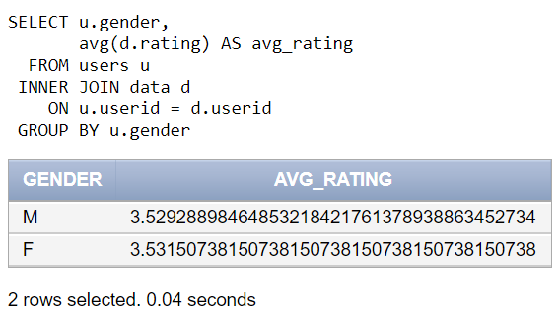
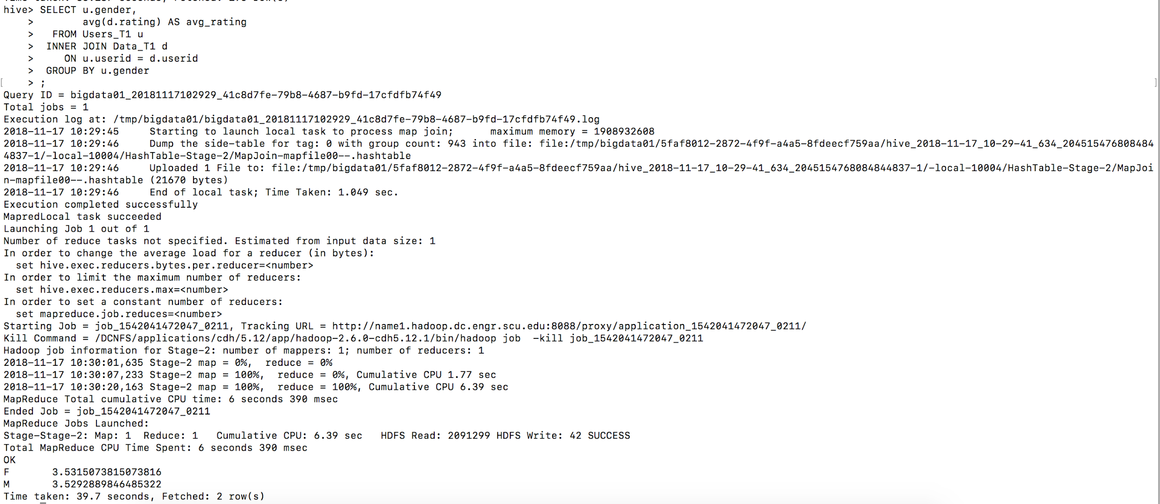
Oracle and Hive query results

Slide 16
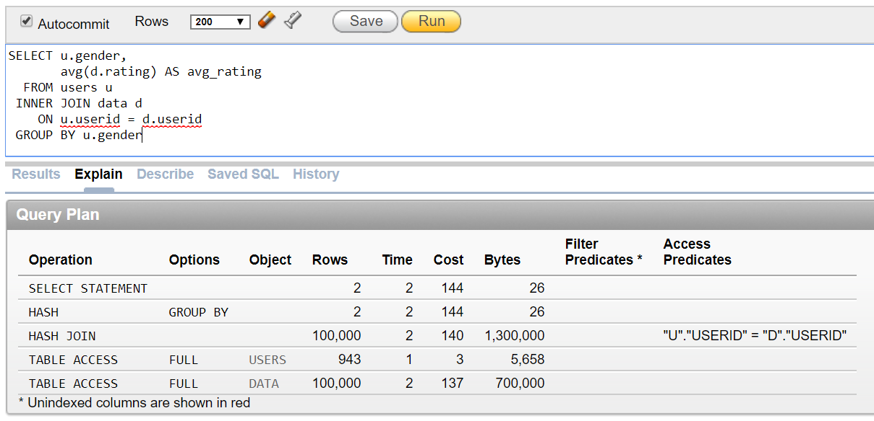
Oracle Explain Plan for Query 3

Slide 17
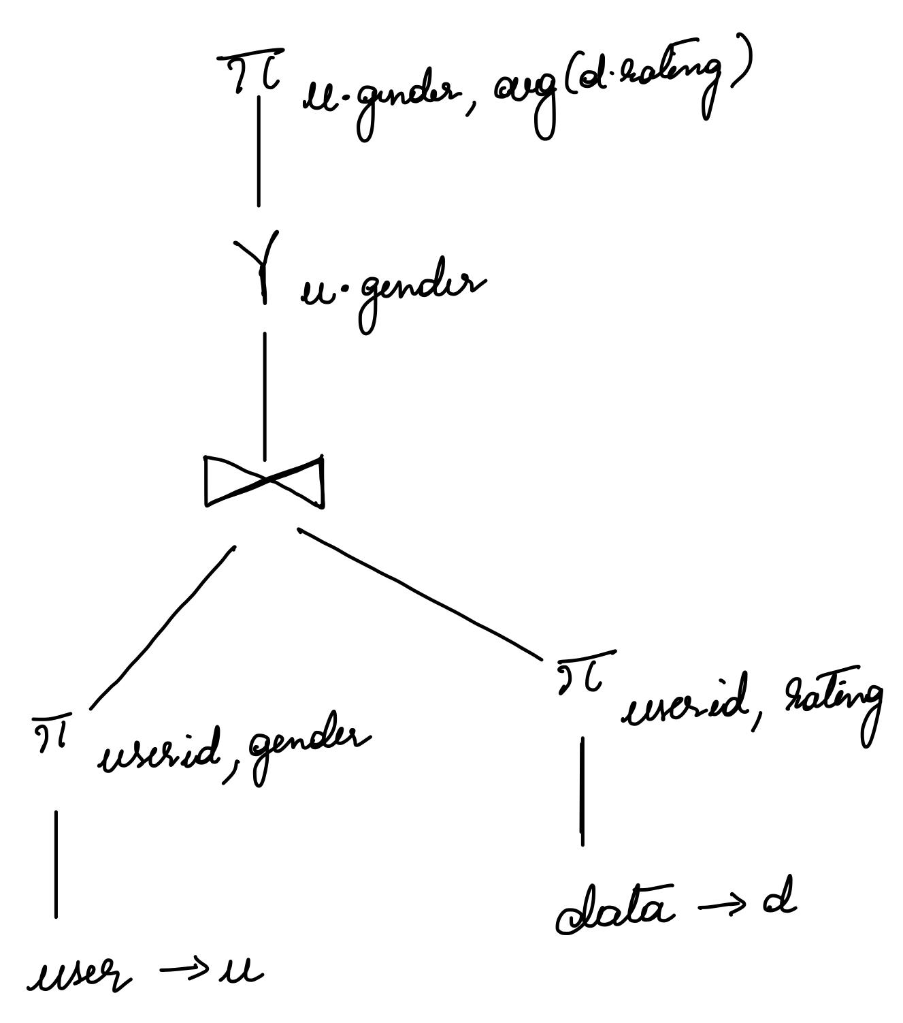
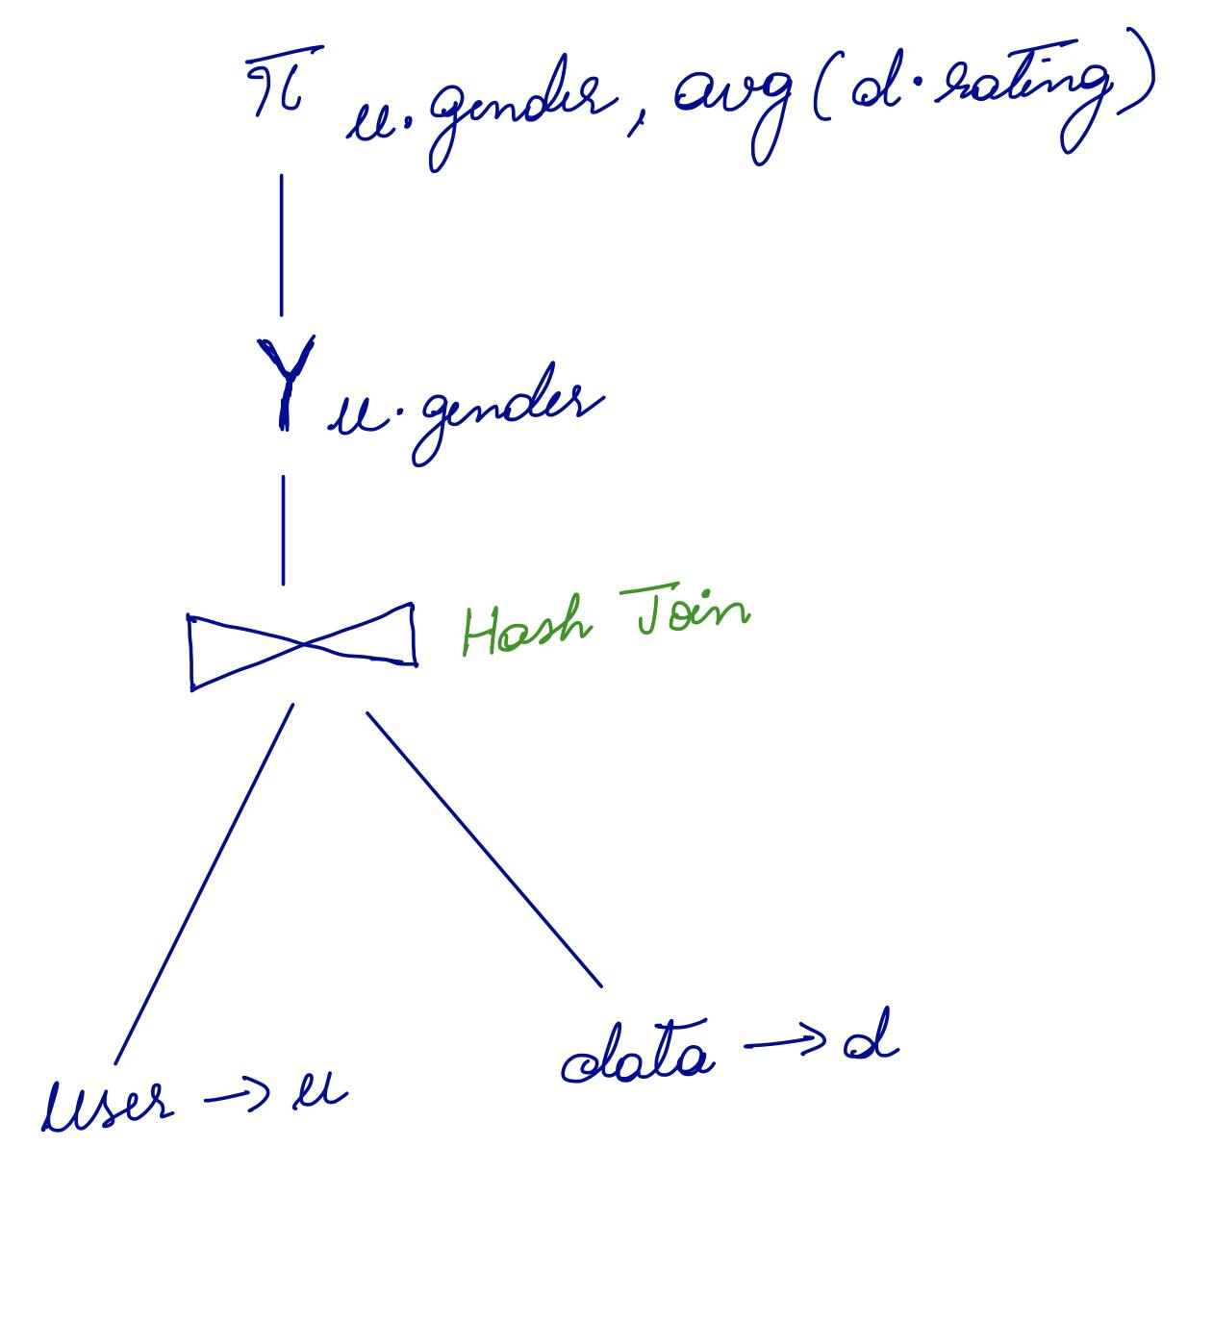
Our Explain Plan
Oracle’s Explain Plan

Slide 18
Query 4
Average rating of movies
SELECT m.title, avg(d.rating) AS avg_rating
FROM data d
INNER JOIN movie m
ON movieid = itemid
GROUP BY m.title;
Result:
Rows fetched: 1664 rows
Oracle : 0.06 seconds
Hive : 33.27 seconds

Slide 19
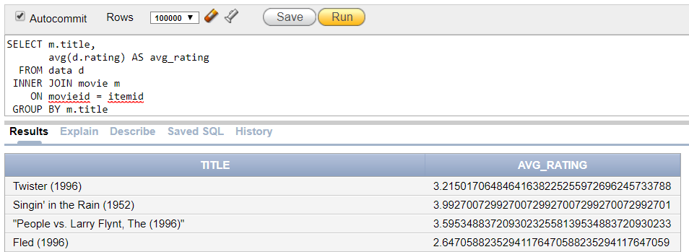
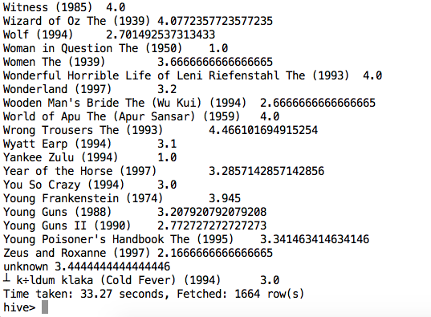
Oracle and Hive query results

Slide 20
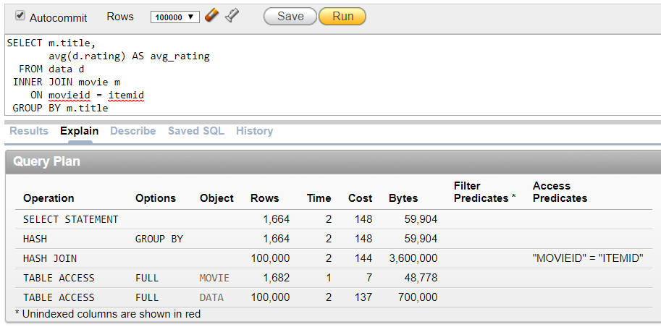
Oracle Explain Plan for Query 4

Slide 21
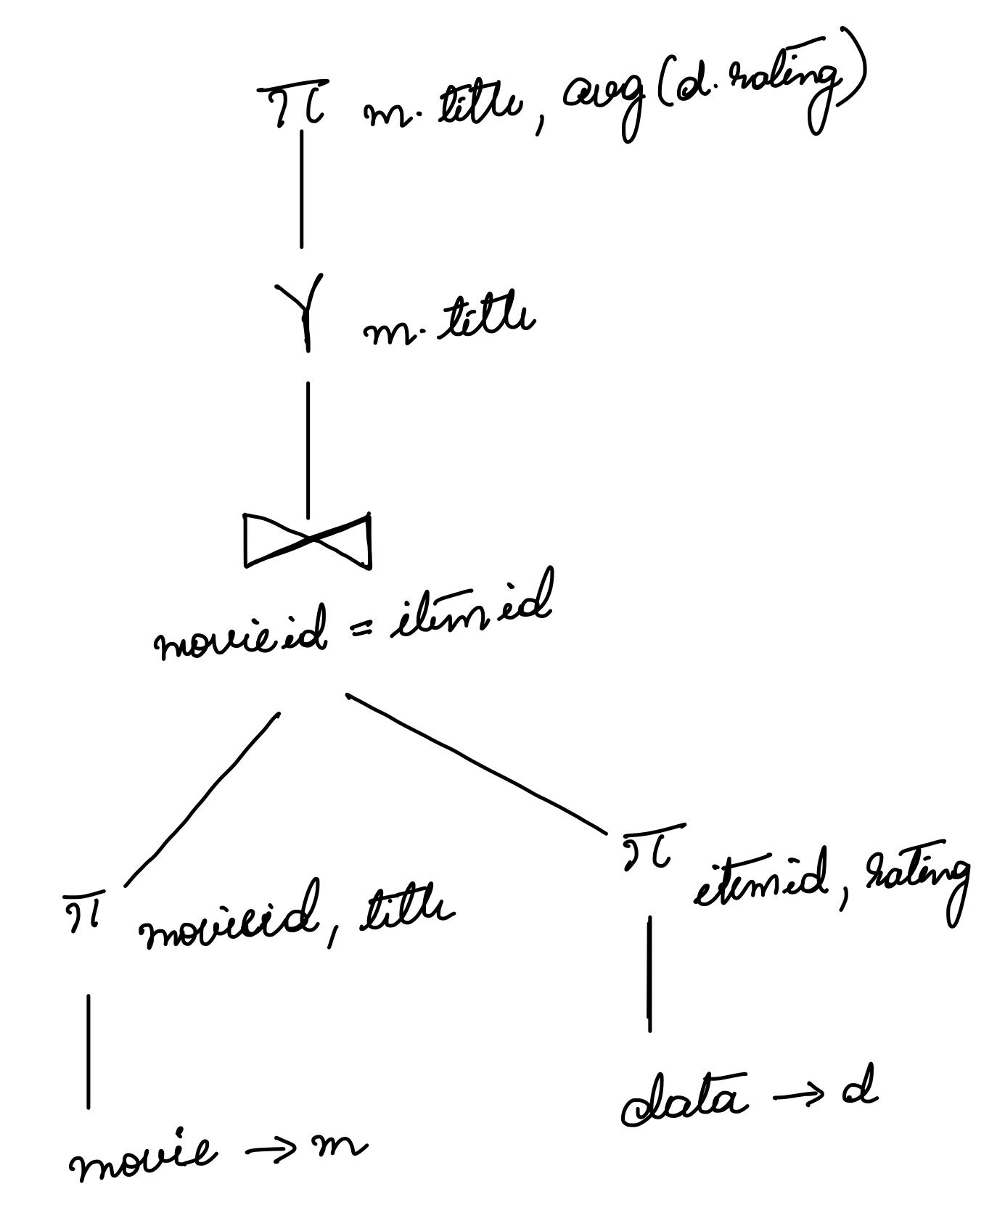
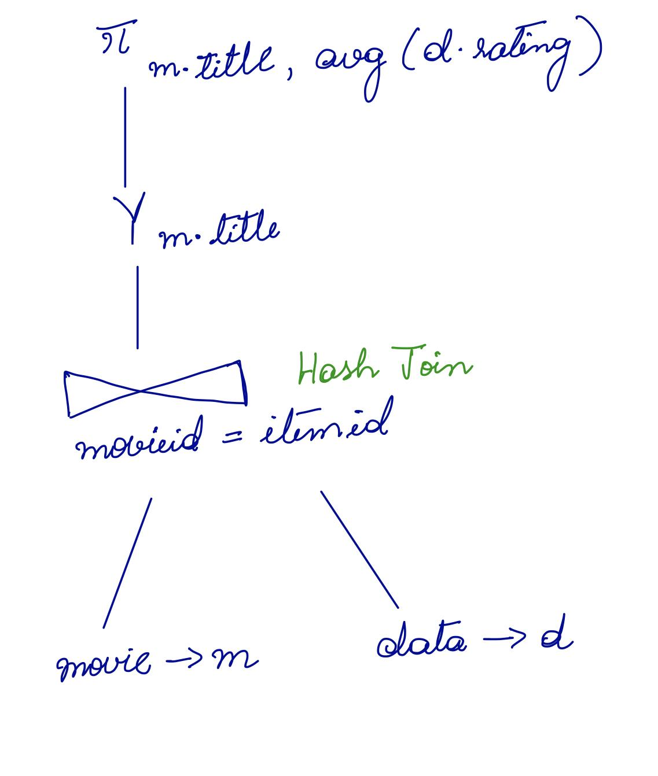
Our Explain Plan
Oracle’s Explain Plan
Notes:
Theta join

Slide 22
Query 5
Full information about our users
Result:
Rows fetched : 943
Oracle : 0.14 seconds
Hive : 36.393 seconds
SELECT u.*, z.city, z.state
FROM users u
LEFT JOIN zipcode z
ON z.zipcode = u.zipcode

Slide 23
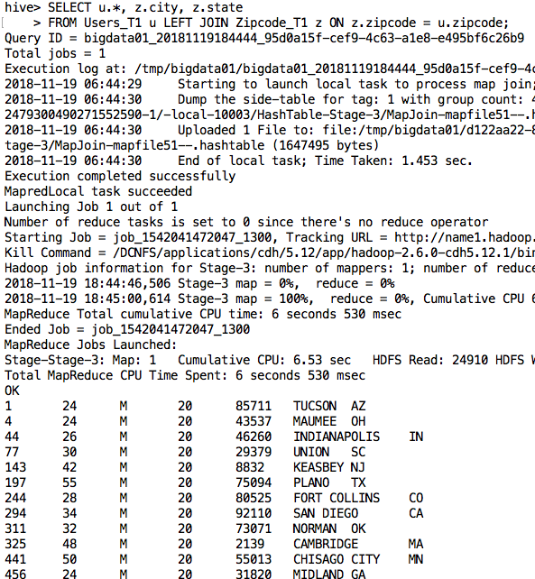
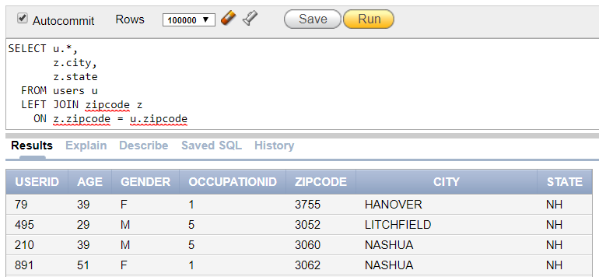

Oracle and Hive query result

Slide 24
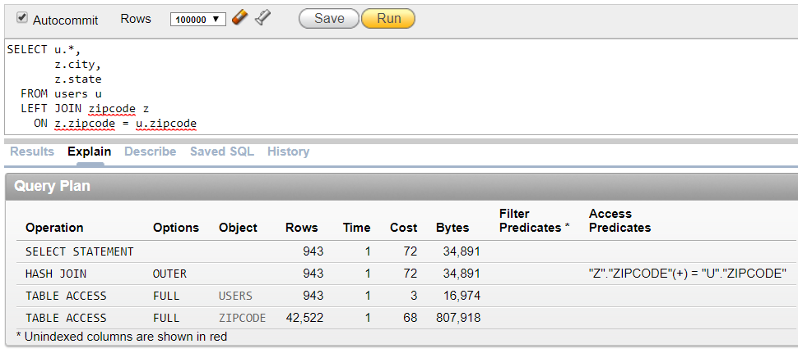
Oracle Explain plan for query 5

Slide 25
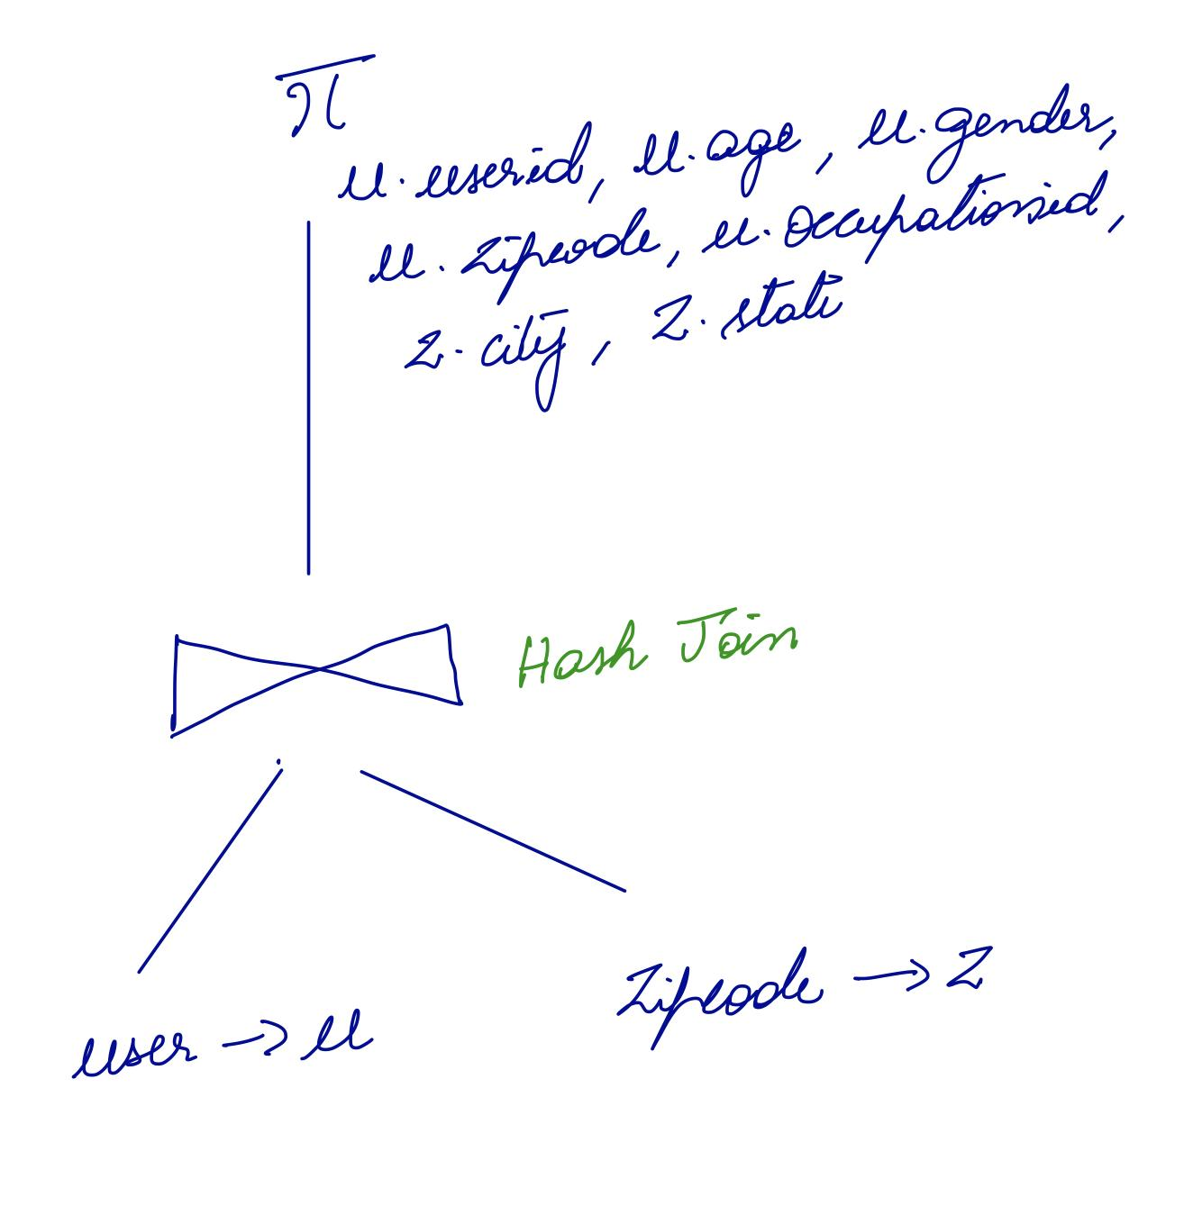
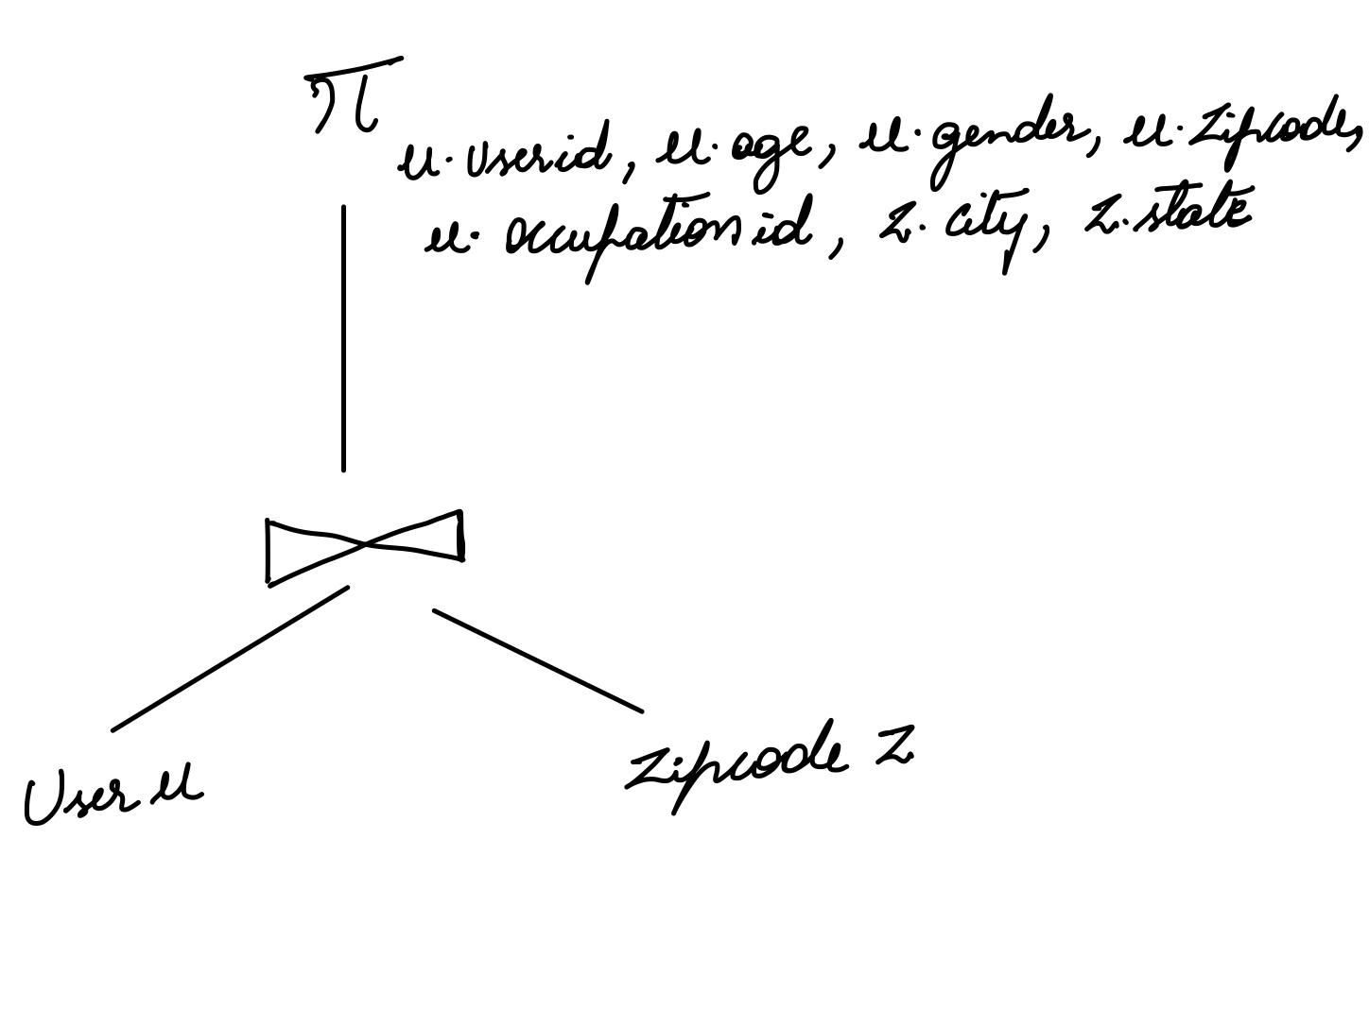
Our Explain Plan
Oracle’s Explain Plan

Slide 26
Query 6
Average rating by occupation
Result:
Rows fetched: 21
Oracle: 0.15 seconds
Hive: 41.735 seconds
SELECT o.occupation, avg(d.rating)
FROM users u
INNER JOIN data d ON u.userid = d.userid
INNER JOIN occupation o ON u.occupationid = o.occupationid
GROUP BY o.occupation

Slide 27
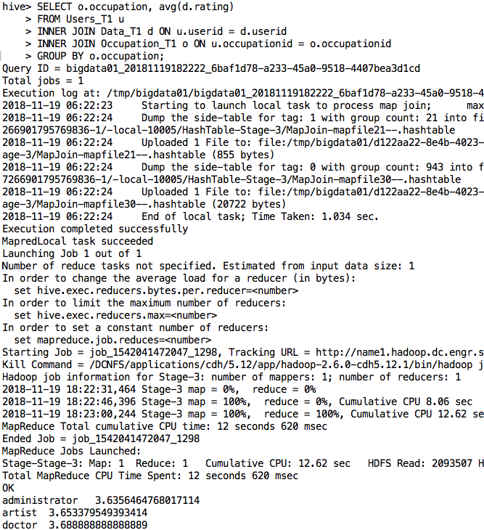
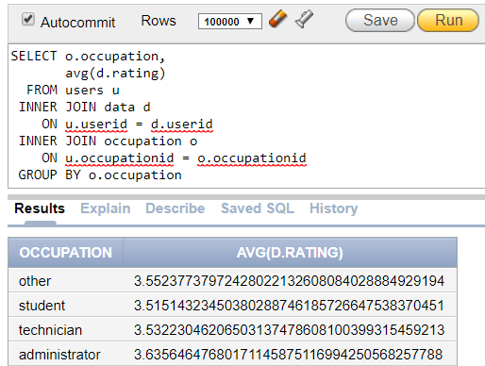


Oracle and Hive query results

Slide 28
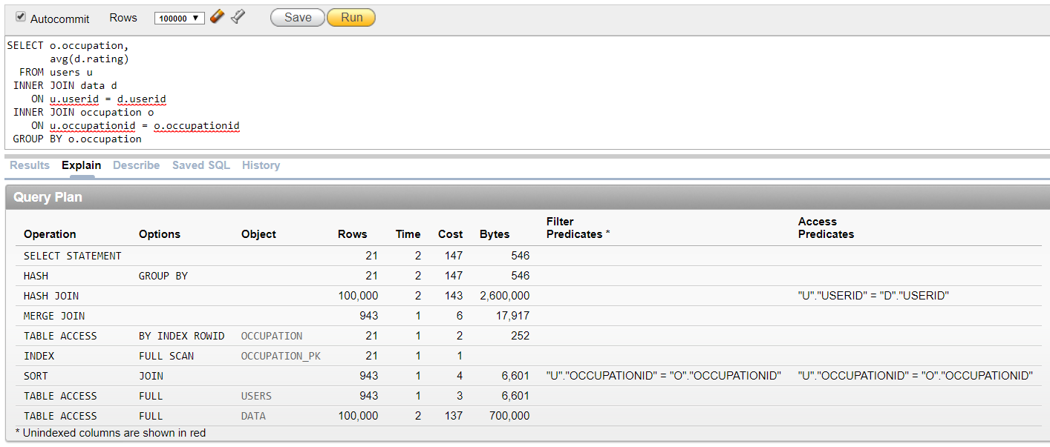
Oracle Explain plan for Query 6
Notes:
SORT, INDEX JOIN (why not using hash join as occupation id )

Slide 29
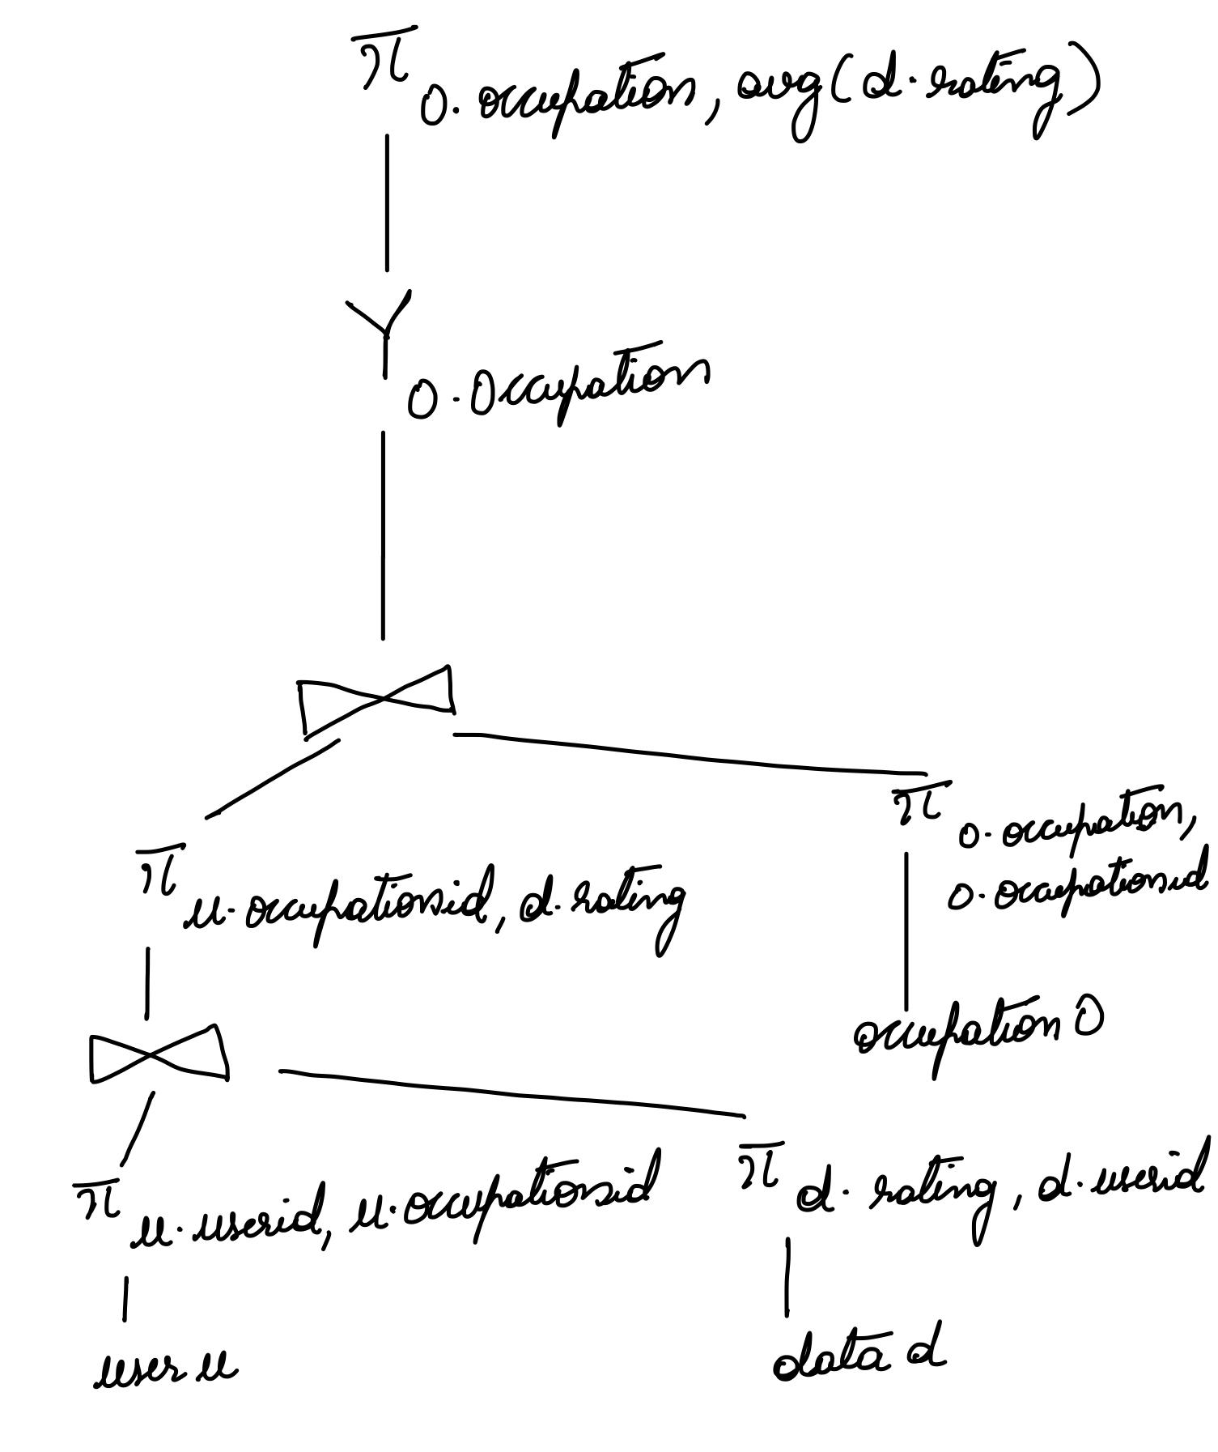
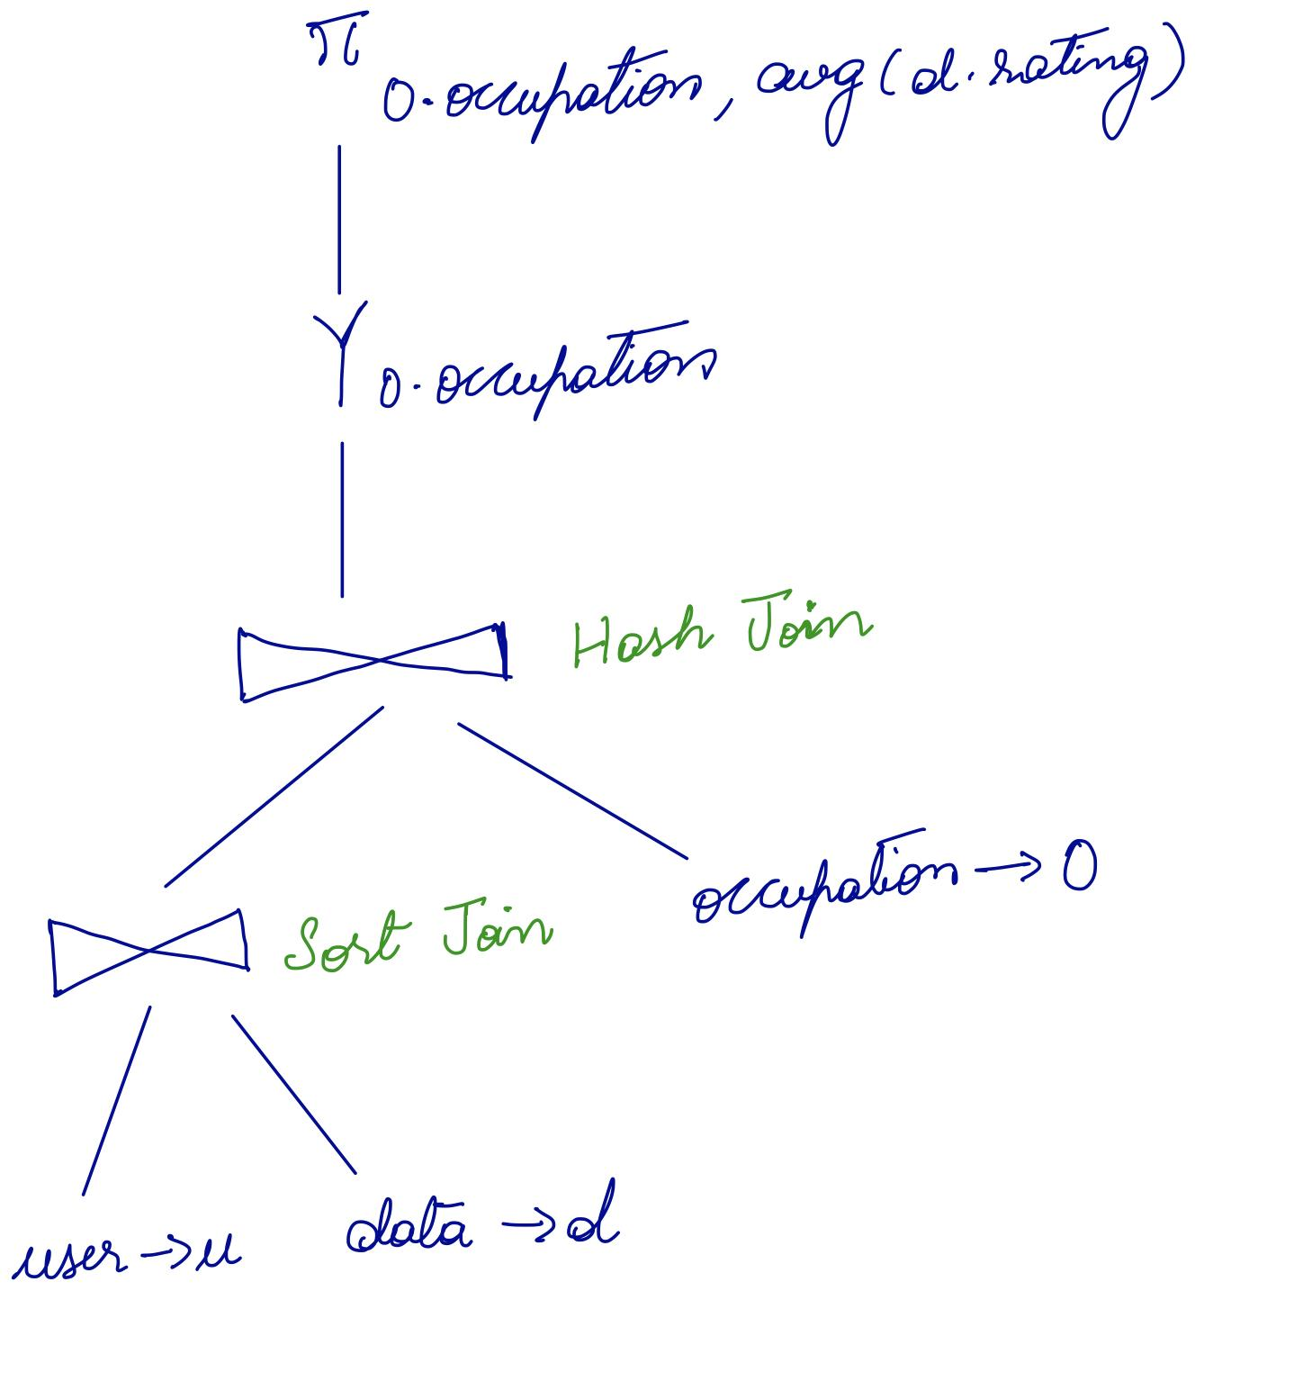
Our Explain Plan
Oracle’s Explain Plan

Slide 30
Query 7
Number of ratings for movies released since Nicholas was born
Result:
Rows fetched : 516
Oracle : 0.10 seconds
Hive : 43.264 seconds
SELECT m.title, m.release_date,
count(d.rating) AS num_ratings
FROM movie m
INNER JOIN data d
ON d.itemid = m.movieid
WHERE m.release_date >= '1996-06-29'
GROUP BY m.title, m.release_date

Slide 31
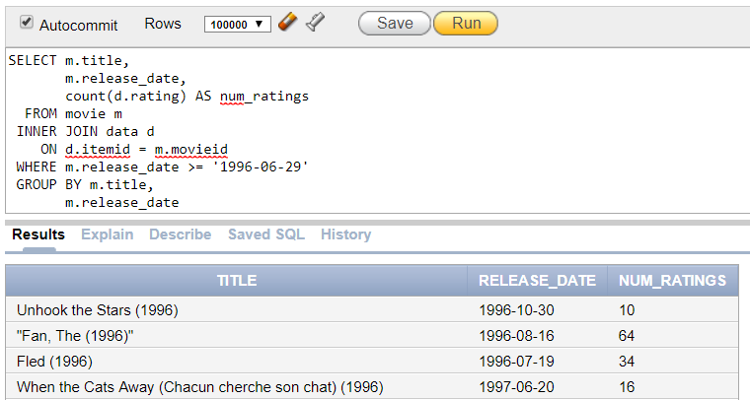
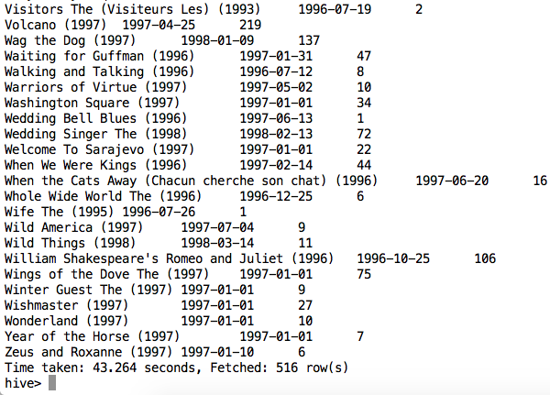
Oracle and Hive query results

Slide 32
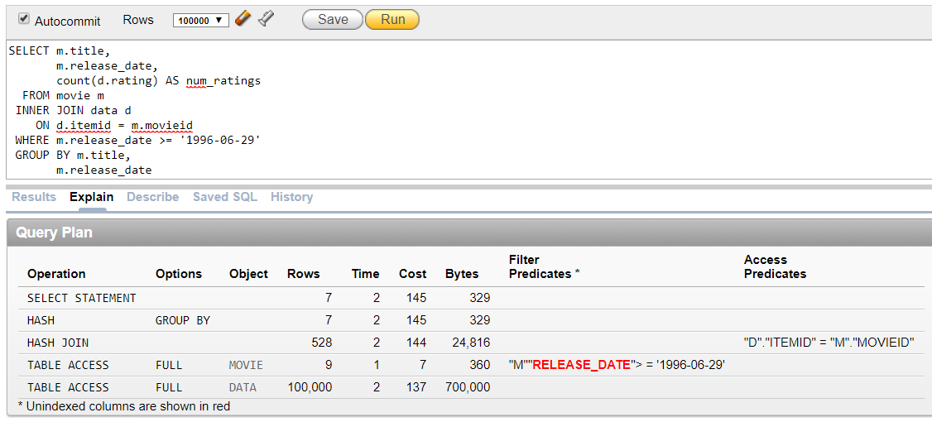
Oracle Explain plan

Slide 33
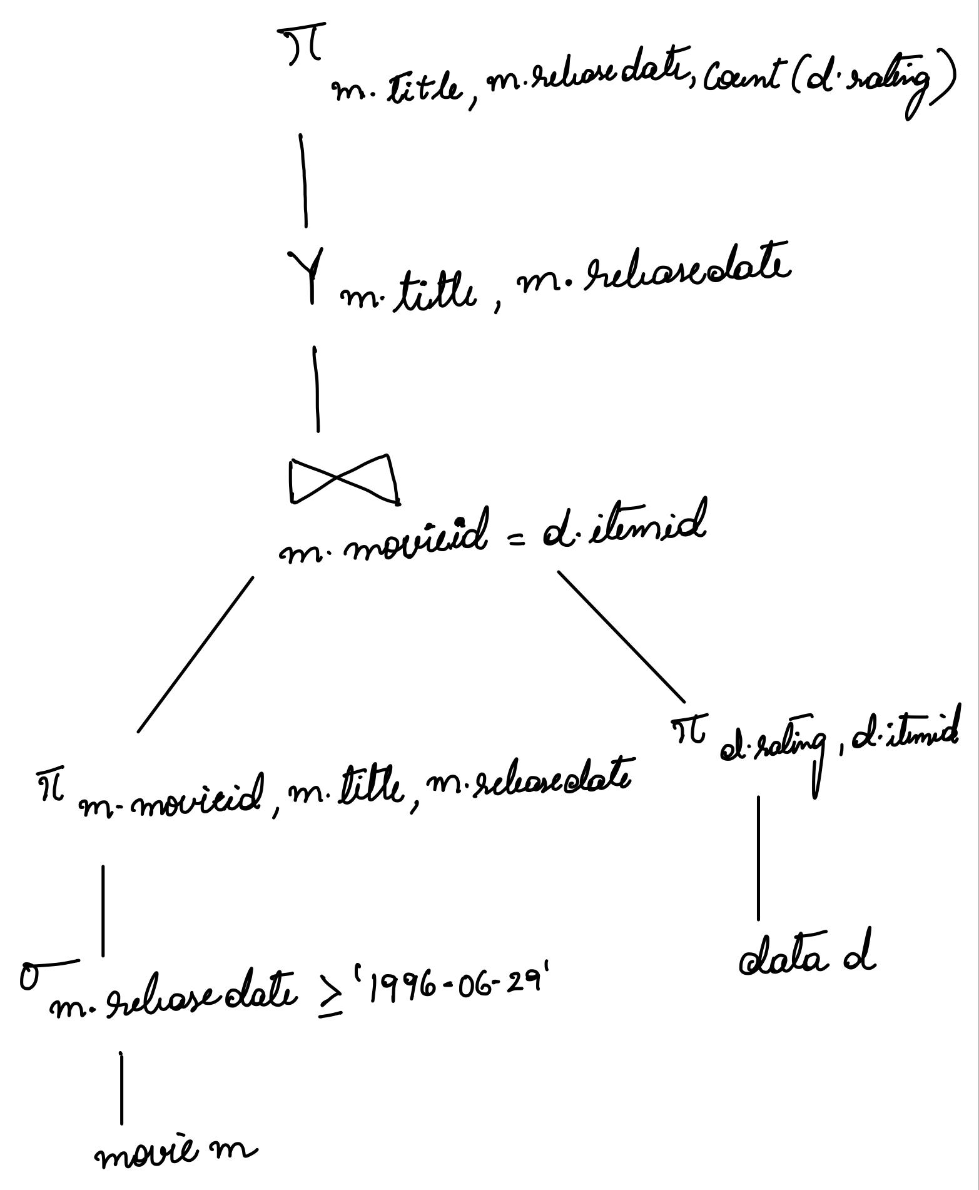
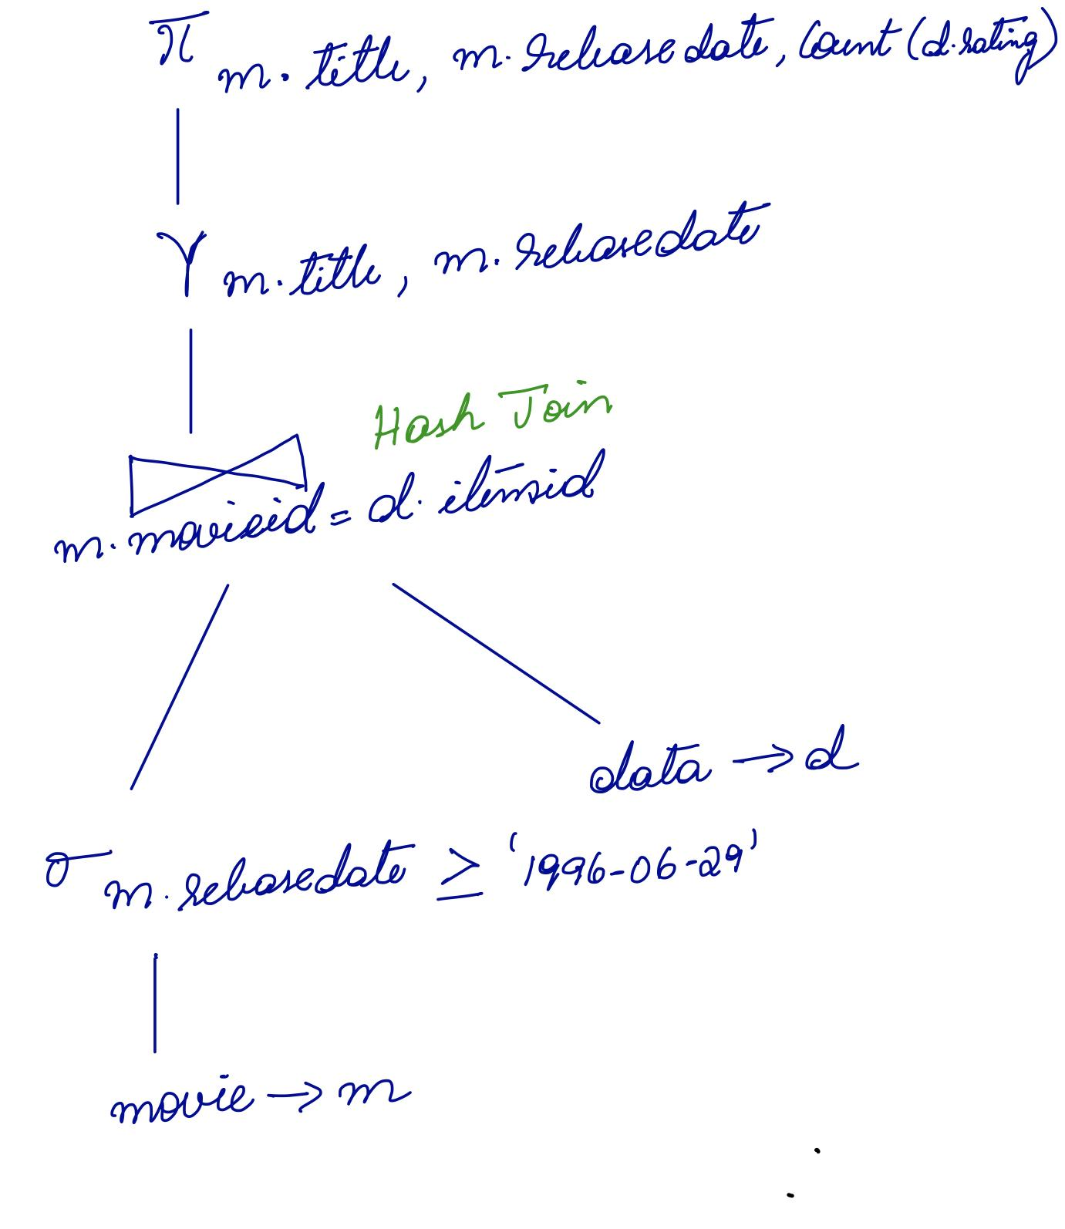
Our Explain Plan
Oracle’s Explain Plan
Notes:
Theta join

Slide 34
Query 8
Select movies watched from users who live in Palo Alto and are not an engineer
SELECT DISTINCT m.title
FROM movie m
WHERE m.movieid IN (
SELECT d.itemid
FROM data d
WHERE d.userid IN (
SELECT u.userid
FROM users u
WHERE u.occupationid IN (
SELECT o.occupationid
FROM occupation o
WHERE o.occupation != 'engineer')
AND u.zipcode IN (
SELECT z.zipcode
FROM zipcode z
WHERE z.city = 'PALO ALTO')))
Result:
Rows fetched: 53
Oracle : 0.10 seconds
Hive : 44.28 seconds

Slide 35
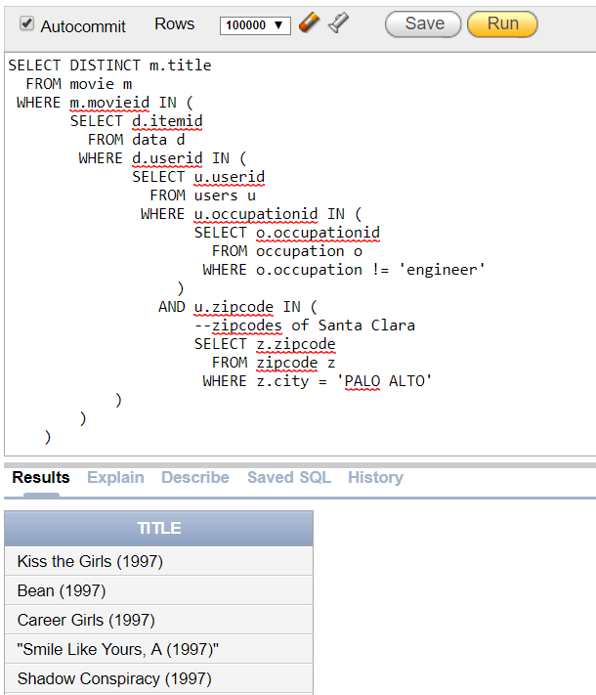
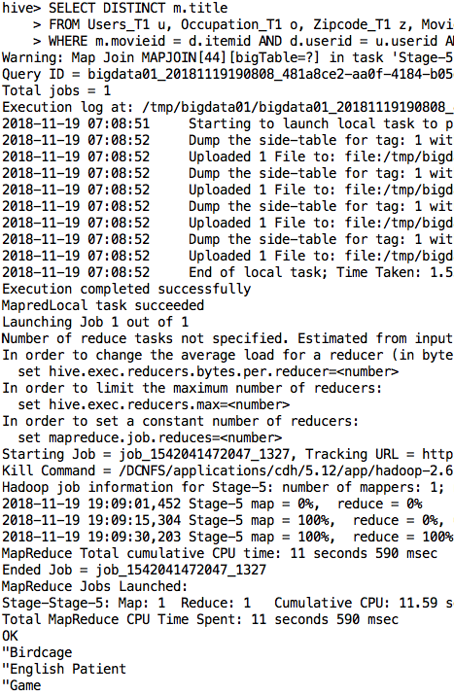
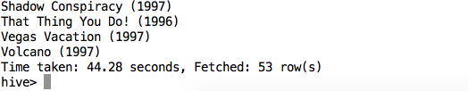
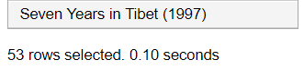
Oracle and Hive query results
Notes:
In doesn’t work in Hive, so we had to change the query to be JOIN rather than nested IN

Slide 36
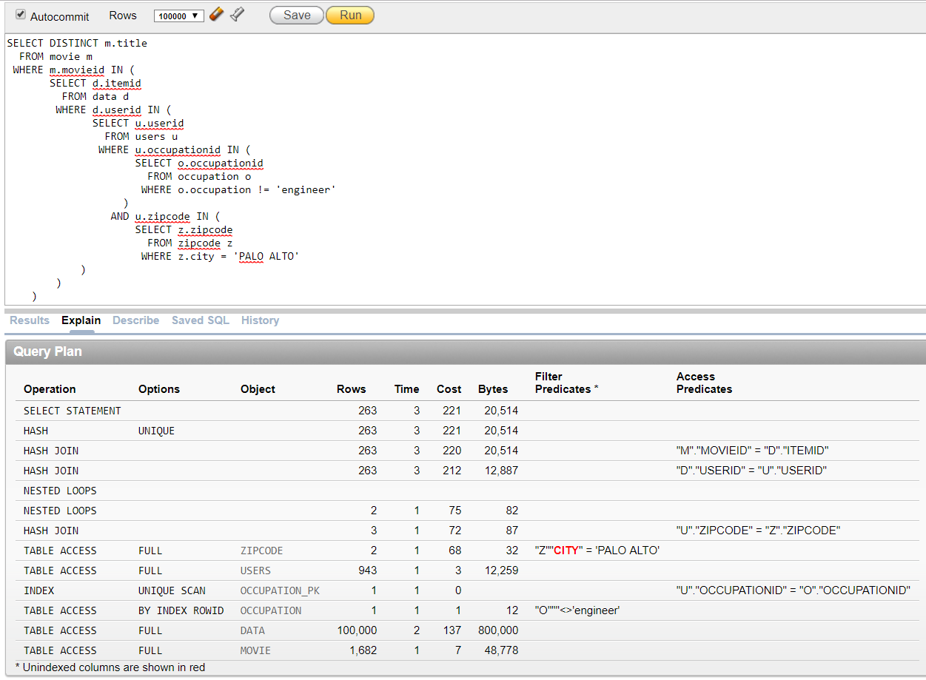
Oracle Explain Plan for Query 8
Notes:
Nested Loops join iterates through one table to look up values in the other table to join. Hash Join can’t do that. Since we have an index being used on the occupation id, doing table lookups is very efficient and thus we use nested loops join instead of hash join

Slide 37


Our Explain Plan
Oracle’s Explain Plan

Slide 38
Conclusion: Oracle is faster than Hive
Oracle uses index
Data is small enough for Oracle to run efficiently
Hive follows schema on read, better suited for large analytic processing
Hive has to do shuffling of the data
Hive has lots of overhead
Notes:
Only 100,000 rows, ~3 MB of data
When looking at the Hive logs, the Map and Reduce functions only take a few seconds, but then the total time taken is much longer. This indicates that overhead is taking place

Slide 39
Q&A

Slide 40
Thank You!!!

