Slide 1


Slide 2
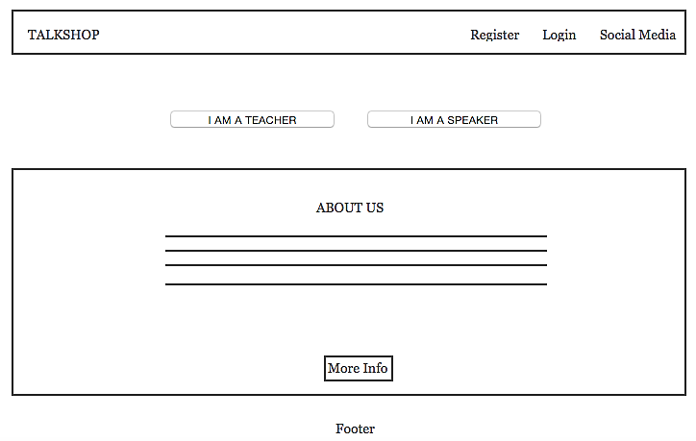
Home Page

Slide 3
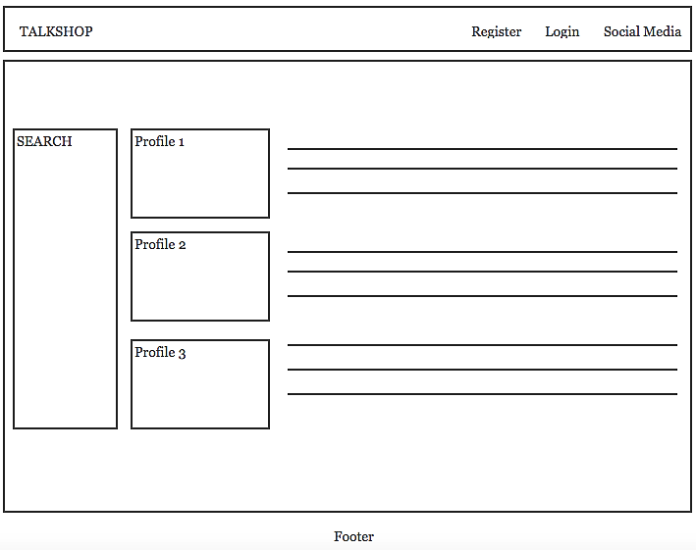
Teacher/Speaker Information Page

Slide 4
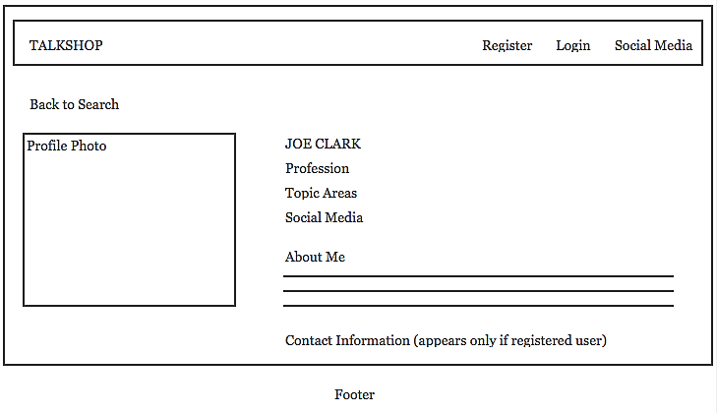
Teacher/Speaker Profile Page

Slide 5
High Level Tasks
Facilitating contact among users.
Search functions and filters.
Rating system for speakers.
Uploading photos for users.

