Slide 1

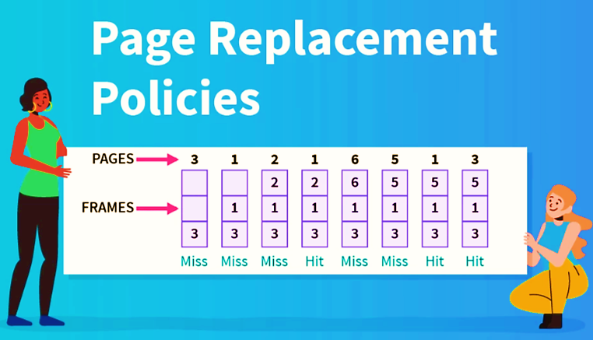
Problem Statement 8
Designing a simulator on Linux to implement the functionality of FIFO, LRU, Optimal Page Replacement Algorithms.
[2021A1R049] Ayush Thakur
[2021A1R053] Sonali Tandon
[2022A1L012] Kanav Dogra
[2021A1R051] Udhayveer Singh

Slide 2
Objective
Simulator should accept number of physical frames, list of page accesses, and the page replacement algorithm and output the number of faults and whether each access was a fault or not. Implementation of FIFO, LRU, and OPTIMAL page replacement algorithms. There must be an input file (*.txt) in the directory. The first line in the file should contain the number of physical frames. Each subsequent line represents one page access, and contains exactly one integer, which represents the page number being accessed. All values must be non-negative and fit in the int data type of the system.

Slide 3
Page Fault
A page fault occurs when the referenced page is not found in the main memory.
Virtual Memory
Virtual memory serves two purposes . First, it allows us to extend the use of physical memory by using disk. Second, it allows us to have memory protection, because each virtual address is translated to a physical address.
Paging
Paging is a storage mechanism that allows OS to retrieve processes from the secondary storage into the main memory in the form of pages.
The primary objective of all the page replacement algorithms is to minimize the number of page faults.

Slide 4
Observation
The FIFO algorithm is used in the paging method for memory management in an operating system to decide which existing page needs to be replaced in queue. FIFO algorithm replaces the First page which was present for the longest time in main memory .Thus, When a new page enters from secondary memory to main memory it selects the front of queue that is the oldest page present and removes that page.
Page Replacement: Definition & Algorithms - Video & Lesson Transcript | Study.com

Slide 5
FIFO page replacement algorithm is commonly known for its simplicity.
FIFO algorithm is much easy to implement as well as understand.
Small systems can use the FIFO algorithm efficiently.
Advantages
This algorithm is not highly effective
The system is required to keep track of each frame
Poor replacement options increase page fault rate and slow process execution.
Disadvantages

Slide 6
Algorithm
FIFO algorithm is the simplest of all the page replacement algorithms. In this, we maintain a queue of all the pages that are in the memory currently. The oldest page in the memory is at the front-end of the queue and the most recent page is at the back or rear-end of the queue. Example: Consider the page reference string as 3, 1, 2, 1, 6, 5, 1, 3 with 3-page frames. Let’s try to find the number of page faults:
Initially, all of the slots are empty so page faults occur at 3,1,2.
Page faults = 3
When page 1 comes, it is in the memory so no page fault occurs.
Page faults = 3
When page 6 comes, it is not present and a page fault occurs. Since there are no empty slots, we remove the front of the queue, i.e 3.
Page faults = 4

Slide 7
Algorithm
When page 5 comes, it is also not present and hence a page fault occurs. The front of the queue i.e 1 is removed.
Page faults = 5
When page 1 comes, it is not found in memory and again a page fault occurs. The front of the queue i.e. 2 is removed.
Page faults = 6
When page 3 comes, it is again not found in memory, a page fault occurs, and page 6 is removed being on top of the queue
Total page faults = 7

Slide 8
# Declare 'S' as a set of current pages in the system. # Declare a Queue name QPage which will be used to store the incoming pages. # Queue will store in a FIFO manner # Page fault PF is Initially set to zero. S= set(); QPage = Queue(); PF=0; for k = 0 to length (N) do if length (S) < C the if P[k] not in S then S.add(P[k]); PF = PF + 1; QPage.put(P[k]); end else
if P[k] not in S then val = QPage.queue[0]; QPage.get(); S.remove(val); S.add(P[k]); QPage.put(P[k]); PF = PF + 1; end end end return PF;

Slide 9
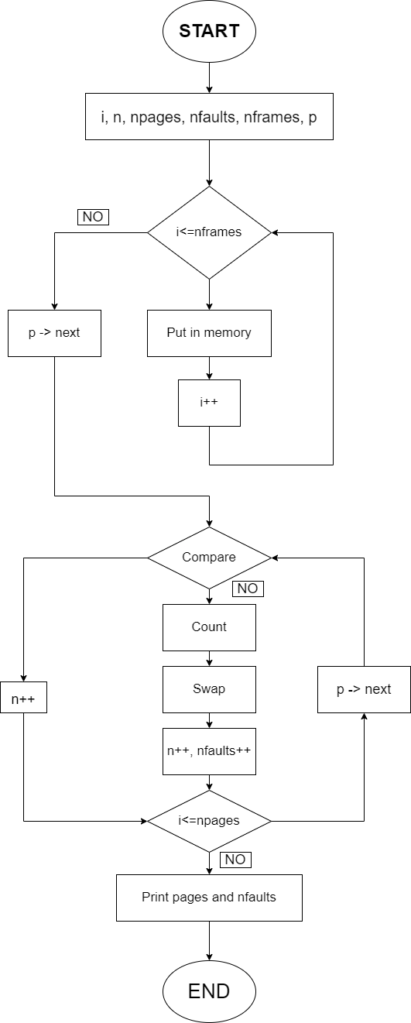
Flowchart

Slide 10
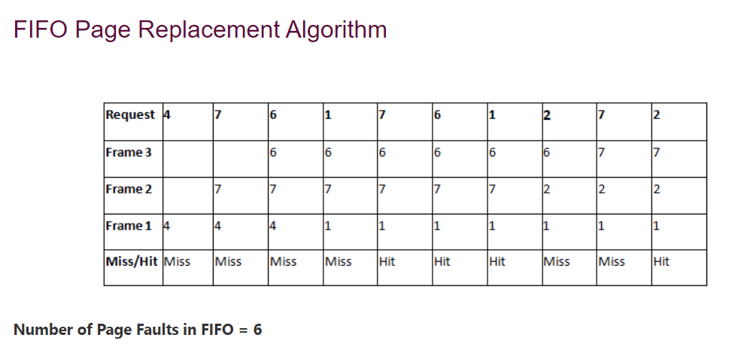
Notes:
10

Slide 11
Observation
Least Recently Used algorithm is a page replacement technique used for memory management. According to this method, that page is replaced which is least recently used . Thus in memory any page that has been unused for a longer period of time than the others is replaced.
LEAST PAGE REPLACEMENT

Slide 12
Pseudo Code
Iterate through the referenced pages.
If the current page is already present in pages:
Remove the current page from pages.
Append the current page to the end of pages.
Increment page hits.
Else:
Increment page faults.
If pages contains less pages than its capacity s:
Append current page into pages.
Else:
Remove the first page from pages.
Append the current page at the end of pages.
Return the number of page hits and page faults.

Slide 13
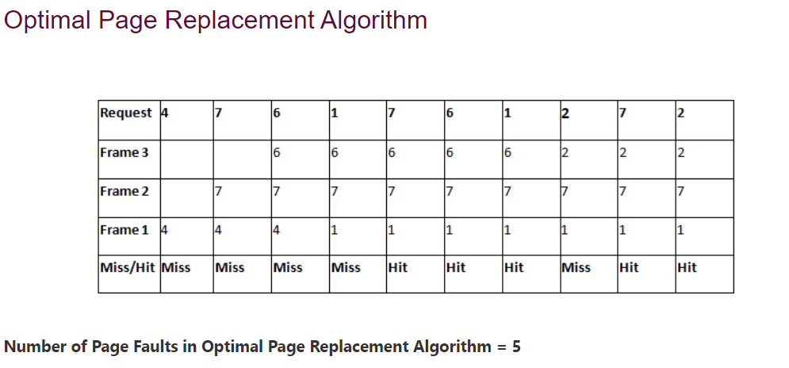

Slide 14
The page that has not been used for the longest time gets replaced.
It gives lesser page faults than any other algorithm.
The algorithm never suffers from the Belady's anomaly .
The algorithm is capable of complete analysis.
Advantages
Belady's anomaly states that increasing number of frames will never increase number of page faults if LRU page replacement algorithm is used.
Complex Implementation.
Expensive.
Requires hardware support
Disadvantages

Slide 15
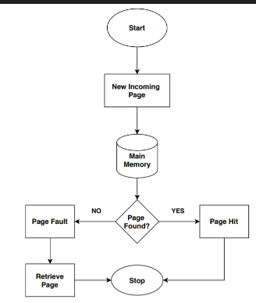
FLOWCHART OF LRU

Slide 16
Observation
In this algorithm , those pages are replaced which would not be used for the longest duration of time i.e. the page in the memory which is going to be referred farthest in the future is replaced .It is possible to implement optimal page replacement on the second run by using the page reference information collected on the first run.
OPTIMAL PAGE REPLACEMENT

Slide 17
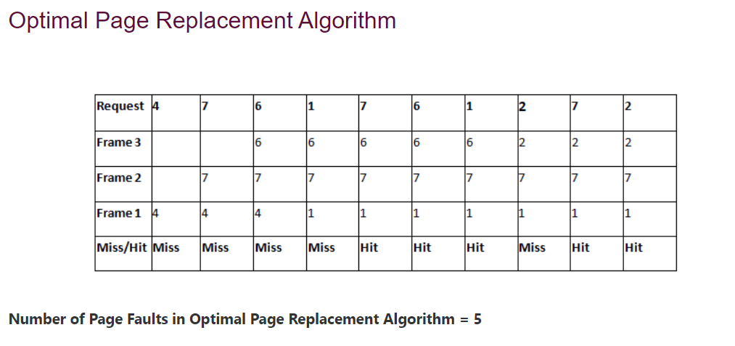

Slide 18
Easy to Implement.
Simple data structures are used.
Highly efficient.
Advantages
Requires future knowledge of the program.
Time-consuming.
Error detection is harder.
Disadvantages

Slide 19
THANK YOU

