Slide 1

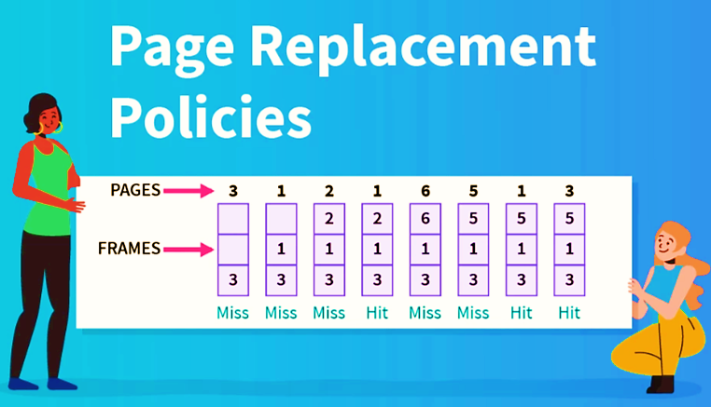
Problem Statement 8
Designing a simulator on Linux to implement the functionality of FIFO, LRU, Optimal Page Replacement Algorithms.
[2021A1R049] Ayush Thakur
[2021A1R053] Sonali Tandon

Slide 2
Objective
Implementation
FIFO (First In First Out)
LRU (Least Recently Used)
OPTIMAL Page Replacement Algorithms.
Simulator should accept:
Number of physical frames
List of page accesses
All values must be non-negative.
OUTPUT
Print page hits and page faults.

Slide 3
FIRST IN FIRST OUT
Algorithm
FIFO algorithm is the simplest of all the page replacement algorithms. In this, we maintain a queue of all the pages that are in the memory currently. The oldest page in the memory is at the front-end of the queue and the most recent page is at the back or rear-end of the queue.

Slide 4
Example
< 3, 2, 1, 3, 4, 1, 6, 2 >
4
4
4
4
3
3
3
3
1
6
6
2
2
2
2
2
2
2
1
1
1
1
1
3

Slide 5


Page Hits and Page Faults
< 3, 2, 1, 3, 4, 1, 6, 2 >
3 | 3 | 3 | 3 | 4 | 4 | 4 | 4
 | 2 | 2 | 2 | 2 | 2 | 6 | 6
 |  | 1 | 1 | 1 | 1 | 1 | 2
1
2
3
PAGE
FAULT
PAGE
FAULT
PAGE
FAULT
PAGE
HIT
PAGE
FAULT
PAGE
HIT
PAGE
FAULT
PAGE
FAULT

Slide 6
Pseudo Code
#declare variable: values, pages, frames, pageFaults, pageHits
#initialize pageHits=0 and pageFaults=0
Enter the number of pages.
Enter the reference string values.
Enter the number of frames.
Start travesing the string values into the frame.
Check if string value already present in the memory.
If yes (pageHit)
Else (pageFault)
Print pageHits and pageFaults

Slide 7
FIFO page replacement algorithm is commonly known for its simplicity.
FIFO algorithm is much easy to implement as well as understand.
Small systems can use the FIFO algorithm efficiently.
Advantages
This algorithm is not highly effective
The system is required to keep track of each frame
Poor replacement options increase page fault rate and slow process execution.
Disadvantages

Slide 8
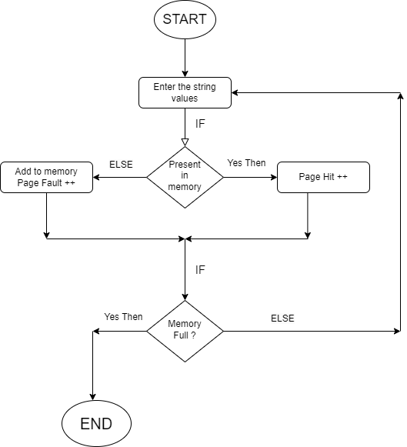
Flowchart

Slide 9
LEAST PAGE REPLACEMENT
Algorithm
Least Recently Used algorithm is a page replacement technique used for memory management. According to this method, that page is replaced which is least recently used . Thus in memory any page that has been unused for a longer period of time than the others is replaced.

Slide 10
Example
< 3, 2, 1, 3, 4, 1, 6, 2 >
6
6
3
3
3
3
3
3
1
2
4
4
4
2
2
2
2
1
1
1
1
1
1
3

Slide 11
Page Hits and Page Faults
< 3, 2, 1, 3, 4, 1, 6, 2 >
3 | 3 | 3 | 3 | 3 | 3 | 6 | 6
 | 2 | 2 | 2 | 4 | 4 | 4 | 2
 |  | 1 | 1 | 1 | 1 | 1 | 1
1
2
3
PAGE
FAULT
PAGE
FAULT
PAGE
FAULT
PAGE
HIT
PAGE
FAULT
PAGE
HIT
PAGE
FAULT
PAGE
FAULT

Slide 12
Pseudo Code
Iterate through the referenced pages.
If the current page is already present in pages:
Remove the current page from pages.
Append the current page to the end of pages.
Increment page hits.
Else:
Increment page faults.
If pages contains less pages than its capacity s:
Append current page into pages.
Else:
Remove the first page from pages.
Append the current page at the end of pages.
Return the number of page hits and page faults.

Slide 13
The page that has not been used for the longest time gets replaced.
It gives lesser page faults than any other algorithm.
The algorithm never suffers from the Belady's anomaly .
The algorithm is capable of complete analysis.
Advantages
Belady's anomaly states that increasing number of frames will never increase number of page faults if LRU page replacement algorithm is used.
Complex Implementation.
Expensive.
Requires hardware support
Disadvantages

Slide 14
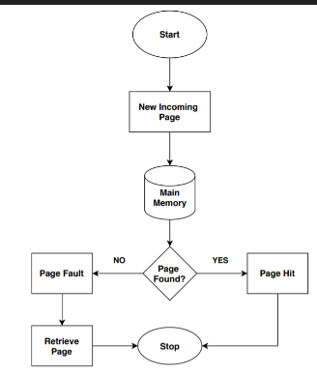
FLOWCHART OF LRU

Slide 15
Optimal Page Replacement
Algorithm
"Optimal page replacement algorithm" is the most desirable page replacement algorithm that we use for replacing pages. This algorithm replaces the page whose demand in the future is least as compared to other pages from frames (secondary memory). The replacement occurs when the page fault appears. The purpose of this algorithm is to minimize the number of page faults.

Slide 16
Example
< 3, 2, 1, 3, 4, 1, 6, 2 >
4
4
4
3
3
4
3
3
1
2
2
2
2
2
2
2
2
6
6
1
1
1
1
3

Slide 17
Page Hits and Page Faults
< 3, 2, 1, 3, 4, 1, 6, 2 >
3 | 3 | 3 | 3 | 4 | 4 | 4 | 4
 | 2 | 2 | 2 | 2 | 2 | 2 | 2
 |  | 1 | 1 | 1 | 1 | 6 | 6
1
2
3
PAGE
FAULT
PAGE
FAULT
PAGE
FAULT
PAGE
HIT
PAGE
FAULT
PAGE
HIT
PAGE
FAULT
PAGE
HIT

Slide 18
Pseudo Code

Slide 19
FLOWCHART OF OPTIMAL PAGE REPLACEMENT

Slide 20
References
Jenny's Lectures: FIFO , LRU and Optimal Page Replacement
Last moment tuitions: FIFO, LRU and OPTIMAL PAGE REPLACEMENT
Geeks For Geeks: Page Replacement Algorithm
Java point: OS Page Replacement Algorithm
Scaler: Page Replacement Algorithm
Wikipedia: Page replacement algorithm
After academy: Page Replacement Algorithms
Research Paper 1
Research Paper 2

Slide 21
THANK YOU

