Slide 1
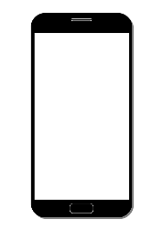
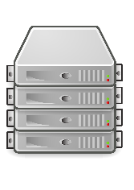



Auth Sequence Diagram
user
Mobile App
server
pot ( IoT )
LoginReq()
Authenticate()
ResponseToken()

Slide 2
EntryPot Sequence Diagram
user
Mobile App
server
pot ( IoT )
AddPot()
EntryPotSerial()
WebSocketListen()
WebSocketConnect()
SendPlantDataObject()
RecvPlantDataObject()
link

Slide 3
Water Sequence Diagram
user
Mobile App
server
pot ( IoT )
SendPlantDataObject()
WaterReq()
RecvPlantDataObject()
WaterTankCheck()
Water()
link

