Slide 2
< Redis Architecture >
Cluster1
worker Node
redis-pod-0
redis-pod-1
redis-pod-2
redis-pod-3
redis-pod-4
redis-pod-5
Host Port
Cluster2
Redis Client

Slide 3
< Redis Architecture in Multi Cluster >
Cluster1
Cluster2
Multi Clustering
redis-svc-0
redis-svc-1
redis-svc-2
redis-svc-3
redis-svc-4
redis-svc-5
redis-svc-0
redis-svc-1
redis-svc-2
redis-svc-3
redis-svc-4
redis-svc-5
redis-pod-0
redis-pod-1
redis-pod-2
redis-pod-3
redis-pod-4
redis-pod-5
Redis Client

Slide 4
< Airflow Architecture >
Cluster1
Cluster2
Airflow
Rest Batch Call
Ingress
Rest Gateway for Airflow
인증 토큰 처리
Call 인증처리
MS1 Svc
MS2 Svc
MS3 Svc
…
…
…
MS1 Pod
MS2 Pod
MS3 Pod
…
…
…

Slide 5
< Airflow Architecture in Multi Cluster >
Cluster1
Cluster2
Multi Clustering
Airflow
Rest Batch Call In Cluster
MS1 Svc
MS2 Svc
MS3 Svc
…
…
…
MS1 Svc
MS2 Svc
MS3 Svc
…
…
…
MS1 Pod
MS2 Pod
MS3 Pod
…
…
…

Slide 6
< Elastic Stack Architecture >
Cluster1
Cluster2
Elastic Data 수집
Elastic Search
Elastic
Svc
APM Server
Fleet Server
Agent Policy
Ingress
APM Svc
Tracing
POD
POD
POD
APM Agent
Ingress
APM Server
APM Data

Slide 7
< Elastic Stack Architecture in Multi Cluster >
Cluster1
Cluster2
Multi Clustering
Elastic Data 수집
Elastic Search
Elastic
Svc
APM Server
Fleet Server
APM Svc
Tracing
POD
POD
POD
APM Agent
Agent Policy
APM Server
APM Data
APM Svc
Elastic Svc

Slide 8
< Multi Cluster Remote POD Call >
Cluster1
Cluster2
frontend
Backend Service
Backend Service
backend-pod-1
10.0.0.1
backend-pod-2
10.0.0.2
backend-pod-1
10.1.0.1
backend-pod-2
10.1.0.2

Slide 9
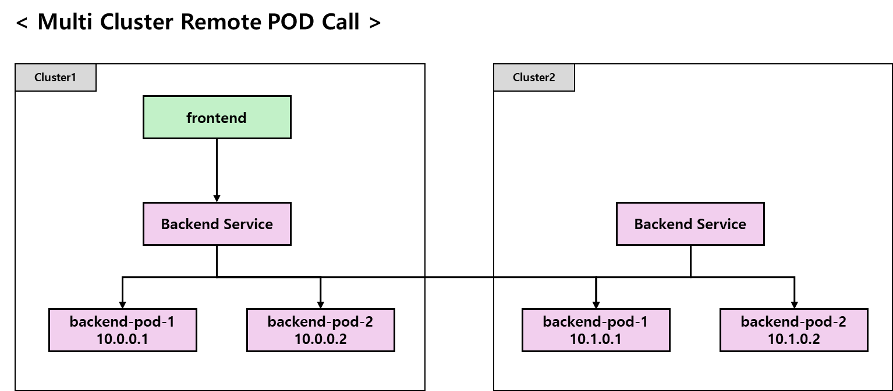

Slide 10
< Cluster Service 별 Routing 설정 >
Cluster1
Cluster2
frontend
Backend Service
Backend Service
← Failover
backend-pod-1
10.0.0.1
backend-pod-2
10.0.0.2
backend-pod-1
10.1.0.1
backend-pod-2
10.1.0.2
장애발생 or Upgrade 사유로 서비스 중지

Slide 11
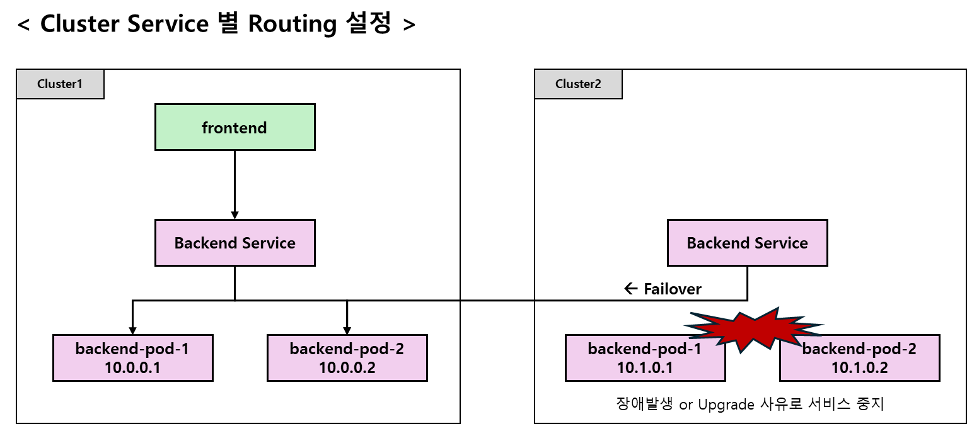

Slide 13






MicroSoft Azure Cloud
http://userlist.songedu.duckdns.org/
K8s Cluster
Load Balancer
VM(Node)
Brower
userlist pod
20.249.174.177
Routing Rule
Node Port
traefik
pod1
Ingress
Controller
userlist-svc
in:80, Out:31271
31271
Service
Azure
Public IP
in:443, Out:31448
pod1
31448
RoundRobbin
Domain을 IP로 변환
Service

