Slide 1
AutoML
2019.1.31

Slide 2
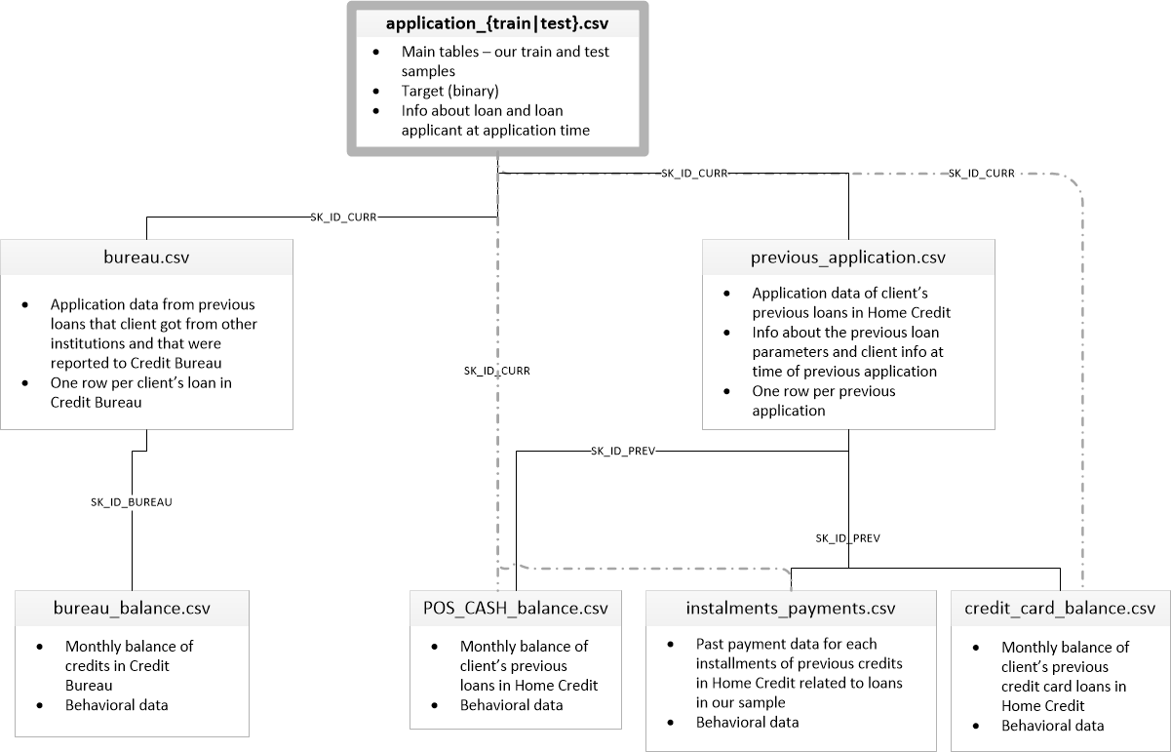
Data introduction
HHome Credit Default Risk
efault Risk
Notes:
application_{train|test}.csv 申请信息，主要是申请人身份数据
bureau.csv 所有客户以前由其他金融机构提供的信用报告
bureau_balance.csv 信用局以前信用的每月余额
POS_CASH_balance.csv 以前POS（销售点）和申请人拥有房屋信贷的现金贷款的每月余额
credit_card_balance.csv 申请人拥有Home Credit的以前信用卡的每月余额。
previous_application.csv 客户之前所有的住房贷款申请
installments_payments.csv 以前支付的房屋信贷信用的还款历史

Slide 3
AutoML Framework
MEAN(payments.payment_amount)
LAST(loans.(MEAN(payments.payment_amount)))
FeatureTools （Feature Engineering ）
Word2Vec （ Feature Engineering ）
LightGBM （Fit Model）
RandomForest （Fit Model）
Autosklearn （Feature Selection+Model+Parameter Optimization）
Hyperopt （Parameter Optimization ）
Tpot （Feature Selection+Model+Parameter Optimization）
Notes:
例如，MEAN（payments.payment_amount）列是深度为1的深层特征，因为它是使用单个聚合创建的。深度为2的特征是LAST（贷款（MEAN（payments.payment_amount））这是通过堆叠两个聚合来实现的，这表示每个客户最近贷款的平均支付额。

Slide 4
AutoML Framework
Model 1st:
Orginal data + Label Encoder + LightGBM
Using Label Encoder to process category features
No feature selection
Using LightGBM to fit data
Manual parameter tuning

Slide 5
AutoML Framework
Model 2^{nd :}
FaetureTools + Label Encoder + LightGBM
Using Label Encoder to process category features
Feature selection with FeatureTools
Using LightGBM to fit data
Manual parameter tuning

Slide 6
AutoML Framework
Model 3rd:
FaetureTools + Label Encoder + LightGBM + Hyperopt
Using Label Encoder to process category features
Feature selection with FeatureTools
Using LightGBM to fit data
Using Hyperopt to tune parameters

Slide 7
AutoML Framework
Model 4th:
FeatureTools + Word2Vec + LightGBM
Using Word2Vec to process category features
Feature selection with FeatureTools
Using LightGBM to fit data
Manual parameter tuning

Slide 8
Model Comparison
Model | Number of Features | Validation ROC AUC | Test ROC AUC
1st | 120 | 0.726 | 0.71
2nd | 262 | 0.7538 | 0.7355
3rd | 262 | 0.7459 | 0.7383
4th | 437 | 0.7552 | 0.64
Notes:
Orginal data + Label Encoder + LightGBM
FaetureTools + Label Encoder + LightGBM
FeatureTools + Label Encoder + LightGBM + Hyperopt
FeatureTools + Word2Vec + LightGBM

Slide 9
AutoML Framework
Model 5th:
Orginal data + Label Encoder + Random Forest(Manual)
Using Label Encoder to process category features
No feature selection
Using Random Forest to fit data
Manual parameter tuning

Slide 10
AutoML Framework
Model 6th:
Orginal data + Label Encoder + AutoSklearn
Using Label Encoder to process category features
Using AutoSklearn for feature selection
Using AutoSklearn to fit data
AutoSklearn for parameter tuning

Slide 11
AutoML Framework
Model 7th:
FeatureTools + Label Encoder + Random Forest(TPOT)
Using Label Encoder to process category features
Feature selection with FeatureTools
Using Random Forest to fit data
Using TPOT to tune parameters

Slide 12
AutoML Framework
Model 8th:
FeatureTools + Label Encoder + AutoSklearn
Using Label Encoder to process category features
Feature selection with FeatureTools
Using AutoSklearn to fit data
Using AutoSklearn to tune parameters

Slide 13
Model Comparison
Model | Number of Features | Validation ROC AUC | Test ROC AUC
5th | 120 | 0.597 | 0.585
6th | 120 | 0.714 | 0.626
7th | 262 | 0.745 | 0.725
8th | 262 | 0.703 | 0.643
Notes:
5th:original data + Label Encoder + RF(default)
6th:original data + Label Encoder + AutoSklearn
7th:Feature Tools + Label Encoder + RF(TPOT)
8th:Feature Tools + Label Encoder + AutoSklearn

