Slide 1





Home
Search
Data 603
Library
Spotify Charts Analysis
New playlist
Liked songs
PYSPARK
DATABRICKS
BIGDATA
Custom sorting
FINAL PROJECT
STREAMING
SONGS
#
ALBUM
ADDED ON
TITLE
Data 603 Final Project
Submitted By: Karan Ajay Pisay & Srashti Soni
DATA 603 – FINAL PROJECT
Artist
1:44
2:29

Slide 2
Introduction:
Spotify, which began in Sweden, has grown to become one of the world's most popular music streaming services.
Since 2006, the company has grown in popularity, and in the first quarter of 2022, it has 182 million paying users.
The enormous number of Spotify users, made it possible to build a big content database and extract useful patterns from Spotify charts and track metadata.
The analysis conducted on the Spotify datasets provides significant insights into the data and popularity of the tracks, artist and it also helps comprehend the types of tracks that were popular in which region across the globe.
Scope of this project is to provide information to the music companies and artists to understand their audience well and produce songs according to the likability of the audience.

Slide 3
Data Gathering, Data cleaning & Data Wrangling
For the current project we have used 3 datasets from Kaggle. The dataset meets the project requirement as it sums up to 3.7 GB after combining them together.
We have used Pyspark to perform extract and transform operations. To gather the data, we had to chunk the large CSV file into small chunks and then load it into data bricks. Once all eleven chunks are loaded into the data bricks, we extracted all of them into 3 data frames.
The extracted data is then cleaned and used for further analysis.
After an overview of the data, we observed that the data had to be cleaned and managed according to the schemas. Moreover, we had to ensure that the null values were eliminated and the data was clean and ready for analysis without any garbage and duplicate values.

Slide 4
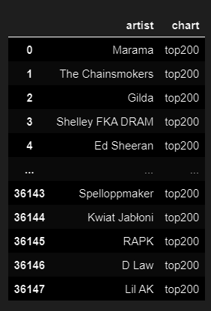


Overview of the data:
- As we can see the data ranges from the following dates. It contains the list of songs, artists, metadata of the music, region of the songs, and several more attributes.
- This is a general overview of the artists that appeared on the top200 charts of Spotify.

Slide 5
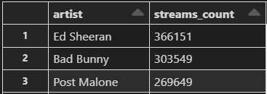
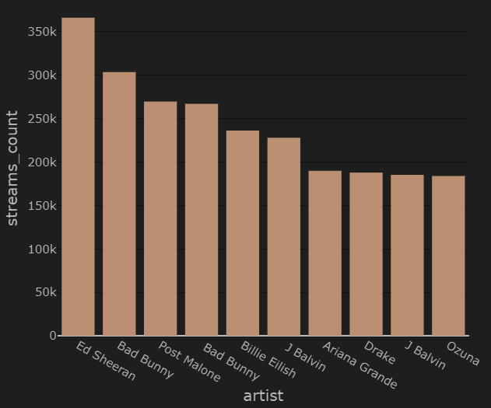
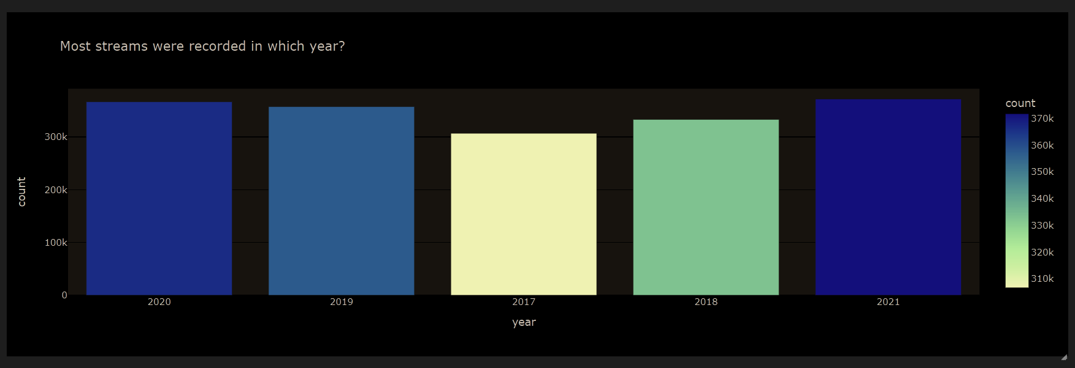
Artists with highest number of appearance on the charts:
Most streams were recorded in which year?
- As we can see in the table, Ed Sheeran appeared on the charts highest number of times followed by Bad Bunny and Post Malone. And after some further research, we were able to find out that Ed Sheeran, Bad Bunny and Post Malone were on the chart's highest times because of the following songs:
Ed Sheeran : Shape Of You, Perfect, Thinking Out Loud
Bad Bunny : Drivers License with(Olivia Rodrigo)(Spanish)
Post Malone: Rockstar and SunFlower.
As we can see that the maximum streams were recorded in the year 2021. However, we cannot completely ignore that the year 2020 and 2021 were the years of COVID pandemic and study suggests that people were more active on social media during this time and in the past couple of years, Spotify also introduced new offers and plans to promote and increase their customer base. Hence there has been a higher number of activity since 2019 in the Spotify dataset.

Slide 6
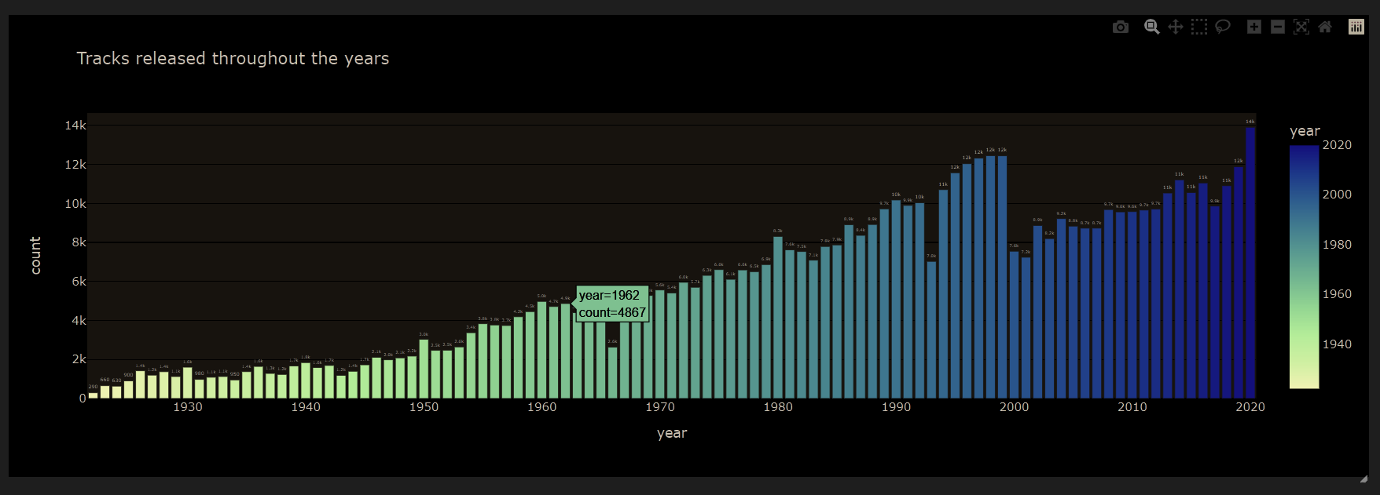

A general overview of the data set shows that the maximum songs were released in the year 2020.
We believe that this significant impact on the number of songs released has happened due to the pandemic.
As people were quarantined, artist had better accessibility to people as a lot of people introduced themselves to their creative sides.

Slide 7
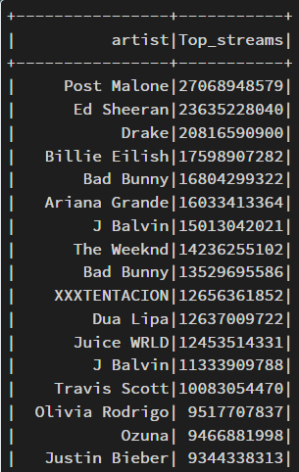
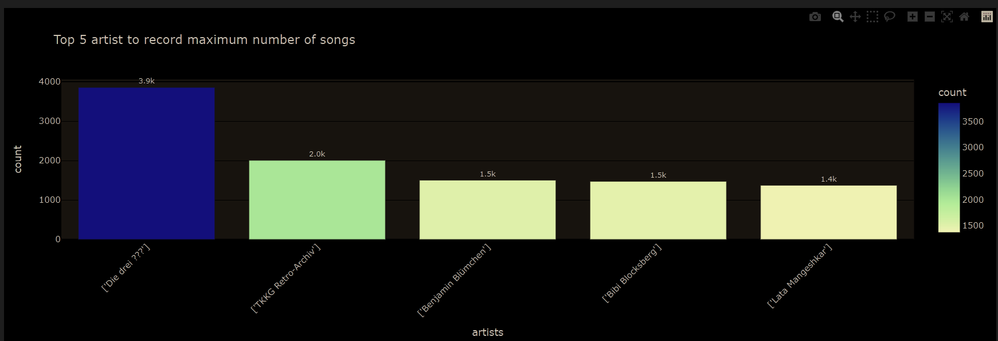
Artist with highest number of streams:
Top 5 artist to record maximum number of songs
FUN Fact: Lata Mangeshkar has lived 94 yrs. that is 33000 days approx. but after some google research it was found that she has over 50,000 sounds recorded under her name.
- Post Malone, Ed Sheeran and Drake have also manages to acquire the highest number of streams on Spotify. Further research showed that Post Malone Is Just The Second Musician To See Five Songs Reach One Billion Streams On Spotify after Justin Bieber.

Slide 8
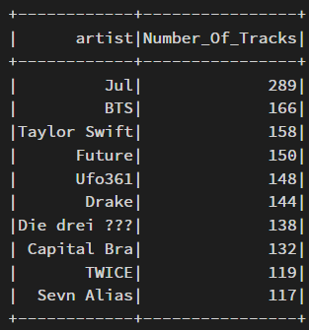
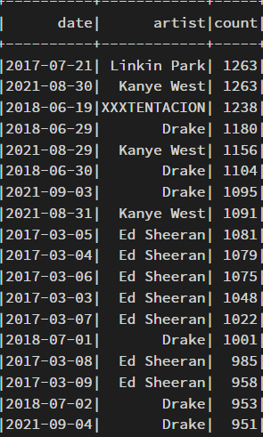
Artist with maximum number of tracks to feature on charts
Artist with highest number of charts in a day:
Jul and BTS, it's no surprise that they're so popular. They make music that appeals to a wide range of people, regardless of their interests, and they promote the notion that it's vital to support and love oneself. Furthermore, topics like self-love was key in the past couple of years.
As we can see in the above table, Linkin Park came across 850+ charts on 07/21/2017. And after a short google search, we found out that in case of Linkin Park, XXXTENTACION and Avicii; they are appeared on the maximum number of charts on Spotify right after the day they died.

Slide 9
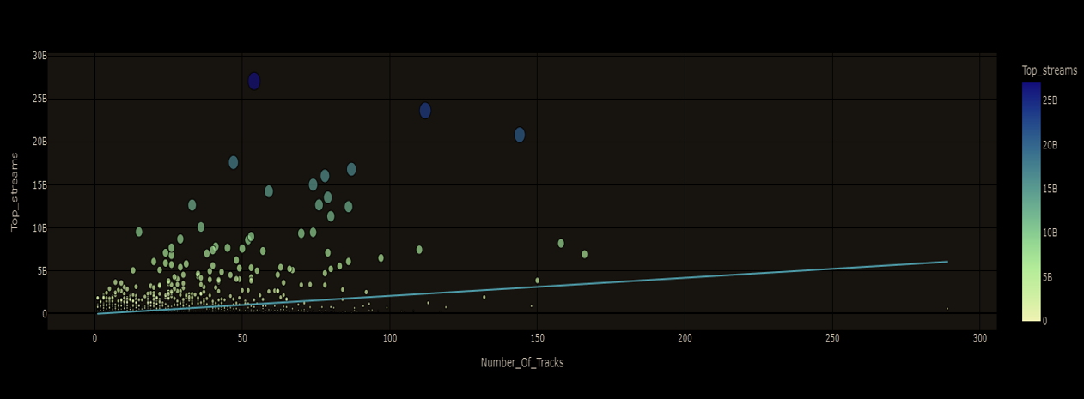
Finding the relation graph between the number of songs and the number of streams:
From the above graph we can evidently see that some streams have managed to get high number of streams or fall in the category of 15 to 20 million plus even though they have no composed more than 5 tracks and on other hand there is a artist who has composed nearly 300 songs but not managed to get the streams. This shows that there is not much correlation between the number of songs and the streams.

Slide 10
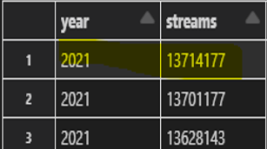
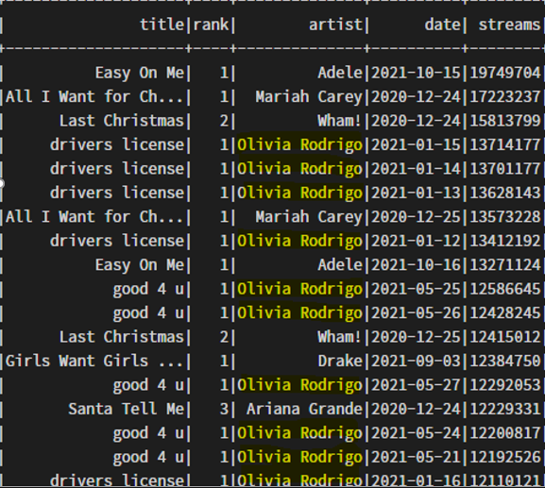
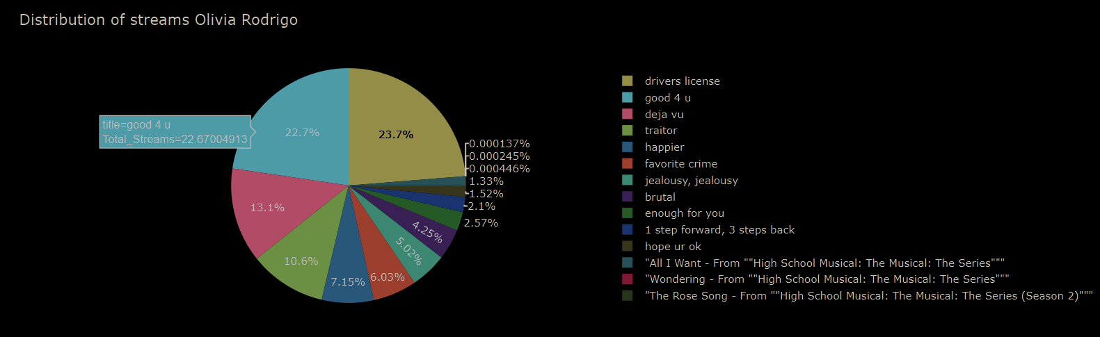
Highest number of streams for a single track on a single day and about ‘Olivia Rodrigo’
Olivia Rodrigo was trending in 2021 because she had released her 2 biggest hits “GOOD 4 U” and “DRIVERS LICENSE “in 2021. She first appeared on top200 charts on 27th Dec 2019.
In the top 20, we see many of them are Christmas songs played a day prior and post 25th DEC. However, All the other 11 are by Olivia Rodrigo.
Out of all her streams maximum streams came from the following two songs:

Slide 11
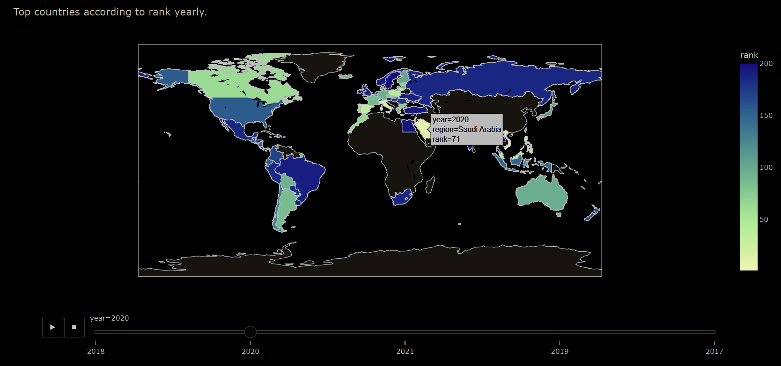
Which region has appeared on top200 charts rank wise:
After playing the visualization, we have observed that European countries and North American and South American countries have been consistent on the Top 200 charts in the year 2017-2021. The songs produced in these contraries have been ranked in the top200 through the years.

Slide 12
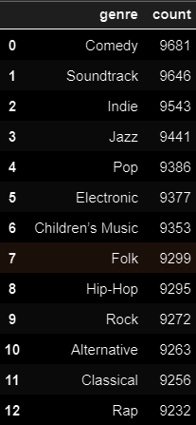
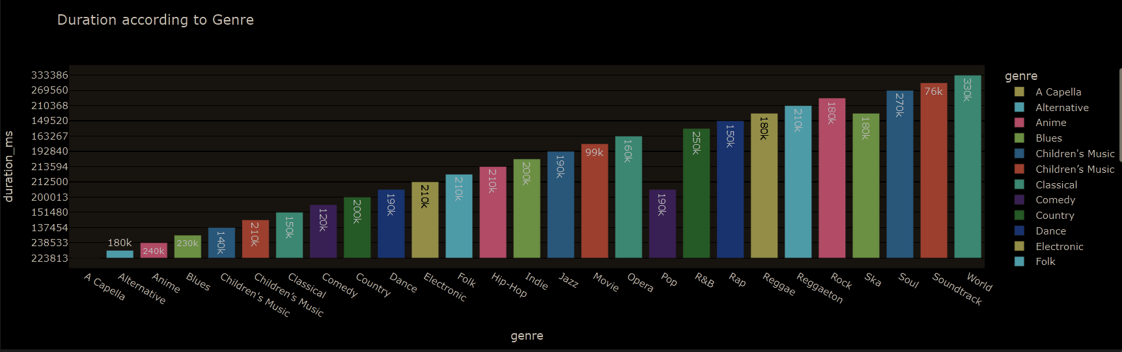
Which Genre has the maximum duration of music produced over the years?
Approximate count of genre according to songs released over the years.
Here we can see that maximum duration of sound produced is from the world genre followed by soundtrack.
World Genre is western popular music clubbed with traditional music.
Soundtrack is a genre. It belongs to shared tradition or a set of conventions.

Slide 13
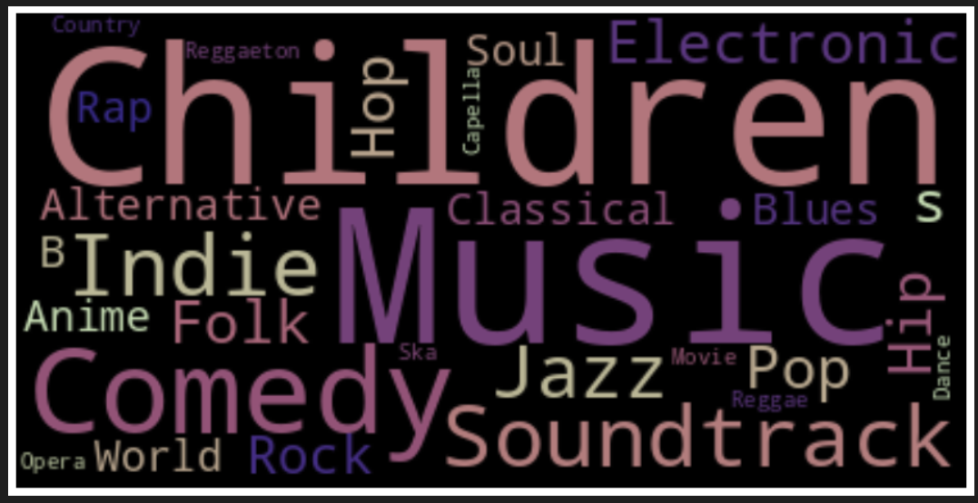
Most popular Genres amongst all!

Slide 14
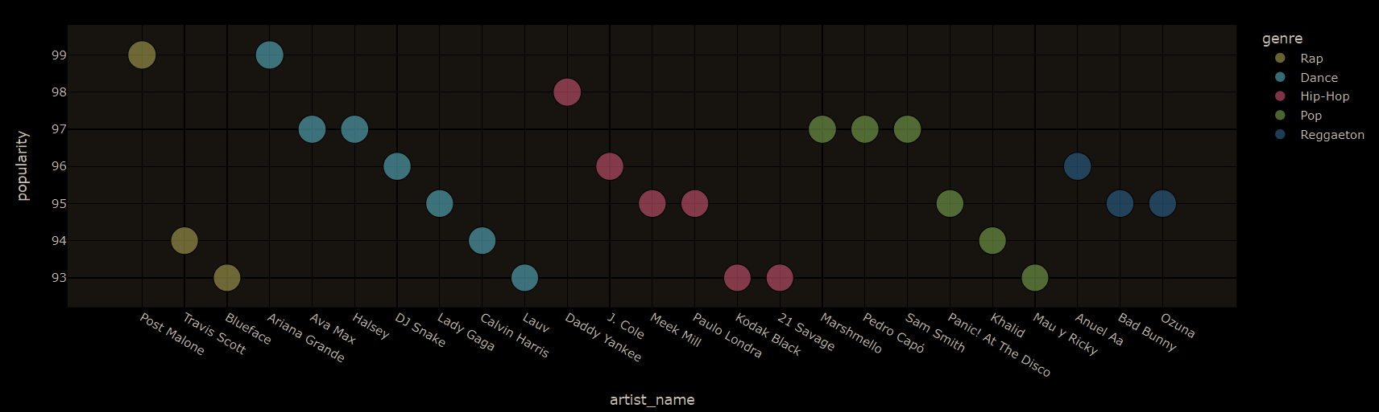
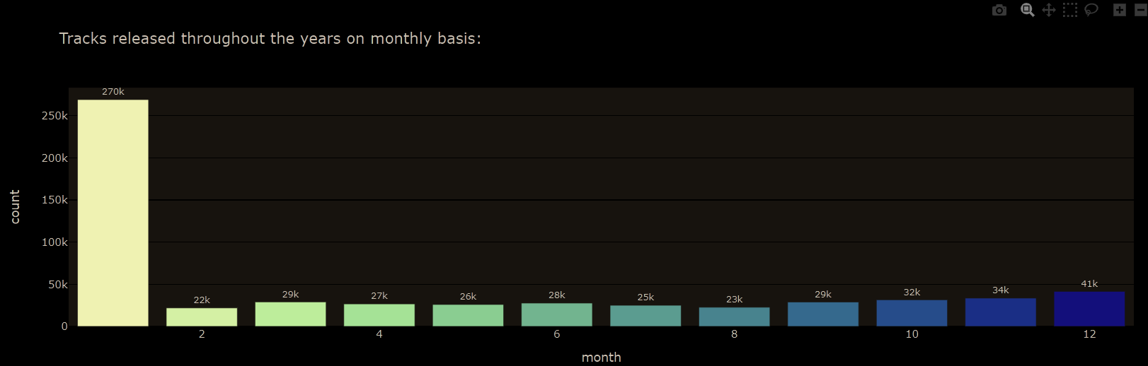
When are the maximum songs released through out the year and why?
Artists with different genre and their popularity
- January, because in the beginning of the year, everyone is also getting back into the swing of things and eager to find the next big thing. Furthermore, initial days of the year, the minds of your listeners are open to new things.
- As we can see that different artist are popular for different styles of music. Below graph shows that how various artist exceled in their Genre and climbed their way to the top.

Slide 15
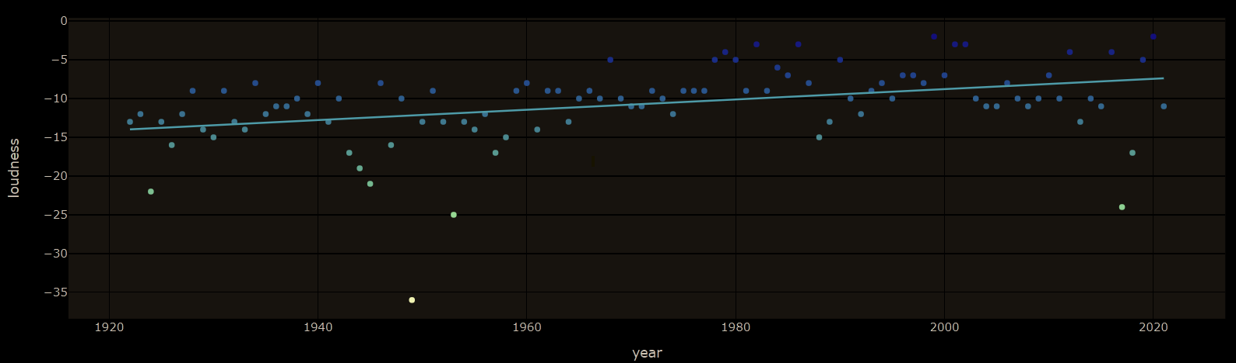
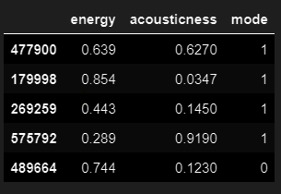
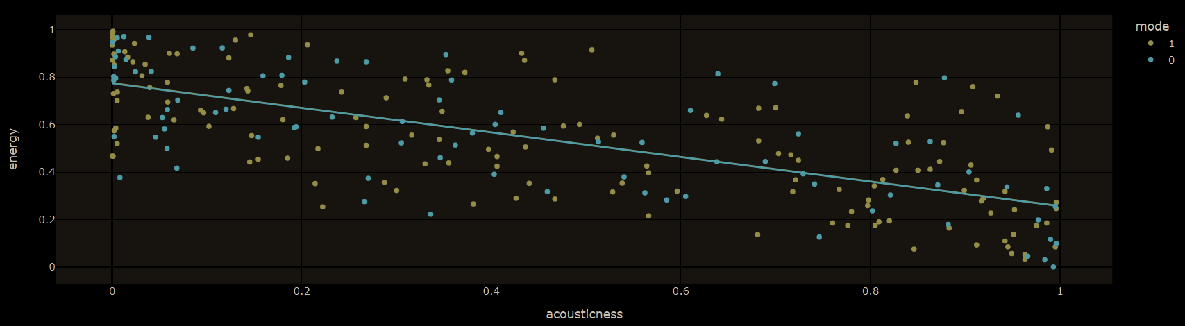
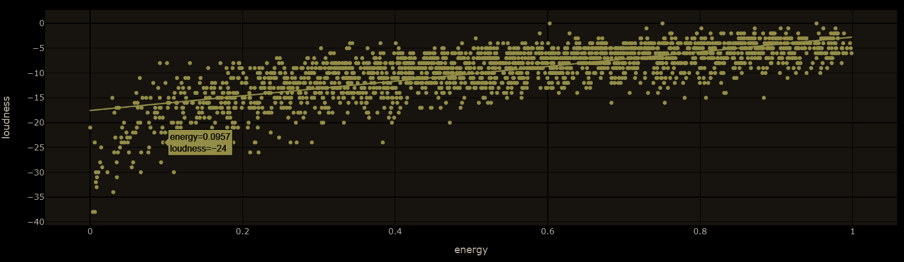
Now let's delve into the minute details of the music:
Loudness of the songs over the years:
Energy VS acousticness of the music:
- As the data suggests, the loudness of the songs over the years have increased but there is no significant raise in the loudness.
- Here we observe that the energy of the songs is inversely proportional to the acousticness as the energy of the song drops the acousticness increases.
Loudness and Energy:

Slide 16
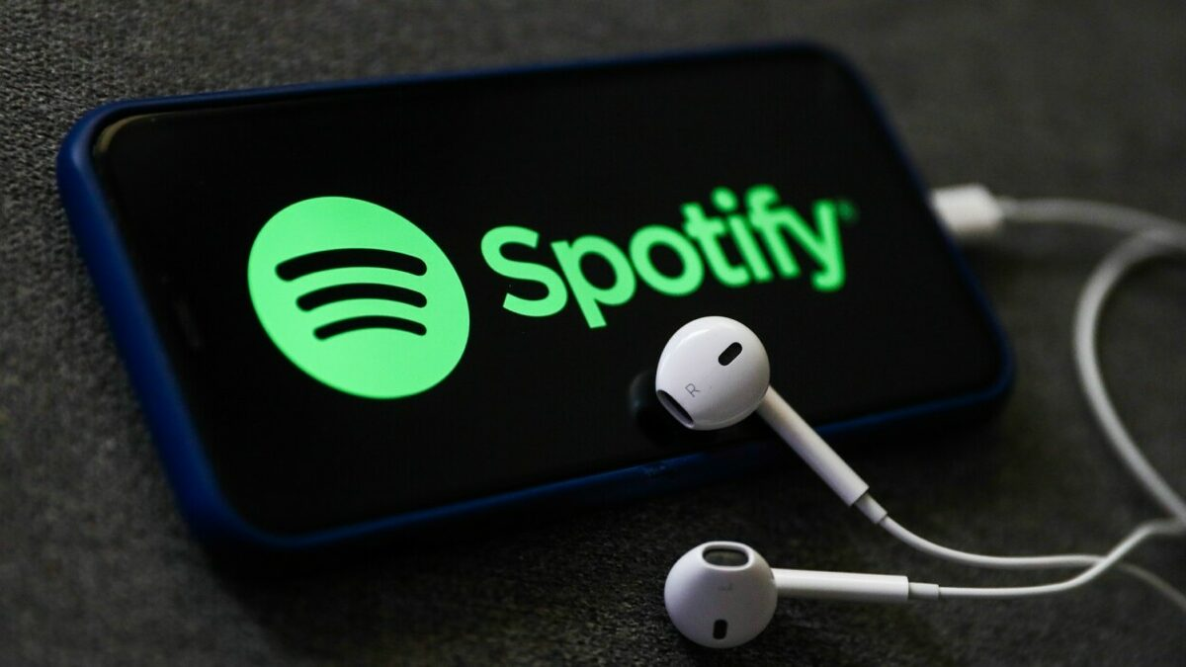
Some Fun Facts About Spotify:
Spotify has 182 million premium users globally in the first quarter of 2022, up from 158 million in the same quarter of 2021. Spotify's subscription base has grown significantly in recent years, more than doubling since early 2017.
For the second year in a row, Bad Bunny was the most-streamed artist in the world on Spotify at the end of 2021.
Bad Bunny became the all-time most-streamed artist on Spotify in a single day on Friday, May 6th, according to Spotify. Within 24 hours, he had 183 million Spotify streams.
"Despacito" was the song that stayed in first position for the longest period of time. This song has been streamed over 1.9 billion times on Spotify.

Slide 17
Conclusion:
After analyzing the data, we were able to conclude that there are humungous number to deal with and gather information from the music industry. Music industry being one of the oldest and the most popular sector contains so many unknown and hidden facts.
Every artist has to out stand of the crowd to ensure success and they must deliver the right type of music depending on their audience to ensure they remain on the charts throughout their time.
Some artist produce music which promotes self-love while the other find their ways by composing music based on the occasions and festivals.
Producing music consistently, does not ensure success or higher number of streams. Popularity of the song is simply based on the music and the audience's likability.
The majority of popular songs are more danceable and energetic. Such tunes are appropriate for lightening our mood or for playing at celebrations.
Ed Sheeran , Bad Bunny and post Malone are considered as the most consistent and highly successful artist of the time.
Out of the millions of artists around the globe, only 2097 were able to make in on the top200 charts.
Despacito was on the top for the maximum number of days
Covid pandemic played a major role in the streams and songs producing as the number spiked highly in the year 2020 and 2021.
January is the best month for releasing songs and most songs are released in January itself because of the mind openness of the people.
At time artist peaked the charts on the single day when they passed away.
Olivia Rodrigo came on Spotify in 2017, and her significance boomed in 2020 and 2021 because of her 2 biggest hits.
Comedy music has recorded maximum duration in the music industry.
Most popular genre is Children as now a days parents use the medium of music to keep their toddlers engaged.
The causticness, loudness and energy play crucial role in audibility of the songs and the loudness of the songs have gone higher over the years.

Slide 18
References:
https://www.kaggle.com/code/liwinson/spotify-charts-artist-diversity-by-country
https://www.kaggle.com/code/dhruvildave/spotify-charts-exploratory-data-analysis
https://www.musicbusinessworldwide.com/bad-bunny-is-king-of-spotify-setting-new-all-time-record-for- streams-in-a-single-day/
https://newsroom.spotify.com/news/
https://en.wikipedia.org/wiki/Spotify

