Slide 1
Virtual Private Cloud (VPC)

Slide 2
Contents

Slide 3
Introduction
Amazon Virtual Private Cloud (Amazon VPC) provides a logically isolated area of the AWS cloud
You have complete control over your virtual networking environment, including a selection of your IP address range, the creation of subnets, and configuration of route tables and network gateways.
You can easily customize the network configuration for your Amazon Virtual Private Cloud.
You can provide multiple layers of security, including security groups and network access control lists, to help control access to Amazon EC2 instances in each subnet.
A VPC can exist only within an AWS region.

Slide 4
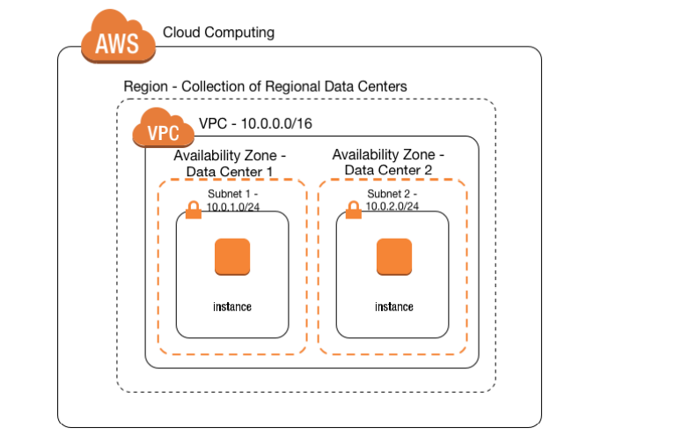
Architecture of VPC

Slide 5
CIDR
CIDR (Classless Inter-Domain Routing) -- also known as supernetting
Its a method of assigning Internet Protocol (IP) addresses that improves the efficiency of address distribution and replaces the previous system based on Class A, Class B and Class C networks.
Example:
Class A, with over 16 million identifiers
Class B, with 65,535 identifiers
Class C, with 254 host identifiers
If an organization needed more than 254 host machines, it would be switched into Class B. However, this could potentially waste over 60,000 hosts if the business didn't need to use them, thus unnecessarily decreasing the availability of IPv4 addresses.
CIDR was introduced by the Internet Engineering Task Force (IETF) in 1993 to fix this problem.
CIDR is based on variable-length subnet masking (VLSM),

Slide 6
VPC CIDR Blocks
a VPC consists of at least one range of contiguous IP addresses.
There are different ways to represent a range of IP addresses. The shortest way is by CIDR notation, sometimes called slash notation.
For example,
the CIDR 172.16.0.0/16 includes all addresses from 172.16.0.0 to 172.16.255.255—a total of 65,536 addresses
The smaller the prefix length, the greater the number of IP addresses in the CIDR. A /28 prefix length gives you only 16 addresses.
IPv4 CIDR Block
IPv6 CIDR Block

Slide 7
Subnets
A subnet is a range of IP addresses in your VPC. You can launch AWS resources into a specified subnet.
Use a public subnet for resources that must be connected to the internet, and a private subnet for resources that won't be connected to the internet.
To protect the AWS resources in each subnet, we can use multiple layers of security, including security groups and network access control lists (ACL).
Types=> Public subnet, private subnet, VPN only subnet
Subnet sizing=> IPV4, IPV6

Slide 8
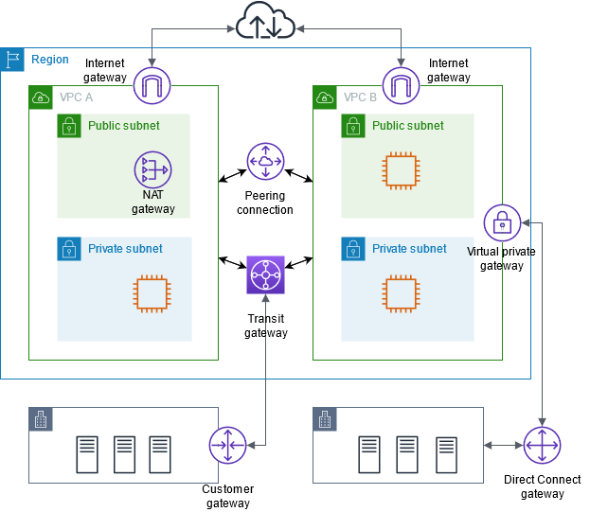
VPC Connectivity
We can connect our virtual private cloud (VPC) to other networks. For example, other VPCs, the internet, or our on-premises network.

Slide 9
Security Groups
A security group controls the traffic that is allowed to reach and leave the resources that it is associated with. For example, after you associate a security group with an EC2 instance, it controls the inbound and outbound traffic for the instance.
When you create a VPC, it comes with a default security group.
Inbound rules
Outbound rules
Some important points to remember:
All inbound traffic is blocked by Default, i.e., you need to add the traffic such as HTTP, HTTPs, etc.
All outbound traffic is allowed automatically.
You can have any number of EC2 instances within a security group.
You can have multiple security groups attached to EC2 instance./li>
Security groups are stateful, i.e., if you create an inbound rule allowing traffic in, that traffic is automatically allowed back out again.

Slide 10
Security Groups(Cont..)
Add inbound rules for HTTP and HTTPs .
Configure instance for testing incoming request from HTTP .
Commands-
Run the command sudo su to move to the root level and then update the EC2 instance by running the command yum update -y.
Install the Apache server so that EC2 instance becomes a web server by running the command yum install httpd -y.
Run the command cd /var/www/html to set the path.
Now, create a text editor by using the command nano index.html.
Start the Apache server by running the command service httpd start.
After starting the server, copy the public IP address, and paste it to the browser.

Slide 11
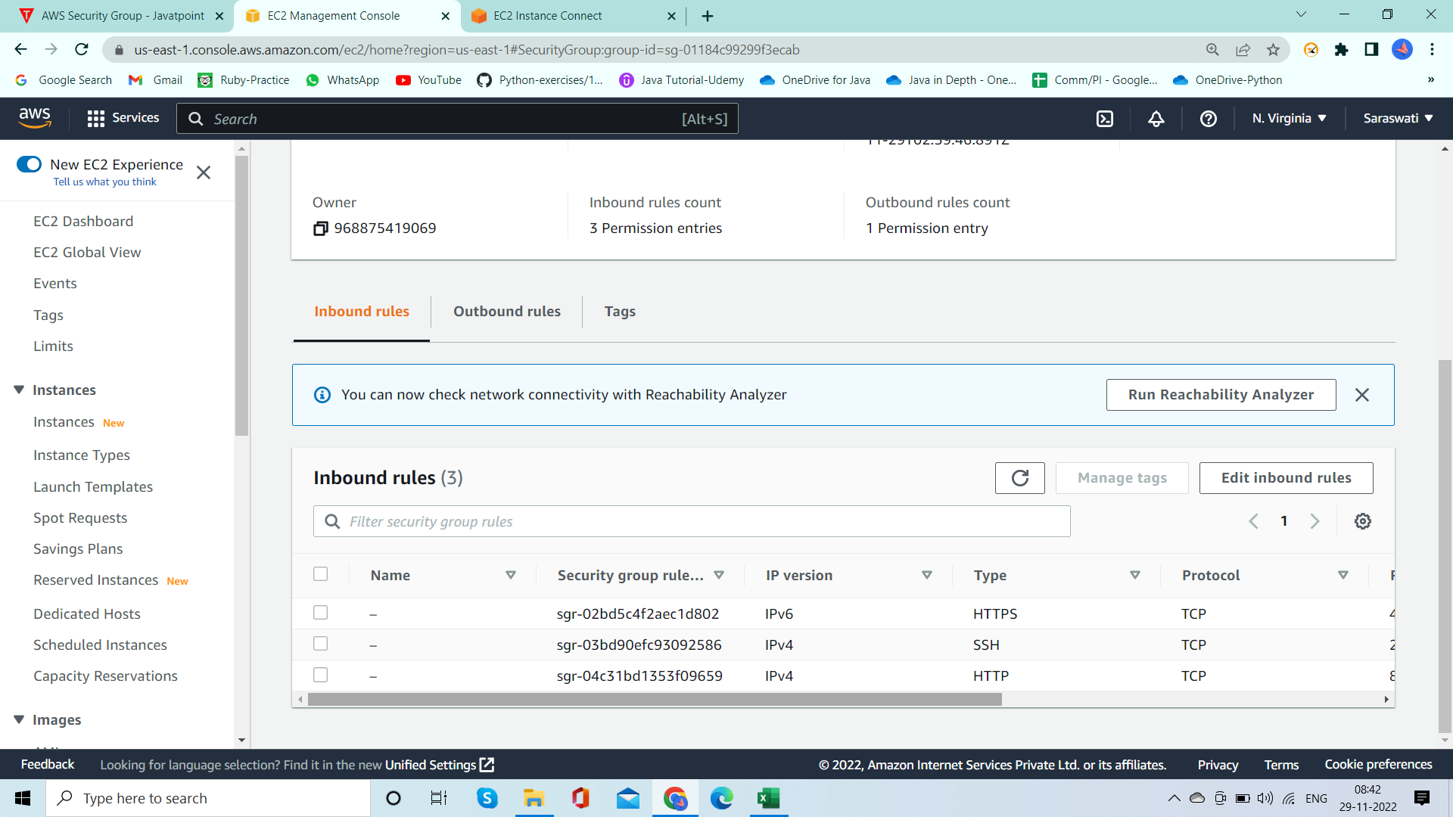

Slide 12
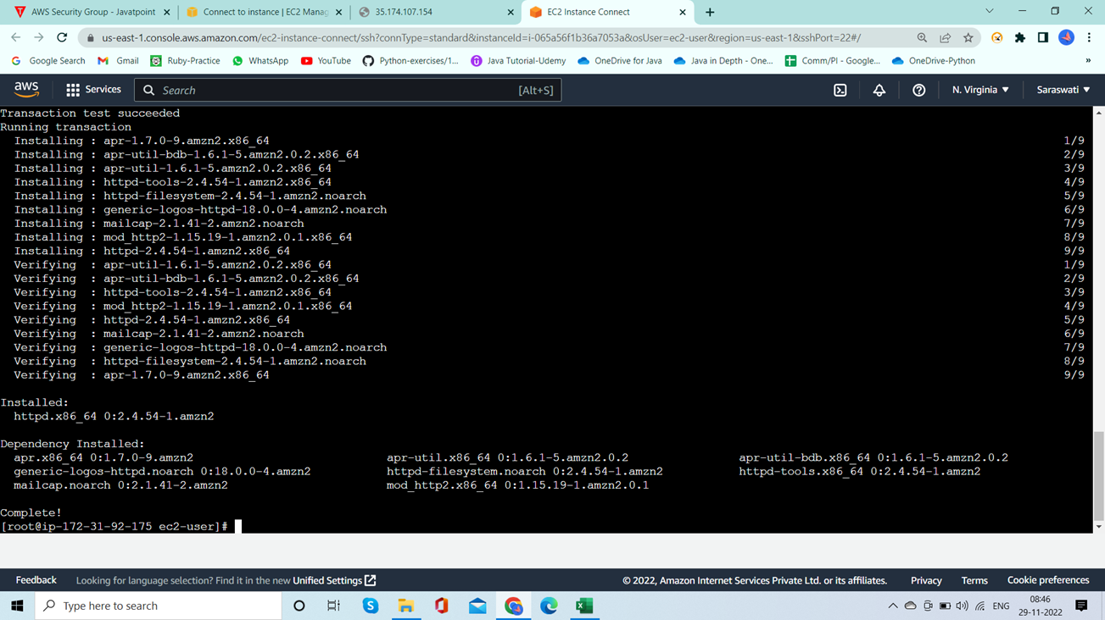

Slide 13
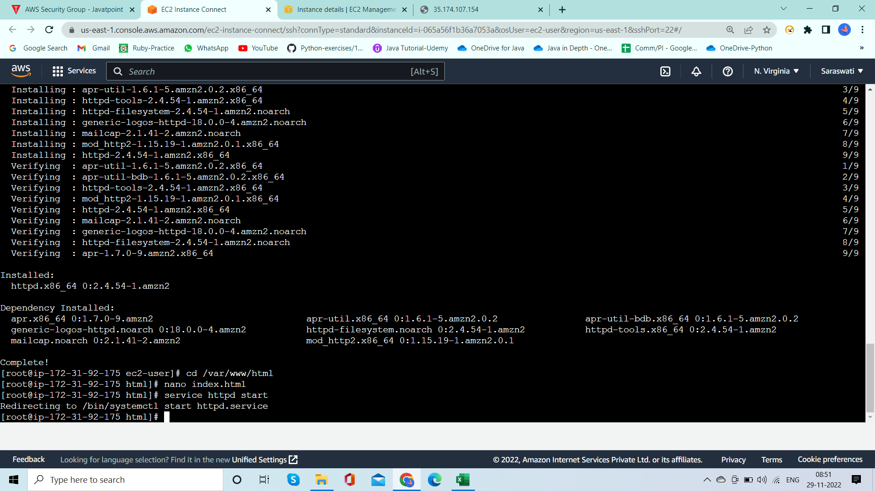

Slide 14
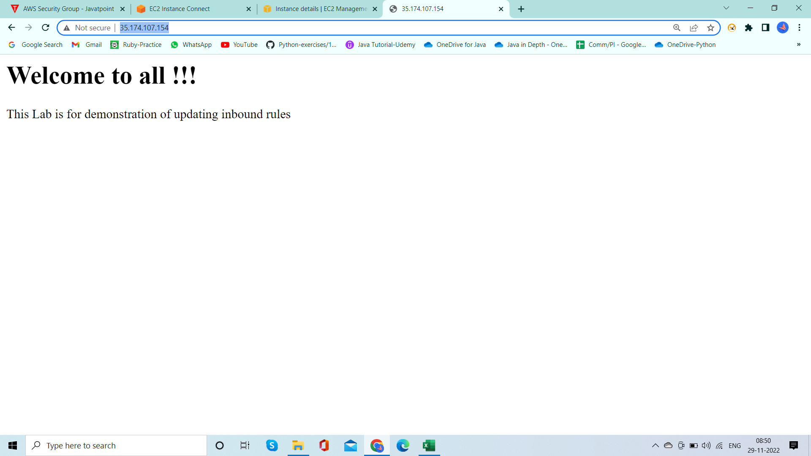

Slide 15
Elastic IP
AWS provides 3 types of IP addresses:
1. Private IP
2. Public IP
3. Elastic IP.
While Private IP addresses are used for internal communications within the VPC.
Public and Elastic IPs allow establishing communication with the internet.
Difference between Public IP and Elastic IP-
A Public IP address associated with an instance is not static and is lost when the instance is stopped
An Elastic IP address is a static public address associated with AWS account.
This IP address is not lost when the instance with which it is associated is stopped and it remains allocated to your AWS account until you release it.
It charged for stopped instance not running instance.

Slide 16
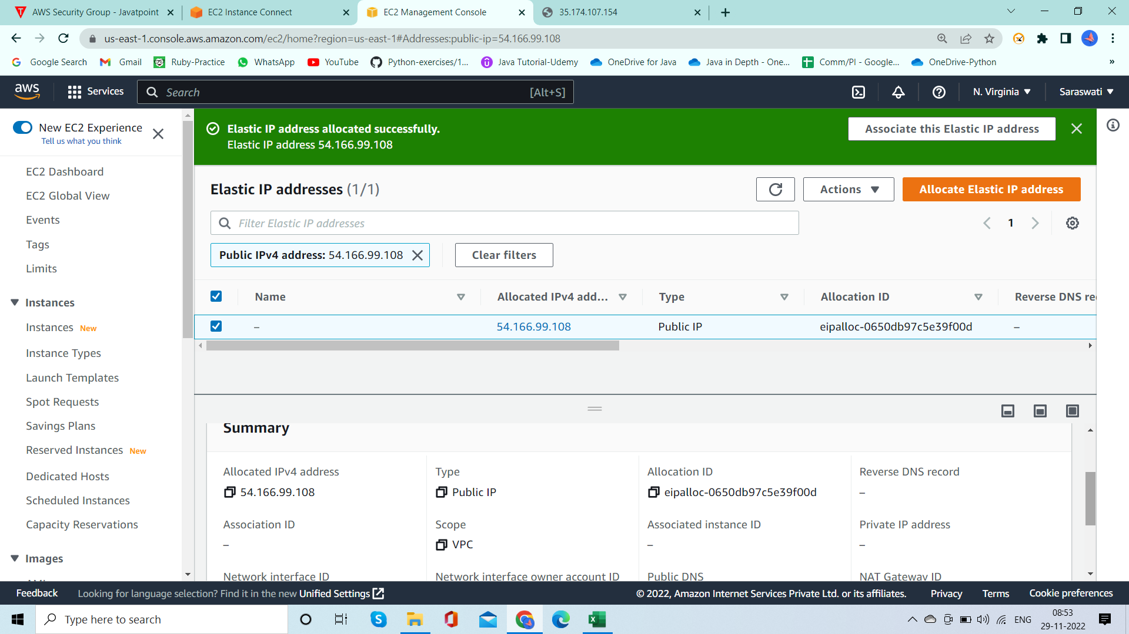

Slide 17
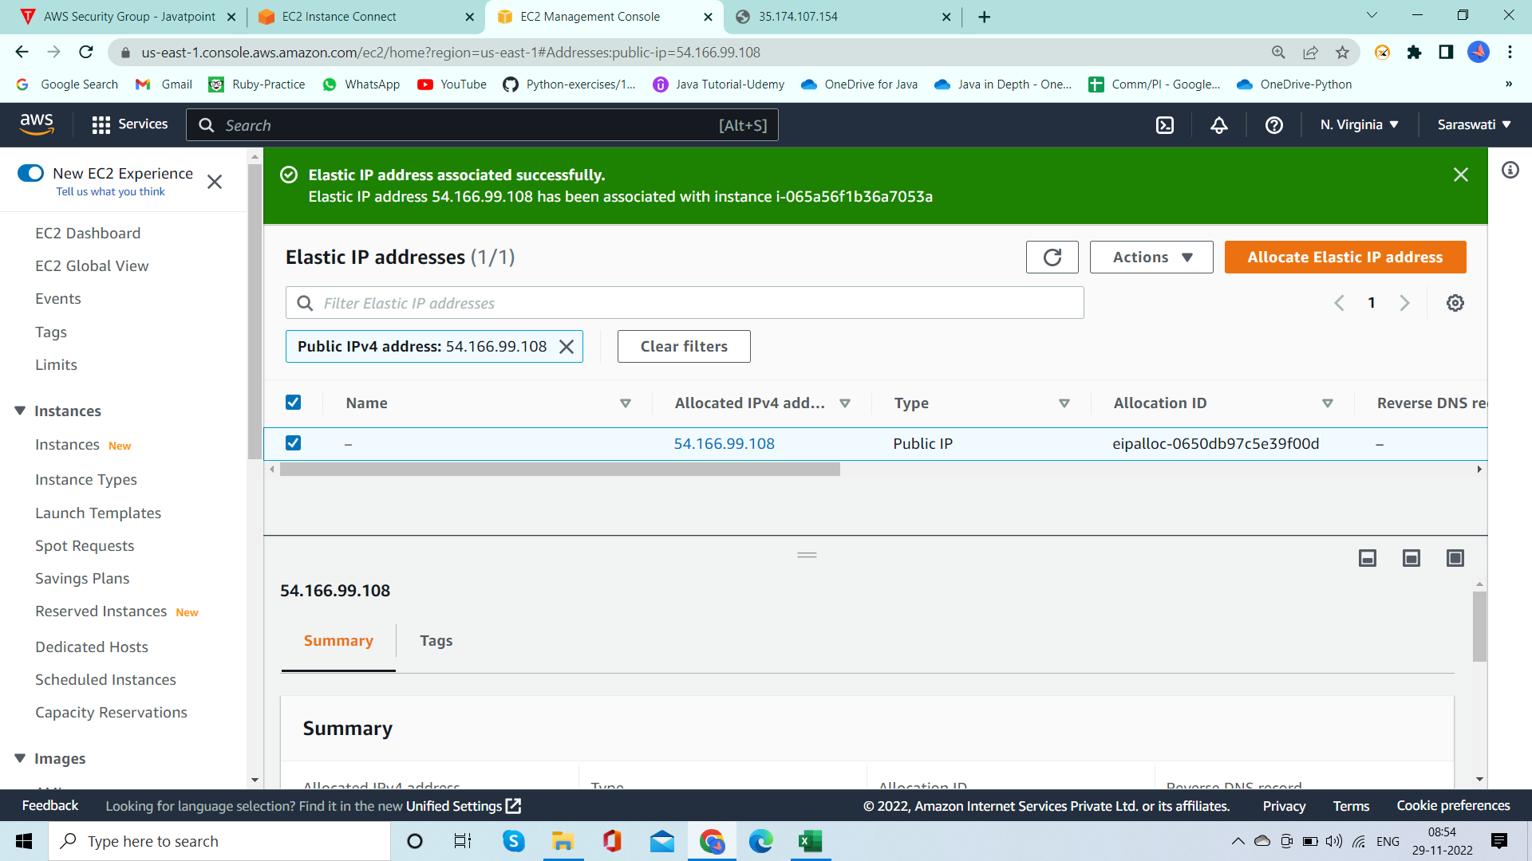

Slide 18
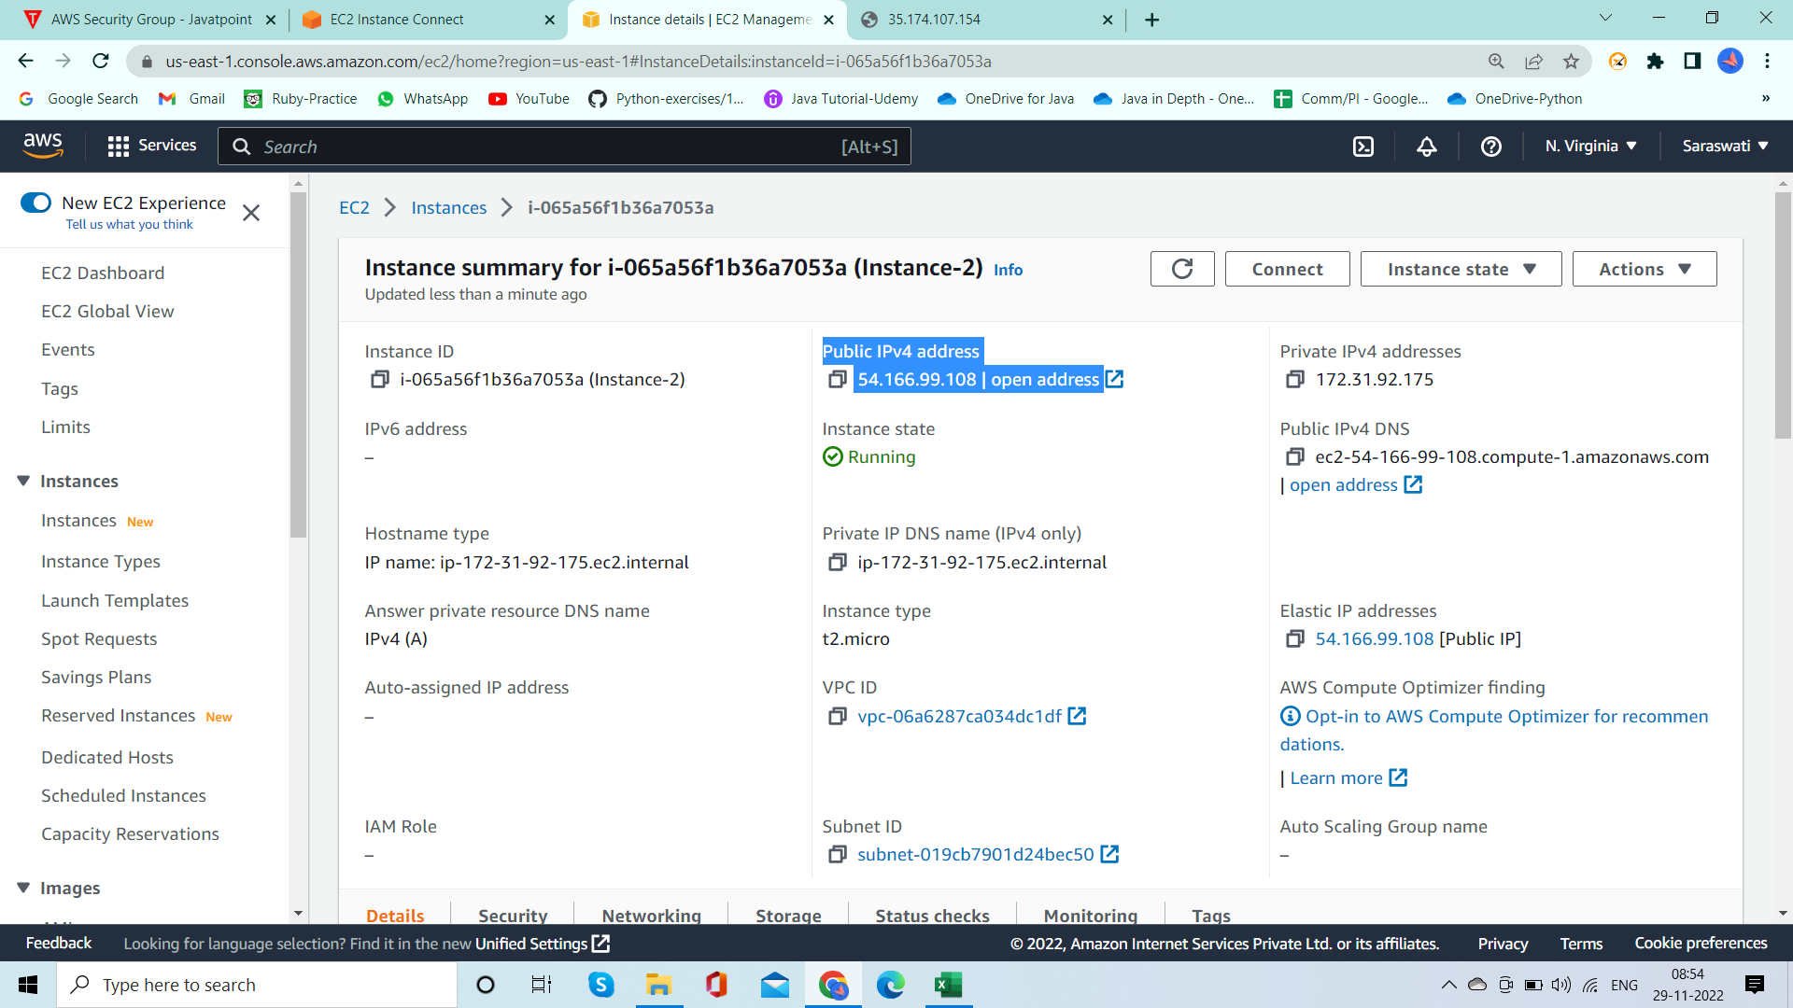

Slide 19
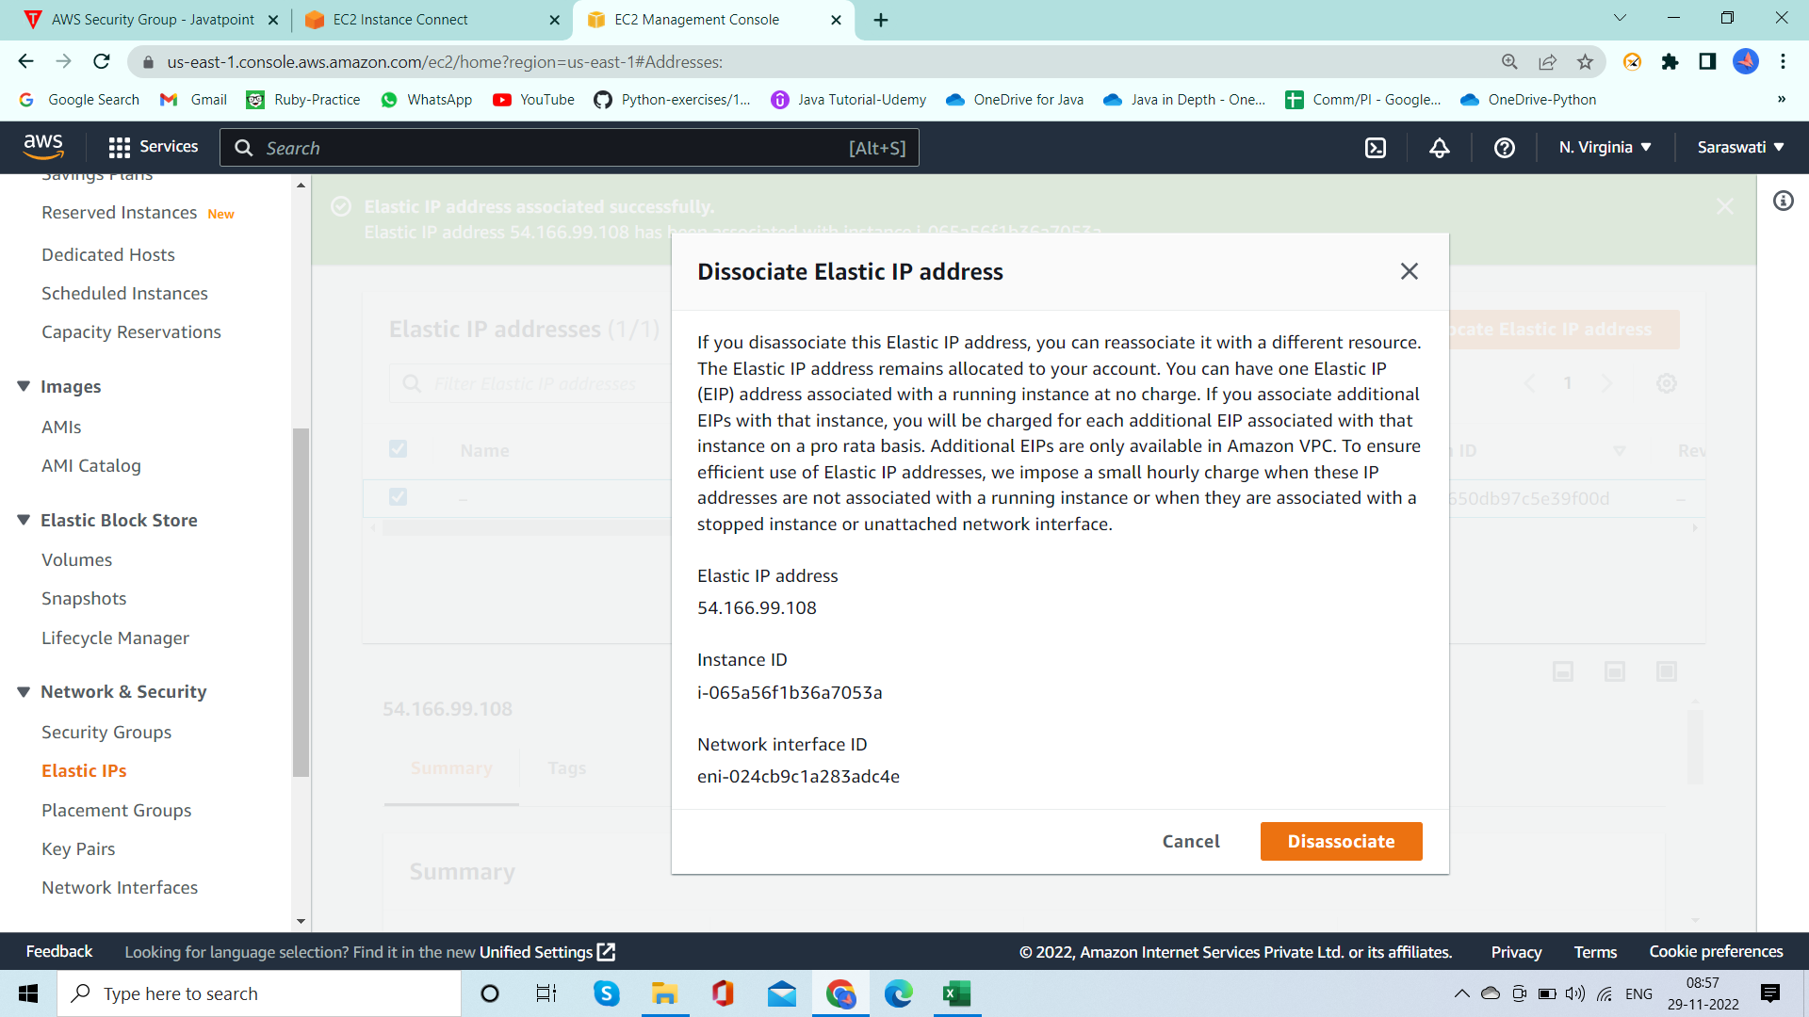

Slide 20
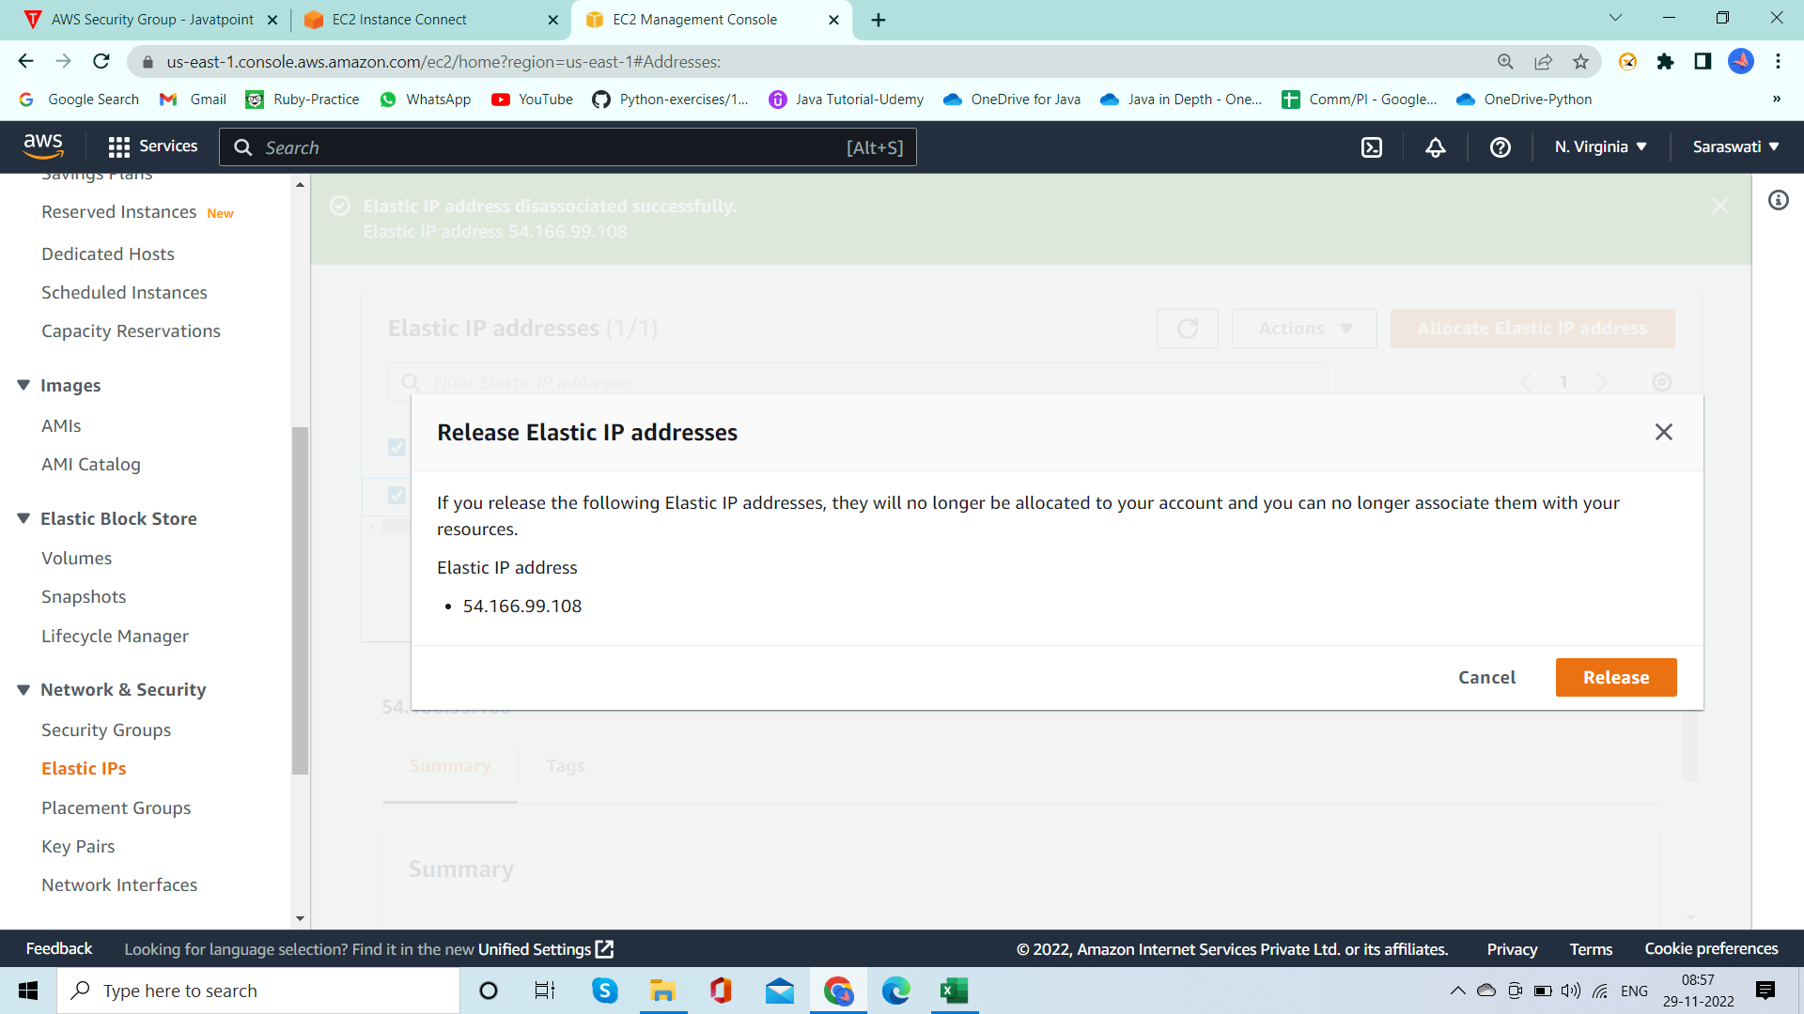

Slide 21
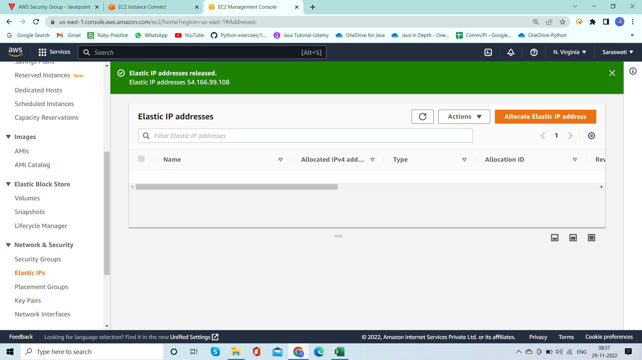

Slide 22
EBS
EBS stands for Elastic Block Store.
Once the storage volume is created, we can create a file system on the top of these volumes, then we can run a database, store the files, applications or we can even use them as a block device in some other way.
It get replicated .
Types:
SSD-backed volumes
HDD-backed volumes
SSD-backed volumes
General Purpose SSD
Provisioned IOPS SSD
HDD-backed volumes
Throughput Optimized HDD (st1)
Cold HDD (sc1)
Magnetic Volume

Slide 23
EBS

Slide 24
IAM
IAM Users
IAM Groups
IAM Policies
IAM Roles

Slide 25
Policy Evaluation
Policy evaluation outcomes
Every policy evaluation has one of three outcomes:
Implicit deny – Denial due to the lack of an allow statement allowing the action.
Explicit deny – Denial due to a matching deny statement. As you may recall, in AWS any deny statement overrides all allow statements.
Explicit allow – The result of matching allow statements.
Note: No “implicit allow” exists; rather, anything not explicitly allowed is implicitly denied.

Slide 26
IAM principals that make requests
Role session:
arn:aws:sts::123456789012:assumed-role/MyRole/MySession Role sessions, represented by temporary credentials for the roles, make the requests.
IAM user:
arn:aws:iam::123456789012:user/MyUser
Federated user (using sts:GetFederationToken):
arn:aws:sts::123456789012:federated-user/MyUser Note: Despite the name, federated users are not directly involved in the standard SSO federation process. Rather, they are temporary sessions (with temporary credentials) derived from IAM users.
Anonymous
Root

Slide 27
Authorization context
Authorization context is a property bag of any information that can be used in policy evaluation
Principal: AROADBQP57FF2AEXAMPLE Action: s3:CreateBucket Resource: arn:aws:s3:::my-bucket
Context: -
aws:UserId=AROADBQP57FF2AEXAMPLE:BobsSession - aws:PrincipalAccount=123456789012 –
aws:PrincipalOrgId=o-example - aws:PrincipalARN=arn:aws:iam::123456789012:role/Bob - aws:MultiFactorAuthPresent=false –
aws:CurrentTime=... - aws:EpochTime=... –
aws:SourceIp=... –
aws:PrincipalTag/dept=123 –
aws:PrincipalTag/project=blue –
aws:RequestTag/dept=123

Slide 28
The next thing that happens in policy evaluation is essentially a matching process on the property bag. In this example, the statement matches the authorization context: the action is the same, the resource matches the “*” wildcard, the condition on aws:PrincipalTag matches the value blue, and so. This statement allows this authorization request:
{
"Effect": "Allow",
"Action": "s3:CreateBucket",
"Resource": "*",
"Condition": {
"StringEquals": {
"aws:PrincipalTag/project": "blue"
}
}
}

Slide 29
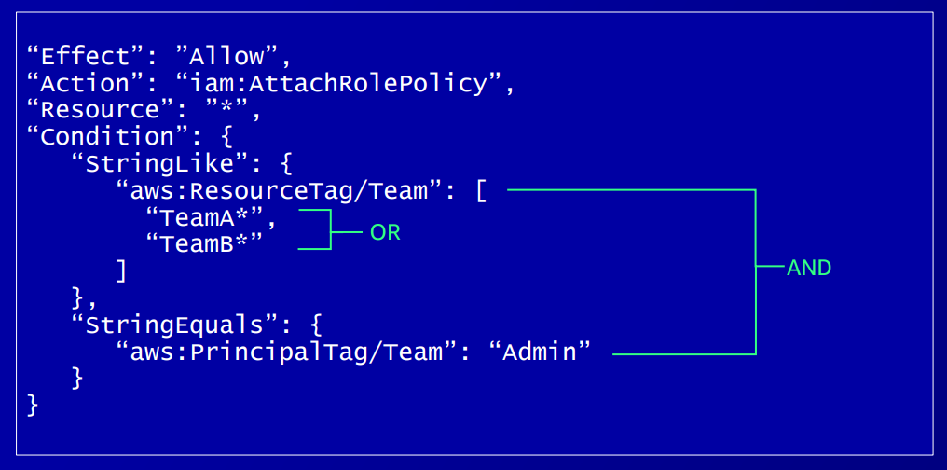
Conditions
Conditions are defined by an operator, keys and values. Different values in brackets are treated as OR conditions, and different operators are treated as AND statements:

Slide 30
