Slide 1
Lab 10 - Minimum Spanning Tree
CS2040S Data Structures & Algorithms
AY20/21 Semester 1
Week 12

Slide 2
Reminders
Take home lab 3 due next Tuesday (10 Nov) 10:00am
  Please begin working on it if you haven’t started!
Visualgo Quiz for next week’s lab
  15 Questions instead of 10
  25 minutes
  Best 1 out of 2

Slide 3
Visualgo Quiz
Topics Tested
  Binary Heap
  BST
  AVL Tree
  UFDS
  Graph Traversal
  MST
Difficulty: Hard

Slide 4

Visualgo Quiz
Use the training on visualgo page to practice

Slide 5
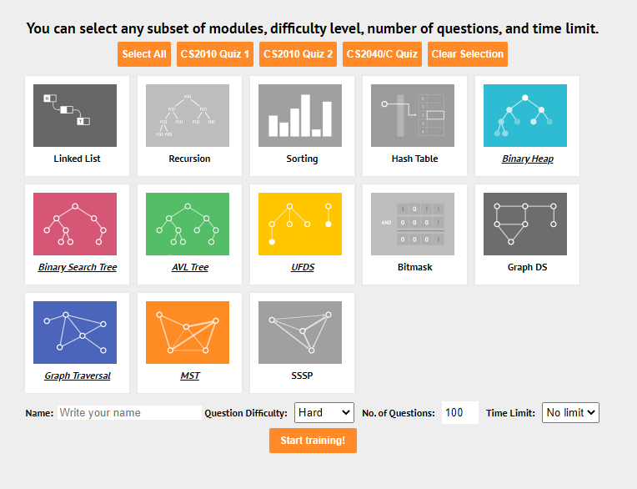
Visualgo Quiz
Use the training on visualgo page to practice

Slide 6
One-Day Assignment 9 - Islands
Given a map of r rows and c columns (1 ≤ r, c ≤ 50), find the minimum number of islands possible
Each cell can represent land (L), water (W) and cloud (C)
Island is defined as region of land that is connected to every other by some path, only in 4 directions (up, down, left, right)

Slide 7
One-Day Assignment 9 - Islands
Curveball: Cloud can be either Land or Water
We want to find the minimum possible number of islands on the map
What should the clouds be?

Slide 8
One-Day Assignment 9 - Islands
How should we store the graph?
  Each coordinate is a vertex
  Each vertex has an edge to the 4 adjacent vertex
You can treat the map itself as the graph!
  Vertex (x, y) has an edge to vertex (a, b) if their coordinate value differ only by one
  (3, 2) has an edge to (2, 2), (4, 2), (3, 1) and (3,3)

Slide 9
General Approach
Let’s assume there are no clouds in our input
How do we count the number of islands?

Slide 10
One-Day Assignment 9 - Islands
w | w | w | w | w | w
L | L | L | w | w | w
w | w | w | w | w | L
w | w | w | L | w | L
w | w | w | w | w | L
w | w | w | w | w | w
Each island can be treated as a connected component consisting only of land cells
There can be multiple disjoint connected components
How to traverse through all land tiles?

Slide 11
Traversing all land tiles
land_count = 0
For y from 0 to r:
  For x from 0 to c:
    If coordinate (x, y) is not visited and is land tile:
      Add 1 to land_count
      dfs/bfs from (x, y)
Guarantees all cells are visited at least once

Slide 12
Traversing all land tiles
land_count = 0
For y from 0 to r:
  For x from 0 to c:
    If coordinate (x, y) is not visited and is land tile:
      Add 1 to land_count
      dfs/bfs from (x, y)
Only searches through land tiles!

Slide 13
Traversing all land tiles
Outer for loop ensures that the entire graph is searched
Whenever a new unvisited land cell is found, the dfs/bfs guarantees all other land cells connected to it will be visited as well
  Prevents duplicate visiting of the same land mass

Slide 14
Moving on
How do we deal with cloud cells?

Slide 15
Dealing with Clouds
w | w | w | w | w | w
w | w | w | w | w | w
w | w | c | c | w | w
w | w | c | c | w | w
w | w | w | w | w | w
w | w | w | w | w | w
How should the cloud cells be treated in this case?
If they are treated as land cells, we end up with 1 more island being formed
Treat them as water cells

Slide 16
Dealing with Clouds
w | w | w | w | w | w
w | w | w | w | w | w
w | L | c | c | L | w
w | w | c | c | w | w
w | w | w | w | w | w
w | w | w | w | w | w
How should the cloud cells be treated in this case?
If the cloud cells are treated as water cells, then we have 2 islands
If they are treated as land cells, the two lands separated by the clouds gets connected to a single island

Slide 17
Dealing with Clouds
If connected to a land tile, treat each cloud tile as a land tile
Otherwise, treat them as water tiles.

Slide 18
Dealing with Clouds
land_count = 0
For y from 0 to r:
  For x from 0 to c:
    If coordinate (x, y) is not visited and is land tile:
      Add 1 to land_count
      dfs/bfs from (x, y)
Now searches through land AND cloud tiles!

Slide 19
Tips & Tricks
Directional Search
// Check left
if (curX - 1 >= 0) {
// do something
}
// Check right
if (curX + 1 < c) {
// do something
}
// Check up
if (curY + 1 < r) {
// do something
}
// Check down
if (curY - 1 >= 0) {
// do something
}
What if you have 8 directions to check now?
Or even 24?

Slide 20
Tips & Tricks
// North, East, South, West
int[] xDir = {0, 1, 0, -1};
int[] yDir = {1, 0, -1, 0};
Make use of a direction array!
int nextX, nextY;
for (int i = 0; i < 4; i++) {
nextX = curX + xDir[i];
nextY = curY + yDir[i];
if (nextX >= 0 && nextX <= c && nextY >= 0 && nextY <= r) {
// do something
}
}
Simple for loop to check all directions:

Slide 21
Minimum Spanning Tree

Slide 22
MST
Two algorithms discussed in lecture
  Prim’s
  Kruskal’s

Slide 23
MST
Both algorithms runs in O(E lg V) time
  Assuming you are using the correct data structures, auxiliary data structures and intermediate algorithms
  E.g. running Prim’s algorithm using an array as PQ instead of binary heap will result in slower runtime
  E.g. running non-comparison sort on Edge List before running Kruskal’s algorithm may result in faster runtime

Slide 24
MST
When given data in a graph data structure, you can transform it to another representation to speed up the algorithm
  E.g. if you are given an Adjacency Matrix, then you can transform it to an Edge List before running Kruskal’s algorithm
  Applies to all graph-related problems!

Slide 25
Prim’s Algorithm
Tends to use alongside with Adjacency List representation of graphs, and (for CS2040) binary heap / bBST for Priority Queue ADT
  Adjacency Matrix is sometimes used if graphs are complete / near-complete

Slide 26
Kruskal’s Algorithm
Tends to use alongside with Edge List representation of graphs, and UFDS for Set ADT

Slide 27
One Day Assignment

Slide 28
One-Day Assignment 10 - Lost Map
n villages in the region (2 ≤ n ≤ 2500)
There exists a network of roads that connects all villages, but the map is lost
You know the shortest distance from each village to every other village
Can you reconstruct the lost map?

Slide 29
One-Day Assignment 10 - Lost Map
“minimum number of roads have been constructed such that each village can reach every other village via a sequence of roads”

Slide 30
One-Day Assignment 10 - Lost Map
“minimum number of roads have been constructed such that each village can reach every other village via a sequence of roads”
edges
vertex
vertex
edges

Slide 31
Assignment Guidelines
Include your name and student number in comments at the top of your code.
You are allowed (and encouraged) to discuss algorithms
  List down all your collaborators in your source code
You are NOT allowed to:
  Copy another person’s code
  Look at another person’s code
  Use another person’s code as a base for your own code
Plagiarism checks will be in place

Slide 32
Take-Home Lab 4A: 10 Kinds of People
Grid of RxC cells
  Cells are either type 1 or type 0
N queries
  Positions of 2 cells A and B
  Can I get from A to B?
    Without changing types
1111100000
1111000000
1110000011
0111100111
0011111111

Slide 33
Take-Home Lab 4A: 10 Kinds of People
Can I get from A to B?
  Without changing types
May not always be able to go between any pair of 0s
  Bottom left 0, top right 0
  Cannot “jump” over the intervening 1s
  Different “islands” of 0s
1111100000
1111000000
1110000011
0111100111
0011111111

Slide 34
Take-Home Lab 4B: Millionaire Madness
RxC grid, of stacks of coins
  Stacks have different (integer) height
I can go 1 step up/down/left/right
  If (next stack - current stack) <= ladder height
    If next stack shorter, always possible
Start at top left, end at bottom right
Minimize ladder height needed
No ladder == “Height 0”

Slide 35
If you can play it slowly you can play it quickly
Let’s make the question slightly more general
  Start/end positions are no longer fixed
Can we get from any point A to any point B?
Minimize ladder height needed

Slide 36
Ladders
Ladder heights are non-negative integers
Can we get from any point A to any point B?
  If my ladder is height 0?
  If my ladder is height 1?
  If my ladder is height 2?
  …
Maybe we can track “usable so far” subgraph…
  What DS do we need here?
What changes, when I increase my ladder height (H-1) -> H?
What is now usable?
  Height differences of +H can now be used
Do I lose anything?
  Longer ladders can be used in place of shorter ones.

Slide 37
Take-Home Lab 4C: Dominos
N dominos
M relationships between dominoes
  Domino A gets hit => Will knock down domino B
Obvious graph model
  Domino => vertex
  Will-knockdown => directed edge
How many dominoes need to be manually knocked over?
  Corresponding concept in graph model?

Slide 38
Examples
B
A
A
B
C
C
A knocks over B, which knocks over C.
A knocks over both B and C.
B
B
A
A
C
C
We need to knock down both B and C, even if A is hit by either.
A only knocks down B, but not C.

Slide 39
No Cycles
If we don’t have any domino “cycles”
  Which dominoes are necessarily to manually hit?
    Can they be knocked over by another domino?
  Which dominoes are sufficient to manually hit?
    For any domino, can we hit it by cascading instead?
How does this idea carry over into our graph model?

Slide 40
All Cycles
B
E
H
A
D
G
C
F
I
Let’s try the complete opposite
  Bunch of dominoes are arranged in a circle
If we have a “cycle” of dominoes knocking down each other
  Does it matter which we start with first?
This still works if we have separate cycle
  Pick 1 per cycle
  “Shrink” cycle down to that single representative

Slide 41
Almost-Cycles
B
A
D
C
For the previous to work, we don’t actually need exact cycles
  What exactly do we want?
  Any choice in here, can “hit” all other dominoes in this “almost-cycle”
    No matter what choice it is
What does this correspond to in our graph model?

Slide 42
Some Cycles?
No domino cycles
  Find which ones are necessary/sufficient
Some domino cycles
  Knock down 1 representative per necessary “almost-cycle”?????
All dominos in separate “almost-cycles”
  Knock down 1 representative per “almost-cycle”

