Slide 1
Lab 4 - List ADT
CS2040S Data Structures & Algorithms
AY20/21 Semester I
Week 6

Slide 2
One Day 2 - Sort of Sorting
Need to use stable sort, which Arrays.sort() or Collections.sort() provides
Write a custom comparator to compare by first 2 characters instead of the entire string
public int compare (String a, String b) {
return a.substr(0, 2).compareTo(b.substr(0, 2));
}

Slide 3
One Day 2 - Sort of Sorting
Or, just define custom Comparator, using extractor API
Collections.sort(list,
Comparator.comparing(name -> name.substring(0,2))
);

Slide 4
Take-home Lab 1A - Train Passengers
Keep track of:
  Current number of passengers on the train
  Capacity of the train

Slide 5
Take-home Lab 1A - Train Passengers
At each station except the last:
  Subtract passengers that got off the train. If train carries < 0 passengers, output impossible
  Add passengers that got on the train. If train carries > capacity, output impossible
  If number of passengers != capacity and passengers waited, output impossible

Slide 6
Take-home Lab 1A - Train Passengers
At last station:
  If passengers getting off != current passengers on train, output impossible
  If passengers got on, or waited at the station, output impossible
After last station:
  If any passengers remain, output impossible

Slide 7
Take-home Lab 1B - Best Relay Team
Use a class to represent a Runner
  Store first-leg timing, subsequent-leg timing, name
Use 2 arrays to store the Runners
  Sort one array by first-leg timing
  Sort other array by subsequent-leg timing
For the first 4 runners in first-leg timing, pick the first 3 runners (that is not the first runner) from the subsequent-leg timing
Output the team that gives the best timing

Slide 8
Generics
Most Java API usage from this lab onwards uses generics
Defines the data type being used
  String[] and ArrayList<String>
  Student[] and ArrayList<Student>
Primitive data types cannot be used as generics, but you can use their relevant Java classes
  ArrayList<Integer>, ArrayList<Double> etc.

Slide 9
Lists
Mainly use ArrayList and LinkedList
Take note of the difference in runtime for each operation
  E.g. ArrayList offers O(1) time to access any element in the list via index, while LinkedList offers O(1) time to access elements at the front and back only

Slide 10
ArrayList<E> API
Method Signature | Description | Runtime
boolean add(E e) | Appends the specified element to the end of this list. | O(1)
void add(int index, E element) | Inserts the specified element at the specified position in this list. | O(size()-index)
void clear() | Removes all of the elements from this list. | O(N)
boolean contains(Object o) | Returns true if this list contains the specified element. (Based off the object’s equals() method) | O(N)
E get(int index) | Returns the element at the specified position in this list. | O(1)
E remove(int index) | Removes the element at the specified position in this list. | O(size()-index)
int size() | Returns the number of elements in this list. | O(1)

Slide 11
LinkedList<E> API
Method Signature | Description | Runtime
boolean add(E e) | Appends the specified element to the end of this list. | O(1)
void add(int index, E element) | Inserts the specified element at the specified position in this list. | min(O(size()-index), O(index),)
void clear() | Removes all of the elements from this list. | O(N)
boolean contains(Object o) | Returns true if this list contains the specified element. (Based off the object’s equals() method) | O(N)
E get(int index) | Returns the element at the specified position in this list. | min(O(size()-index), O(index),)
E remove(int index) | Removes the element at the specified position in this list. | min(O(size()-index), O(index),)
int size() | Returns the number of elements in this list. | O(1)

Slide 12
Stacks & Queues
Stacks allow inserting, accessing and deleting from top of the stack in O(1) time
  FILO (First-in, Last-out)
Queues allow accessing and deleting from front of queue, and inserting from back of queue in O(1) time
  FIFO (First-in, first-out)

Slide 13
Stacks & Queues
Stack is a Java class, can instantiate directly
  Stack<YourClass> stack = new Stack<YourClass>();
Queue is a Java interface, cannot instantiate directly
  Queue<YourClass> queue = new LinkedList<YourClass>();

Slide 14
Stack<E> API
pop()
push()
Method Signature | Description | Runtime
boolean empty() | Tests if this stack is empty. | O(1)
E peek() | Looks at the object at the top of this stack without removing it from the stack. | O(1)
E pop() | Removes the object at the top of this stack and returns that object as the value of this function. | O(1)
E push(E item) | Pushes an item onto the top of this stack. | O(1)

Slide 15
Queue<E> API (if using LinkedList)
Method Signature | Description | Runtime
boolean isEmpty() | Returns true if this collection contains no elements. | O(1)
E peek() | Retrieves, but does not remove, the head of this queue, or returns null if this queue is empty. | O(1)
E poll() | Retrieves and removes the head of this queue, or returns null if this queue is empty. | O(1)
boolean offer(E e) | Inserts the specified element into this queue if it is possible to do so immediately without violating capacity restrictions. | O(1)
poll()
offer()

Slide 16
Stack + Queue = Deque
Deque = “Double-ended queue”
Can add/remove from both ends
Deque is a Java interface, cannot instantiate directly
  Deque<YourClass> queue = new LinkedList<YourClass>();
  Deque<YourClass> queue = new ArrayDeque<YourClass>();
    Faster than LinkedList or Stack!

Slide 17
Deque<E> API
pollFirst()
popLast()
offerFirst()
offerLast()
Method Signature | Description | Runtime
boolean isEmpty() | Returns true if this collection contains no elements. | O(1)
E peek[First|Last]() | Retrieves, but does not remove, the [head|tail] of this deque, or returns null if this deque is empty. | O(1)
E poll[First|Last]() | Retrieves and removes the [head|tail] of this deque, or returns null if this deque is empty. | O(1)
boolean offer[First|Last](E e) | Inserts the specified element at the [head|tail] of this deque if it is possible to do so immediately without violating capacity restrictions. | O(1)

Slide 18
Week 3B Take Home - Join Strings
Given a list of strings, concatenate them together, and output the final string
  Concatenating strings (via concat or + operator) takes O(k) time, where k = length of resultant string
  Using StringBuilder/StringBuffer’s append() method is slightly better, but may be too slow
  Need to find a way to do so in O(1) time when handling queries

Slide 19
Week 3B Take Home - Teque
Create a custom data structure to support O(1) operations:
  push_back
  push_front
  push_middle
  get
    Random access
push_front
push_middle
push_back

Slide 20
One-day 3 - Coconut Splat
Simulate a counting-out game
A player’s hand has 4 possible states
  Both hands folded together (initial state)
  Fist
  Palm down
  Behind back
A player’s hand moves from state n to state (n+1) if hand is touched last
A player is out of the game if both hands are behind the back
Find out which player will be the last player standing

Slide 21
One-day 3 - Coconut Splat
State 1 (Folded)
  Counts as a set of hands instead of two individual hands
State 1 (Folded) → State 2 (Fist)
  Split folded hands into 2 fists, counting begins from the first fist on the next round
State 2 (Fist) → State 3 (Palm Down)
  Change fist into palm down, counting begins with next hand
State 3 (Palm Down) → State 4 (Behind Back)
  Hand is no longer in play, counting begins with next hand

Slide 22
Week 3B One-day - Coconut Splat
Following slides contain example of the game simulated for 3 players with 3 syllables
  Input: 3 3
  Output: 2

Slide 23
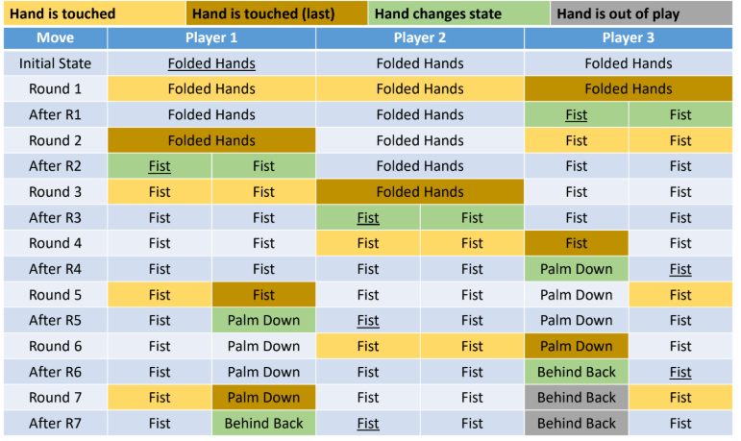

Slide 24
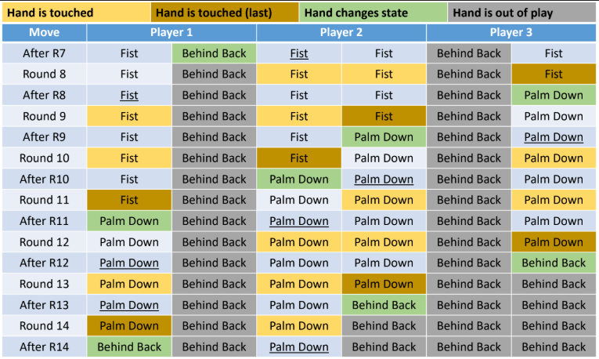

Slide 25
Week 3B One-day - Coconut Splat
Plan first before coding!
  If you code without planning, and if you are not using a debugger, it is very difficult to find bugs

Slide 26
Assignment Guidelines
Include your name and student number in comments at the top of your code.
You are allowed (and encouraged) to discuss algorithms
  List down all your collaborators in your source code
You are NOT allowed to:
  Copy another person’s code
  Look at another person’s code
  Use another person’s code as a base for your own code
Plagiarism checks will be in place

