Slide 1


NISO AI — PHASE I
Enterprise AI Opportunity & Transformation Strategy
From AI uncertainty to board-ready implementation blueprint in 7–11 business days. NISOL Discovery™ replaces 3–6 months consulting cycles with rapid diagnostic, 15 board deliverables, and zero vendor lock-in.

Slide 2

MARKET CHALLENGE
The Enterprise AI Dilemma
The Traditional Consulting Trap
85%+ of AI initiatives stall in POC Hell
3–6 month strategy decks at massive cost
No engineering reality or code execution
Unclear financials breed executive skepticism
Disjointed experiments create compliance risk
What Enterprise Leaders Actually Need
Rapid diagnostic to prioritize high-impact use cases in days
Calculated financial business case with 5-year ROI
Production-grade blueprints ready for dev teams
End-to-end partner who can build, manage, or monitor
Complete ownership — zero vendor lock-in

Slide 3
STRATEGIC DIFFERENCE
Transformation Partner, Not Strategy Advisory
Lifecycle Aspect
Traditional Consulting Firms
Niso AI Transformation Partner
Primary Delivery
High-level advisory & static PPT decks
Data-driven diagnostic & actionable engineering blueprints
Time to Value
12–24 Weeks (3–6 Months)
7–11 Business Days
Capability Lifecycle
Recommend & exit engagement
Discover → Build → Govern → Monitor → Scale
Technology Stack
Static manual spreadsheets
Nisol Intelligence™ AI Platform + Senior Architects

Slide 4

ENGAGEMENT SCOPE
Phase I: Nisol Discovery™ Architecture
Audit & Assess
1
Evaluate 15 enterprise capabilities: data pipelines, LLMOps, talent, and governance.
Map & Prioritize
2
Identify 20+ use cases categorized into a 2×2 Quick Wins vs. Strategic Bets matrix.
Financial ROI Model
3
Build a 5-year financial model with CapEx/OpEx breakdown and 3–6 month payback schedule.
Solution Blueprints
4
Deliver production-grade technical blueprints and compliance frameworks for dev teams.

Slide 5

ENGINEERED PRECISION
Proprietary Diagnostic Framework
62-Point Assessment
Structured discovery across 15 enterprise capabilities evaluating data hygiene, security, cloud infrastructure, and talent readiness.
Nisol Intelligence™ Platform
Proprietary AI diagnostic platform synthesizes discovery inputs, benchmarks readiness scores, and generates initial blueprints.
25+ Years Enterprise Oversight
Senior enterprise architects review, audit, and validate every deliverable for executive board defense.

Slide 6

EXECUTIVE ASSETS
15 Board-Ready Deliverables in 3 Packs
Executive Intelligence Pack
AI Opportunity Pack
Executive Summary
AI Maturity Scorecard
Executive Dashboard
Readiness Audit Report
Opportunity Matrix (2×2)
Top 20 Use Cases
Quick Wins vs. Strategic Bets
Implementation Framework
Transformation Pack
3-Year Roadmap
Financial ROI Model
Business Case Defense
Solution Blueprints
Change Management Plan
Risk & Compliance Matrix
KPI Success Dashboard

Slide 7
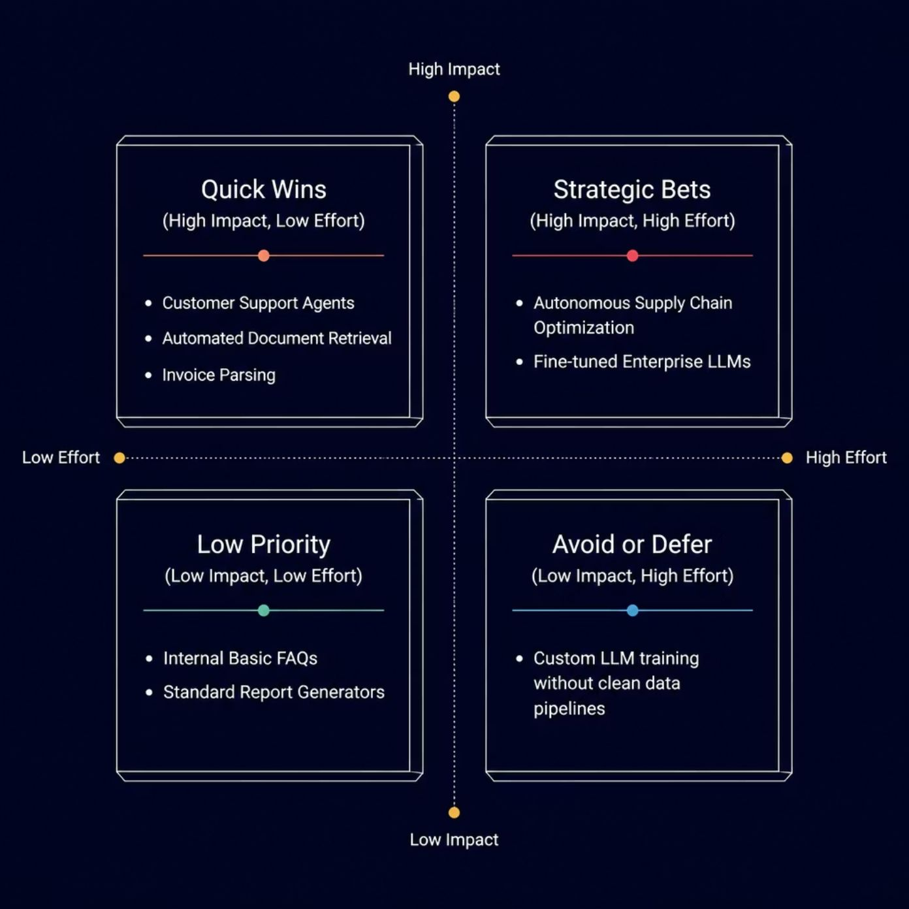
PRIORITIZATION FRAMEWORK
Strategic AI Opportunity Matrix (2×2)
Every AI use case is scored on business impact vs. implementation effort, creating a clear, defensible prioritization framework for executive decision-making.

Slide 8

FINANCIAL MODELING
Quantified Business ROI & Financial Defense
10–50x
3–6
Target ROI
Month Payback
Operational efficiency, labor cost savings, and automated workflow execution.
Quick-Win AI agents generate immediate returns to fund the long-term roadmap.
5
Year Financial Model
Complete CapEx/OpEx modeling including cloud compute and licensing costs.

Slide 9

PHASE II EXECUTION
Flexible Delivery Pathways — Your Way
Model 1: Build
Model 2: Manage
End-to-End Implementation
We design, engineer, deploy, and operationalize custom AI agents and platforms for your enterprise.
Program & Vendor Oversight
We manage internal engineering teams or external vendors to ensure architecture standards and delivery specs.
Model 3: Monitor
Advisory & Code QA
We conduct independent code reviews, security audits, and architectural QA to ensure roadmap alignment.

Slide 10

EXECUTION CADENCE
7–11 Business Day Discovery Timeline
Timeline
Focus Area
Key Deliverables
Days 1–2
Kickoff & Discovery Sessions
62-point diagnostic interview with executive & tech leads
Days 3–5
AI Engine Processing & Capability Audit
Maturity scorecard & infrastructure gap analysis
Days 6–7
Use Case Mapping & Matrix
2×2 Opportunity Matrix & Top 20 Use Cases
Days 8–9
Financial ROI & Blueprints
5-Year Financial ROI Model & Solution Blueprints
Days 10–11
Consultant Review & Board Defense
Complete 15-Deliverable Package & C-Suite presentation
Every deliverable is reviewed by senior enterprise architects before final board presentation.

Slide 11
VALUE PROPOSITION
Why Invest in Nisol Discovery™?
The Investment Value
Guaranteed Engagement Outcome
Prevent costly mistakes — Avoid millions in capital allocation to doomed AI pilots
"At the conclusion of 11 business days, your leadership team receives complete executive clarity, an audited 5-year financial model, and production-ready solution blueprints ready for immediate execution in Phase II."
Senior-led expertise — 25+ year enterprise architects, zero junior consultants
Fast-track delivery — 11 business days vs. the industry standard of 3–6 months
Zero lock-in — 100% code & IP ownership guaranteed

Slide 12


NEXT STEPS
Turn AI Ambition into Enterprise Reality
01
02
Schedule Alignment
Launch Diagnostic
30-minute discovery session to scope diagnostic parameters and align on enterprise priorities.
Execute the 62-point audit with key enterprise stakeholders across business and technology.
03
Executive Presentation
Receive 15 board-ready deliverables in 11 business days — ready for C-suite defense.
Niso AI Transformation Practice · nisolai.com · info@nisolai.com

