Slide 1
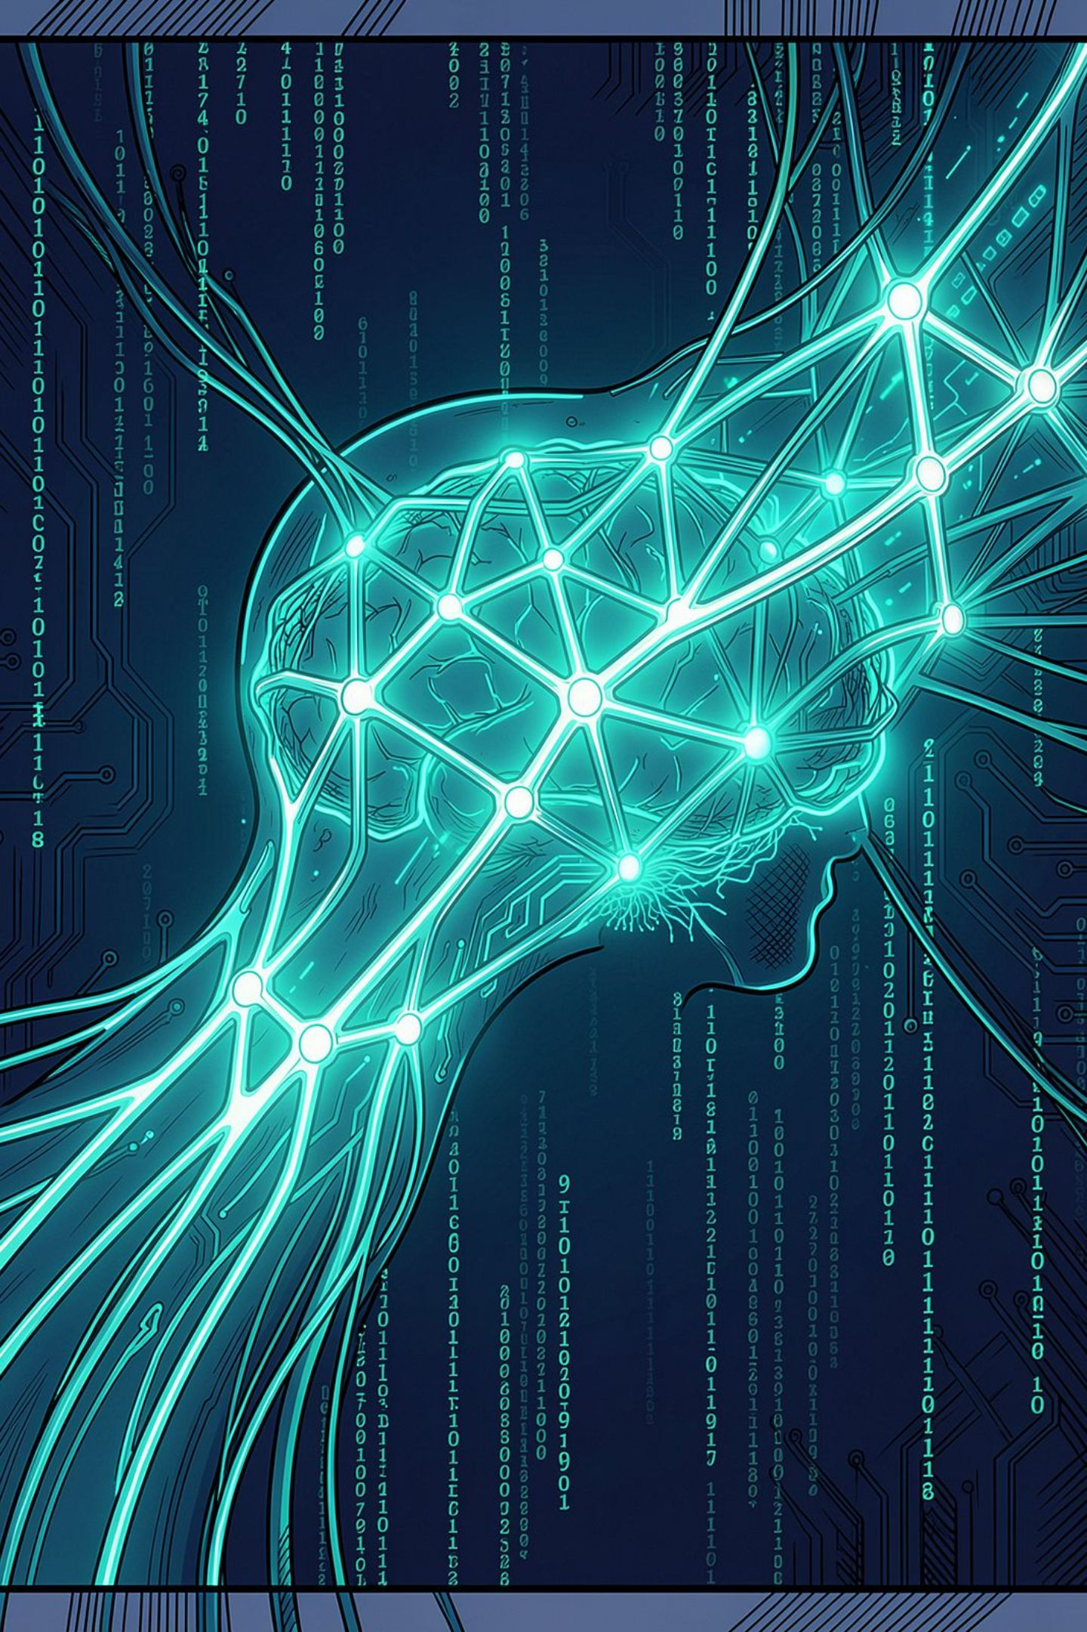
The Novatech AI Advantage
Readiness & Demystification
Session 1: Your Superpower, Not Your Replacement
We are not here to teach you computer science. We are here to give you back 10 hours of your week. Let's talk about your actual jobs.

Slide 2
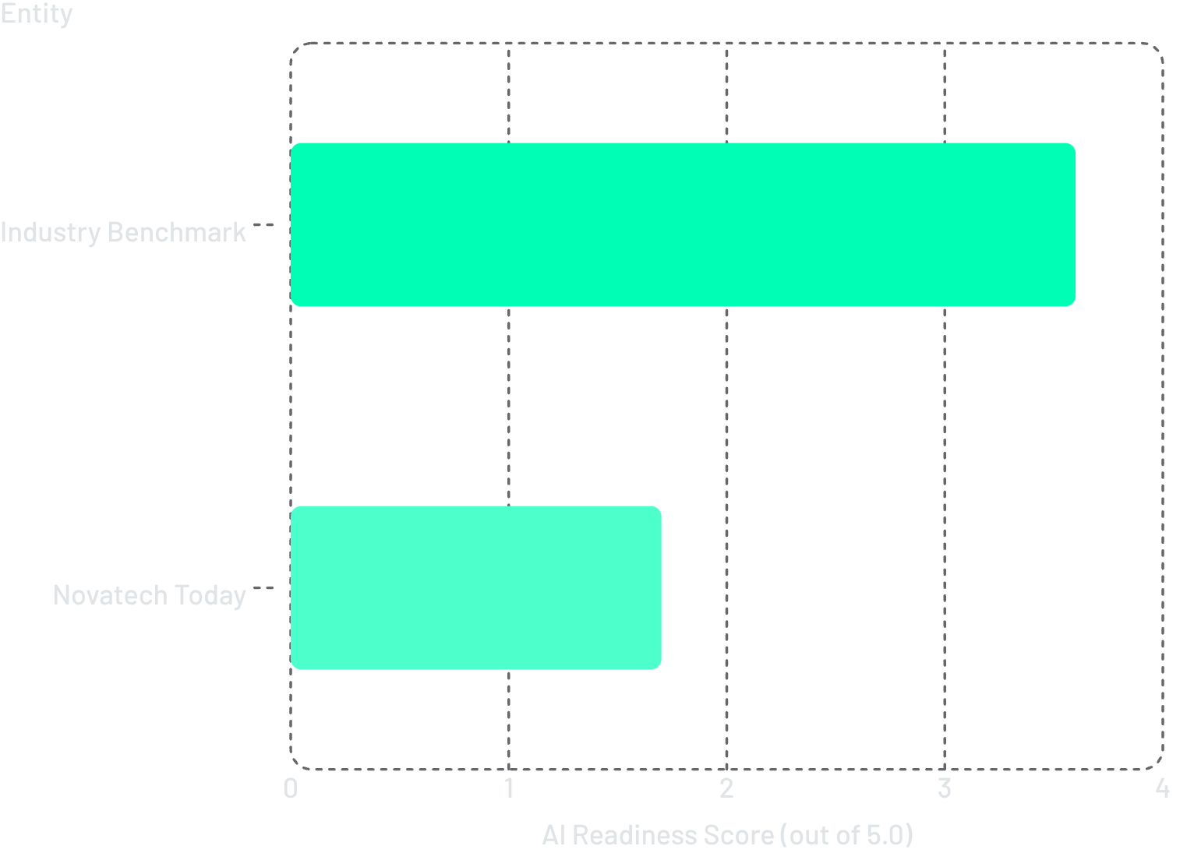

THE UNCOMFORTABLE TRUTH
We Are 38 Points Behind Our Top Competitors
Our Shared Call to Action
Our competitors are shipping features 3× faster — using AI to write QA tests, generate RFPs, and automate manual workflows.
This is not an accusation. It is a 90-day mandate to close the gap.
AI readiness is now a competitive differentiator. The window to act is open — but not indefinitely.

Slide 3
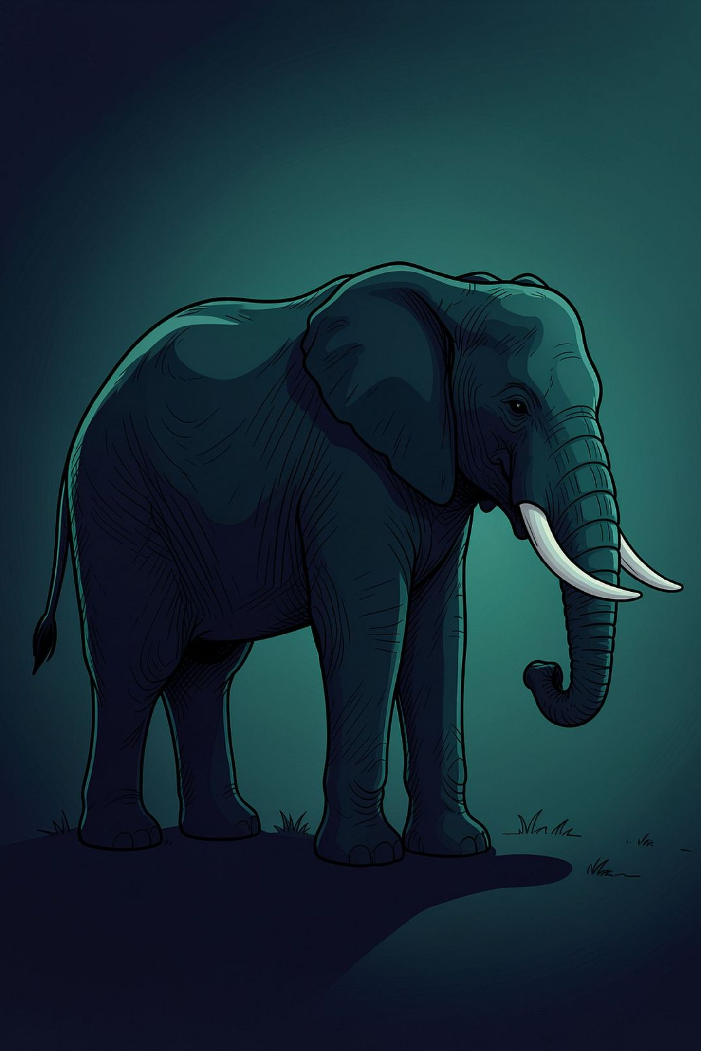
"Will AI take my job?"
The honest answer is no. But a person using AI will absolutely outperform a person who doesn't.
What We Are Automating
Boring, repetitive tasks that drain your week — boilerplate code, invoice matching, proposal hunting.
What You Become
From Typist to Architect. You design, review, and decide. AI executes the draft.

Slide 4
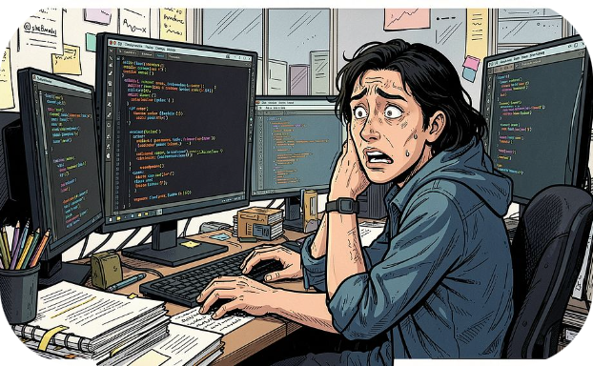
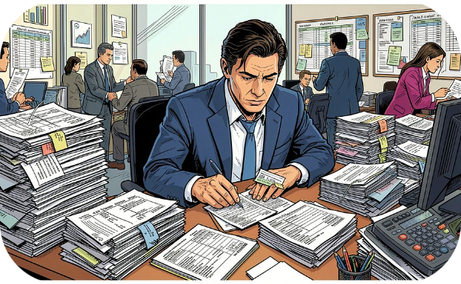
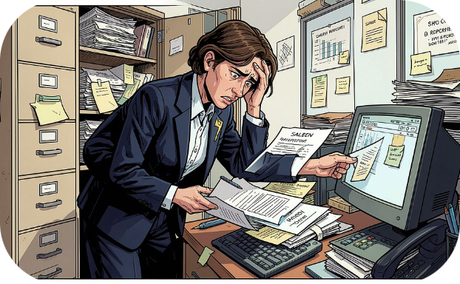
THE PAIN POINT
Your Day, Before AI
Manual labor with zero strategic return — causing burnout, delays, and missed client commitments.
Engineers
Finance
Sales
15 hours/week writing boilerplate test scripts — time stolen from core product development.
5 manual touches on every invoice. Slow approvals. Month-end close takes 10 days.
20+ hours/week hunting for past proposals instead of building client relationships.

Slide 5

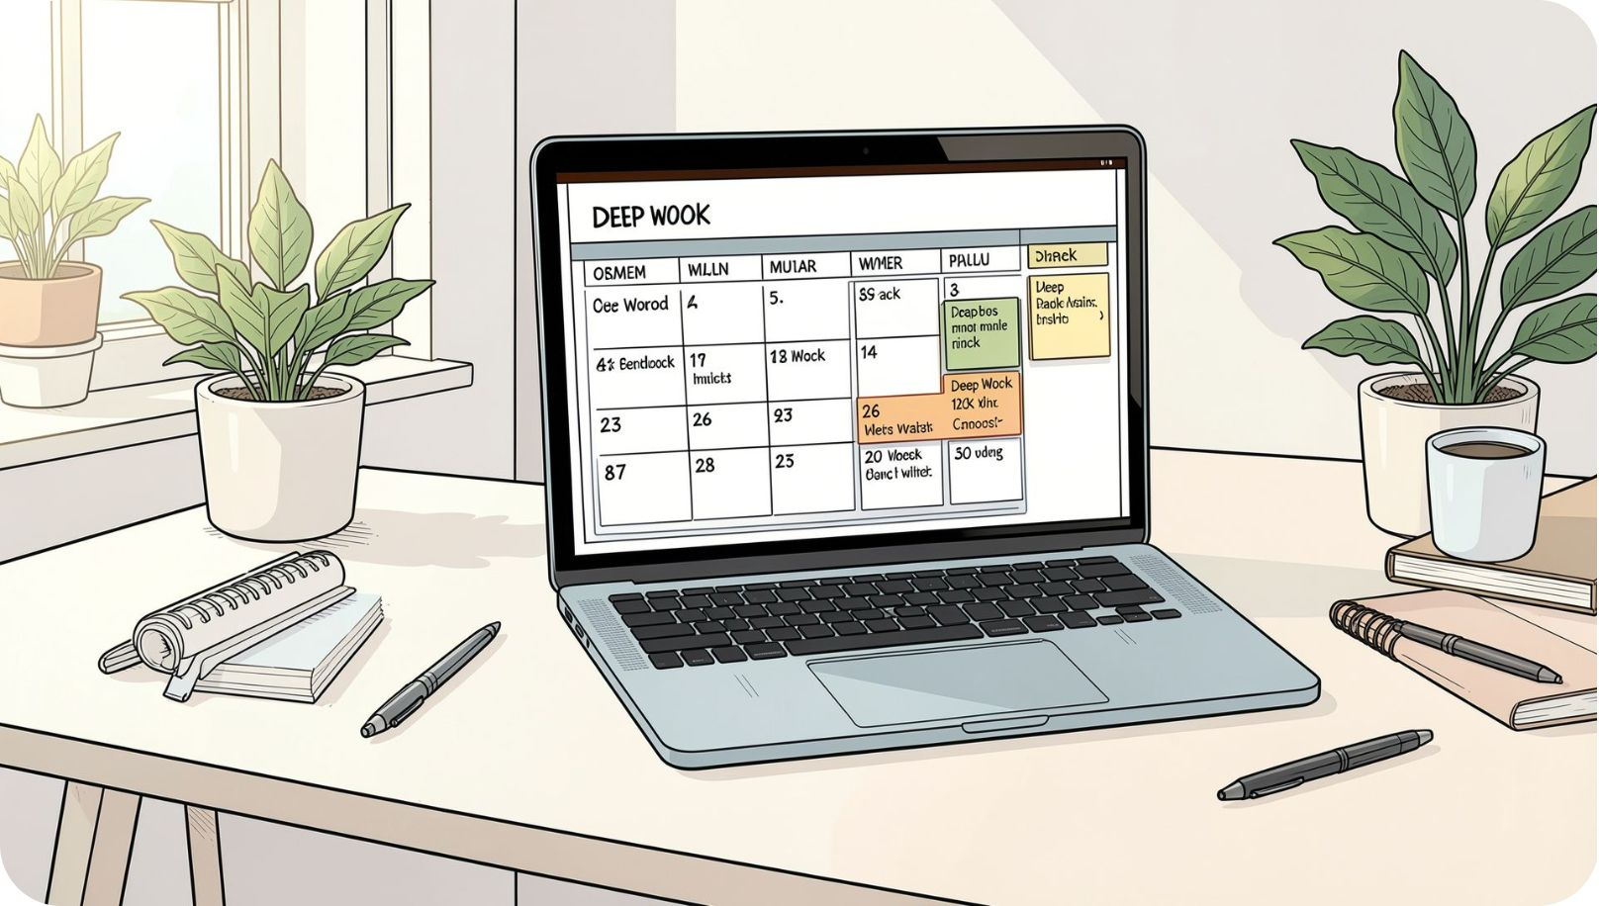

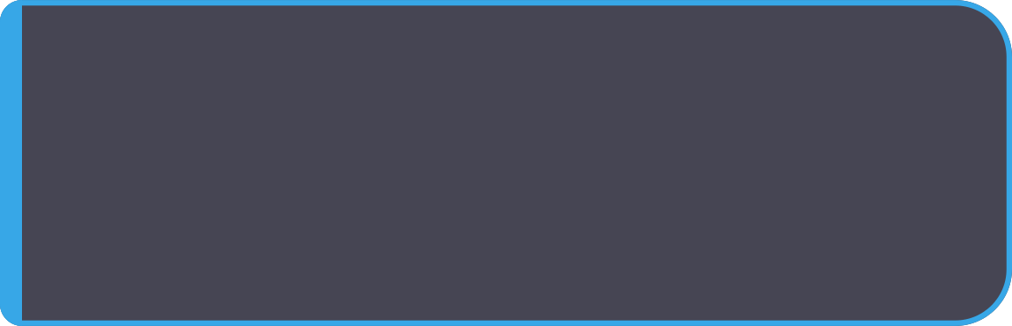
THE DESTINATION
Your Day, After AI
AI handles the 80% grunt work. You focus on the 20% — high-judgment, high-impact decisions.
Before → After
Engineers
15 hrs → 1 hr review. 14 hrs recovered for product development.
Finance
5 touches → 1 click approve. Close books in 4 days, not 10.
Sales
20 hrs → 25 min draft. Spend the rest winning the deal.

Slide 6
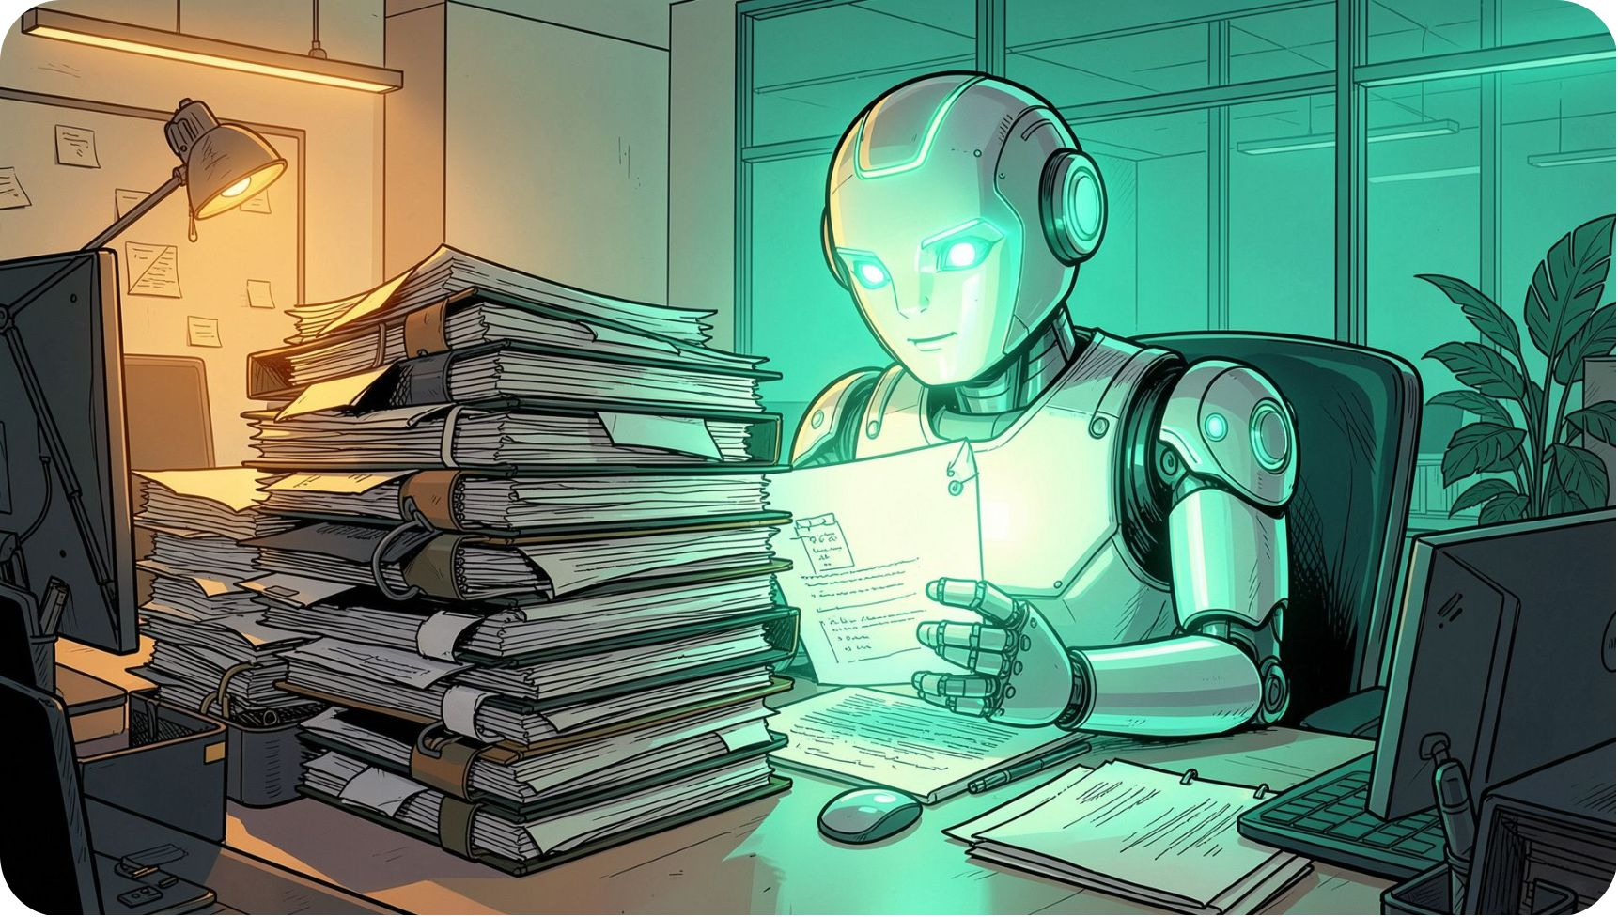



HOW IT WORKS
Meet Your Digital Intern
It has read every past proposal, every code commit, and every policy handbook at Novatech.
What It Does
Predicts the next best word using Novatech's historical data — at machine speed, 24/7.
What It Can't Do
It has zero common sense. It cannot judge brand tone, strategic risk, or client nuance.
Your Role
Review. Correct. Approve. You are the quality controller.

Slide 7
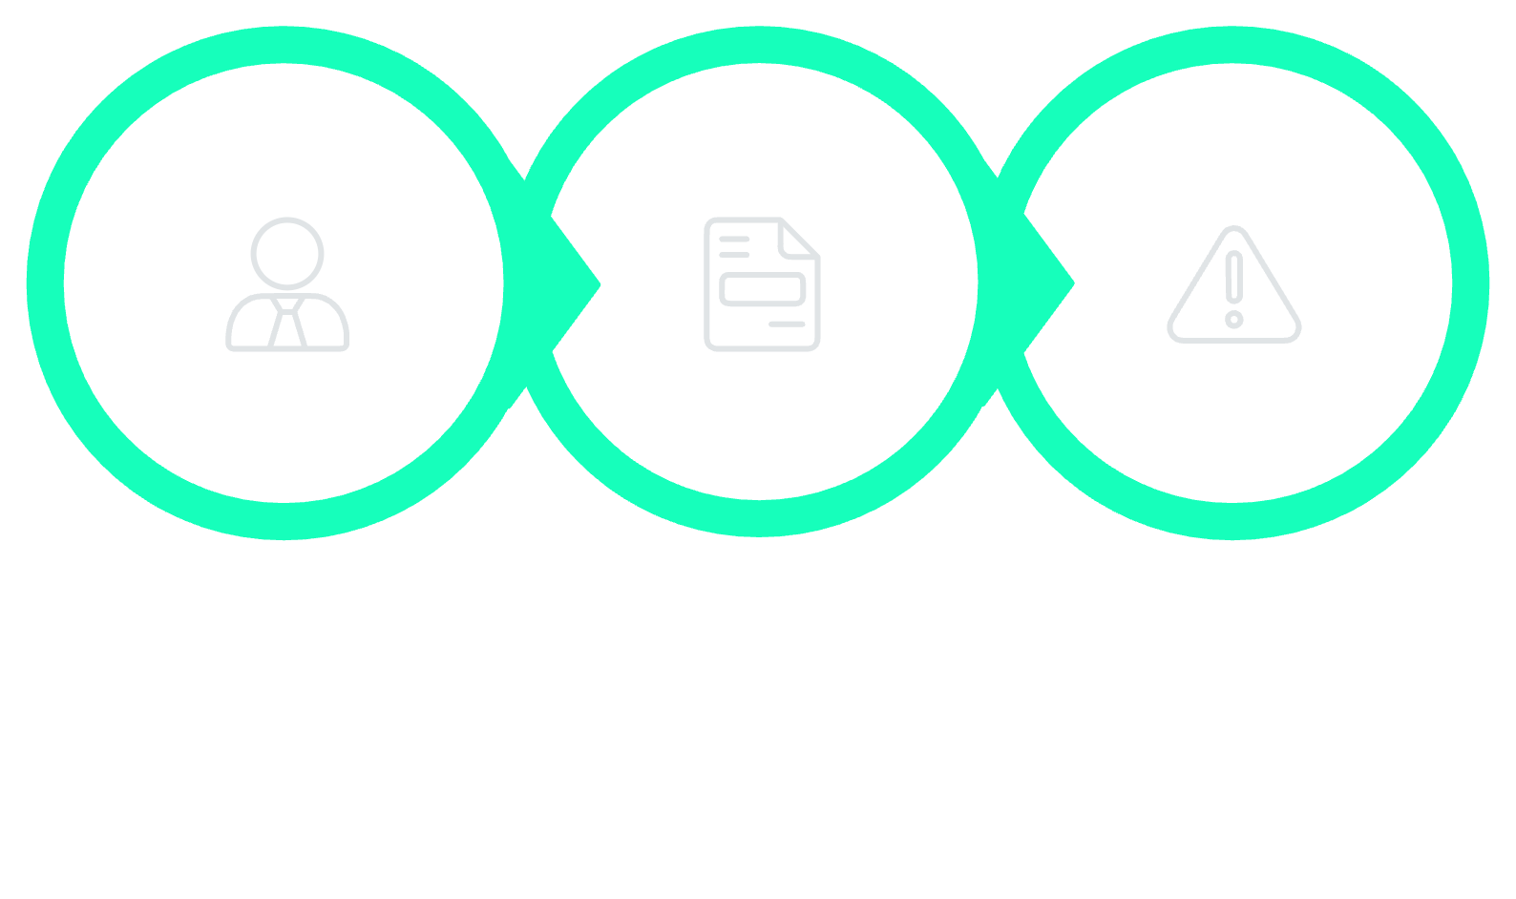

PROMPTING 101
The Goldilocks Framework
Generic prompts yield generic results. This three-step structure — not too vague, not too specific — delivers exactly what you need, every time.
Context
Task
Constraints
Rule: Garbage In = Garbage Out. Be specific about who the AI is, what it should do, and what rules it must follow. Precision is the superpower.

Slide 8
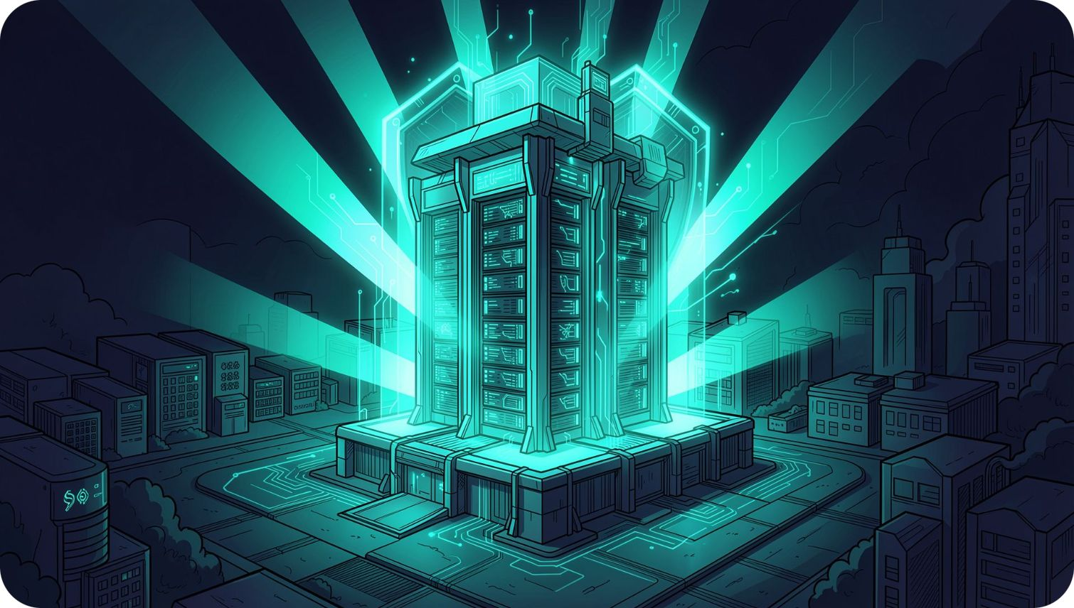



RESPONSIBLE AI
Novatech's Zero-Trust AI Proxy
Security is our #1 priority. Our reverse-proxy wall ensures zero data leaks — no client data, no employee PII, no proprietary code ever leaves our network.
PII Scanning
Auto-Redaction
100% Audit Trail
Names, Aadhaar numbers, and phone numbers are detected and blocked before processing.
Sensitive data is stripped automatically before any request leaves our infrastructure.
Every interaction is logged. Nothing outside Novatech sees your code or customer data.

Slide 9
WHAT'S IN IT FOR YOU
Your Role, Mapped to Your Gain
Wave 1 initiatives — built for your specific workflow, not a generic template.
Your Role | AI Does This | You Get This
Software Engineer | Writes Playwright test scripts automatically | 14 hrs/week for new features
Finance Lead | Extracts 15 invoice fields instantly | Close books 6 days faster
Sales Rep | Drafts technical RFP responses | Win 22% more deals
PMO Manager | Aggregates Jira/Slack status updates | 8 hrs/week freed up

Slide 10
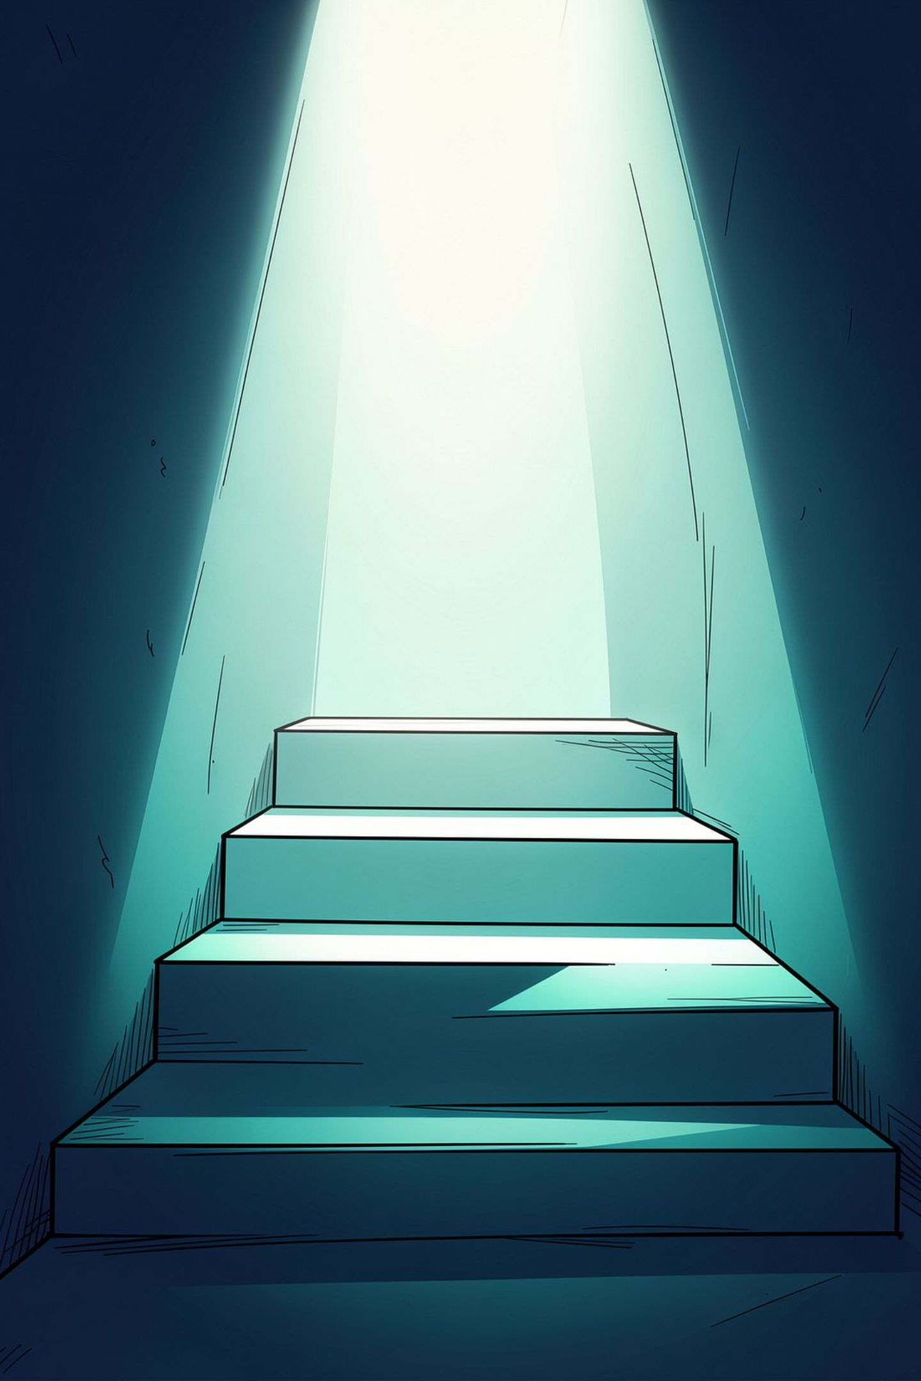
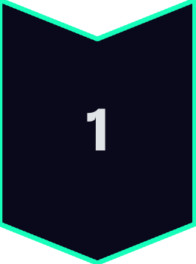
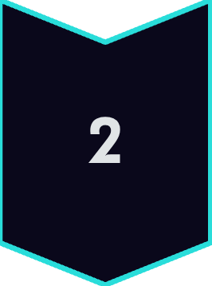
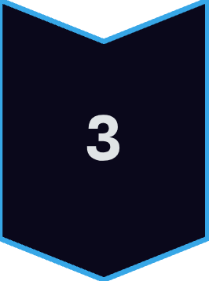
YOUR JOURNEY
The 3-Track Roadmap
Track 1 — Today
Demystification. You are here. Understanding the "what" and the "why" behind AI at Novatech.
Track 2 — Coming Next
Champions Sandbox. Hands-on with real Novatech data. Build your first automation live.
Your Homework
Bring one boring, repetitive task from your daily work to the next lab. We will automate it together.
We don't expect you to become AI experts today. We expect you to be curious. Bring your biggest workflow headache — and we'll fix it.

