Slide 1

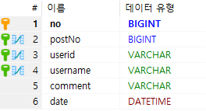
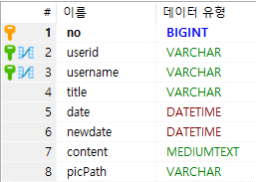
TB_MEMBER
TB_COMMENT
TB_SIMPLEBOARD
POSTNO=NO

