Slide 1
Insurance customer’s claim prediction system
201632202 An geonha
201835518 Jeon Soyeong
201935006 Ko Hyojin
201935077 Oh yejin

Slide 2
#Contents
Objective
Dataset Information
End - to - end process
Open source
Result
conclusion

Slide 3

#Objective
Predict customer claim and select the best insurance model with the least risk
Notes:
https://7t.co/blog/3-benefits-of-predictive-analytics-for-car-insurance-companies/

Slide 4
#Objective-Benefits
Optimizing insurance pricing
Reducing fraudulent claims
Improving marketing by forecasting buyer behavior
Notes:
https://7t.co/blog/3-benefits-of-predictive-analytics-for-car-insurance-companies/

Slide 5
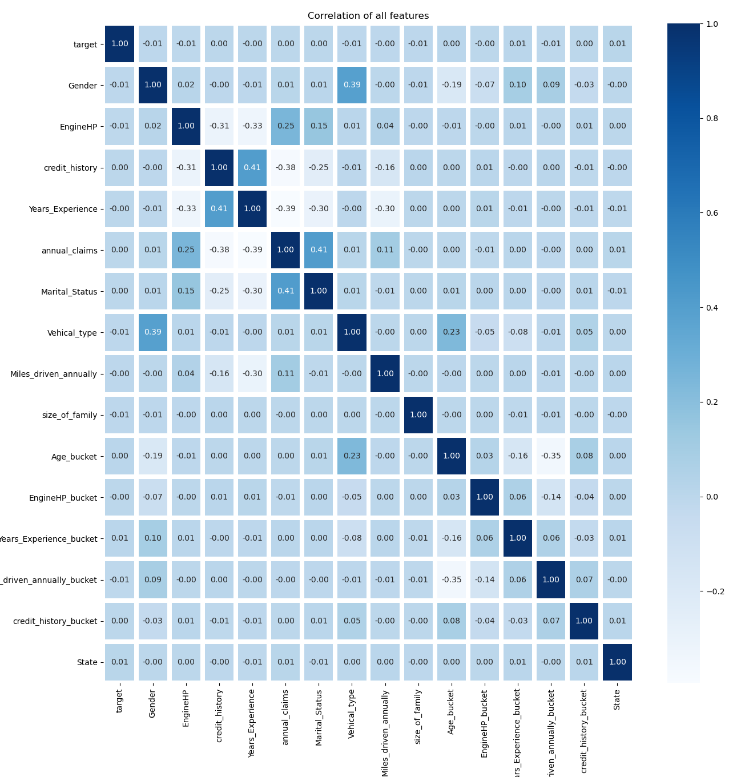
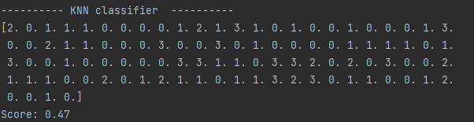
#Result
After analyzing the data in various ways, the predictions of data less than 50%.
It was observed that the obtained data were not very related to the target feature.

Slide 6
#Dataset Information
ID
Marital Status
Credit History
Gender
Age
State
Credit History
Size of Family

Slide 7
#Dataset Information
Vehicle Type
Engine HP
Engine HP Bucket
Miles Driven Annually
Miles Driven Annually Bucket

Slide 8
#Dataset Information
Credit History
Years Experience
Years Experience Bucket
Annual Claims
Target

Slide 9
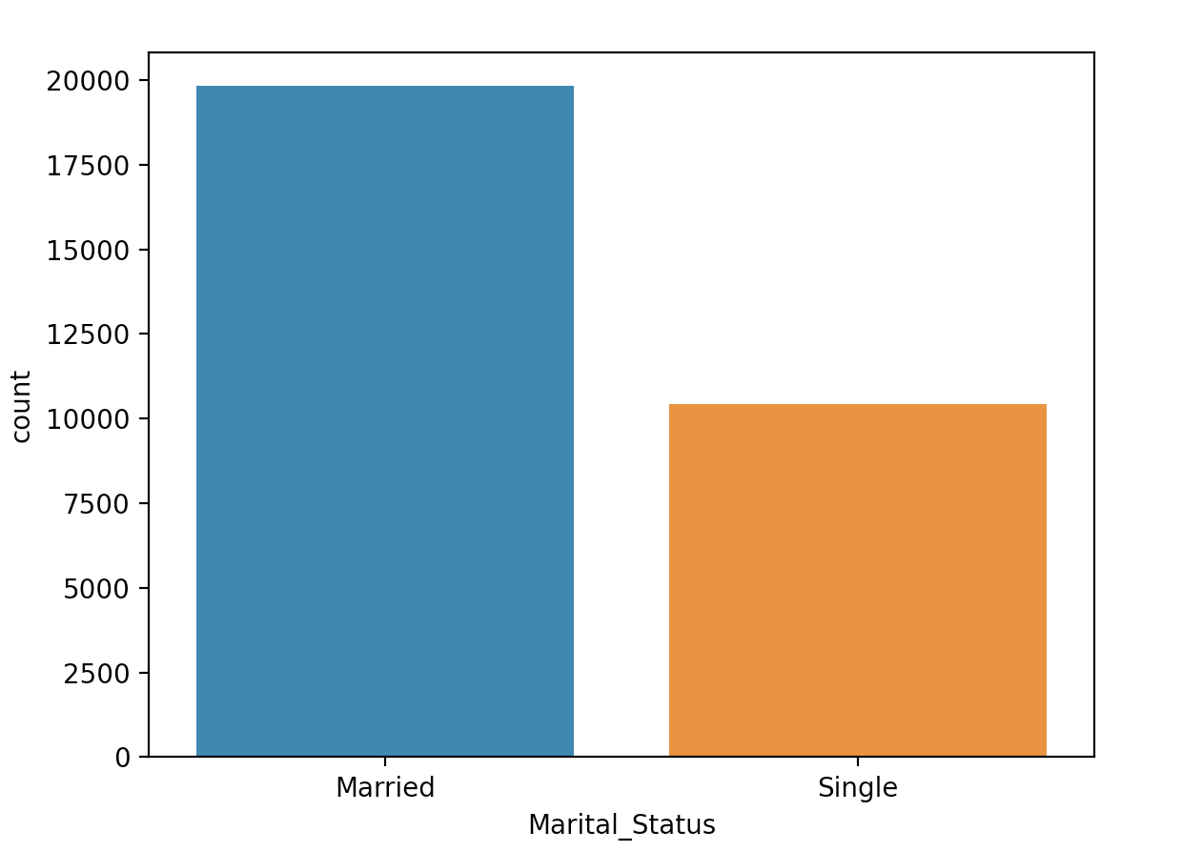
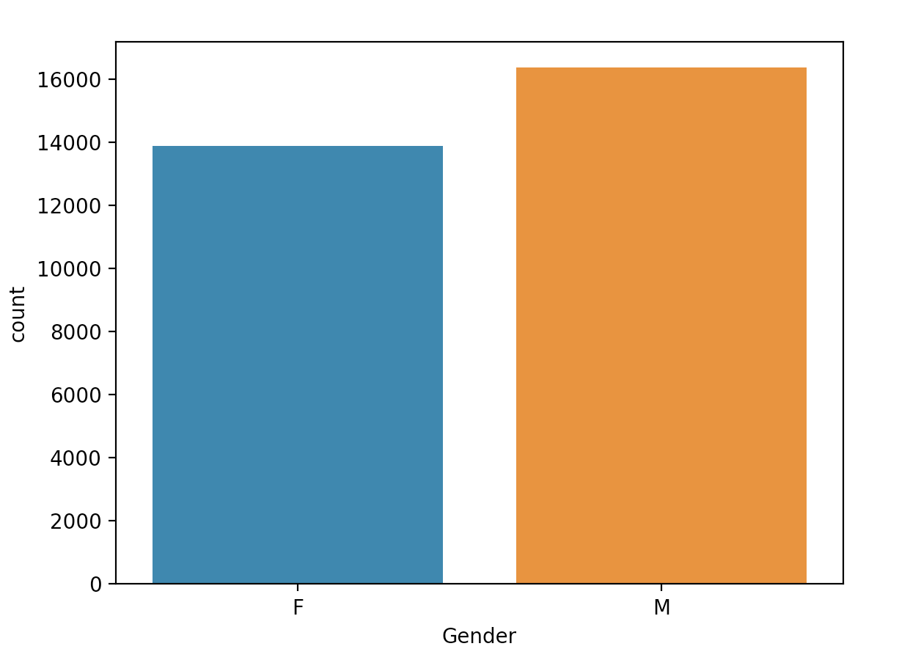
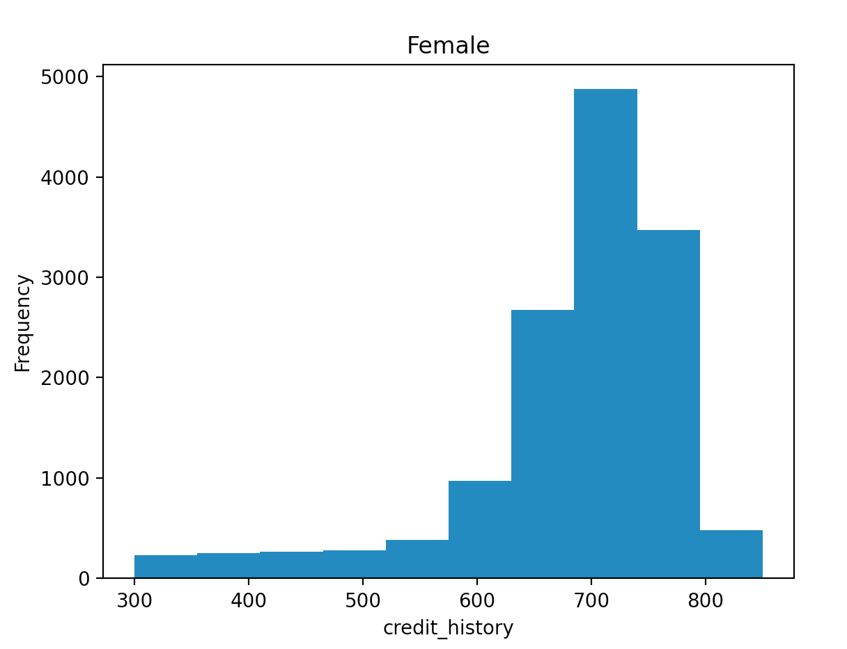
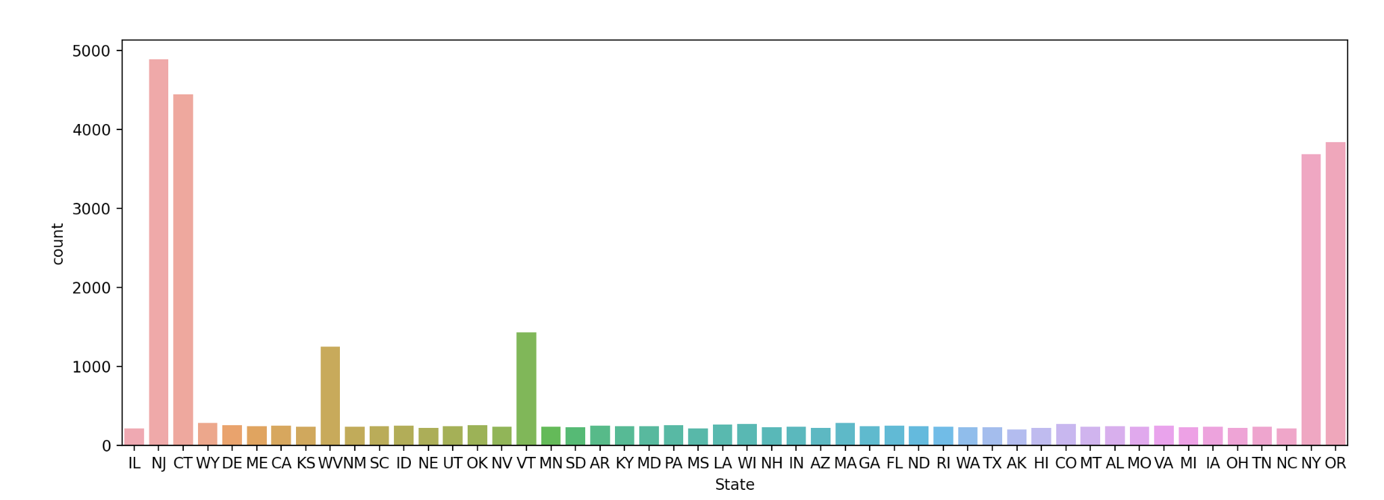
#Dataset Information

Slide 10
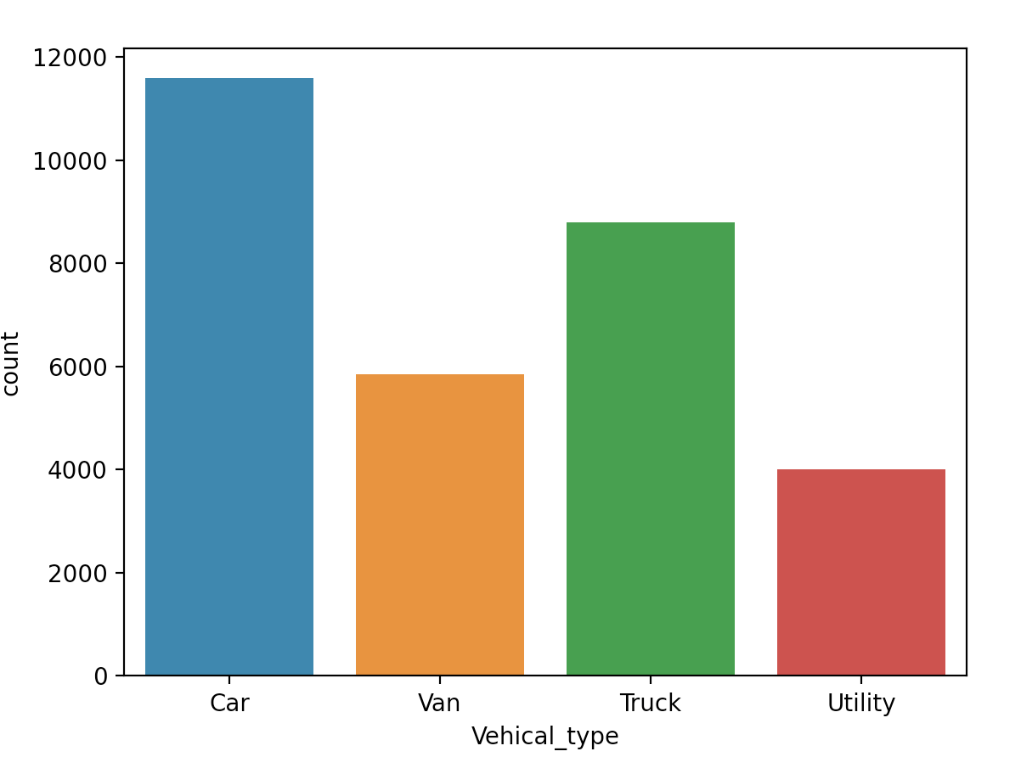
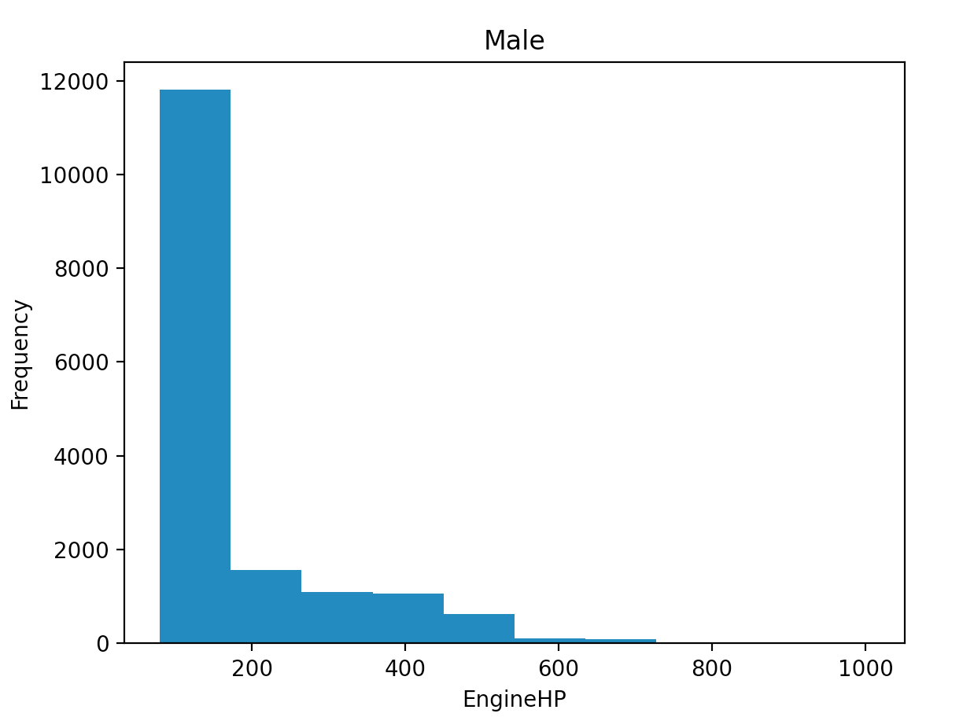
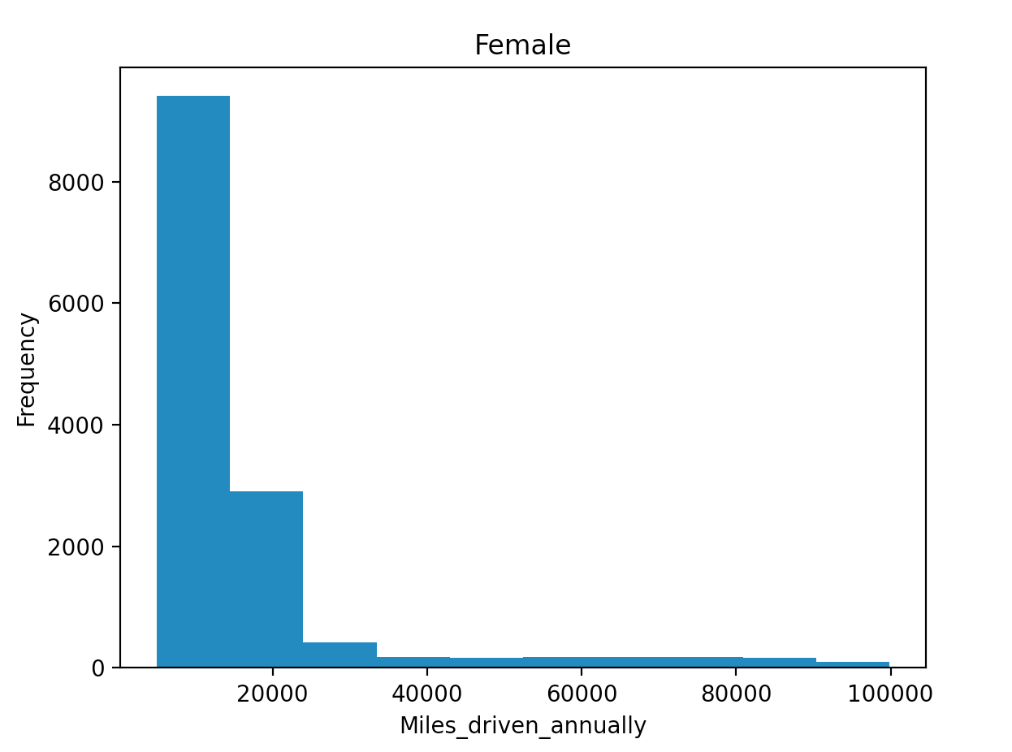
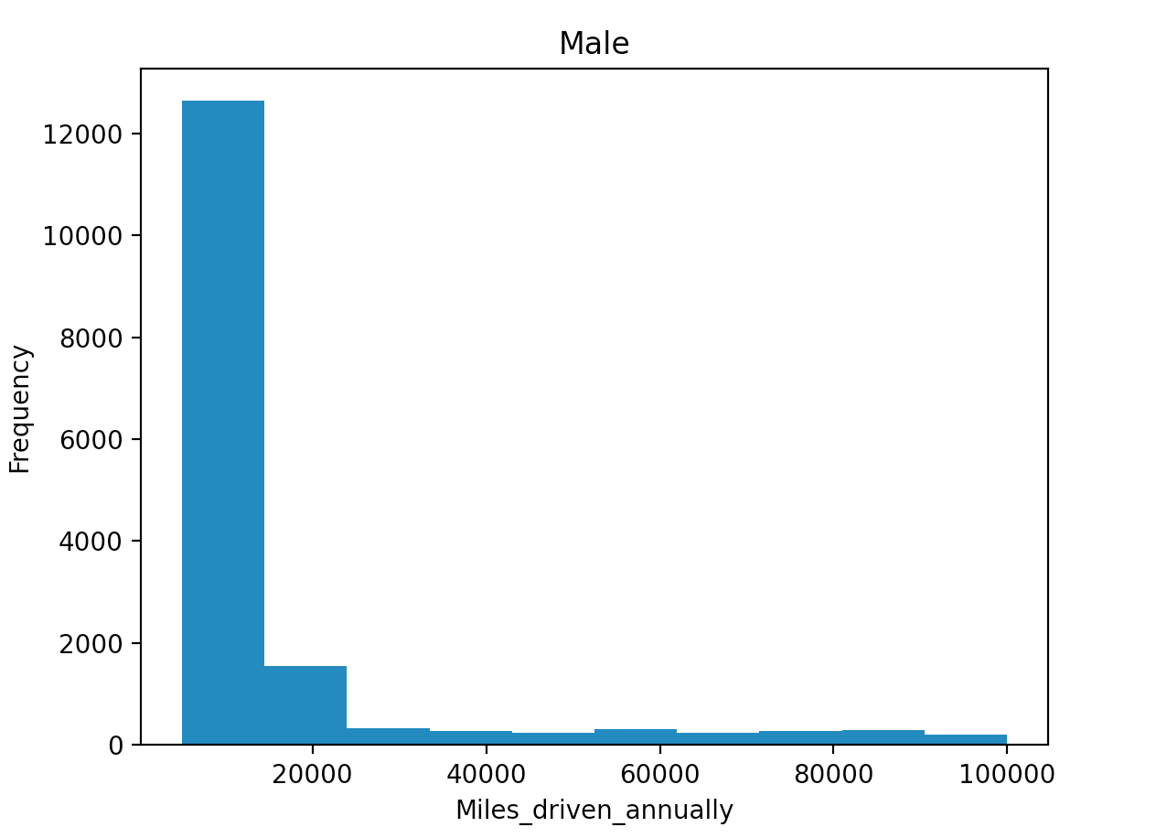
#Dataset Information

Slide 11
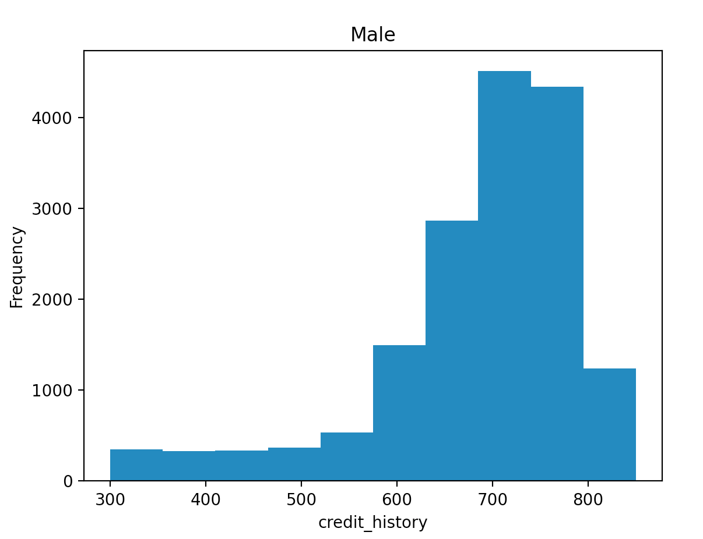
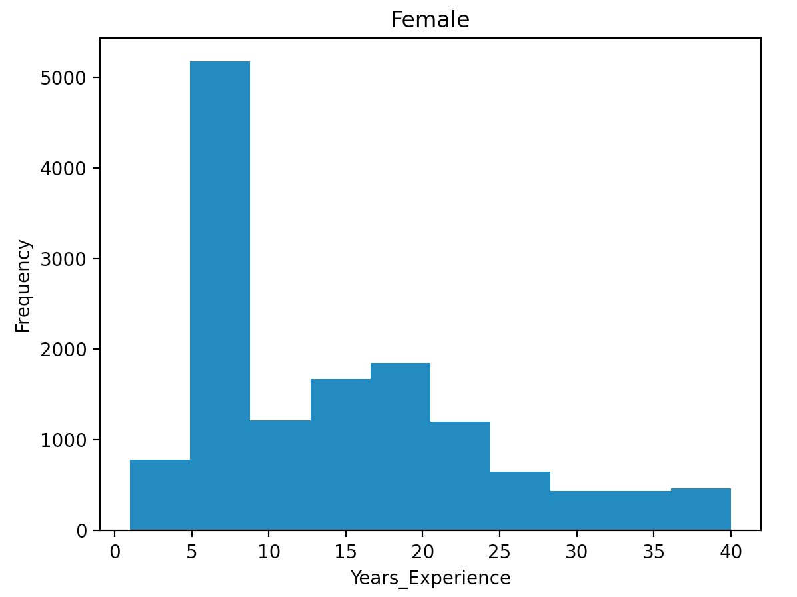
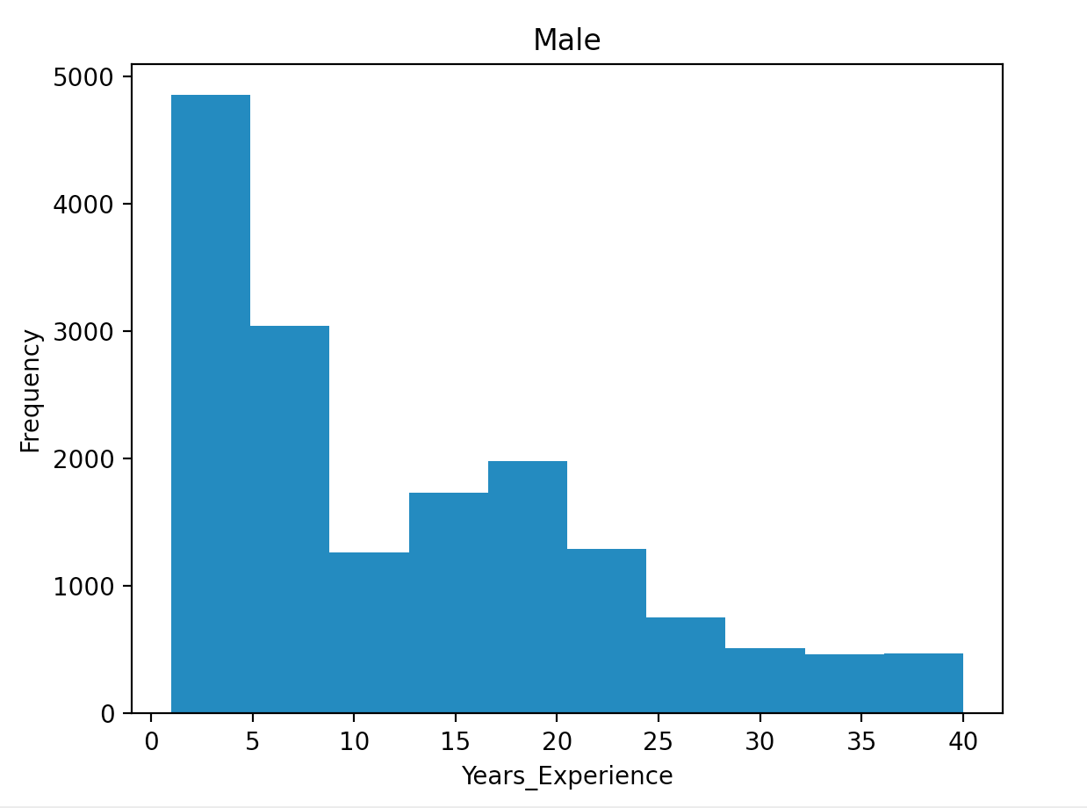
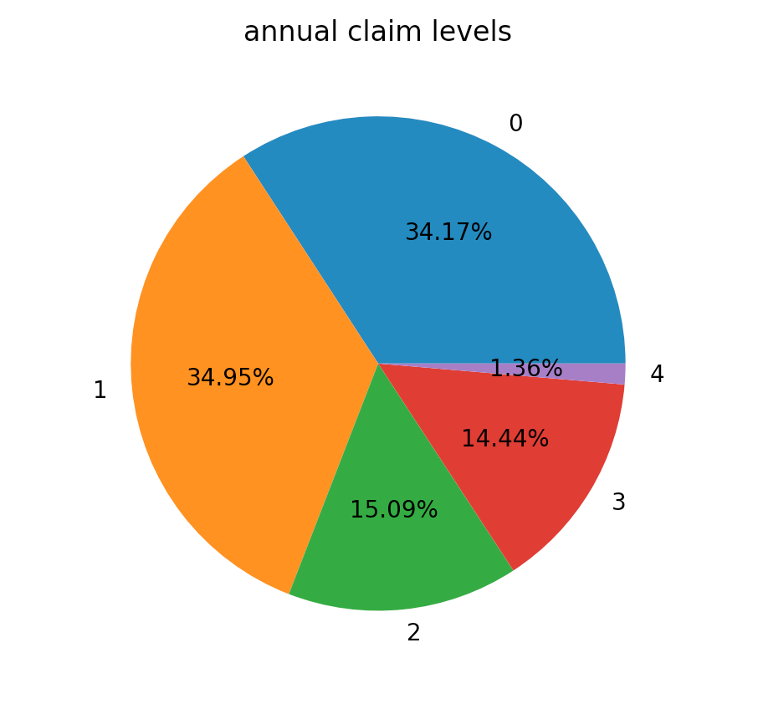
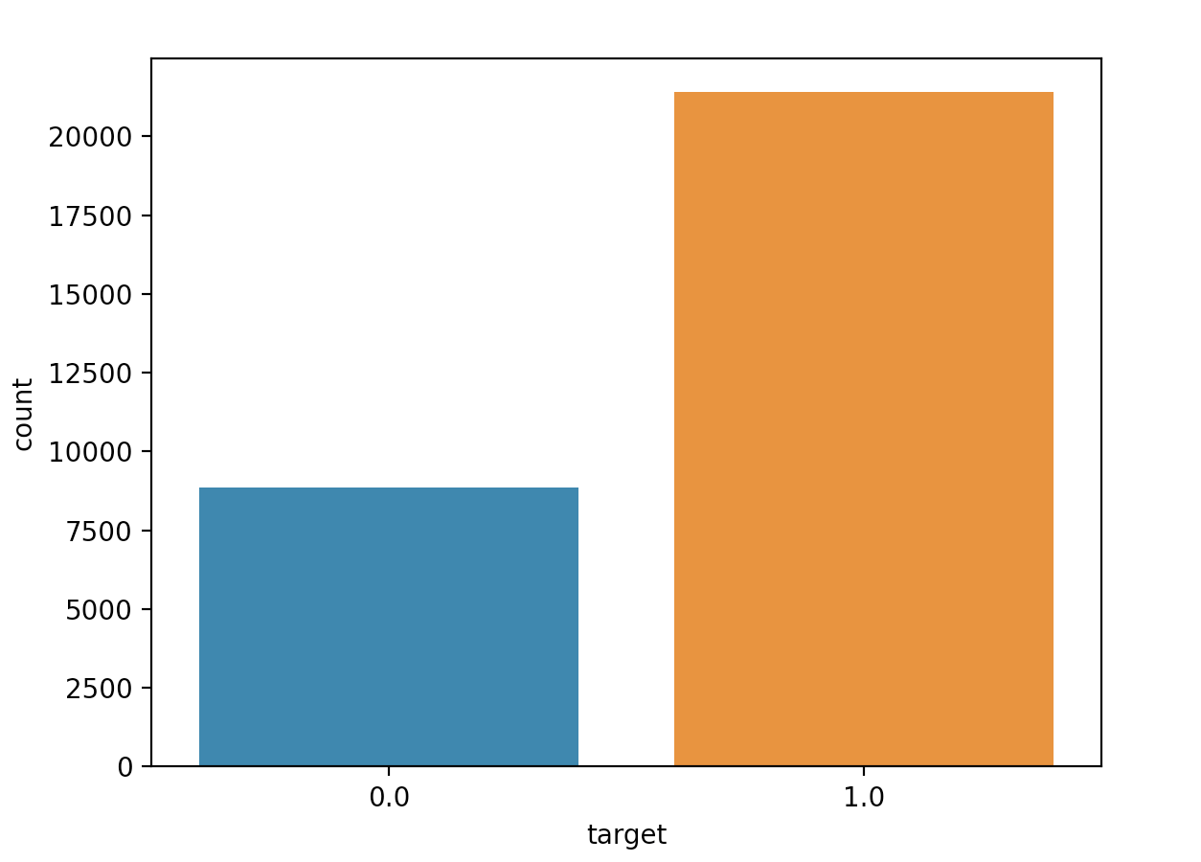
#Dataset Information

Slide 12
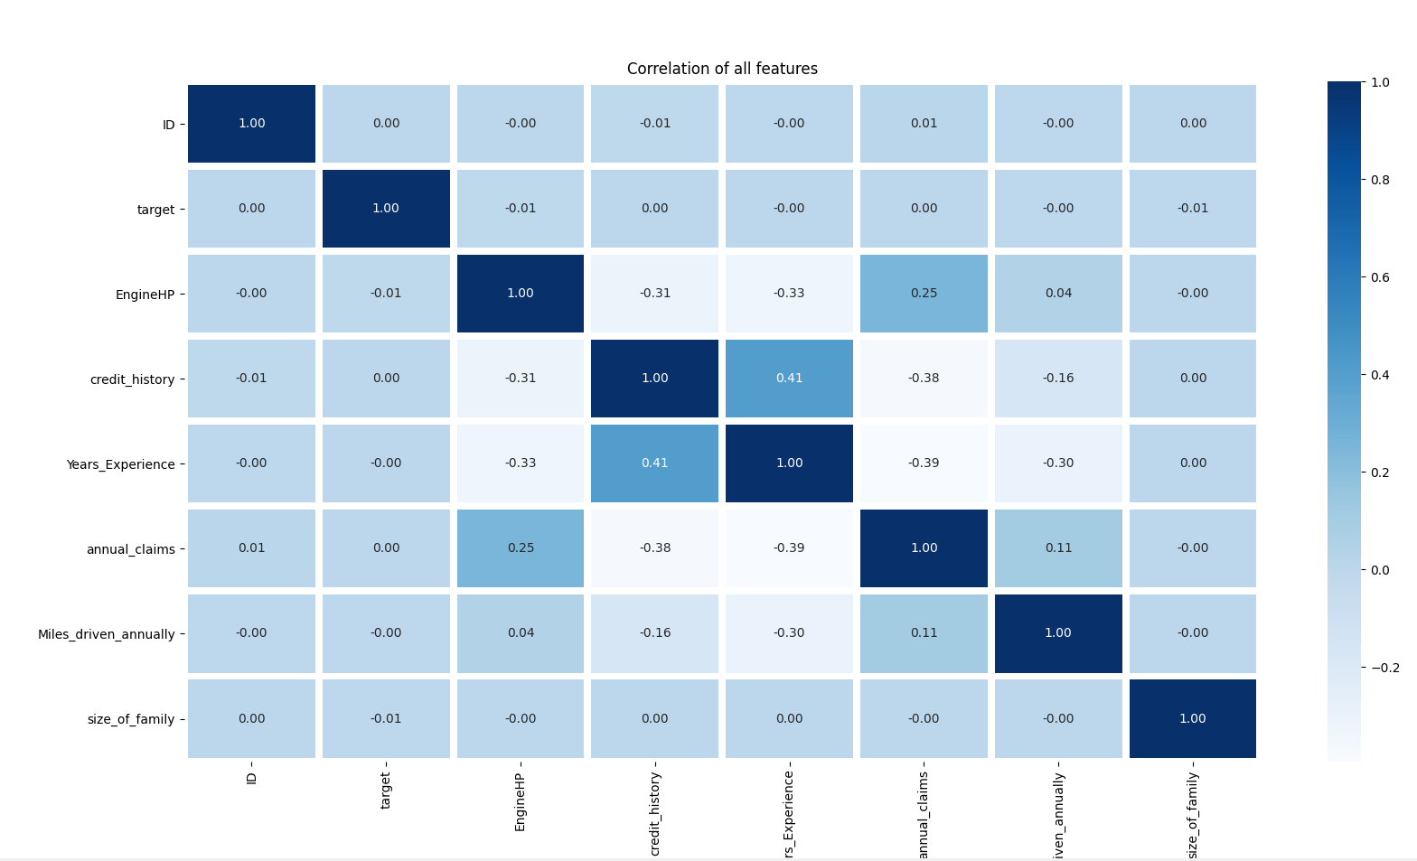
#Dataset Information

Slide 13
#Dataset Preprocessing
Data Restructuring
Handle Missing Data
Feature Encoding
Splitting data into Train and Test set
Feature Scaling
Preprocessing result

Slide 14
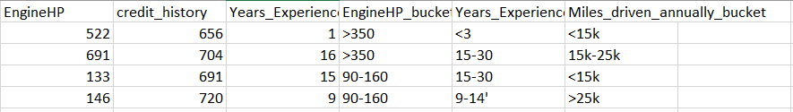
#Dataset Preprocessing
Data Restructuring
We remove overlapping columns.
Columns with the same meaning were included twice.
(Age - Age Bucket, EngineHP - EngineHP Bucket, etc,...)

Slide 15
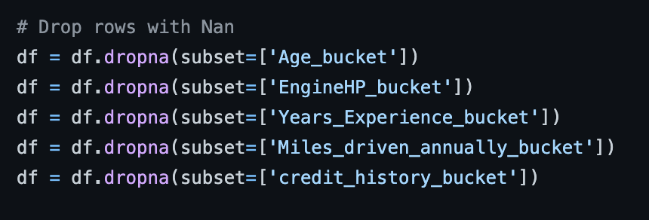
#Dataset Preprocessing
2. Handle Missing Data
However, there was a problem that the score was not accurate.
So, we added overlapping columns again, dropped the bucket data with missing values.

Slide 16
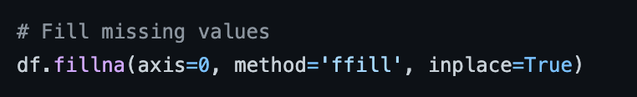
#Dataset Preprocessing
2. Handle Missing Data
And fill missing values with ‘ffill’

Slide 17
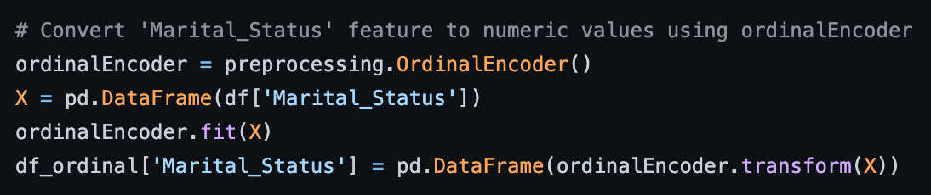
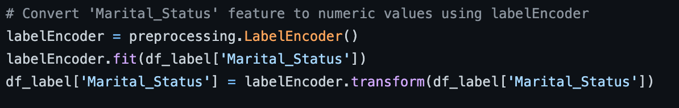
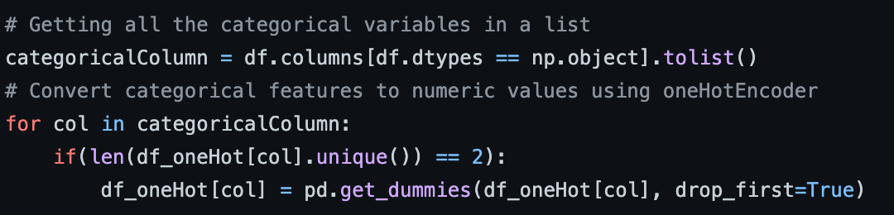
#Dataset Preprocessing
3. Feature Encoding
Applying the three encoding method: Ordinal, Label, OneHot

Slide 18
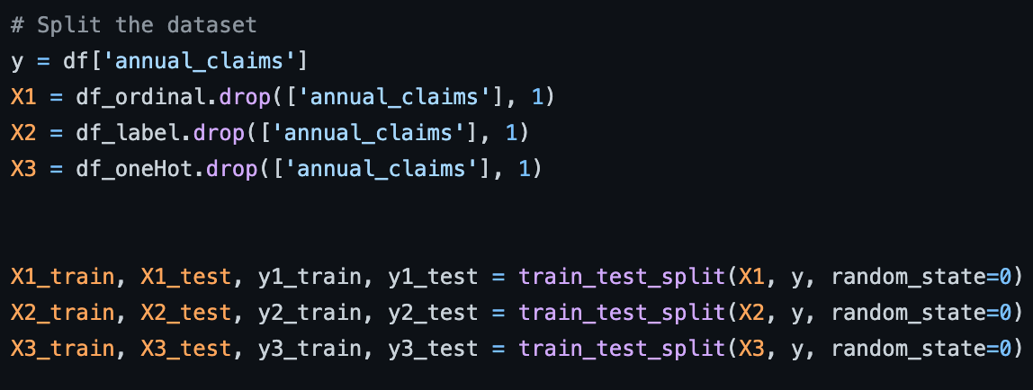
#Dataset Preprocessing
4. Splitting data into train and test set
Drop the target column of the encoded data and split it into test and train set

Slide 19
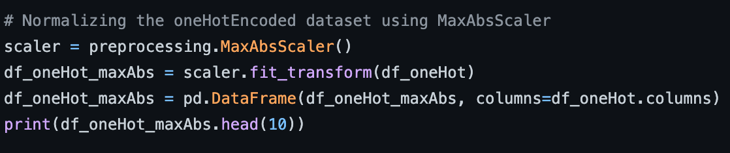
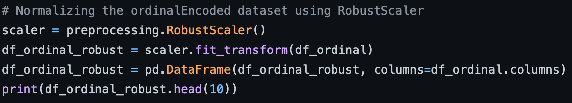
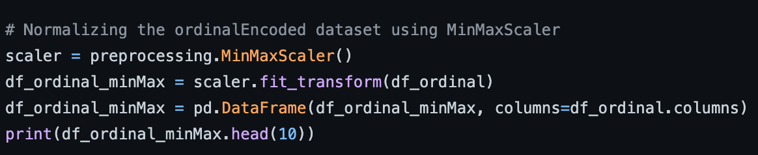
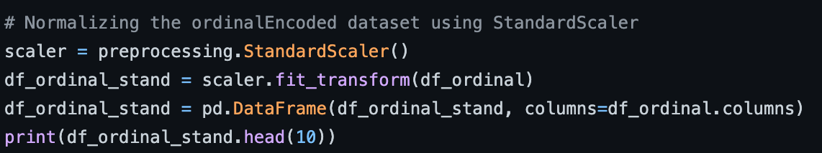
#Dataset Preprocessing
5. Feature Scaling
Scaling Three-way encoded data using MinMax, Robust, MaxAbs, Standard scaler

Slide 20
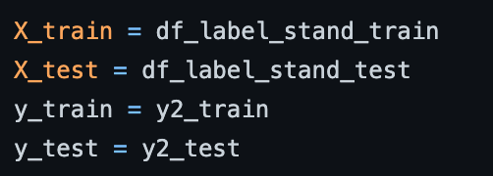
#Dataset Preprocessing
6. Preprocessing result
Then, we select the most appropriate data that was encoded with label encoder and scaled with standard scaler.

Slide 21
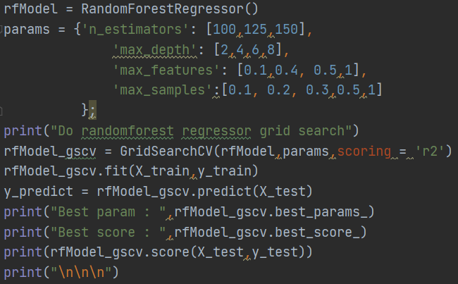
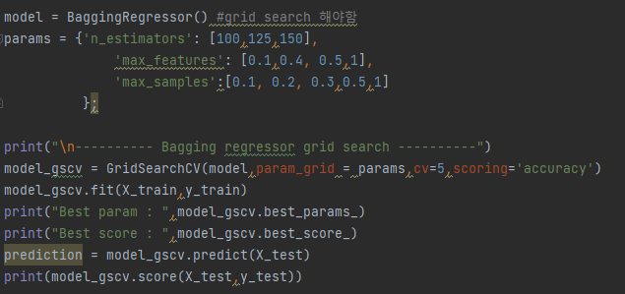

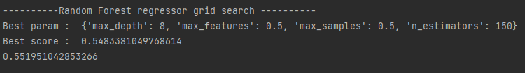
#Algorithm
random forest regressor
(grid search)
bagging regressor
(grid search)
score : 0.48
score : 0.55

Slide 22
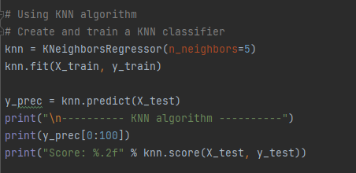
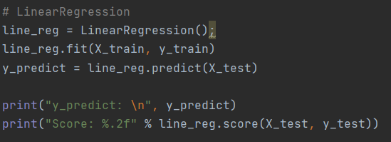
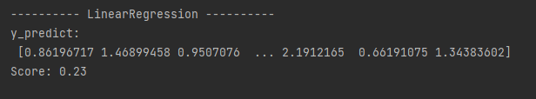

#Algorithm
knn regressor
Linear regressor
score : 0.23
score : 0.47

Slide 23
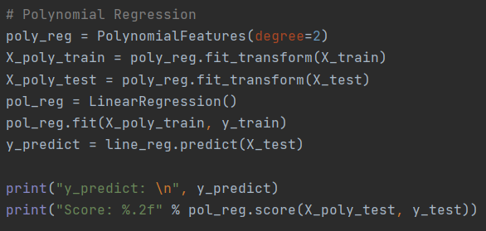
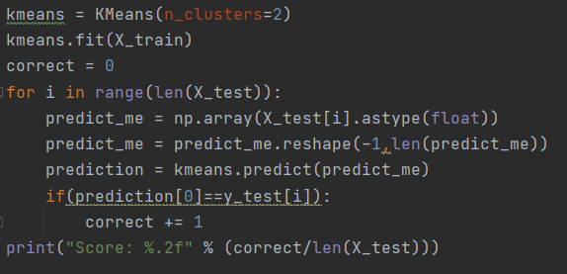
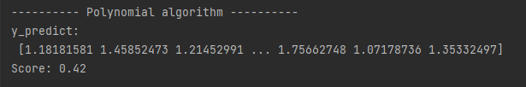

#Algorithm
Polynomial regressor
K-mean clustering
score : 0.42
score : 0.35

Slide 24
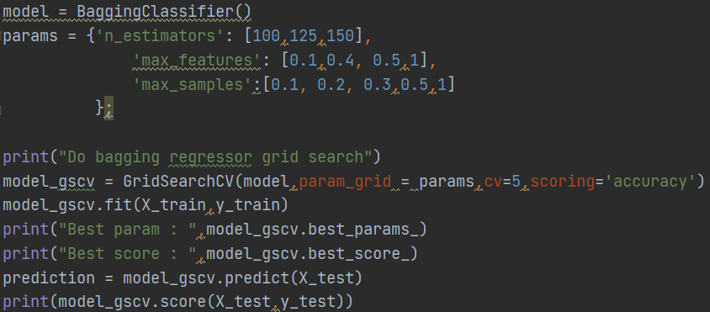
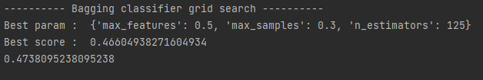
#Algorithm
Bagging Classifier (grid search)
score : 0.47

Slide 25
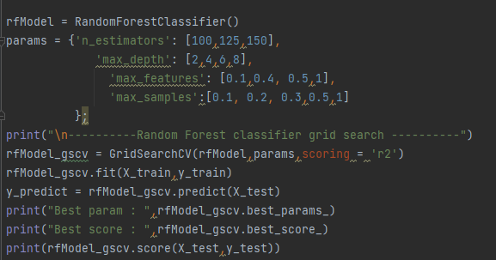

#Algorithm
Random Forest Classifier (grid search)
score : 0.3

Slide 26
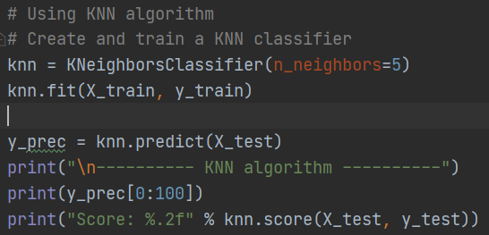
#Algorithm
KNN Classifier
score : 0.47

Slide 27
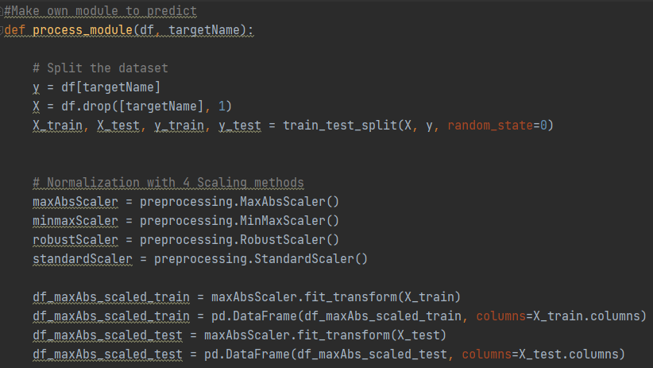
#Module
Split the dataset
into test and train set
2. Scaling with
MaxAbsScaler, MinMaxScaler, RobustScaler and StandardScaler
...

Slide 28
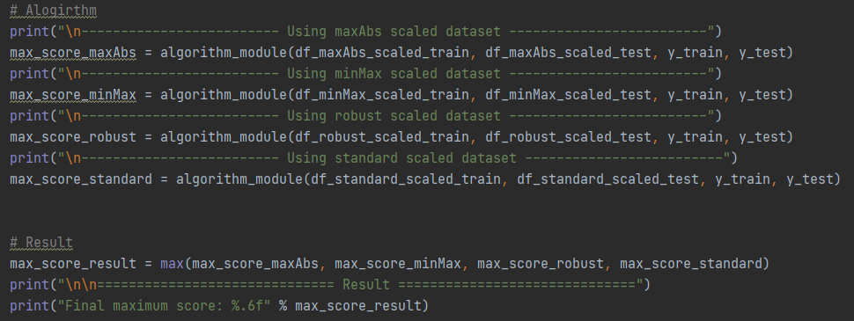
#Module
3. Analyze using algorithm_module

Slide 29
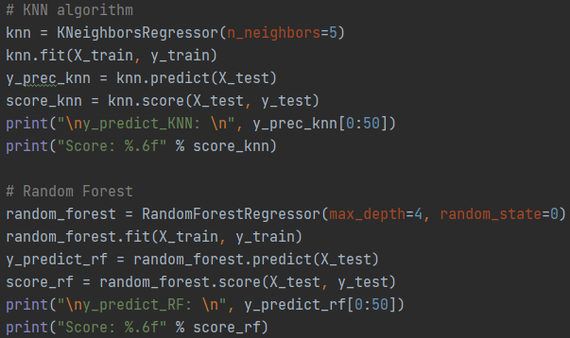
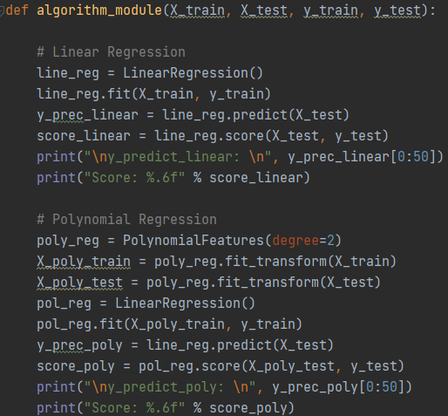
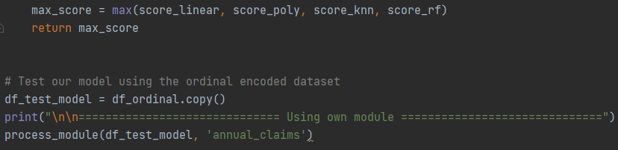
#Module
4. Return the best score
using LinearRegression, PolynomialRegression,
KNN, and RandomForest algorithms.

Slide 30
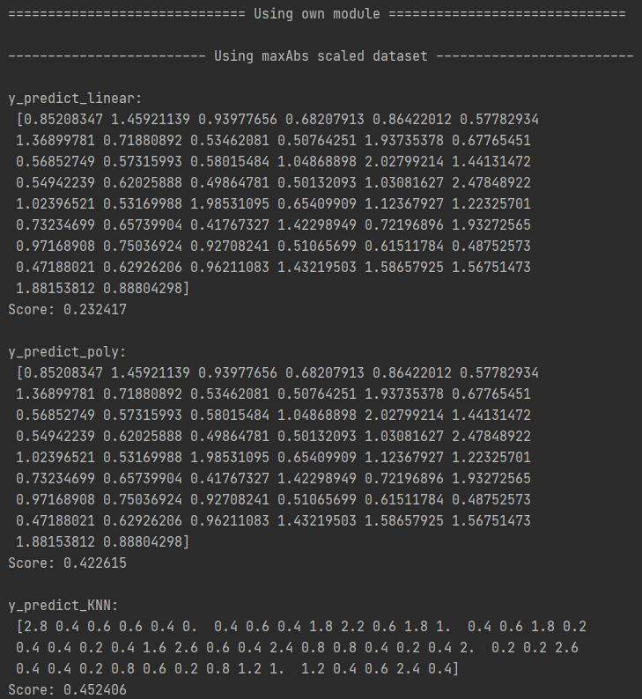
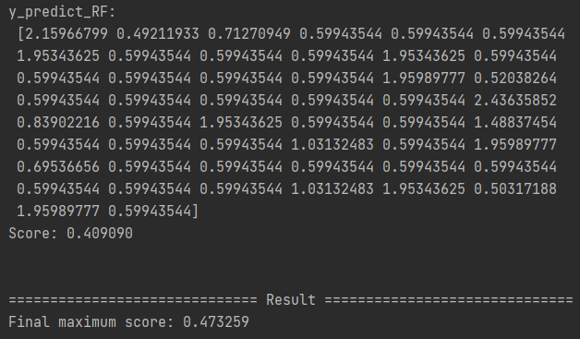
#Module
...
Best score : 0.47
https://github.com/Hyojinko/2021_datascience/blob/main/module.py

Slide 31
#Conclusion
We find that even if the data seems to be related to the information we are trying to predict, if we analyze them in practice, sometimes they are not significant predictions. Through this, I felt that it was important not only to analyze the data but also to determine what data we would need to achieve the results we wanted.

Slide 32
#Conclusion
Feature that we can predict with this dataset
Whether the driver will initiate the auto insurance
2. Traffic Safety Status by State

Slide 33
#Conclusion
The features we will add for better prediction are...
1. Claims : Paid claims, Pending claims
2. Coverage Types: Medical expense, Legal expense, Fine , Legligence rate
3. Total insurance

Slide 34

#Role
Ko Hyojin
-Preprocessing
-Open source scailing
-Graph
-Contribution : 25%
An Geonha
-Preprocessing
-Grid search
-Final modify after merging
-Contribution : 25%
Jeon Soyeong
-Preprocessing
- Open source algorithm
- Analyze accuracy issue
-Contribution : 25%
Oh Yejin
-Preprocessing
-Analyze accuracy issue
-Contribution : 25%

Slide 35



#Documentation
GitHub
Google slides
Google meet

