Slide 1
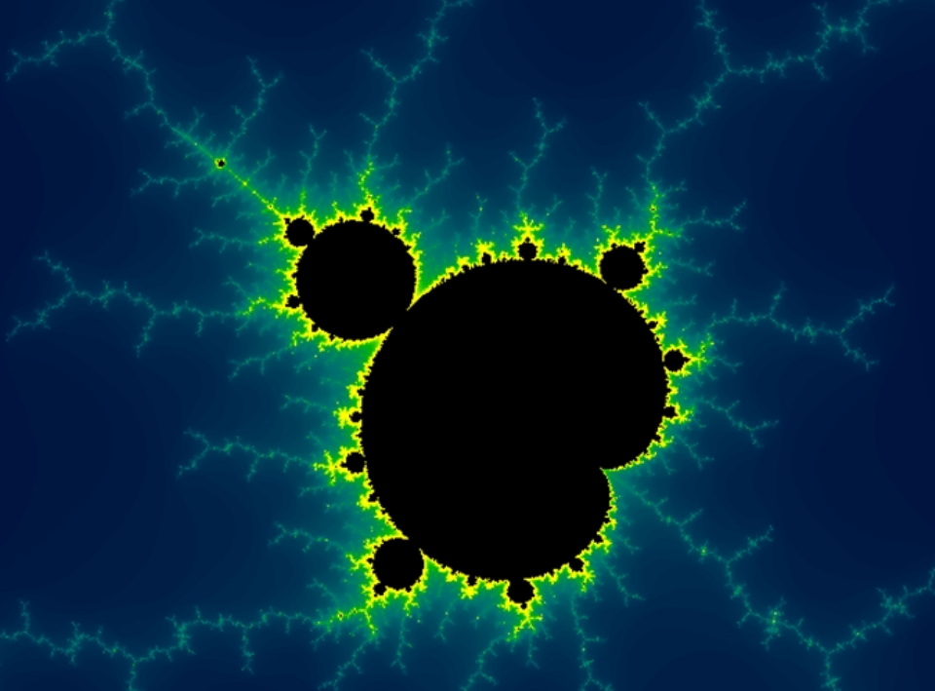
Fractals
Asha Bharambe

Slide 3
Fractals
A fractal is a geometric construction that is self-similar at different scales.
Fractals can be found in nature around us and have been heavily utilized in mathematics and computer science to simulate and model natural objects.
A mathematical fractal is based on an equation that undergoes iteration, a form of feedback based on recursion.

Slide 4
Fractals features
Have fine structure when viewed at arbitrarily small scales.
Satisfy the property of self-similarity.
Exactly self-similarity
Appears identical at different scales.
Defined by iterated functions
Quasi self-similarity
Appears approximately but not exactly identical when seen at different scales
Contains small copies of entire fractal in distorted and degenerated forms.
Defined by recurrence relations.
Statistical self-similarity
Has numerical or statistical measures which are preserved across scale.
Defined by statistical

Slide 5
The Concept of Dimension
So far we have used "dimension" in two senses:
The three dimensions of Euclidean space (D=1,2,3)
The number of variables in a dynamic system
Fractals, which are irregular geometric objects, require a third meaning….

Slide 6
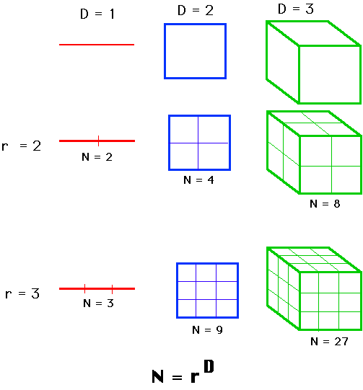
The Hausdorff Dimension
If we take an object residing in Euclidean dimension D and reduce its linear size by 1/r in each spatial direction, its measure (length, area, or volume) would increase to
N=r^{D}
times the original.

Slide 7
The Hausdorff Dimension
We consider N=r^{D}, take the log of both sides, and get
log(N) = D log(r).
If we solve for D.
D = log(N)/log(r)
The point: examined this way, D need not be an integer, as it is in Euclidean geometry.
It could be a fraction, as it is in fractal geometry.
This generalized treatment of dimension is named after the German mathematician, Felix Hausdorff.
It has proved useful for describing natural objects and for evaluating trajectories of dynamic systems.

Slide 8
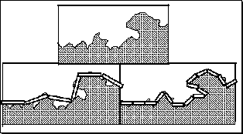
The length of a coastline

Slide 9
Fractals
Sierpinski's triangle
Koch Curve
Contour 1/3rd
Fern leaf
Julia Set

Slide 10
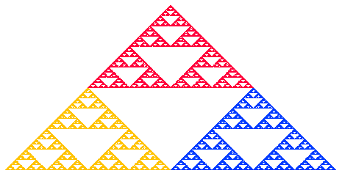
Sierpinski Gasket

Slide 11
Koch Curve

Slide 12
Cantor Middle-Thirds Set

Slide 13
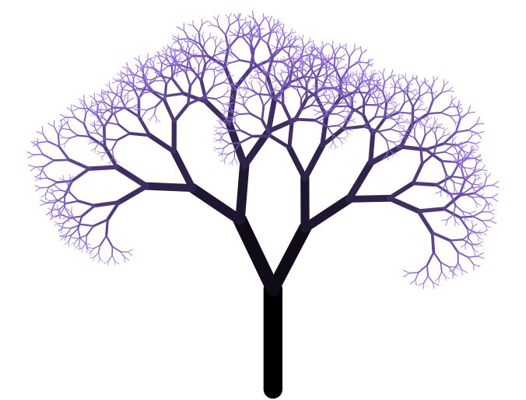
Fractal tree

Slide 14
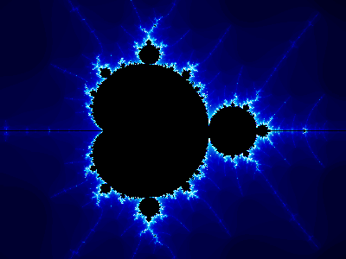
Mandelbrot Set

Slide 15
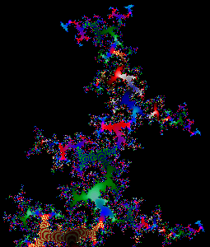
Julia Set

Slide 16
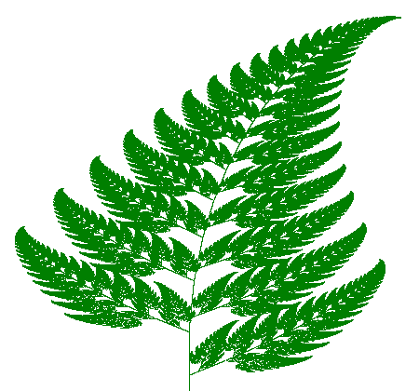
Barnsley Fern

Slide 17
Fractal Surface

