Slide 1
Project/Team Name
Team Members

Slide 2
Overview
Project Overview
Design
Implementation
Demonstration
Reflection

Slide 3
Project Description

Slide 4
Burndown Charts
I will provide you with a nearly-complete Sprint 2 burndown chart on Wednesday or Thursday.
Sprint 1
Sprint 2

Slide 5
Overview
Project Overview
Design
Implementation
Demonstration
Reflection

Slide 6
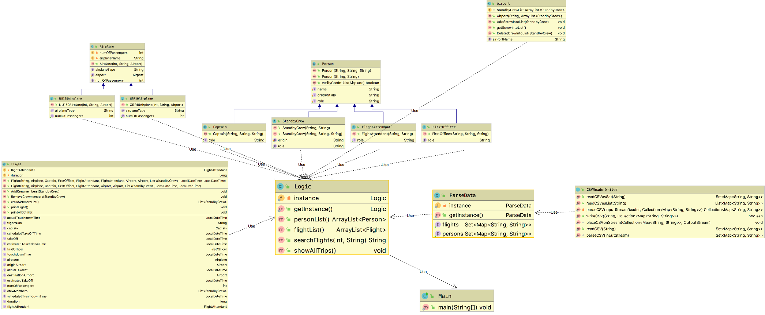
Subsystem Decomposition

Slide 7
Other Architectural Issues
Include slides as appropriate to discuss interesting elements of your architecture. For example, if access control is a big part of your architecture but persistent data management isn’t, then include a slide for access control but don’t include one for persistent data management.

Slide 8
Class Diagram: XYZ Subsystem
Your class diagram be easier to read if you show us just one subsystem at a time.
Add additional slides as necessary, one slide per subsystem.
Provide name of actual subsystem

Slide 9
Overview
Project Overview
Design
Implementation
Demonstration
Reflection

Slide 10
Implementation
add additional slide(s) to show any interesting code.
Libraries / Dependencies:Class CSVReaderHeaderAware
(other interesting info)
Progress:

Slide 11
Experience Report
OPTIONAL
If you used something that we talked about in class but didn’t include in an assignment, please discuss it here.
Possible examples: TDD, CI, ORM, in-memory testing

Slide 12
Overview
Project Overview
Design
Implementation
Demonstration
Reflection

Slide 13
Demo
In your slide deck, a few screen shots would be nice.
In your presentation, you should do a live demo of your application instead of stepping through the screenshots.

Slide 14
Overview
Project Overview
Design
Implementation
Demonstration
Reflection

Slide 15
Reflection What went well

Slide 16
Reflection What didn’t go well
1,No discussing about architecture in the start of the sprint which results in inefficient work, duplication of work by team members, and work of team members not needed by the project
2, Spending a lot of time on the design of the class, I think it is unnecessary.
3,There is no division of labor among the members of the group, which causes the members of the group to not know what to do next and what are the goals to be achieved at this stage

Slide 17
Reflection Lessons Learned
If you had to do it all over again, what would you do differently?
1,We increased teamwork experience(knew how to cooperate and communicate with team members)

