Slide 1
Bohn’s Drones
Matt, Ayush, Ryan, Soham

Slide 2
Overview
Project Overview
Design
Implementation
Demonstration
Reflection

Slide 3
Project Description
Package Tracker 2
Bohn's Drones
Track a package
Track Drone movements
Request A package
Pickup a package
Deliver a package

Slide 4
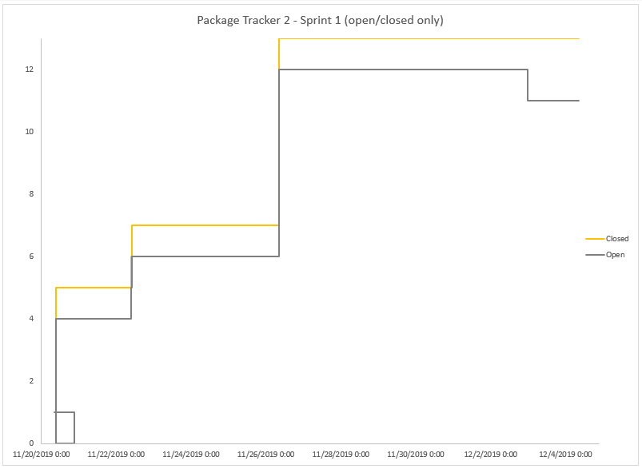
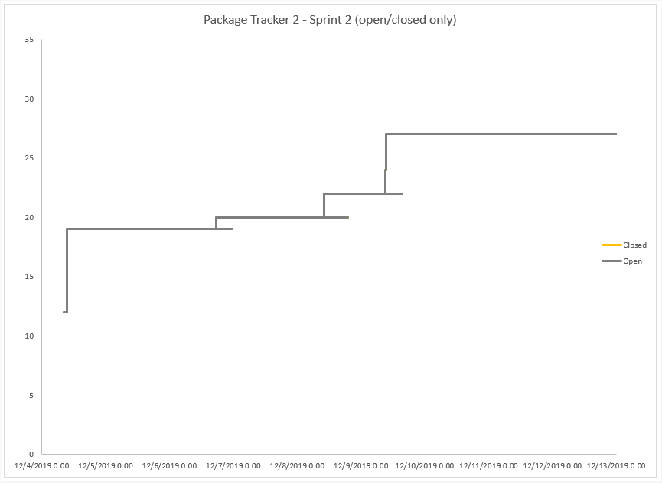
Burndown Charts
Sprint 1
Sprint 2

Slide 5
Overview
Project Overview
Design
Implementation
Demonstration
Reflection

Slide 6
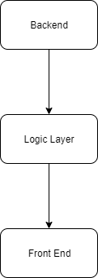
Subsystem Decomposition
Backend: initializes data from CSV files and backs up date to CSV files
Logic Layer: Holds the math for the system and manipulating system parameters.
Allows users to run commands

Slide 7
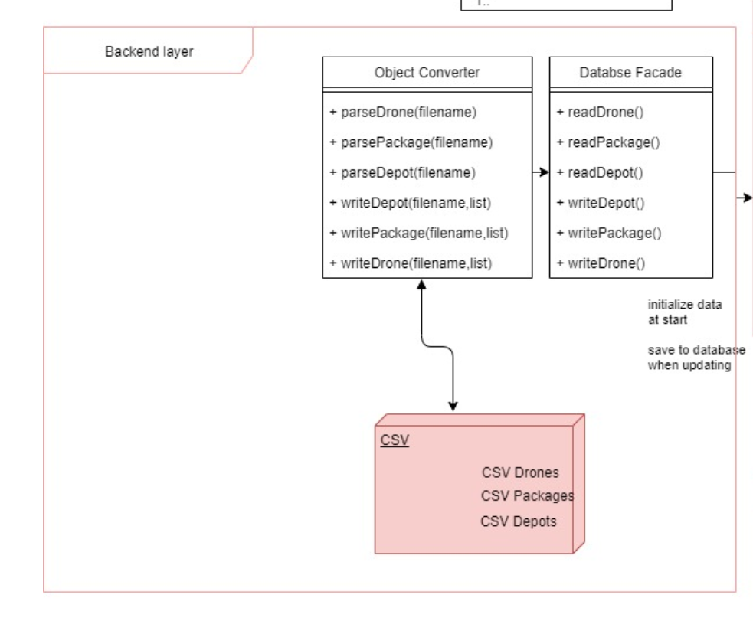
Backend

Slide 8
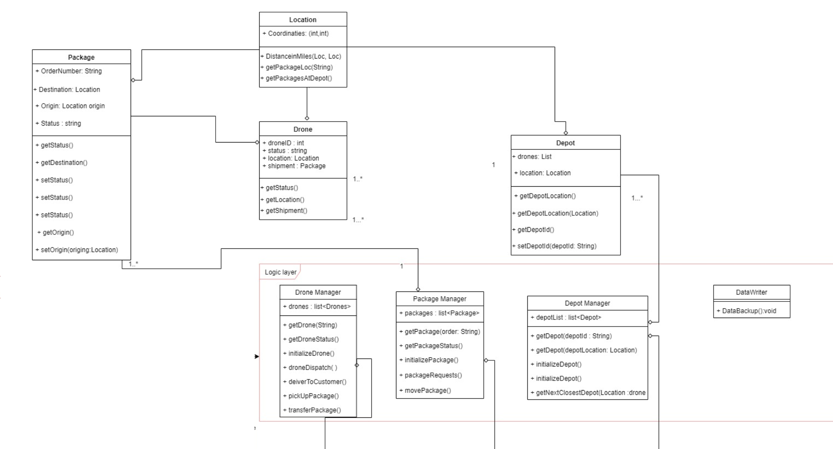
Logic Layer

Slide 9
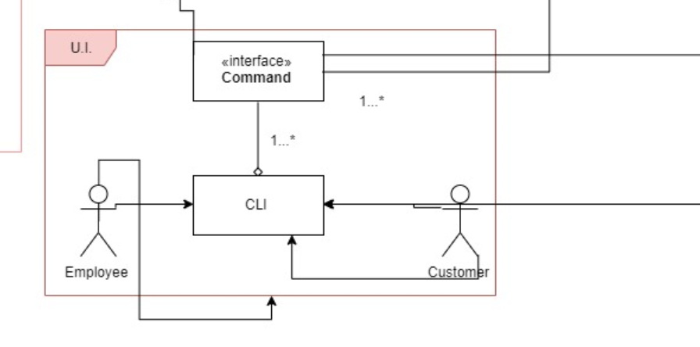
Front end

Slide 10
Overview
Project Overview
Design
Implementation
Demonstration
Reflection

Slide 11
Implementation
Libraries / Dependencies: Dependent on Bohn's CSVReaderWriter
Progress:

Slide 12
Overview
Project Overview
Design
Implementation
Demonstration
Reflection

Slide 13
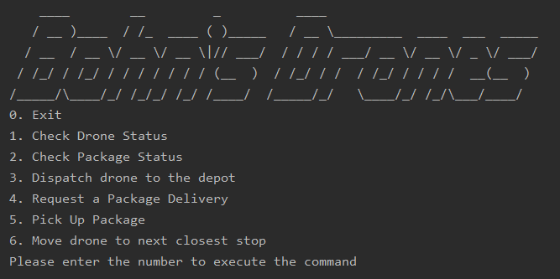
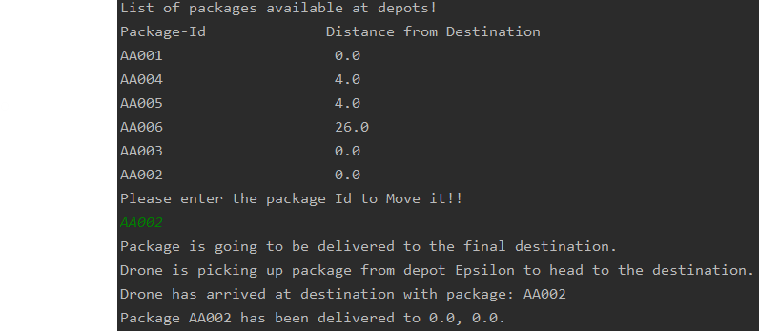
Demo

Slide 14
Overview
Project Overview
Design
Implementation
Demonstration
Reflection

Slide 15
Reflection What went well
Deciding on an architecture early on
Prioritizing functions that fulfilled dependencies
Keeping functions modular

Slide 16
Reflection What didn’t go well
Not prioritizing a testing suite
Poor branching discipline

Slide 17
Reflection Lessons Learned
Make unit test to streamline testing
Maintain issue tracking better

