Slide 1


Slide 2
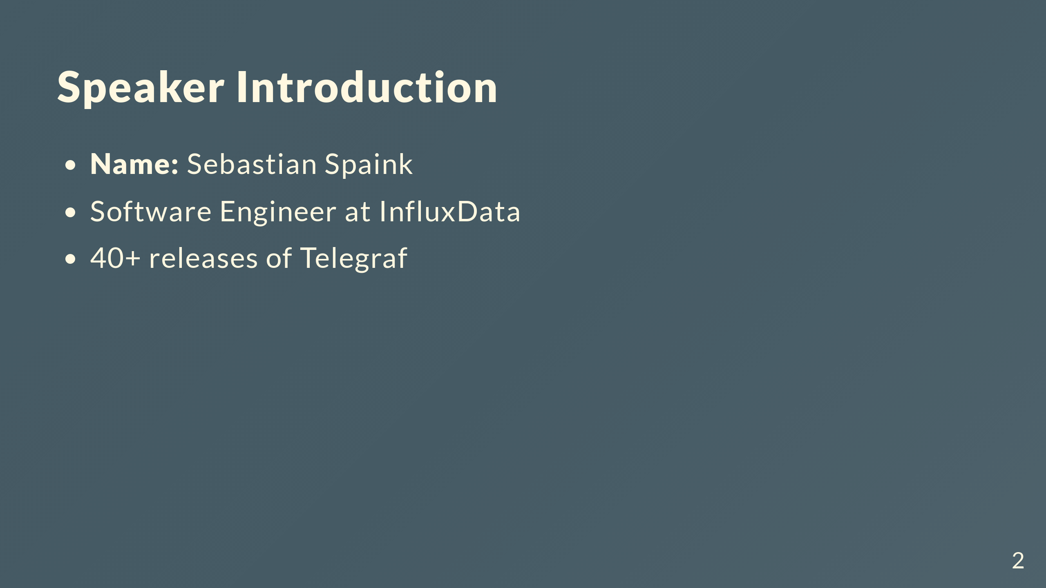
Notes:
_style: lead invert

Slide 3

Notes:
This is a presenter note for this page. EXAMPLE: An EXAMPLE directive is not defined in Marp/Marpit, so this works as presenter notes.

Slide 4


