Slide 1
Demo: Machine Learning Model Development Using Hypothetical Clinical Data
Version 1.0

Slide 2
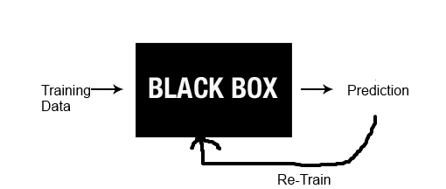
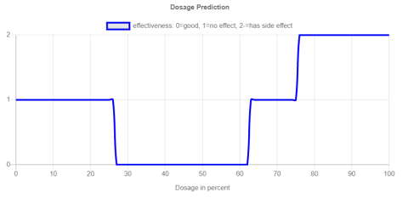
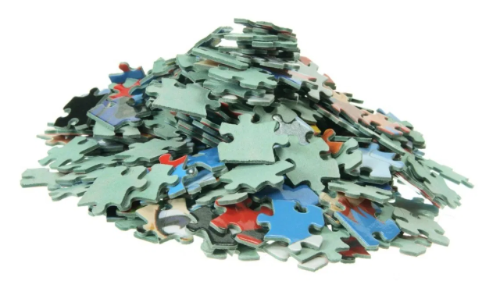
Goal: Create a model to predict dosage effectiveness
Create/Train/Validate
Machine Learning Model
To predict dosage recommendation
Predict dosage effectiveness
On Patients with different
Profile using the model
(Dummy)
Clinical Trial Data
on various patient profile
Duration Estimation for Typical ML development Project
75% - 80% time duration to prepare
the data
15% - 25% on model development and training
2% - 5% on model deployment for easy consumption

