Slide 1

Product Review Sentiment Analysis Using NLP and BERT
Machine Learning Project · Academic Year 2026–27
Team Members
Under the Esteemed Guidance of
T. Parinitha — 2520030562
Dharmika P — 2520030012
Jyothsna Datti
Assistant Professor, CSE

Slide 2


Abstract
The Challenge
E-commerce platforms generate massive volumes of customer reviews daily. Manual analysis is time-consuming and inconsistent at scale.
Our Approach
Automated sentiment classification using NLP and BERT on the Amazon Product Reviews dataset — binary classification: Positive or Negative.
Evaluation & Impact
Metrics: Accuracy, Precision, Recall, F1-Score, Confusion Matrix. Helps businesses extract actionable insights and drive data-informed decisions.

Slide 3

Introduction
Reviews Matter
Online reviews influence purchasing decisions and brand reputation at massive scale.
Scale Challenge
Large review volumes make manual sentiment analysis entirely impractical for businesses.
Contextual Complexity
Reviews contain sarcasm, varied expressions, and nuanced context that simple keyword matching cannot capture.
Why BERT?
BERT understands bidirectional context and semantic relationships — enabling accurate, scalable sentiment classification.

Slide 4
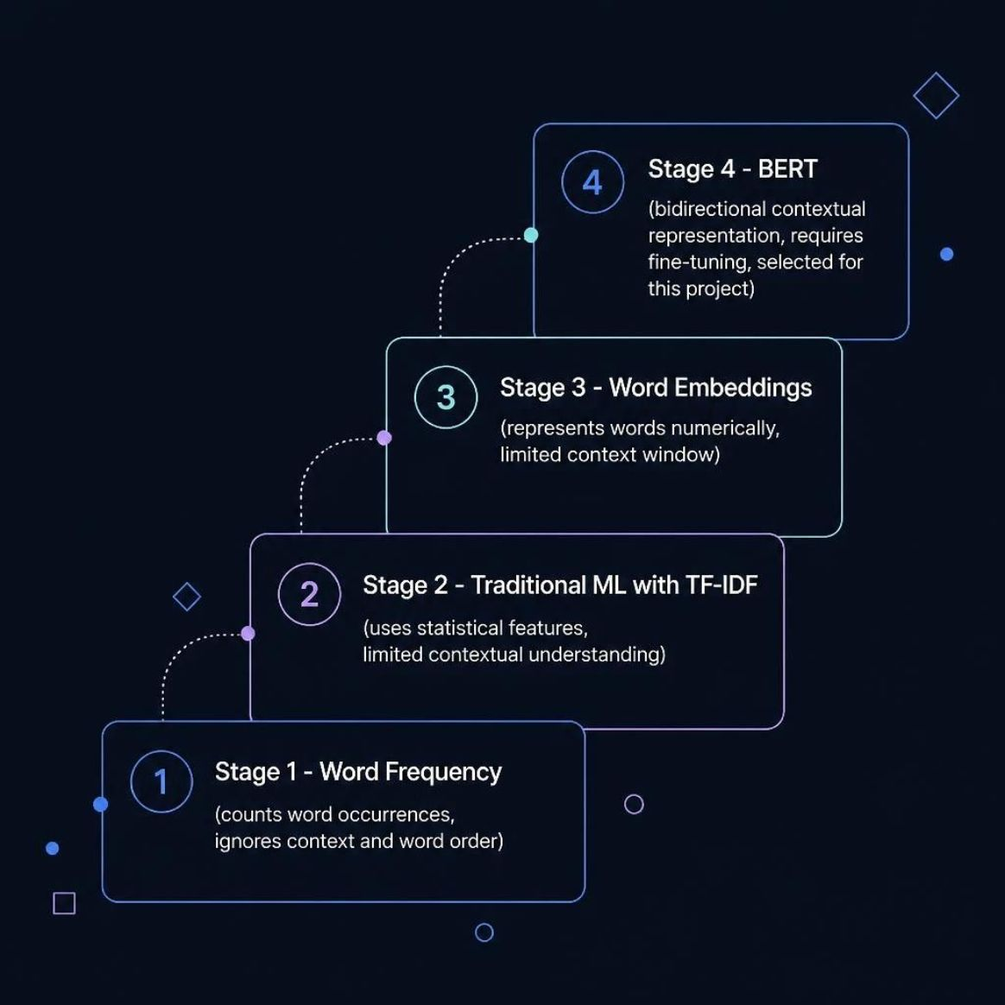

Literature Survey
Evolution of Sentiment Analysis Techniques
Selection Rationale
Each prior technique represented an incremental improvement, yet none could fully model the bidirectional context inherent in natural language.
Word Frequency
TF-IDF + Traditional ML
Word Embeddings
BERT (Selected)
Counts occurrences — ignores context and word order entirely.
Statistical features improve over frequency — but understanding remains shallow.
Numerical word representation — context window remains limited.
Full bidirectional context — ideal for nuanced sentiment in product reviews.

Slide 5

Problem Statement & Objectives
Problem
Project Objectives
Large volumes of product reviews are difficult to manually analyze. An automated system is needed to identify whether reviews express positive or negative sentiment — consistently and at scale.
01
Preprocess Review Text
Binary Classification: Positive / Negative Sentiment
Cleaning, normalization, and tokenization of raw review data.
02
Prepare BERT Input Format
Structure text to meet BERT tokenization requirements.
03
Split Data
Partition dataset into training and testing sets.
04
Fine-Tune BERT
Train the model on labeled Amazon review data.
05
Classify & Evaluate
Predict sentiment and measure performance using standard metrics.

Slide 6



Dataset, Methodology & Requirements
Dataset
Methodology Pipeline
Software & Libraries
Amazon Product Reviews
Raw Reviews → Preprocessing → Train/Test Split → BERT Tokenization → Fine-Tuning → Prediction → Evaluation
Python, PyTorch / TensorFlow
Hugging Face Transformers
Pandas, NumPy, Scikit-learn, Matplotlib
Positive: "Excellent product and great quality."
Negative: "Very poor quality and disappointing."

Slide 7
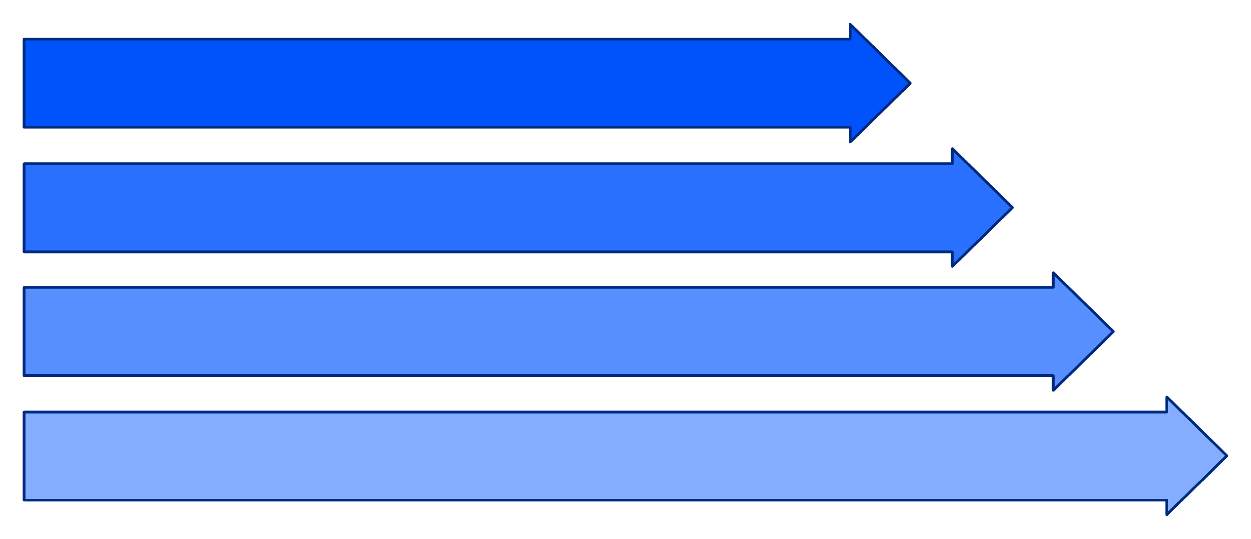
System Architecture & Flowchart
End-to-End Pipeline: From Raw Reviews to Performance Evaluation
Data Ingest
Preprocessing
Tokenize
Train & Eval
Each stage transforms raw unstructured review text into a structured, evaluated sentiment prediction — enabling scalable, automated customer feedback analysis.

Slide 8








Results & Evaluation Metrics
Accuracy
Precision
Recall
Overall correctness of predictions across all review samples.
Accuracy of positive predictions — minimizing false positives.
Coverage of actual positive cases — minimizing false negatives.
F1-Score
Confusion Matrix
Harmonic mean of Precision and Recall — balanced performance measure.
Visualizes True Positives, True Negatives, False Positives, and False Negatives.
Numerical results will be reported after model training and testing. Placeholder values will be replaced with actual performance metrics upon completion.

Slide 9

Conclusion & Future Scope
Conclusion
Future Scope
NLP and BERT enable automated, scalable classification of customer review sentiment — helping businesses efficiently analyze large volumes of feedback and extract actionable insights from customer opinions.
Multi-Class Sentiment
Extend to Positive / Neutral / Negative classification for richer insight.
Applications
Broader Datasets
Customer satisfaction analysis and monitoring
Identifying common complaints and pain points
Real-time product feedback tracking
Supporting data-driven business decisions
Train on larger, more diverse datasets spanning multiple product categories.
Real-Time Analysis
Build streaming review analysis and alerting pipelines.
Sentiment Dashboard
Develop an interactive e-commerce sentiment visualization dashboard.
Turning Customer Feedback into Actionable Insight

