Slide 1
Fashion MNIST with Keras and Deep Learning
Satyen, Jay, Ashraf, Mina

Slide 2
Introduction
We will train a Normal Neural Network and Deep Neural Network with Keras on the Fashion-MNIST dataset, to classify fashion images and categories. The Fashion-MNIST dataset is meant to be more challenging than the existing MNIST digit dataset that classify 0 - 9 digits.
The Fashion MNIST dataset includes:
60,000 training examples
10,000 testing examples
10 classes
28×28 grayscale/single channel images
*MNIST … (Modified National Institute of Standards and Technology database)
Notes:
Our script is on Google Collab and dataset training is on AWS (s3). The requirement
We classified fashion images into categories such as t-shirts, trousers, boots by machine learning using fashion MNIST dataset

Slide 3
What are we trying to solve?
We will compare the accuracy rate of Normal Neural Network (1 Hidden Layer of 100 Nodes) vs Deep Neural Network (2 Hidden Layers of 100 Nodes) on the same set of Training and Test Data. We are expecting Deep Neural Network to provide higher accuracy on Test Data when compared to Normal Neural Network.
Result:
As per our analysis there is no difference in accuracy between Normal Neural Network and Deep Neural Network.
Notes:
Our script is on Google Collab and dataset training is on AWS (s3). The requirement

Slide 4




Tool sets requirement:
ML: Image processing
Tools used:
ML - Tensorflow (Keras)
Google Colab
Amazon AWS (S3)
Python Pandas
Python Matplotlib
Notes:
Our script is run by Python on Google Collab.
Data test and training data is on AWS (S3).

Slide 5
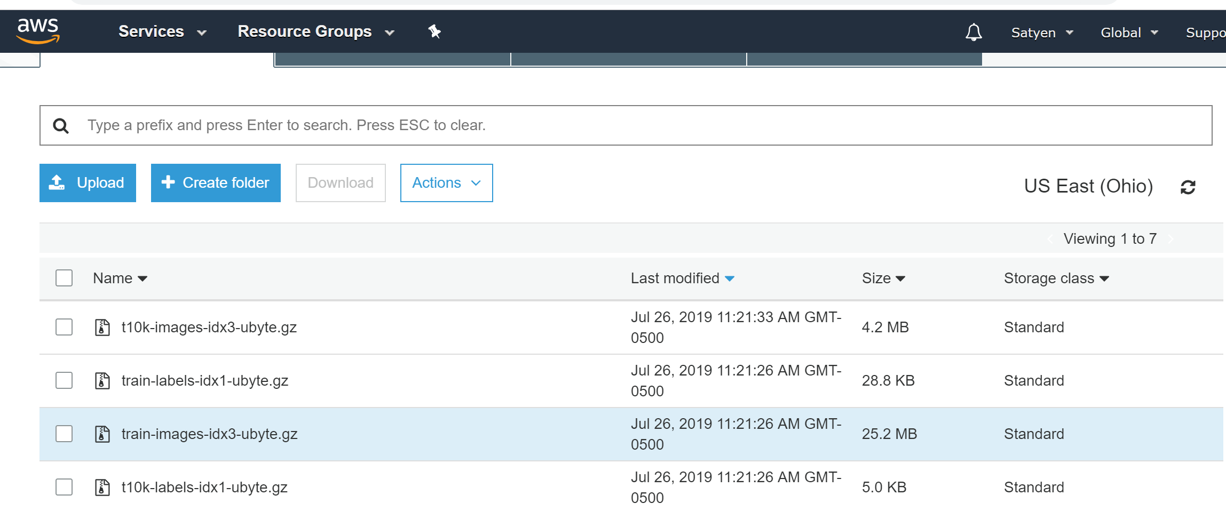
Amazon AWS (S3)
Notes:
Our script is run by Python on Google Collab.
Data test and training data is on AWS (S3).

Slide 6
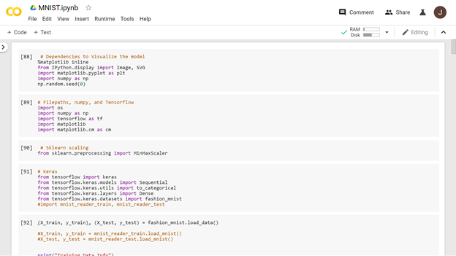
Google Colab
Notes:
Our script is run by Python on Google Collab.
Data test and training data is on AWS (S3).

Slide 7
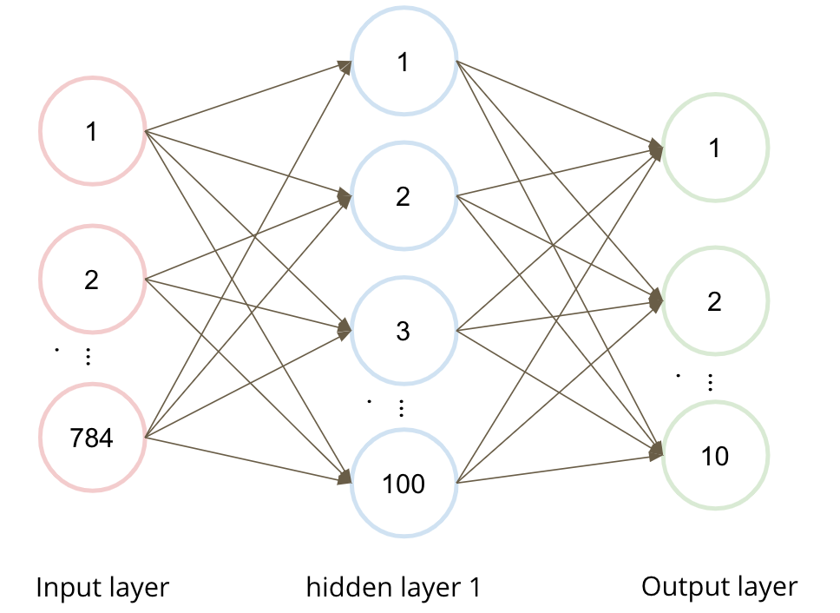
Normal Neural Network (1/2)
Keras Sequential Model
Input layer = 784 Nodes
Hidden Layer 1 = 100 Nodes
Output Layer = 10 Classification
Activation Fun (Hidden Layers) = RELU
Activation Fun (Output Layer) = SOFTMAX

Slide 8
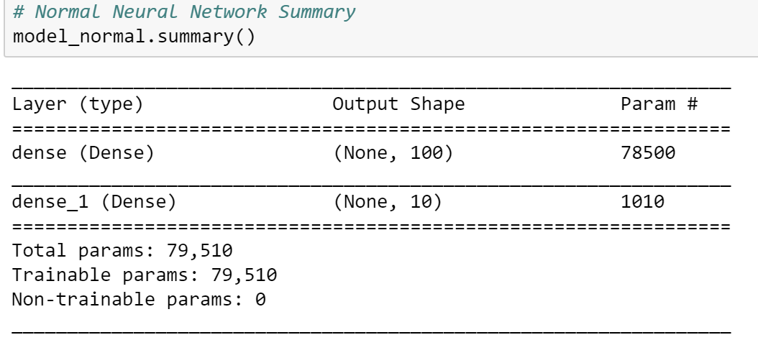
Model Summary - Normal Network (2/2)

Slide 9
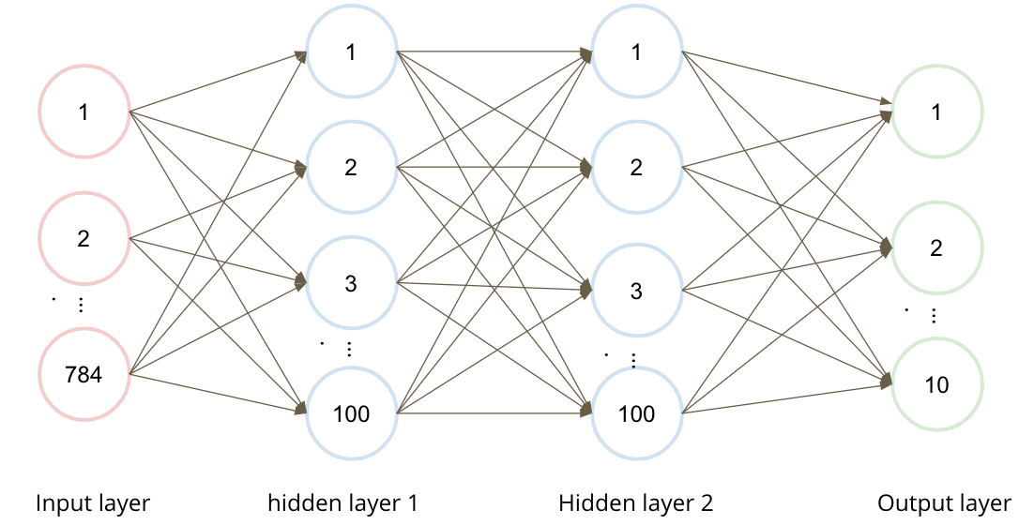
Deep Neural Network (1/2)
Keras Sequential Model
Input layer = 784 Nodes
Hidden Layer 1 = 100 Nodes
Hidden Layer 2 = 100 Node
Output Layer = 10 Classification
Activation Fun (Hidden Layers) = RELU
Activation Fun (Output Layer) = SOFTMAX

Slide 10
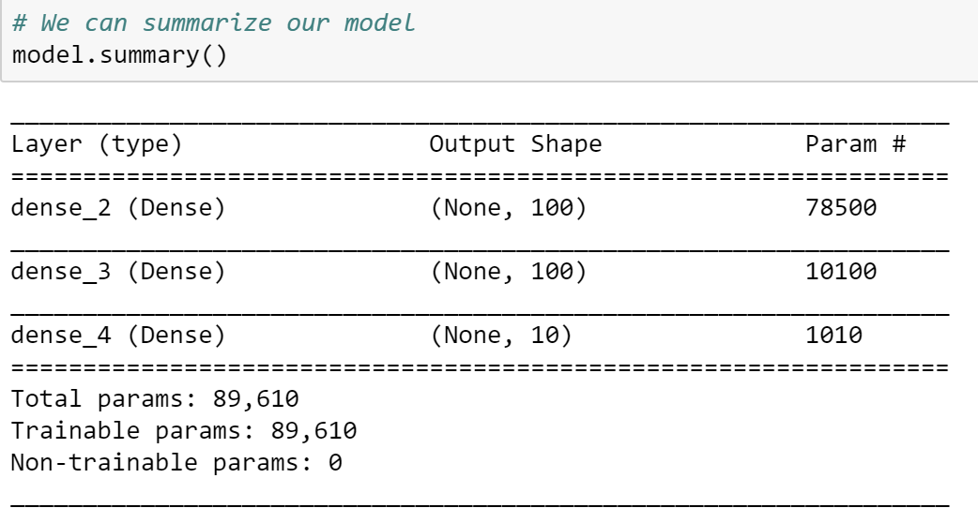
Model Summary - Deep Network (2/2)

Slide 11
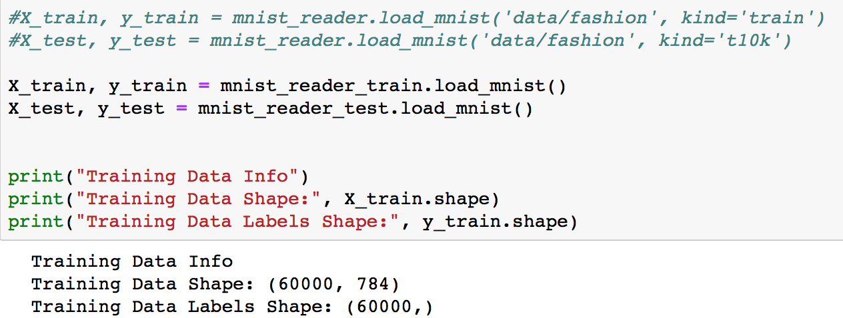
Input layer
Fashion_mnist is a dataset of images in Tensorflow. They have 28*28 numpy arrays in 60,000 dataset.

Slide 12
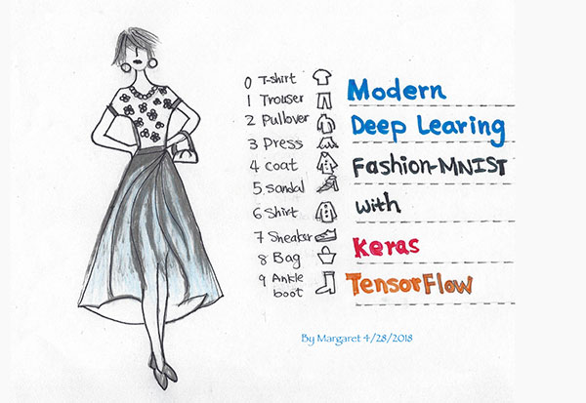
Classification
0: T-shirt
1: Trouser
2: Pullover
3: Dress
4: Coat
5: Sandal
6: Shirt
7: Sneaker
8: Bag
9: Ankle boot

Slide 13
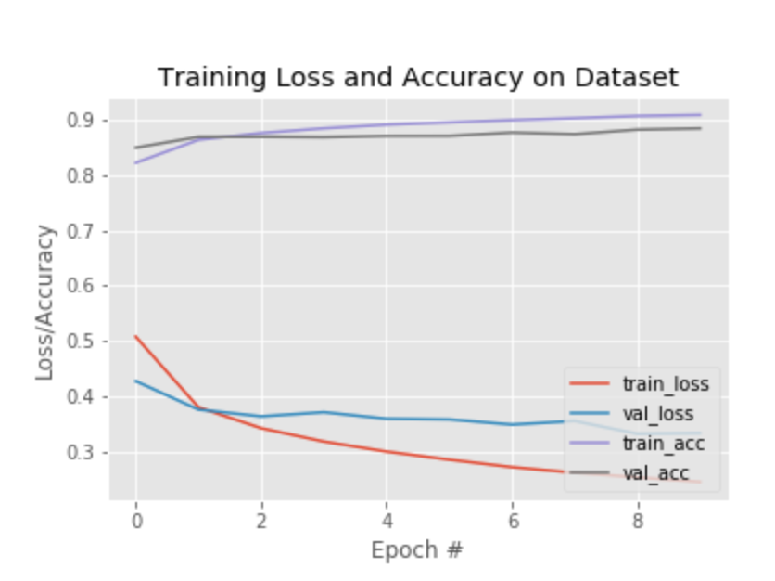
Accuracy/Loss Rate - Normal Network (1/2)
Train Accuracy and Loss
Epoch 1/10: [loss: 0.5111 - acc: 0.8197]
Epoch 2/10: [loss: 0.3848 - acc: 0.8620]
Epoch 3/10: [loss: 0.3439 - acc: 0.8748]
:
:
Epoch 9/10: [loss: 0.2527 - acc: 0.9064]
Epoch 10/10:[loss: 0.2442 - acc: 0.9086]

Slide 14
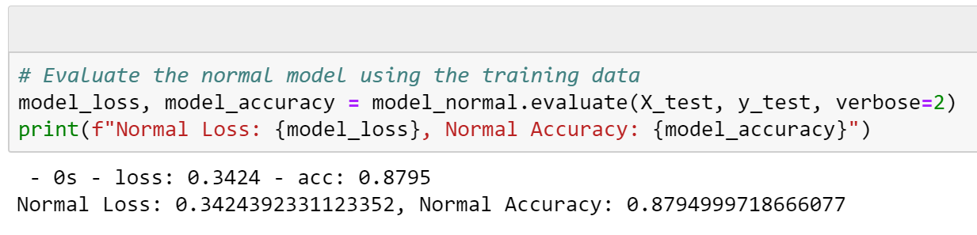
Evaluating the Model (2/2)
Normal Network

Slide 15
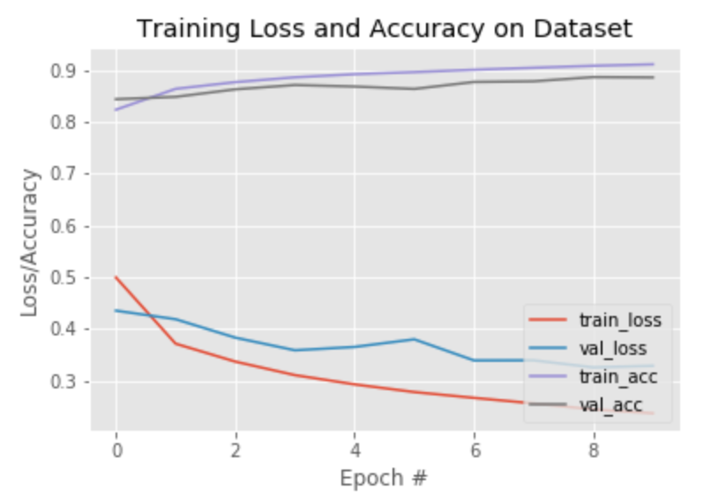
Accuracy/Loss Rate - Deep Neural Network (1/2)
Train Accuracy and Loss
Epoch 1/10 [sample - loss: 0.4922 - acc: 0.8256]
Epoch 2/10 [sample - loss: 0.3668 - acc: 0.8661]
Epoch 3/10 [sample - loss: 0.3327 - acc: 0.8762]
:
:
Epoch 9/10 [sample - loss: 0.2464 - acc: 0.9065]
Epoch 10/10 [sample - loss: 0.2376- acc: 0.9092]

Slide 16
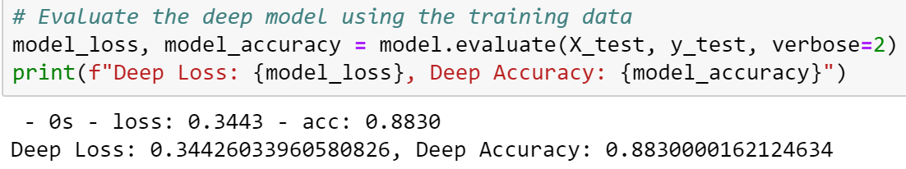
Evaluating the Model (2/2)
Deep Network

Slide 17
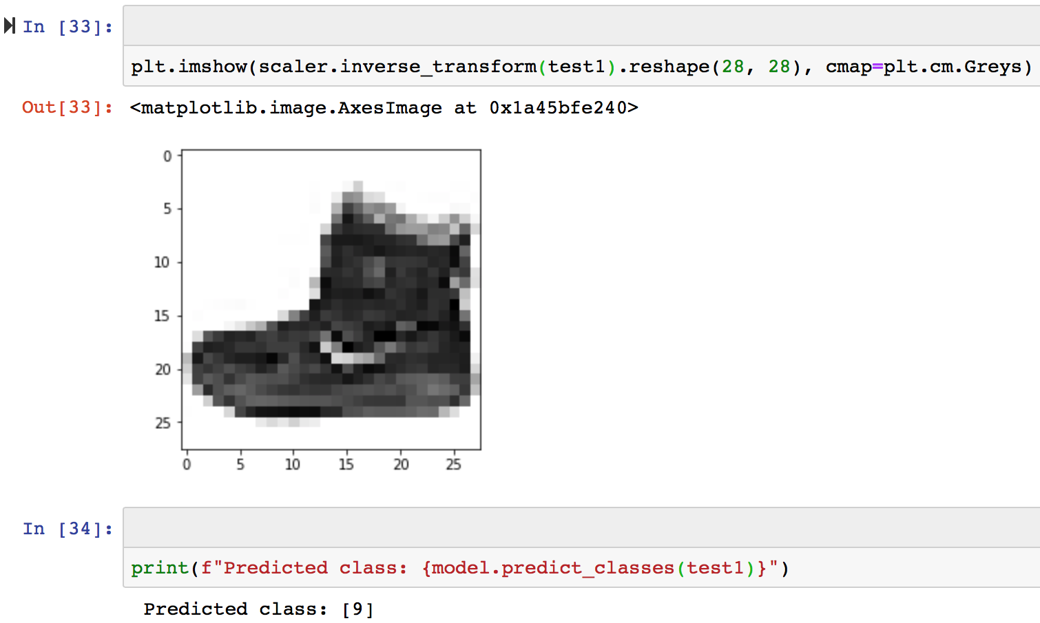
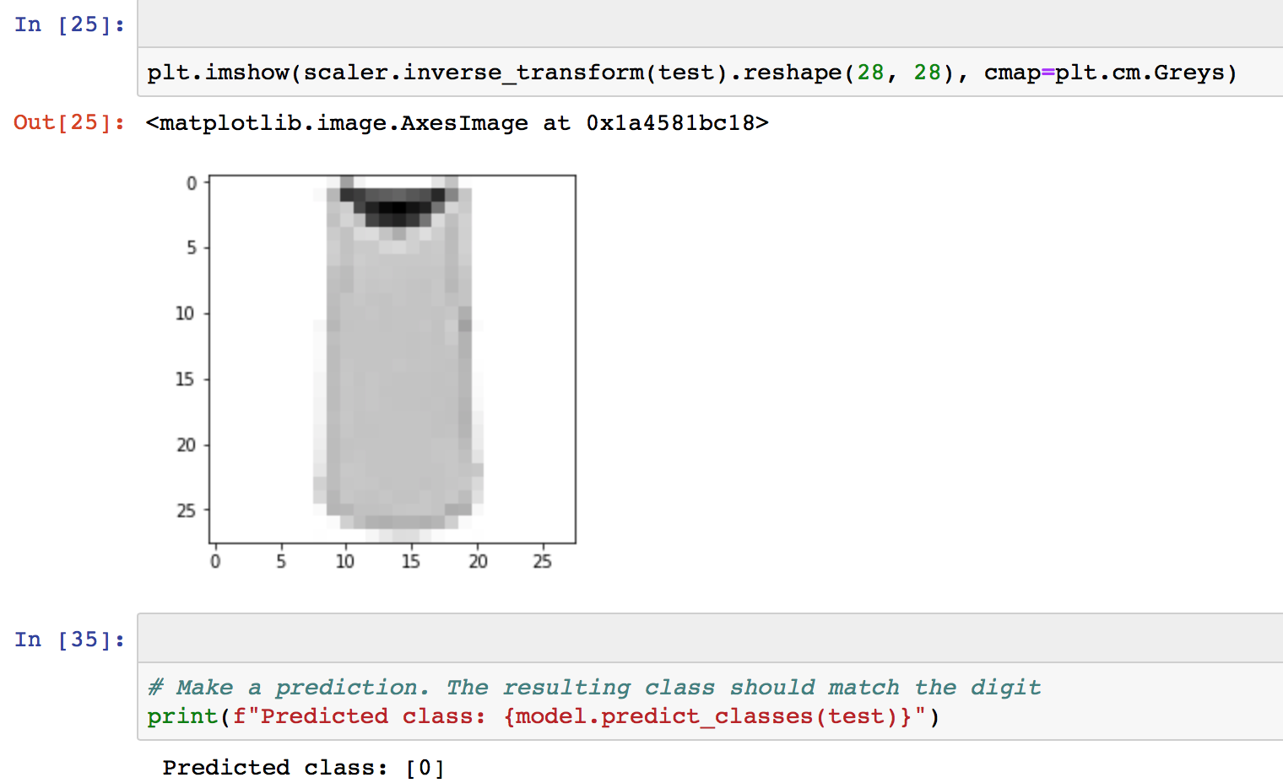
Prediction

Slide 18
Questions

Slide 19
Thank you!

