Slide 1

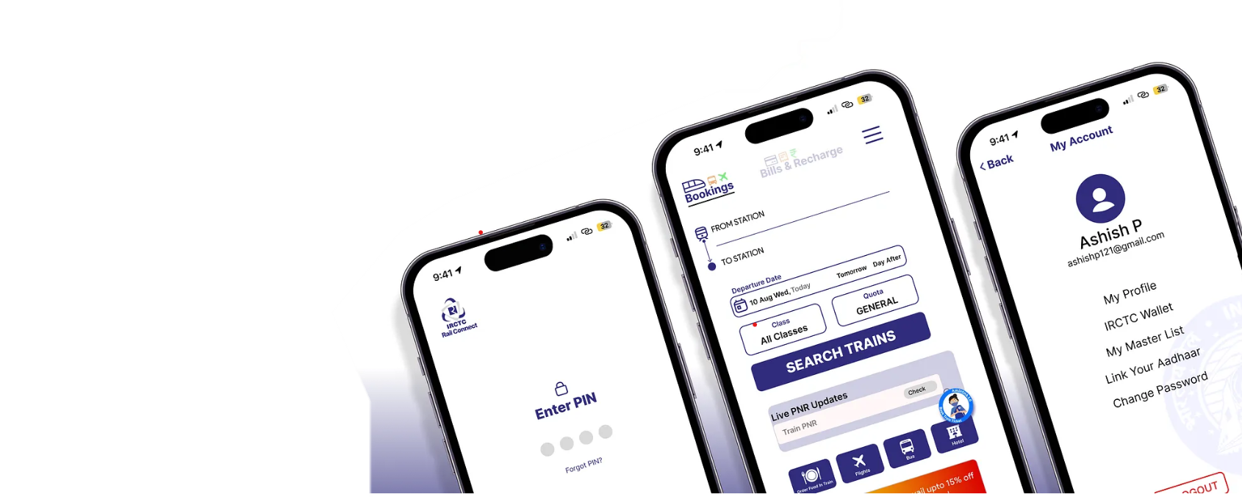
Ever Wondered How Millions Book Train Tickets in Seconds?
Indian Railway Catering and Tourism Corporation
Case Study on IRCTC and SQL Data Management

Slide 2

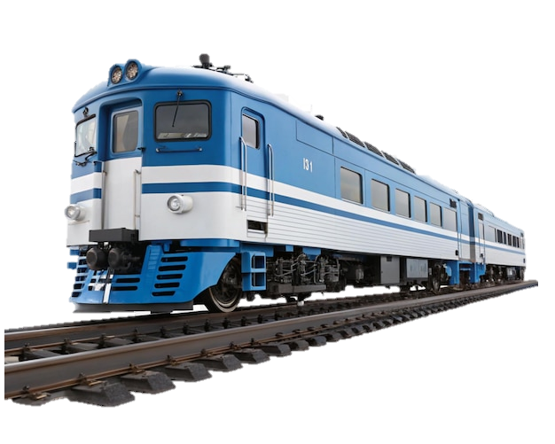
Overview of the Railway Industry:
Indian Railways (IR) is the national railway system of India, owned and operated by the Government of India through the Ministry of Railways. It is one of the largest employers in the world with more than 1.2 million employees and is often described as the lifeline of the nation. Global Standing Fourth-largest railway network in the world (after USA, China, and Russia).
IRCTC (Indian Railway Catering and Tourism Corporation)
PRS (Passenger Reservation System)
UTS (Unreserved Ticketing System)
NTES (National Train Enquiry System)
FOIS (Freight Operations Information System)
COA (Control Office Application)

Slide 3
IRCTC
PASSENGER
Passenger_ID
Name
Age
Gender
Contact_Number
Email_ID
ID_Proof
TRAIN
Train_ID
Train_Name
Source_Station
Destination_Station
Departure_Time
Arrival_Time
Train_Type
TICKET
Ticket_ID
Passenger_ID
Train_ID
Booking_Date
Journey_Date
Class
Seat_Number
Status
PAYMENT
Payment_ID
Ticket_ID
Payment_Mode
Amount
Payment Status
Transaction_Date
STATION
Station_ID
Station_Name
Location
Station_Code
COACH
Coach_ID
Train_ID
Coach_Number
Coach_Type
Total_Seats
EMPLOYEE
Employee_ID
Name
Age
Gender
Role
Contact_Number
Assigned_Train
FOOD ORDER
Order_ID
Passenger_ID
Train_ID
Order_Date, Food_Item
Quantity
Total_Price, Payment_Status
ROUTE
Route_ID
Train_ID
Station_ID
WAITLIST
Waitlist_ID
Ticket_ID
Passenger_ID
Train_ID
Waitlist_number
Status

Slide 4
SQL Queries for IRCTC Database
Availability of seats
SELECT seat_no, coach_no FROM reservations WHERE train_no = 12951 AND journey_date = '2025-09-01’ AND status = 'Available’;
No of Trains arriving in the given time slot
SELECT platform_no FROM schedule WHERE station_code = 'NDLS’ AND arrival_time BETWEEN '10:00' AND '12:00’;
Cancellation of tickets
UPDATE Ticket SET Status = 'Cancelled’ WHERE Ticket_ID = 501;

Slide 5
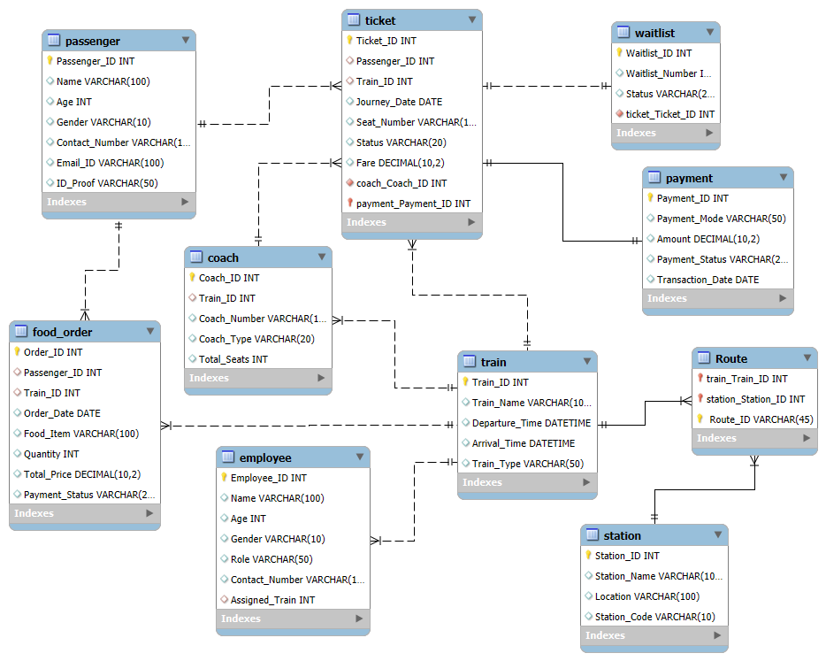

Slide 6
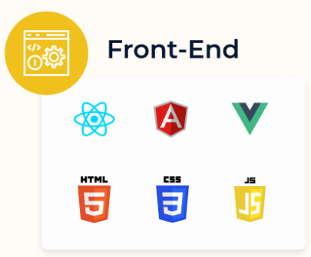
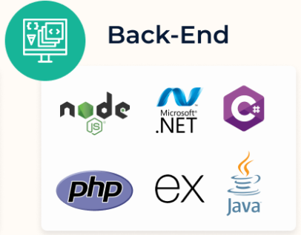
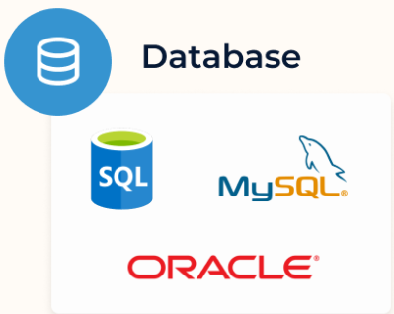
Technology Framework:
Oracle Database → IRCTC uses Oracle as the backend because of its scalability and security.
Frontend → Booking app and website where users book tickets.
Backend → Built with Java, Python, to process requests.
Database → MySQL, Oracle, PostgreSQL store passenger and train data.
ETL → Tools like Kafka, Talend move and clean data.
Analytics → Power BI, Tableau, Python, R show reports and insights.
Cloud → AWS, Azure, GCP host and run the system.

Slide 7


Business Problems
Real-time PRN Inquiry
Food And Catering Orders
Ticket Booking And Reservations
Tatkal Booking Rush

Slide 8


Problems
High Transactions – Millions of queries (Tatkal) cause delays & locks. Real-Time Updates – PNR, train status, seat allocation slow queries. Complex Reservations – Multiple quotas make rules complicated. Payments & Refunds – Cancellations & refunds need strong consistency. Security & Fraud – SQL injection, fake bookings, misuse of quotas.
Solutions
Database partitioning, indexing, caching for load balancing. Real-time data pipelines, APIs, and materialized views for faster access Stored procedures, triggers, and automated seat allocation algorithms. Transaction management with ACID compliance and SQL retry mechanisms. Parameterized queries, encryption, and role-based access control.

Slide 9






Strengths:
Faster Bookings → Handles crores of users smoothly, even during Tatkal.
Accurate Seat Allocation → Automatic rules ensure fair distribution.
Real-Time Information → Instant PNR, train location, and seat status.
Safe Payments → Secure transactions and reliable refund system.
Improved Customer Experience → Less wait, more trust, easy travel.
Better Decision-Making → Data helps in planning new trains and routes.

Slide 10
Takeaways
Scalability is Key → Systems must handle crores of users smoothly.
Automation Helps → SQL procedures ensure fair seat allocation.
Real-Time Data Matters → Live updates improve customer trust.
Security First → Safe queries, encryption, and fraud control.
Integration with Tools → SQL + BI tools = smarter decisions.

Slide 11



