Slide 1

ArcGIS Online Administration at Scale
Virginia GIS Conference 2018
Seth Peery, Sr. GIS Architect, Virginia Tech
Notes:
Techniques and strategies for the administration of ArcGIS Online organizations
Progress Bar

Slide 2
Overview and notes
Stuff to do
  Types of identities and Enterprise logins
  Auto login vs invitations
  ArcGIS Pro licenses
  Privileges and roles
  Groups and ids
  Credit increases
  Content transfers
  Deprovisioning; affiliation checks and idP attrs.
  Gallery and featured content
  Storage consumption
  Group assignment
  User deletion.
Structure.
  Why admin and how it changes at scale, who we are, etc.
  Stuff to do automatically
  Stuff to do ad hoc
  Stuff to do unattended
References
  ArgGIS Pton API
  Jupyter howto
  Flow chart for user lifecycle with things to do
  Microservice approach example in AWS???

Slide 3
Rationale for AGOL organization management
Software as a Service products must be managed with the same attention we give on-premises systems
AGOL depends on finite resources (credits, named users, etc)
AGOL orgs can become unwieldy at scale
User lifecycle is a moving target
Management objective is to lower impediments to use of AGOL
Built in software controls are only one component of resource stewardship: processes, training and automation become increasingly important for large orgs

Slide 4
Shared Resources
Named users
  The named user model is central to the WebGIS pattern
  Identity types : {ArcGIS, Enterprise, Social}
  Requires conscientious user lifecycle management
  Licensing considerations
Service Credits
  Prevent big mistakes
  Monitor insidious credit sinks
ArcGIS Pro licenses
Usability/organization of the site

Slide 5
Organization administration model
Questions admins ask
How are my users identified?
How are my users authorized?
What can my users do?
How many credits are being used?
What happens when someone leaves the organization?
User lifecycle stages
Onboarding
Active user
Deprovisioning
Action types
One time
Ad hoc
Automated

Slide 6
Org Administration Process Flow: Users
New user
Initial login
Provision named user
Allocate Pro license
Assign privileges
Refill credits
Active
use
Assign default role
Add to group(s)
Assign credit budget
Enable ESRI access
Add to group(s)
Define user level {1|2}
Transfer content
Onboarding
Monitor credit usage
Check for inactivity
Check for eligibility
idP may block authN
Notify user
User leaves organization
Self-service content transfer
event
Admin content transfer
built-in process
Account deletion
recurring process
Deprovisioning
ad hoc process

Slide 7
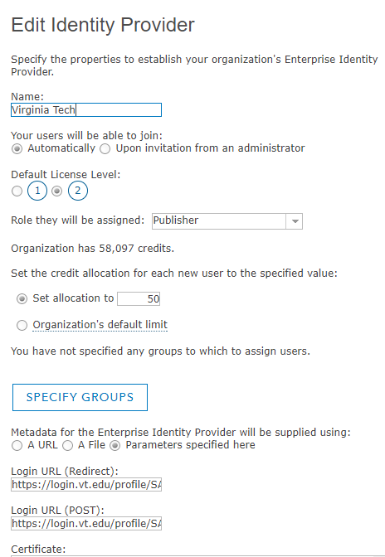





Named Users
Identity is a core component of distributed GIS
Is necessary for integrations with other systems
Enables explicit granular content ownership
What is a named user?
  Institutional Identity / ESRI identity
  / User-owned identity (e.g., social login)
  No one right answer,
  Need to balance control and flexibility
Management considerations
  What is the identity lifecycle? (provisioning, authN/Z, deprovisioning)
  What artifacts persist during and after the identity lifecycle?
    Who should own them?
    How should they be discoverable/archived?
    Content (maps, apps, data)
    Training portfolio
In order for WebGIS to be pervasive across an institution and realize its full value adding potential, barriers to provisioning named users should be minimal.
control and
management
Enterprise Logins
Portal
Local
Identity
GIS Server
Local
Identity
Global accounts
GDB
Local
Identity
Social Logins
flexibility and
persistence
Notes:
Next big idea and the first of the architectural points of webGIS that make it unique and add value. IDENTITY.
Identity is a core component of distributed GIS; the named use model is pervasive throughout the geoinformation model.
In the past we might have had user accounts for ArcSDE, ArcGIS Server, and other stack components in addition to users’ institutional identities. Lots of passwords to keep up with.
The big idea is that a single identity is used throughout webGIS. That identity might be local to the portal, might be an ESRI global account, might be an enterprise login, might be social. Enables explicit granular content ownership
There are trade offs to the identity provider used in a given implementation. Consider:
Who owns the identity? Is it portable, does it travel with our transient user base as they leave the institution or do we control it
Can we cross-reference the identity to institutional attributes – enrolled status, college/dept affiliation, etc.
In the WebGIS model there are artifacts and attributes associated with identities. Those must be managed throughout the account lifecycle.
Artifacts are things like content items, training histories.
We have greater control if we control the identity, but the users have a more personalized

Slide 8
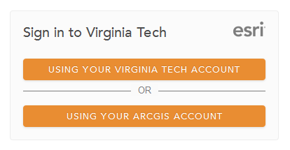
Enterprise Logins
The most important step in taking control of named users
  You should implement Enterprise Logins if your
  infrastructure supports it
  … the sooner the better
A best practice from ESRI, and in any case promotes sanity of admins
Single sign on via SAML2
For users: one less credential
Facilitates site license compliance
At VT we use Shibboleth for our idP, integrated with our two-factor authentication (Duo). Other options include ADFS, LDAP
Note: it may never be possible (or desirable) to get rid of ArcGIS logins (“enable ESRI Access”)

Slide 9
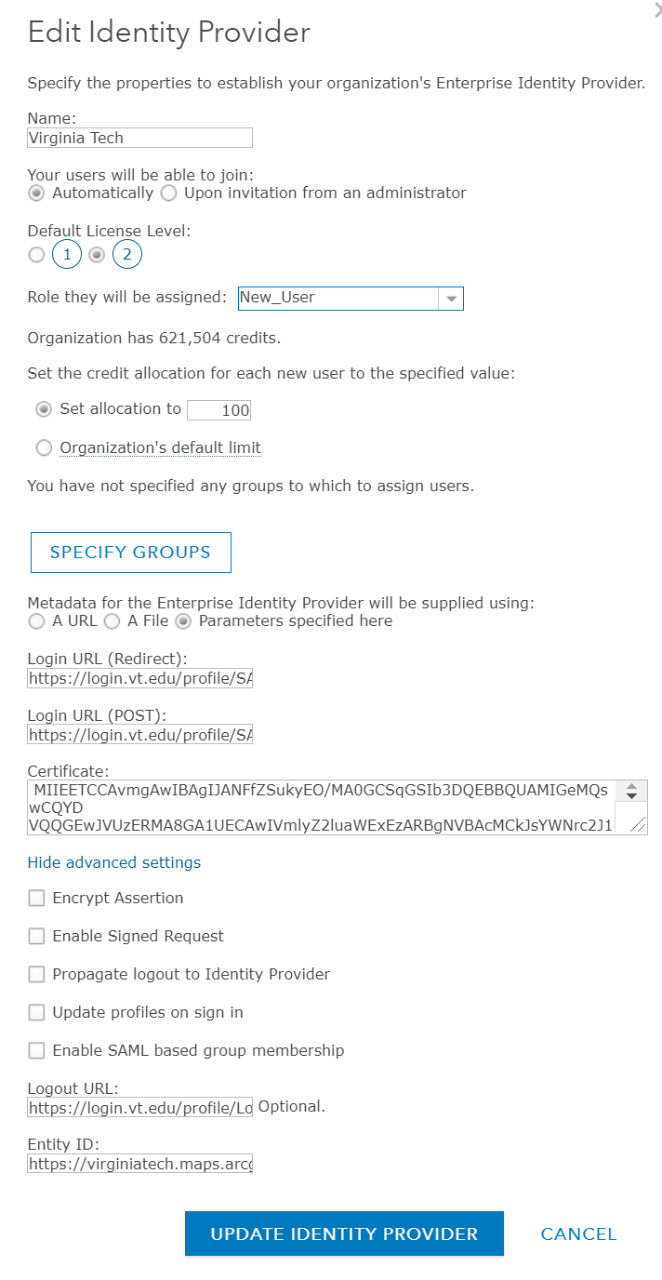
Enterprise Logins Process
The objective is to set up a SAML trust relationship with your identity provider (idP)
Provide single sign on login and logout URLs
Generate a cert to send to idP to establish trust with AGOL
Optionally can encrypt assertions and requests
** Note: Currently AGOL only pulls the username and email attributes from the idP via SAML

Slide 10
Default privileges for new users
Applies whether invited or auto-login
License Level
  1: Read only users; cannot be assigned
  publisher or content owner privileges
  2: Full users: can own content and be
  assigned any privilege in the organization
Initial (custom?) role
Initial credit budget
Initial groups

Slide 11
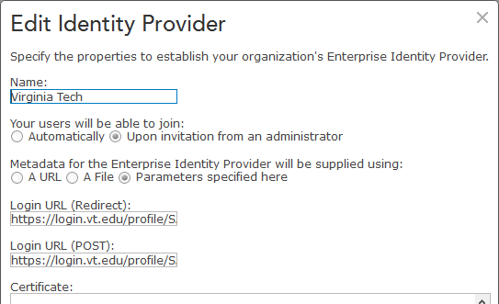
To auto join or not?
Pros:
  No need to invite users and wait for them to accept
    A named user is allocated upon first login
    From user perspective it appears they have always had access
  No more e-mails from ESRI with clickable links
  Less administrative burden on the front end
Cons:
  Named users could be exhausted by the curious (“drive bys”)
  More administrative burden down the line… requires keeping track of who the named users are, what content they own and who is still eligible

Slide 12
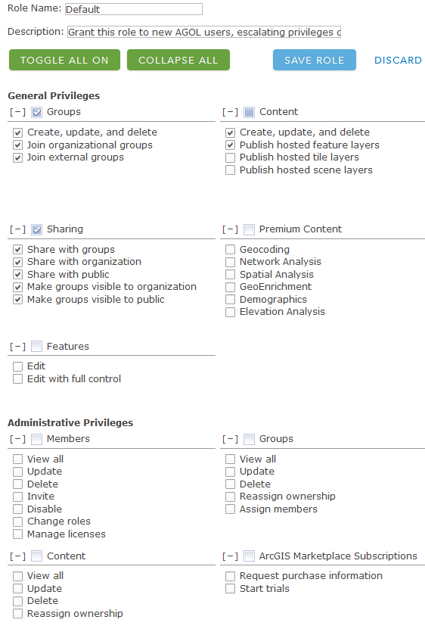
Privileges and Roles
Roles group together granular privileges, and are assigned to users.
Default roles include user, publisher
Custom roles enable admins to define a subset of privileges to assign to specific groups of users
“Can” be useful for managing credits, but with credit budgeting admins have more latitude to grant generous default privileges

Slide 13
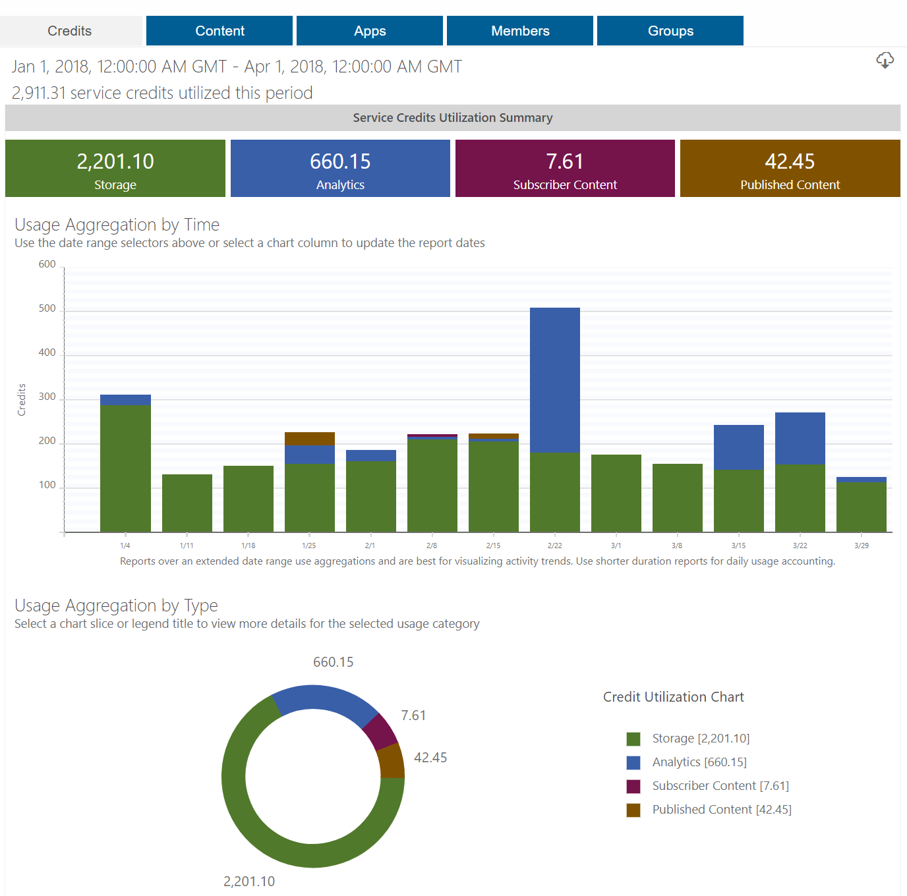
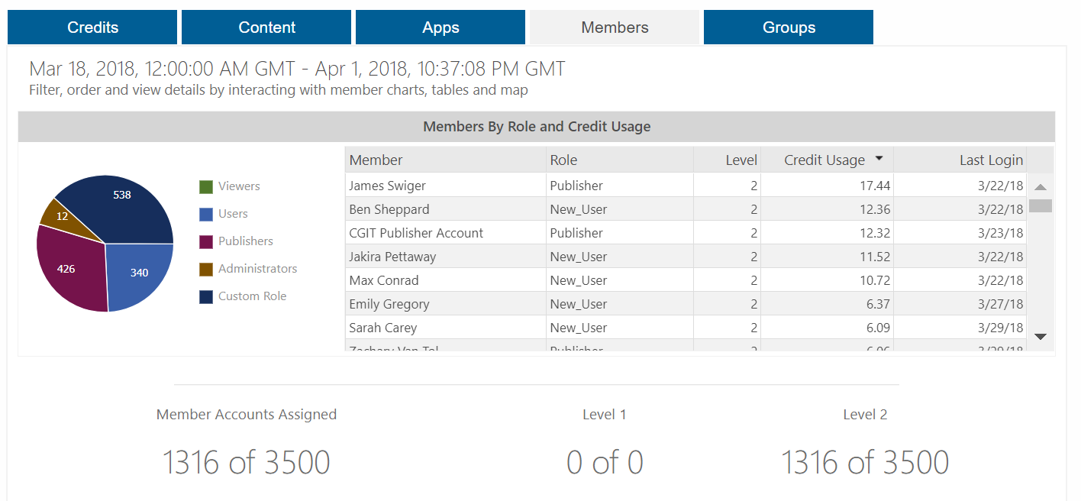
Credits
A metric of resource usage via which ESRI meters access to the platform
Built-in “Status” tab can be useful for usage overviews
Credit budgets prevent Inadvertent Total Credit Exhaustion
Credit consumption can be tracked down to the individual user level
Note that over time, storage costs are cumulative in large organizations

Slide 14
ESRI Access and ArcGIS Pro licenses
A special set of “entitlements” not conferred through roles
ESRI Access
  Enables users to access My ESRI, GeoNet, online training
ArcGIS Pro licenses
  Ideally, the license count is 1:1 with your named user count, in which case grant indiscriminately
  Can also be granted as ad hoc requests
  ArcGIS Pro licensing can be confusing for end users
Can be assigned programmatically (see example)

Slide 15
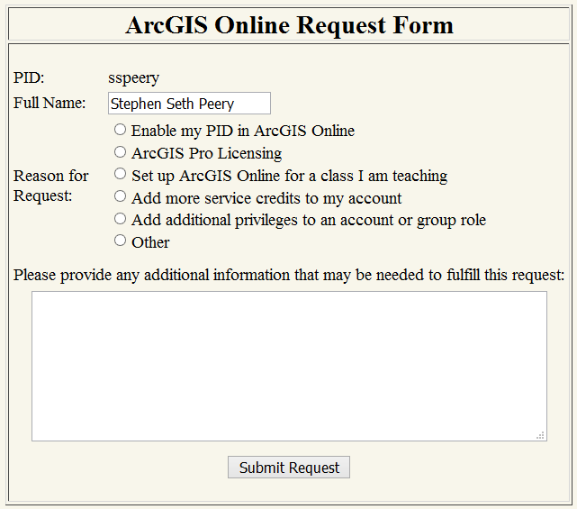
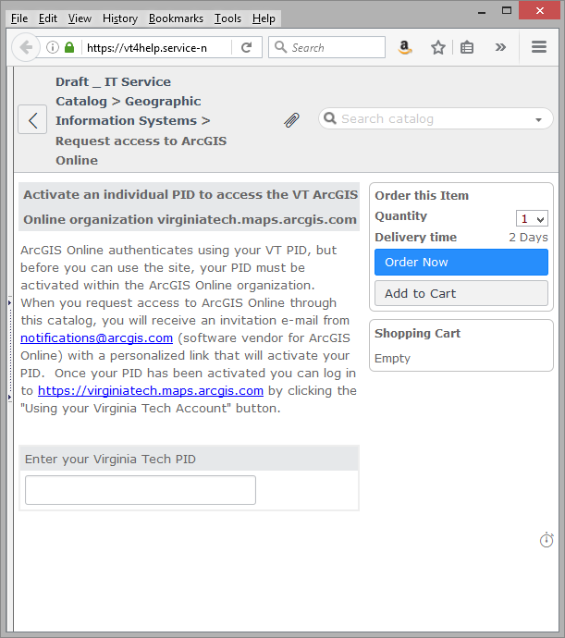
Centralizing end user ad hoc requests
At scale we need a single, well known point of entry for AGOL requests and questions
Ideally, users are not e-mailing you directly for this!
Custom form vs. integration with Service Catalog
Dispositions of requests in the pipeline
  Send someone an e-mail
  Generate a ticket
  Automatic fulfillment with REST microservices

Slide 16
Deprovisioning
  Know when a user should be deprovisioned
    Important for license compliance
    Important for site security
    “Could” be automatic with Enterprise Login model
    …. depending on idP
  What to do with the content if there is any
    User copies it somewhere else (self service operation)
    An active user inherits it *(admin must do this)
    Archive it
    Delete it
  Have clear communication of timelines and then delete account

Slide 17
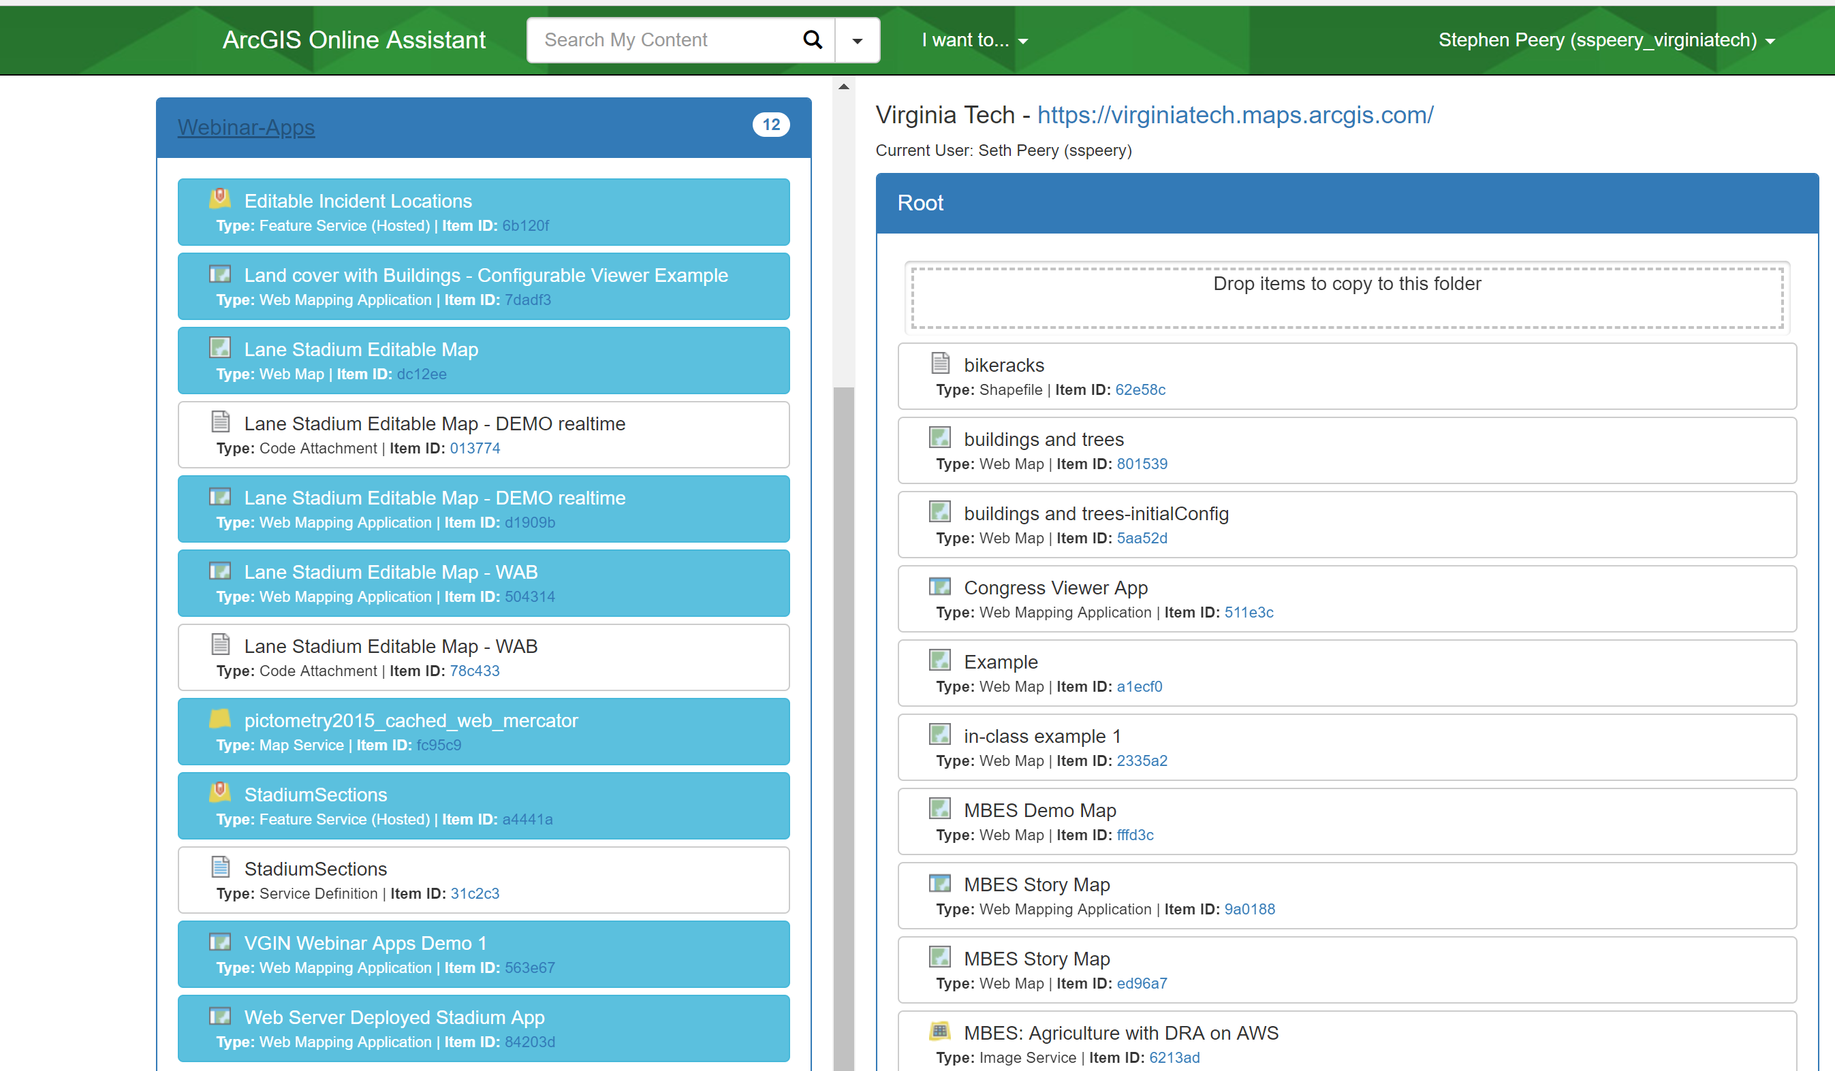
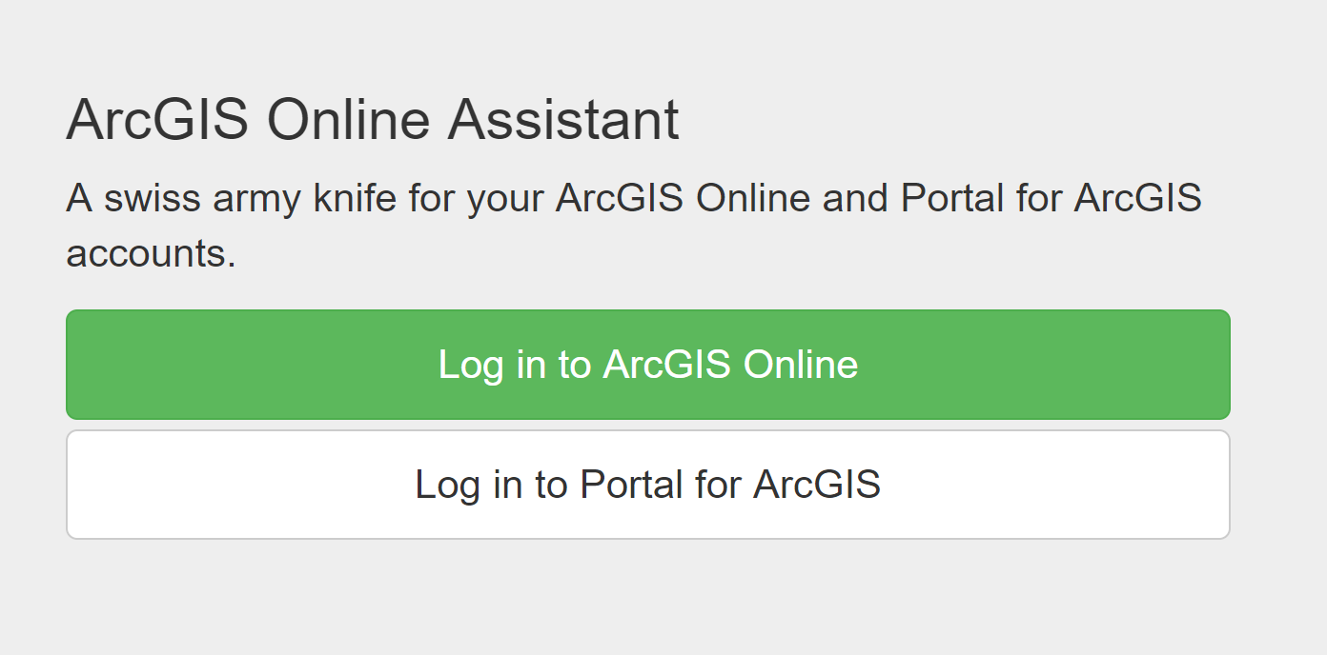
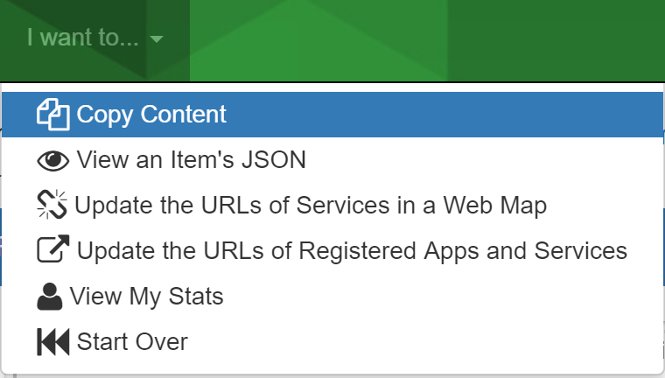
Self service content migration
https://ago-assistant.esri.com/

Slide 18
Strategies for determining user eligibility
Some idPs (e.g., Active Directory) may return a negative authentication response once a user has been deactivated or removed. Thus users are locked out automatically.
At the University of Michigan, identities don’t expire upon graduation, but the idP inserted code into their authentication backend that checks a username for the required affiliations, then returns a negative authN if authZ is negative.
VT’s idP returns positive authN regardless of authZ. So we developed a microservice to check eligibility and ran that out of band

Slide 19
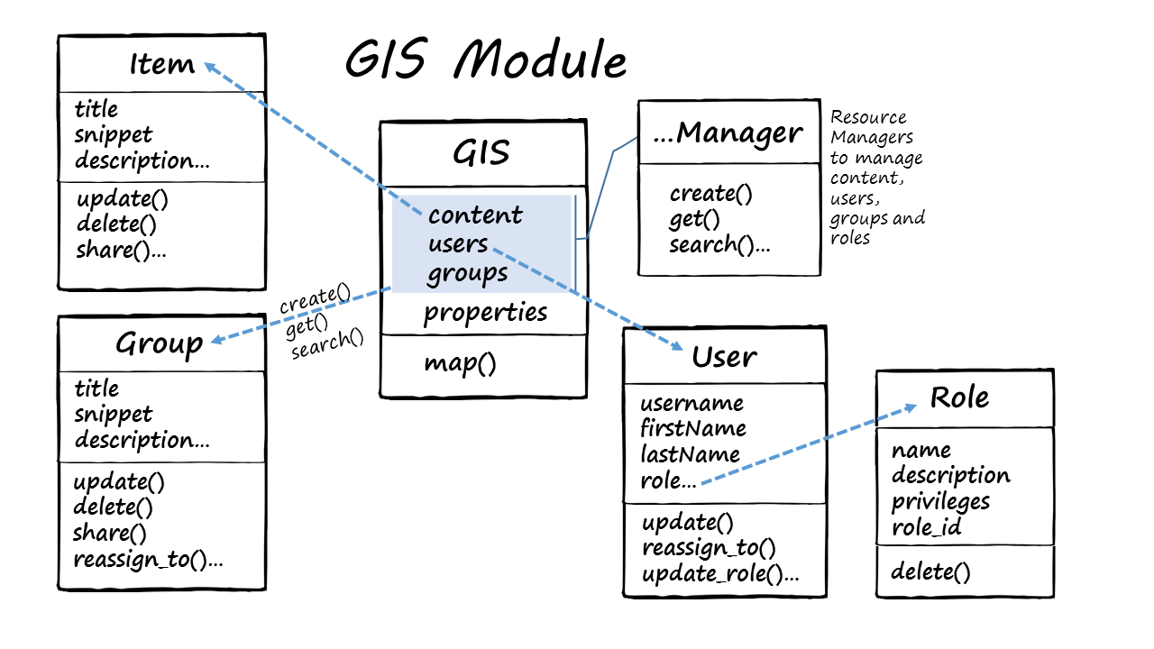
Automating ArcGIS Online Administration
Using the Python API
ArcGIS Python API wraps REST API calls for ease of interacting with your site
The GIS Module contains interfaces to manipulate users, groups, content items, roles and settings of the site itself
Calls to this API can run on a recurring (unattended) basis or as ad hoc actions
I did not select this font. Stay classy, ESRI
https://developers.arcgis.com/python/guide/the-gis-module/
https://esri.github.io/arcgis-python-api/apidoc/html/arcgis.gis.toc.html

Slide 20
Where can we run automated admin workflows?
Ad hoc/ interactive
  Python command line on a local machine
  Jupyter notebooks
Unattended/ recurring
  Cron jobs on local infrastructure
  Cron jobs on AWS
… Towards event driven
  As AWS lambda microservices invoked from

Slide 21
Automation Examples
See jupyter notebook here:
https://jupyter.aws.gis.cloud.vt.edu:8888/notebooks/vagisconf/Virginia_GIS_Conference_AGOL_Admin.ipynb
Connecting to an organization
Getting user lists
Reclaiming named users from inactive members
Clean up custom roles
Assigning ArcGIS Pro licenses
Group membership
Credit usage and reporting
Finding large content items
Finding users authenticated but no longer authorized
Content migration

Slide 22
Communication
Successful management of AGOL is a collaborative process with stakeholders.
The out of the box functionality of an AGOL org is wrapped in a business process layer that will depend on your administration strategy.
Users need to know how you operate your organizations.
Define standard operating procedures for
  User onboarding
  Credit consumption and budgeting
  Default role privileges and escalation processes
  Process for deprovisioning
  Process to request more credits/privileges/ content transfer
Identify a single point to request ad hoc operations or ask questions.
User training via documentation, seminars, presentations
The message evolves with the ArcGIS Platform.

Slide 23
Presenter Contact Information
Seth Peery
Senior GIS Architect
Enterprise GIS (0214)
1700 Pratt Drive
Blacksburg, VA 24061
(540) 231-2178
sspeery@vt.edu
http://gis.vt.edu
Notes:
That’s my story and I’m sticking to it!

